Slide 1

Introduction to Artificial Intelligence

Slide 2
Summary (so far)
Modelling a problem as a CSP
Variables
Value domains
Constraints
Inference techniques
Arc consistency

Slide 3
Boolean Satisfiability (SAT)
Instance:
A finite set, U, of variables, {x1..xn}
A formula over this set, consisting of a conjunction of clauses, where each clause is a disjunction of literals formed from U.
Question:
Is F satisfiable?

Slide 4
Example
U = {x1, x2, x3}
F = (x1 x2 ¬x3)
(x1 ¬x2 ¬x3)
(¬x1 ¬x2 x3)
(x1 x2)
(¬x2 ¬x3)

Slide 5
Depth first search
(x1 V x2 V ¬x3)
(x1 V ¬x2 V ¬x3)
(¬x1 V ¬x2 V x3)
(x1 V x2)
(¬x2 V ¬x3)
{}
We could have searched breadth-first and found the same assignment first.
{x1 = T}
{x1 = T
x2 = T}
{x1=T
x2 = F}
{x1 = T
x2 = T
x3 = T}
{x1 = T
x2 = T
x3 = F}
{x1 = T
x2 = F
X3 = T}

Slide 6
Complexity
The search tree contains 2^{n} leaves, and in the worst case the search will have to visit all of them.
This would happen if the formula were unsatisfiable.
The inference techniques of consistency-checking and propagation can help dramatically in practice.

Slide 7
SAT as a CSP
The variables in a SAT formula correspond to the variables of a CSP
The domains of all the variables are the Boolean domain {T,F}
The clauses of the formula are the constraints of the CSP
The problem is then to find an assignment to the variables that satisfies all the constraints (the formula).

Slide 8
A 2-SAT example
U = {x1,x2}
F = (x1 v x2)
(x1 v ¬x2)
(¬x1 v x2)
(¬x1 v ¬x2)
Is this formula satisfiable?
No!

Slide 9
F = (x1 v x2)
(x1 v ¬x2)
(¬x1 v x2)
(¬x1 v ¬x2)
{}
{x1 = T}
{x1 = F}
{x1 = T
x2 = T}
{x1 = T
x2 = F}
{x1 = F
x2 = T}
{x1 = F
x2 = F}
We could have worked this out straight away by noticing that if we set x1 to T then there is no value for x2 that satisfies the remaining constraints, and if we set x1 to F there is still no value for x2 that satisfies all the remaining constraints.
This analysis tells us that the formula is unsatisfiable with No Search.

Slide 10
This example in detail
V = {x1,x2}
D = {T,F}
C1 = (x1 v x2), Rc1 = {(T,T),(T,F),(F,T)}
C2 = (x1 v ¬x2), Rc2 = {(T,T),(T,F),(F,F)}
C3 = (¬x1 v x2), Rc3 = {(T,T),(F,T),(F,F)}
C4 = (¬x1 v ¬x2), Rc4 = {(F,F),(T,F),(F,T)}
These constraints are all binary
Does arc consistency tell you that this formula is unsatisfiable?
No, but the intersection of the relations is empty.

Slide 11
Constraint Propagation during Search
Every time we choose an assignment for a new variable we extend our partial assignment towards a complete assignment.
If the constraints are binary, we can use arc consistency to prune the search.

Slide 12
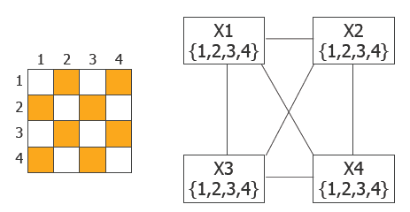
4-Queens Problem

Slide 13
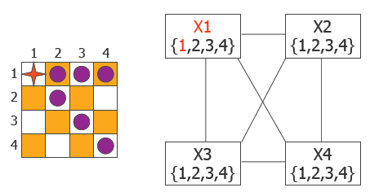
4-Queens Problem

Slide 14
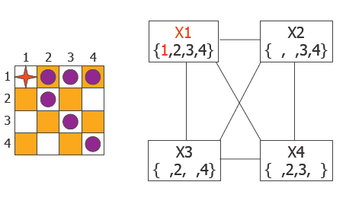
4-Queens Problem

Slide 15
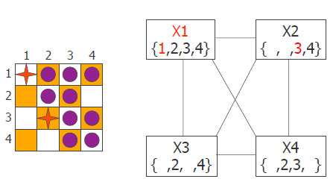
4-Queens Problem

Slide 16
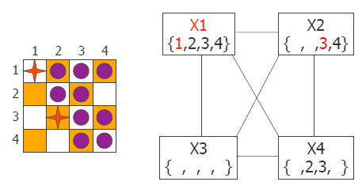
4-Queens Problem

Slide 17
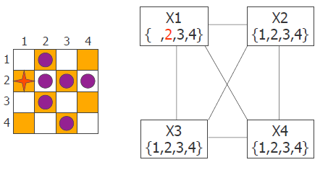
4-Queens Problem

Slide 18
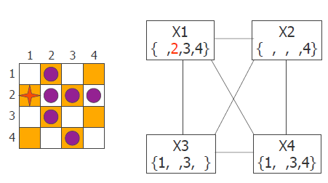
4-Queens Problem

Slide 19
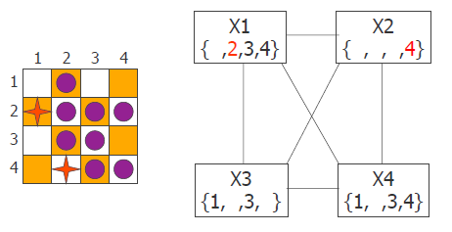
4-Queens Problem

Slide 20
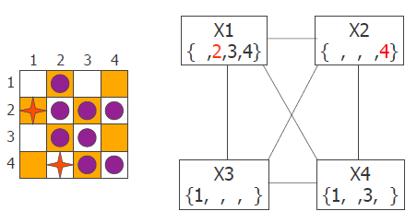
4-Queens Problem

Slide 21
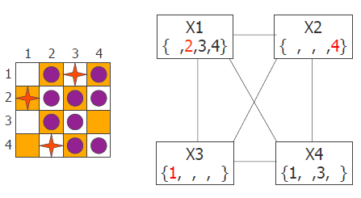
4-Queens Problem

Slide 22
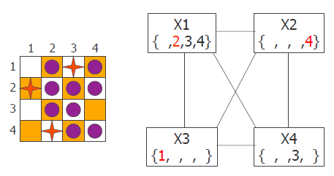
4-Queens Problem

Slide 23
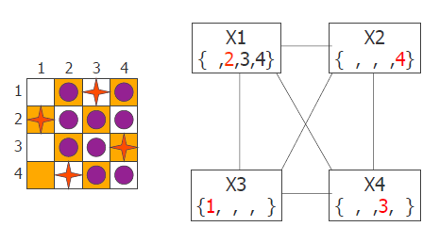
4-Queens Problem

