Slide 1
Signals and Systems
Systems and their classifications-III
Time Variant and Invariant Systems
Stable and Unstable Systems

Slide 2
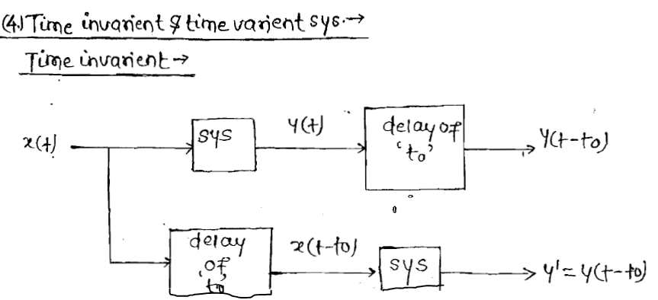
Time Variant and Invariant Systems

Slide 3
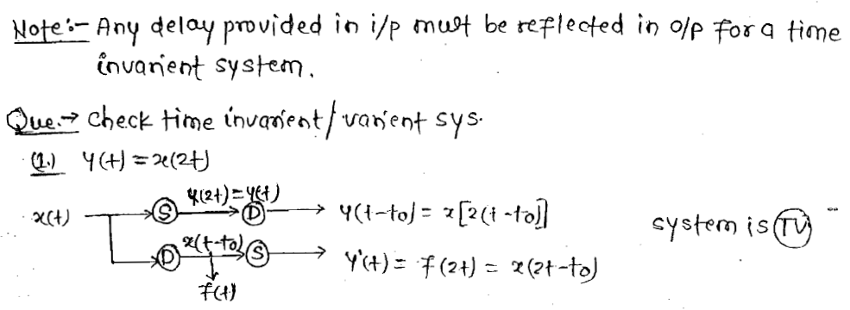
Cont..

Slide 4
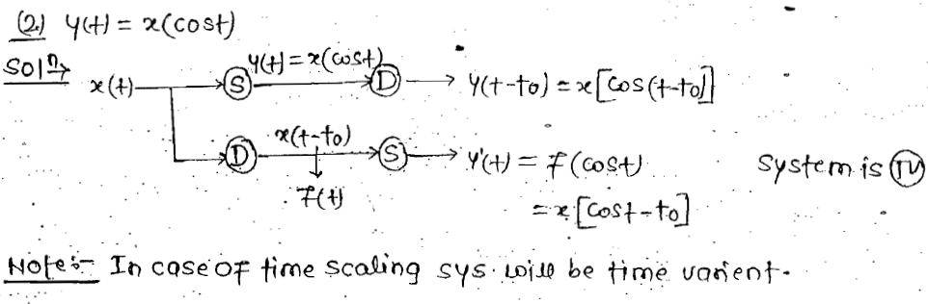
Cont..

Slide 5
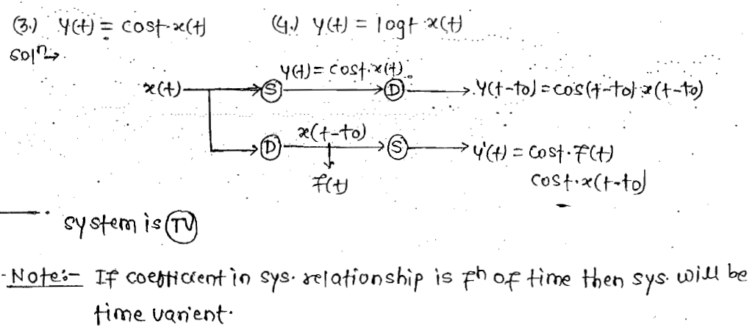
Cont..

Slide 6
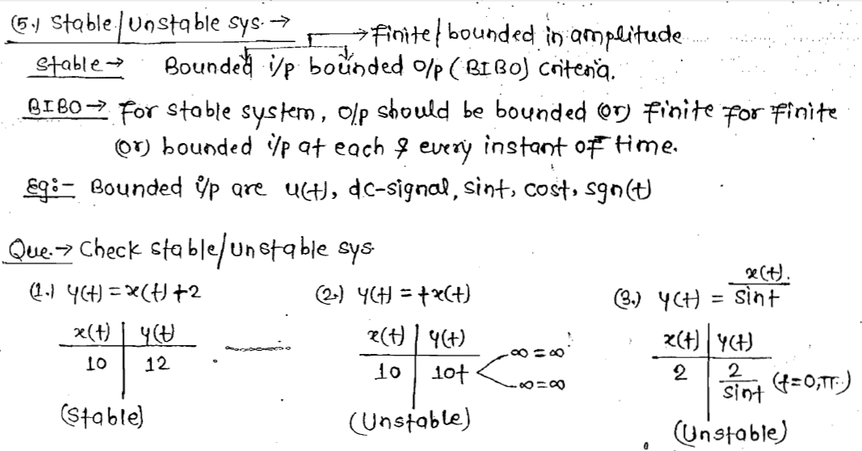
Stable and Unstable Systems

Slide 7
Cont..

Slide 8
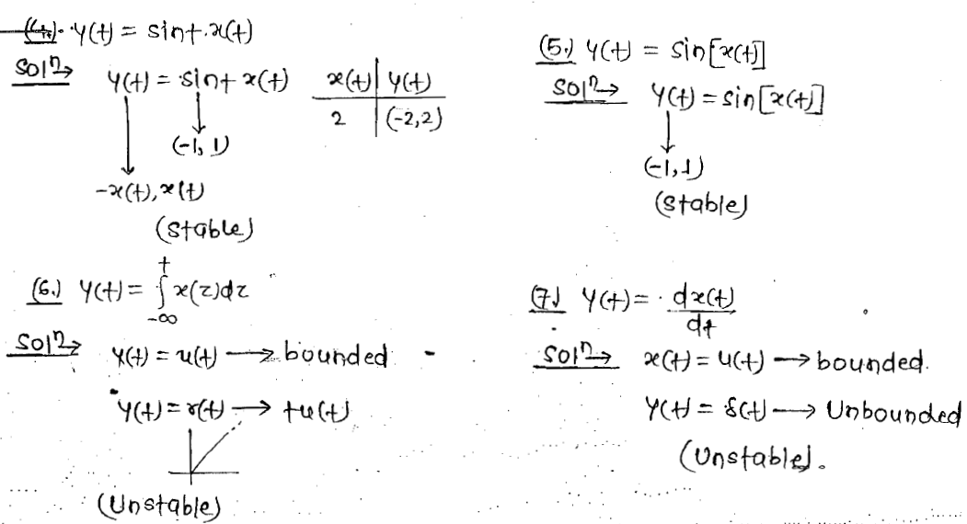
Cont..

Slide 9
Cont..

Slide 10
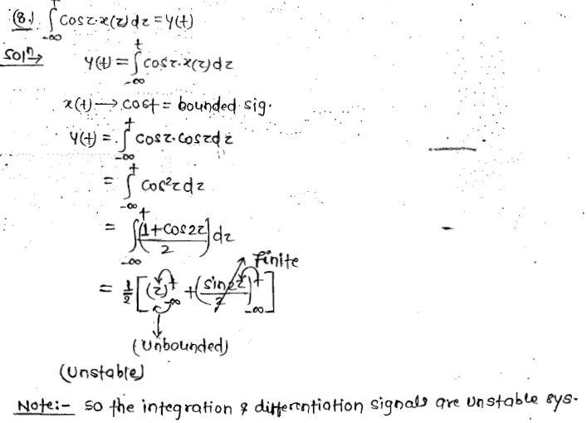
Cont..

Slide 11
Thank You

