Slide 1
Signals and Systems
Response of LTI System-III

Slide 2

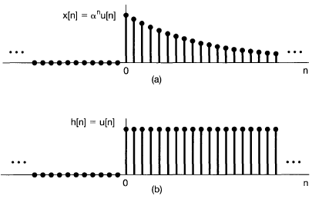
Example

Slide 3
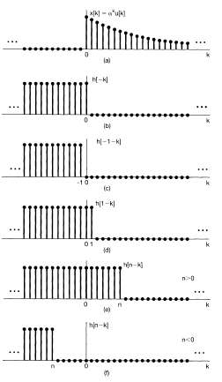
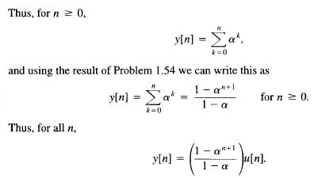
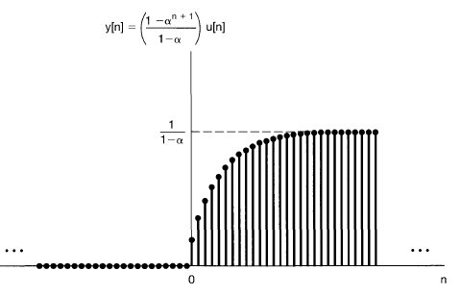

Slide 4
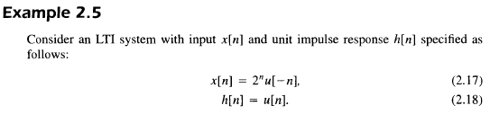
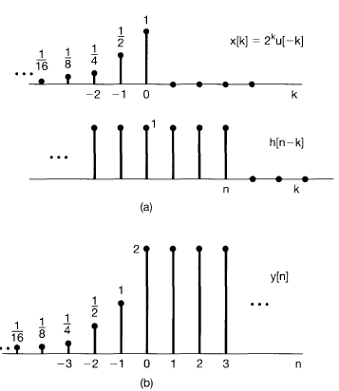
Cont..

Slide 5
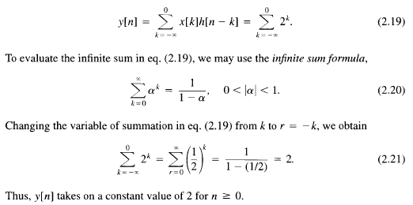
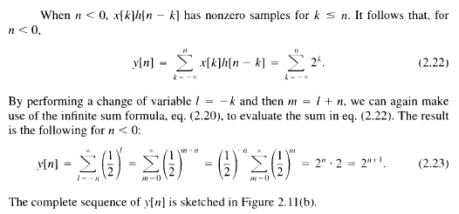
Cont..

Slide 6
Cont..

Slide 7
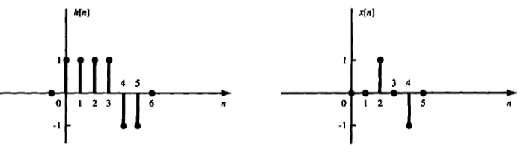
Cont..
The impulse response h[n] of a discrete-time LTI system. (a). Determine and sketch the output y[n] of this system to the input x[n]. (b) without using the convolution technique.

Slide 8

Cont..

Slide 9

Cont..

Slide 10
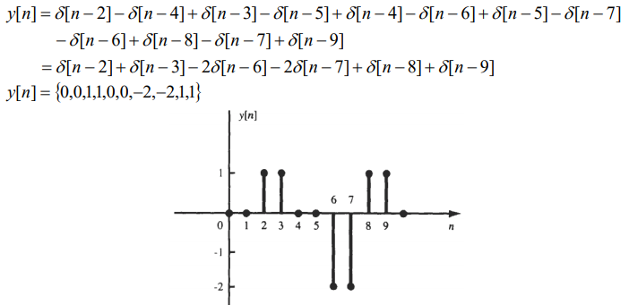
Cont..

Slide 11
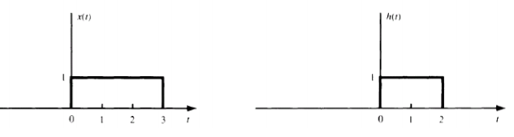
Cont..

Slide 12
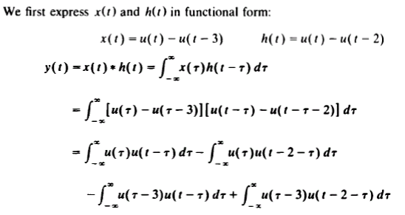
Cont..

Slide 13
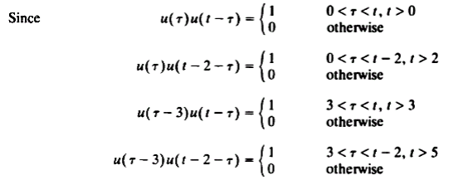
Cont..

Slide 14
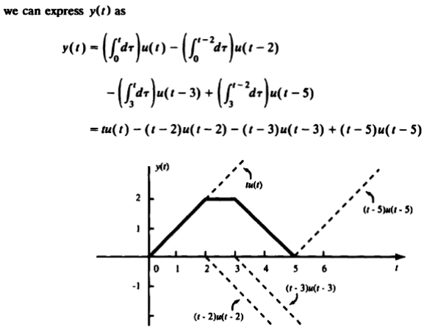
Cont..

Slide 15
Thank You

