Slide 1
Inheritance In C++

Slide 2
Inheritance
C++ strongly supports the concept of Reusability.
The mechanism of deriving a new class from an old class is called inheritance.
The old class is referred to as Base class or Super class while the new class is referred to as the Derived class or Sub class.

Slide 3
Types of Inheritance
Single Inheritance
Multilevel Inheritance
Multiple Inheritance
Hierarchical Inheritance
Hybrid Inheritance

Slide 4
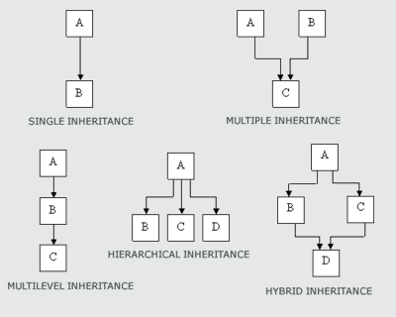
Types of Inheritance

Slide 5
Inheritance
Syntax:
class derived_class_name : access_specifier base_class_name
{
//
}
Example:
class derived : private base {
};
class derived : public base {
};
class derived : base {
};

Slide 6
Inheritance
When a base class is publicly inherited by a derived class, “public members” of base class become “public members” of derived class and therefore they are accessible to the objects of the derived class. Private member of base class will never become the member of derived class.
class derived : public base {
};
When a base class is privately inherited by a derived class, “public members” of base class become “private members” of derived class and therefore the public member of base class can only be accessed by the member function of derived class. They are inaccessible to the object of the derived class.
class derived : private base {
};

Slide 7
class B {
int a;
public:
int b;
void set_ab() {
a=5; b=10;
}
int get_a() {
return a;
}
void show_a() {
cout<<“a = “<<a<<“\n”;;
}
};
Class D : public B {
int c;
public :
void mul() {
c = b * get_a(); // a can’t be used directly because it is private member of B class.
}
void display() {
cout << “a = “<<get_a()<<“\n”<<“b = “<<b<<“\n”<<“c = “<<c<<“\n”;
}
};
int main() {
D d;
d.set_ab();
d.mul();
d.show_a();
d.display();
d.b = 20;
d.mul();
d.display();
return 0;
}

Slide 8
class B {
int a;
public:
int b;
void set_ab() {
a=5; b=10;
}
int get_a() {
return a;
}
void show_a() {
cout<<“a = “<<a<<“\n”;;
}
};
Class D : public B {
int c;
public :
void mul() {
c = b * get_a();
}
void display() {
cout << “a = “<<get_a()<<“\n”<<“b = “<<b<<“\n”<<“c = “<<c<<“\n”;
}
};
int main() {
D d;
d.set_ab();
d.mul();
d.show_a();
d.display();
d.b = 20;
d.mul();
d.display();
return 0;
}
Output:
a=5
a=5
b=10
c=50
a=5
b=20
c=100

Slide 9
class B {
int a;
public:
int b;
void set_ab() {
a=5; b=10;
}
int get_a() {
return a;
}
void show_a() {
cout<<“a = “<<a<<“\n”;;
}
};
Class D : private B {
int c;
public :
void mul() {
set_ab();
c = b * get_a();
}
void display() {
cout << “a = “<<get_a()<<“\n”<<“b = “<<b<<“\n”<<“c = “<<c<<“\n”;
}
};
int main() {
D d;
d.mul();
d.display();
//d.show_a() //error
return 0;
}

Slide 10
} class B {
int a;
public:
int b;
void set_ab() {
a=5; b=10;
}
int get_a() {
return a;
}
void show_a() {
cout<<“a = “<<a<<“\n”;;
}
};
Class D : private B {
int c;
public :
void mul() {
set_ab();
c = b * get_a();
}
void display() {
cout << “a = “<<get_a()<<“\n”<<“b = “<<b<<“\n”<<“c = “<<c<<“\n”;
}
};
int main() {
D d;
d.mul();
d.display();
//d.show_a() //error
return 0;
}
Output:
a=5
b=10
c=50

Slide 11
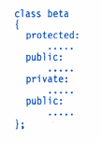
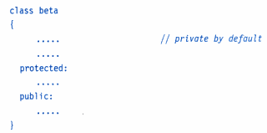
Protected: Making a Private Member Inheritable
C++ provides a third access specifier: protected
A member declared as protected is accessible by the member functions within its class and any class immediately derived from it

Slide 12
When a protected member is inherited in public mode it becomes protected in the derived class too and therefore is accessible by the member functions of the derived class. It is also ready for further inheritance.
A protected member, inherited in the private mode, becomes private in derived class. Although it is available to the member functions of the derived class, it is not available for further inheritance.
It is also possible to inherit a base class in protected mode. In this case both the public and protected members of the class become protected members of the derived class.

Slide 13
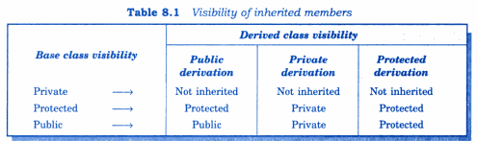
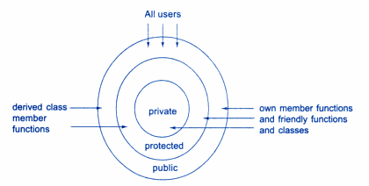

Slide 14
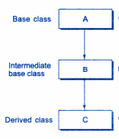
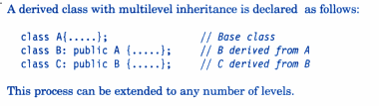
Multilevel Inheritance
Class A serves as a base class for the derived class B, which in turn serves as a base class for the derived class C.
The class B is known as intermediate base class.

Slide 15
class student {
protected:
int rollNo;
public:
void getRollNo(int a) {
rollNo = a;
}
void putRollNo() {
cout<<“Roll No “<<rollNo<<“\n”;
}
};
class test : public student {
protected:
float sub1;
float sub2;
public :
void getMarks(float x, float y) {
sub1 = x;
sub2 = y;
}
void putMarks() {
cout << “Marks :“<<sub1<<“ ”<<sub2<<“\n”;
}
};

Slide 16
class result : public test {
float total;
public :
void display() {
total = sub1 + sub2;
putRollNo();
putMarks();
cout << “Total :“<<total<<“\n”;
}
};
int main() {
result student1;
student1.getRollNo(123);
student1.getMarks(75.0, 65.5);
student1.display();
return 0;
}

Slide 17
class result : public test {
float total;
public :
void display() {
total = sub1 + sub2;
putRollNo();
putMarks();
cout << “Total :“<<total<<“\n”;
}
};
int main() {
result student1;
student1.getRollNo(123);
student1.getMarks(75.0, 65.5);
student1.display();
return 0;
}
Output:
Roll No 123
Marks : 75.0 65.5
Total : 140.5

Slide 18
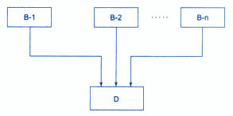

Multiple Inheritance
Multiple inheritance allows us to combine the features of several existing classes as a starting point for defining new classes.

Slide 19
class M {
protected:
int m;
public:
void getM(int a) {
m = a;
}
};
class N {
protected:
int n;
public:
void getN(int b) {
n = b;
}
};
class P: public M, public N {
public :
void display() {
cout << “m =“<<m<<“n =”<<n<<“m*n = “<<m*n<<“\n”;
}
};
int main() {
P p;
p.getM(10);
p.getN(20);
p.display();
return 0;
}

Slide 20
class M {
protected:
int m;
public:
void getM(int a) {
m = a;
}
};
class N {
protected:
int n;
public:
void getN(int b) {
n = b;
}
};
class P: public M, public N {
public :
void display() {
cout << “m =“<<m<<“n =”<<n<<“m*n = “<<m*n<<“\n”;
}
};
int main() {
P p;
p.getM(10);
p.getN(20);
p.display();
return 0;
}
Output:
m = 10 n = 20 m*n = 200

Slide 21
Ambiguity in Single Inheritance
class A {
public :
void display() {
cout << “A \n”;
}
};
class B: public A {
public :
void display() {
cout << “B \n”;
}
};
int main() {
B b;
b.display();
return 0;
}
Which display() function get invoked?

Slide 22
Ambiguity in Single Inheritance
class A {
public :
void display() {
cout << “A \n”;
}
};
class B: public A {
public :
void display() {
cout << “B \n”;
}
};
int main() {
B b;
b.display();
b.A::display();
b.B::display();
return 0;
}
Output:
B
A
B

Slide 23
Ambiguity in Multiple Inheritance
class A {
public :
void display() {
cout << “A \n”;
}
};
class B {
public :
void display() {
cout << “B \n”;
}
};
class C: public A, public B {
};
int main() {
C c;
c.display();
return 0;
}
Which display() function get invoked?

Slide 24
Ambiguity in Multiple Inheritance
class A {
public :
void display() {
cout << “A \n”;
}
};
class B {
public :
void display() {
cout << “B \n”;
}
};
class C: public A, public B {
};
int main() {
C c;
c.display();
return 0;
}
Error: request for member 'display' is ambiguous

Slide 25
Ambiguity in Multiple Inheritance
class A {
public :
void display() {
cout << “A \n”;
}
};
class B {
public :
void display() {
cout << “B \n”;
}
};
class C: public A, public B {
public :
void display() {
A :: display();
}
};
int main() {
C c;
c.display();
return 0;
}
Output:
A

Slide 26
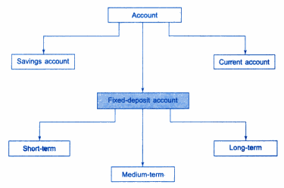
Hierarchical Inheritance
The base class includes all the features that are common to subclasses. Any number of subclasses can be constructed by inheriting the properties of the base class. A subclass can serve as a base class for the lower level classes and so on.

Slide 27
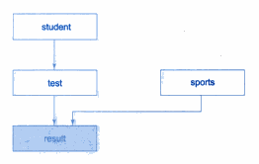
Hybrid Inheritance
There could be situations where we need to apply two or more types of inheritance to design a program.
Multilevel + Multiple Inheritance

Slide 28
class student {
protected:
int rollNo;
public:
void getRollNo(int a) {
rollNo = a;
}
void putRollNo() {
cout<<“Roll No “<<rollNo<<“\n”;
}
};
class test : public student {
protected:
float sub1;
float sub2;
public :
void getMarks(float x, float y) {
sub1 = x;
sub2 = y;
}
void putMarks() {
cout << “Marks :“<<sub1<<“ ”<<sub2<<“\n”;
}
};

Slide 29
class sports {
protected:
float score;
public :
void getScore(float s) {
score = s;
}
void putScore() {
cout << “Sports wt:“<<score<<“\n”;
}
};
class result : public test, public sports {
float total;
public :
void display() {
total = sub1 + sub2 + score;
putRollNo();
putMarks();
putScore();
cout << “Total :“<<total<<“\n”;
}
};
int main() {
result student1;
student1.getRollNo(123);
student1.getMarks(75.0, 65.5);
student1.getScore(6.0);
student1.display();
return 0;
}

Slide 30
class sports {
protected:
float score;
public :
void getScore(float s) {
score = s;
}
void putScore() {
cout << “Sports wt:“<<score<<“\n”;
}
};
class result : public test, public sports {
float total;
public :
void display() {
total = sub1 + sub2 + score;
putRollNo();
putMarks();
putScore();
cout << “Total :“<<total<<“\n”;
}
};
int main() {
result student1;
student1.getRollNo(123);
student1.getMarks(75.0, 65.5);
student1.getScore(6.0);
student1.display();
return 0;
}
Output:
Roll No 123
Marks : 75.0 65.5
Sports wt: 6.0
Total : 146.5

Slide 31
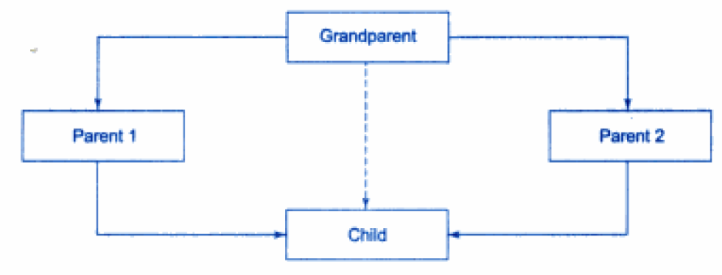
Virtual Base Classes
Consider a situation where all the three kinds of inheritance, namely, multilevel, multiple and hierarchical inheritance are involved.
The child has two direct base classes parent 1 and parent 2 which themselves have a common base class grandparent. The child inherits the traits of grandparents via two separate paths. It can also inherit directly as shown by the broken line. Grandparent referred as indirect base class.

Slide 32
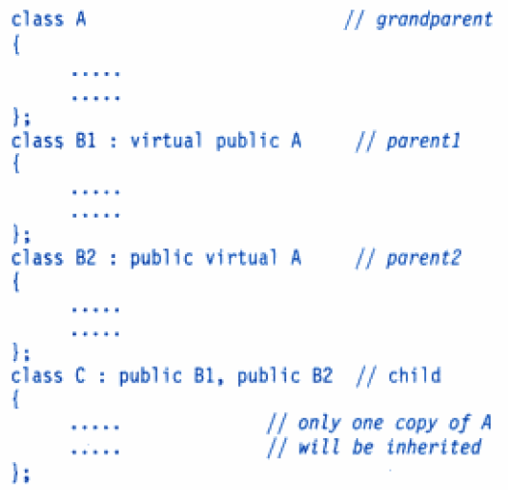
All the public and protected members of grand parent are inherited into child twice first via parent1 and again via parent2. This means child would have duplicate sets of members inherited from grandparents. This introduces ambiguity and should be avoided.
This duplication can be removed by making the common base class (ancestor class) as virtual base class while declaring the direct base classes as shown below.

Slide 33
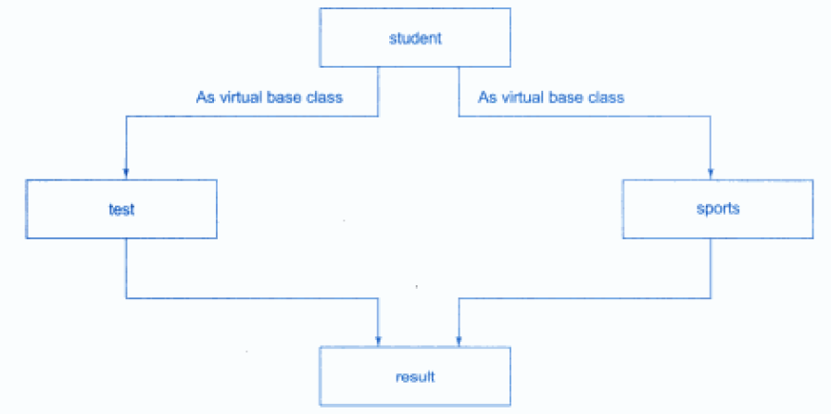
When a class is made a virtual base class, C++ takes care that only one copy of that class is inherited.
Consider again the student results processing system. Assume that the class sports derives the rollno from the class student. Then the inheritance relationship will be as shown in figure.

Slide 34
class student {
protected:
int rollNo;
public:
void getRollNo(int a) {
rollNo = a;
}
void putRollNo() {
cout<<“Roll No “<<rollNo<<“\n”;
}
};
class test : virtual public student {
protected:
float sub1;
float sub2;
public :
void getMarks(float x, float y) {
sub1 = x;
sub2 = y;
}
void putMarks() {
cout << “Marks :“<<sub1<<“ ”<<sub2<<“\n”;
}
};

Slide 35
class sports: public virtual student {
protected:
float score;
public :
void getScore(float s) {
score = s;
}
void putScore() {
cout << “Sports wt:“<<score<<“\n”;
}
};
class result : public test, public sports {
float total;
public :
void display() {
total = sub1 + sub2 + score;
putRollNo();
putMarks();
putScore();
cout << “Total :“<<total<<“\n”;
}
};
int main() {
result student1;
student1.getRollNo(123);
student1.getMarks(75.0, 65.5);
student1.getScore(6.0);
student1.display();
return 0;
}

Slide 36
class sports: public virtual student{
protected:
float score;
public :
void getScore(float s) {
score = s;
}
void putScore() {
cout << “Sports wt:“<<score<<“\n”;
}
};
class result : public test, public sports {
float total;
public :
void display() {
total = sub1 + sub2 + score;
putRollNo();
putMarks();
putScore();
cout << “Total :“<<total<<“\n”;
}
};
int main() {
result student1;
student1.getRollNo(123);
student1.getMarks(75.0, 65.5);
student1.getScore(6.0);
student1.display();
return 0;
}
Output:
Roll No 123
Marks : 75.0 65.5
Sports wt: 6.0
Total : 146.5

Slide 37
Constructors in Derived Classes
Constructor play an important role in initializing objects.
If no base class constructor takes any arguments, the derived class need not have a constructor function.
If any base class contains a constructor with one or more arguments, then it is mandatory for the derived class to have a constructor and pass the argument to the base class constructor.
When both the derived and base classes contain constructors, the base constructor is executed first then the constructor in derived class executed.
In case of multiple inheritance, the base classes are constructed in the order in which they appears in the declaration of the derived class.
Similarly in multilevel inheritance, the constructor will be executed in the order of inheritance.

Slide 38
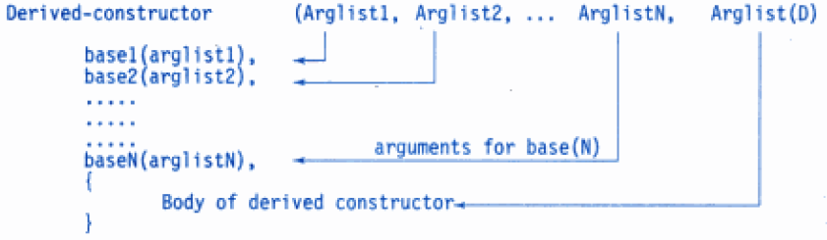
The constructor of the derived class receives the entire list of values as its arguments and passes them on to the base constructors in the order in which they are declared in the derived class.
The base constructors are called and executed before executing the statements in the body of the derived constructor.

Slide 39
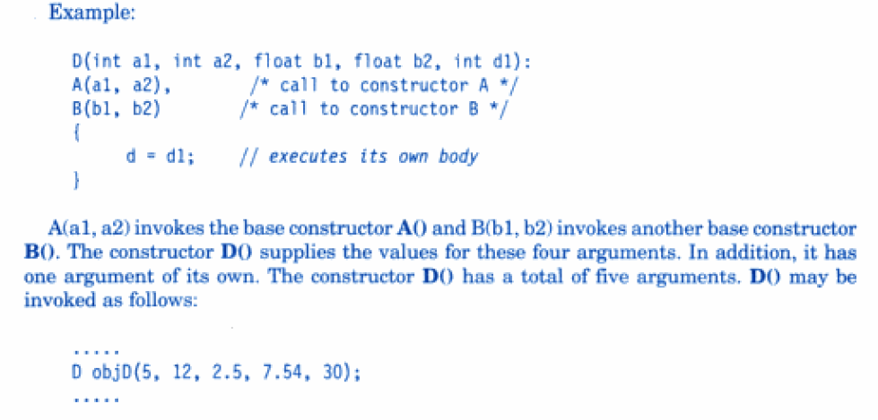
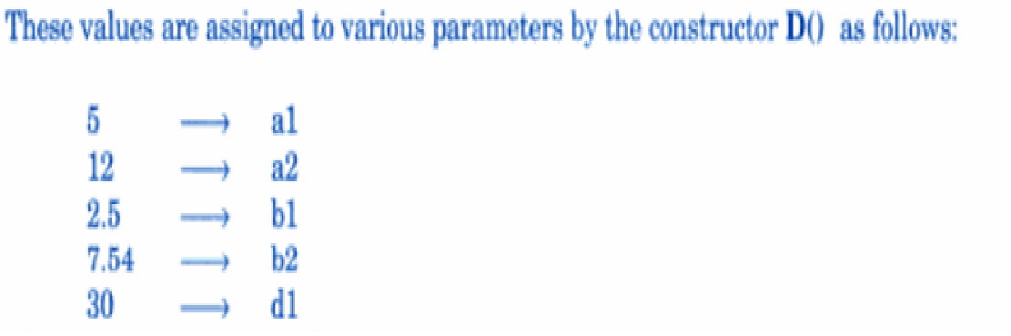

Slide 40
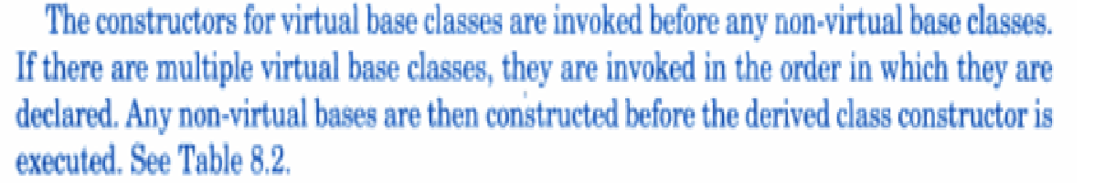
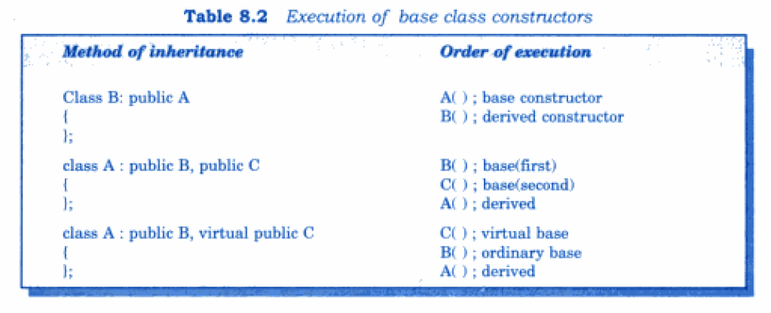

Slide 41
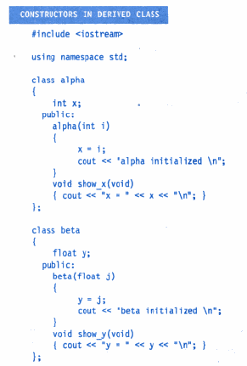

Slide 42
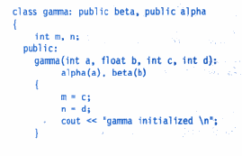
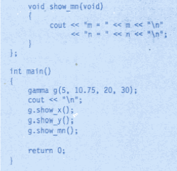

Slide 43
Output:
beta initialized
alpha initialized
gamma initialized
x=5
y=10.75
m=20
n=30
Note: beta is initialized first, although it appears second in the derived constructor.

Slide 44
#include<iostream>
Using namespace std;
class alpha
{
int x;
public:
alpha(int i)
{
x=i;
cout<<“\n alpha constructed”;
}
};
class beta
{
float p,q;
public:
beta(float a, float b): p(a), q(b+p)
{
cout <<“\n beta constructed”;
}

Slide 45
void show_beta(void)
{
cout<<“p = “<<q <<“\n”;
cout<< “ q =“<<q<<“\n”;
}
};
class gamma : public beta, public alpha
{
int u,v;
public:
gamma(int a, int b, float c): alpha(a*2), beta(c,c), u(a)
{
v=b;
cout<<“\n gamma constructed”;}
void show_gamma(void)
{
cout<<“u = “<< u<< “\n”;
cout<< “ v= “<<v<<“\n”;
}
};

Slide 46
int main()
{
gamma g(2,4,2.5);
cout<<“\n \n display member values “<<“\n \n”;
g.show_alpha();
g.show_beta();
g.show_gamma();
return 0;
};

Slide 47
Int main()
{
gamma g(2,4,2.5);
cout<<“\n \n display member values “<<“\n \n”;
g.show_alpha();
g.show_beta();
g.show_gamma();
return 0;
};
Output:
beta constructed
alpha constructed
gamma constructed
Display member values
X=4
P=2.5
Q=5
U=2
V=4

Slide 48
“this” Pointer
Within a member function, the this keyword is a pointer to the current obj(object through which the fn was called).
The this pointer is a constant pointer.
Every obj has access to own add. through a ptr called this.
A static member function does not have a this pointer.
this pointer can be used inside the member functions only.
Member functions use the this ptr implicitly or explicitly
Implicitly when accessing members directly
Explicitly when using keyword this

Slide 49
this pointer
Example program
#include<iostream>
class test
{
private:
int a;
public:
void setdata(int x)
{
a=x;// normal way to set data
cout<<“address of my bject”<<this;
this->a=x;// another way to set data
}
void showdata()
{
cout<<“\n address of object for showdata()”<<this;
cout<<“a=“<<a;
cout<<“ this->a”<<this->a;
}
};
void main()
{
test t,s;
t.setdata(30);
t.showdata();
s.setdata(40);
s.showdata();
}
Address of my object : 0X22fefc
Address of object for showdata():0X22fefc
a=30;
This->a 30
Address of my object : 0X22fffc
Address of object for showdata():0X22fffc
a=40;
This->a 40
The member function of a
class always with the pointer
called this, which points to the
object with which the function
is invoked.

Slide 50
friend functions and classes
Private and protected members of a class cannot be accessible to out side the class. The non member functions cannot have an access to these data of a class.
When two classes need to access the same function- make such function to be friend to both the classes.
Allow the function to have access to the private members of these two classes.
Such a function need not be member function of any of these classes.
Friend functions
Allow the non-member function to access even the private members of a class using the friend function or friend classes.
Friend functions are used to access private members of a class
syntax
class classname
{
…..
…..
public:
friend returntype functionname(object arg);
};

Slide 51
Characteristics of friend function
Function declaration is preceded by the keyword friend.
Its not a member function of the class. However, access to private members of a class.
The scope of the friend is not limited to the class in which it has been declared.
Since it is not in the scope of the class, It cannot be invoked using the object of that class.
Invoked like a normal function.
It can be declared either in the public or the private part of a class.
It takes object as an argument.
Unlike the member functions, it cannot access the class members directly. However, it can use the object and dot operator with each member name to access both the private and public data.
The function is defined any where in the program
Function definition need not required any scope resolution operator.

Slide 52
Example on friend function
Class xyz;// advanced class declaration
class abc
{
private:
int a;
public:
void setdata(int x)
{
a=x; }
friend int add( abc ab,xyz xy);
};
Class xyz
{
private:
int b;
public:
void setdata(int y)
{
b=y; }
friend int add( abc ab,xyz xy);
};
int add( abc ab, xyz xy)
{
return ab.a+xy.b;
}// a and b are private
int main()
{
abc ab;
xyz xy;
ab.setdata(10);
xy.setdata(20);
cout<<“sum of the two no=“ <<add(ab,xy);
return 0;
}

Slide 53
Friend class
Whenever all the functions of one class can have access to the private members of the another class.
It is possible to make the entire class as a friend of another class. So that all the members of the friend class can have access to the private members of the another class.
Syntax
class A
{
……..
………………..
friend class B;
};
Class B
{
………
……….
}

Slide 54
Example on friend class
class ABC
{
private:
int a,b;
public:
ABC(int x,int y)
{
a=x;
b=y;
}
// make a class XYZ as friend class
to ABC
friend class XYZ;
};
class XYZ{
public:
void display( ABC ab){
cout<<“\n a in ABC class=“<<ab.a;
cout<<“\n b in ABC class=“<<ab.b;
}
};
void main()
{
ABC ab(10,20);
XYZ xy;//object of XYZ
xy.display(ab);
}
Display is function of friend class so that pass class object as argument

Slide 55
What is Polymorphism?
Polymorphism is the ability to use an operator or function in different ways. Polymorphism gives different meanings or functions to the operators or functions.
A single function usage or an operator functioning in many ways can be called polymorphism.
Polymorphism refers to codes, operations or objects that behave differently in different contexts.

Slide 56
Two type polymorphism
Function Overloading
Function Overriding
Function overloading
Function overloading- The process of two or more functions having same name and different in their signature( no. of arguments, type of arguments).
However, the overloading function differ only in their return type is not allowed.
Use of function overloading
Function overloading is one of the most powerful features of C++ programming language. It forms the basis of polymorphism (compile-time polymorphism).
Most of the time you’ll be overloading the constructor of a class.

Slide 57
Swapping of two numbers
void swap_int(int a,int b)
{
int temp;
temp=a;
a=b;
b=temp;
}
void swap_float(float a, float b)
{
float temp;
temp=a;
a=b;
b=temp;
}
Function overloading
Void swap(int a,int b);
Void swap(float a,float b);
Void swap(char a,char b);
void add();
void add(int a);
void add(int a, int b);
int add(int a, int b);
last two functions are not overloading

Slide 58
Overloading Functions that differ in terms of no of arguments
#include<iostream.h>
//FUNTION PROTOTYPES
int func(int i);
int func(int i, int j);
int main()
{
cout<<func(10);//func(int i)is called
cout<<func(10,10);//func(int i, int j) is called
return 0;
}
int func(int i)
{ return i;
}
int func(int i, int j)
{
return i+j;
}

Slide 59
Overloading Functions that differ in terms of TYPE OF arguments
#include<iostream.h>
int func(int i);
double func(double i);
void main()
{
cout<<func(10);//func(int i)is called cout<<func(10.201);//func(double i) is called
}
int func(int i)
{
return i;
}
double func(double i)
{
return i;
}

Slide 60
include<iostream.h>
int func(int i);
double func(int i);
int main()
{
cout<<func(10);
cout<<func(10.201);
return 0;
}
int func(int i)
{
return i;
}
double func(int i)
{
return i;
}
This program wont work because you cant
over load the functions if they are differ only
in terms of data type they return.
Write a c++ program to calculate area of circle,
rectangle, square using function overloading.?

Slide 61
#include "iostream"
using namespace std;
class measure
{
public:
void shape(int r){
cout<<"area of the circle is "<<3.14*r*r;
}
void shape(int l,int b) {
cout<<"area of the rectangle is"<<l*b;
}
void shape(long a) {
cout<<"area of the square is"<<a*a;
}
};

Slide 62
int main()
{
int r,d,e,l,b;
float t,c,h;
long a;
int ch;
double j,f;
long int g;
measure obj;
cout<<"\tCALCULATION OF AREA AND VOLUME";
cout<<"\n\n1. area of circle";
cout<<"\n2. area of rectangle";
cout<<"\n3. area of square";
cout<<"\n\tEnter your choice ";
cin>>ch;

Slide 63
switch(ch){
case 1:
cout<<"enter the value of radius of the circle \n";
cin>>r;
obj.shape(r);break;
case 2:
cout<<"enter the sides of rectangle \n";
cin>>l>>b;
obj.shape(l,b);break;
case 3:
cout<<"enter the sides of square";
cin>>a;
obj.shape(a);break;
default:
cout<<"\nThe choice entered is a wrong choice";
}
}

Slide 64
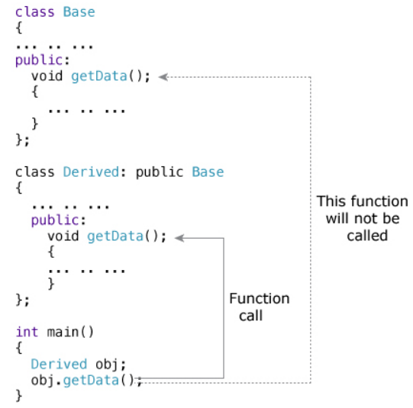
Function Overriding
If we inherit a class into the derived class and provide a definition for one of the base class's function again inside the derived class, then that function is said to be overridden, and this mechanism is called Function Overriding.

Slide 65
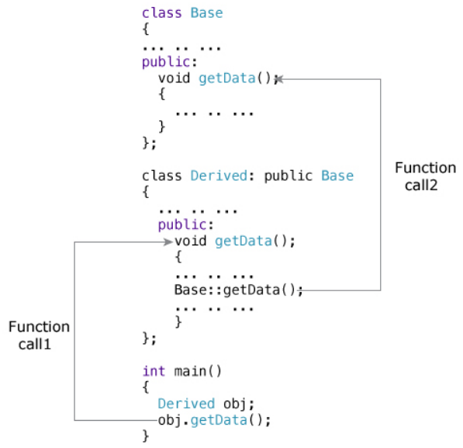
To access the overridden function of the base class from the derived class, scope resolution operator :: is used. For example

Slide 66
Q1. Write a program in C++ to create a class Time. The class should have three fields for hours, minutes and seconds. It should have constructor to initialize the hours, minutes and seconds and a method printTime() to print the time. Overload the following operators: plus operator (+) (add two time objects based on 24 hour clock) and minus operator (-) (sub two time objects based on 24 hour clock)

Slide 67
#include using namespace std; class Time { private: int hr, min, sec; public: Time(); // constructor Time(int,int,int); // constructor void get(); void show(); Time operator + (Time); Time operator - (Time); }; Time::Time() { hr=0; min=0; sec=0; }
Time::Time(int h,int m,int s) { hr=h; min=m; sec=s; } void Time::get() { cout<<"nEnter hrs:"; cin>>hr; cout<<"Enter min:"; cin>>min; cout<<"Enter sec:"; cin>>sec; } void Time::show() { cout<<"Time is "<<hr<<":"<<min<<":"<<sec<<endl; }

Slide 68
Time Time::operator + ( Time t) { int h,m,s; int sum; sum = (hr + t.hr)*3600 + (min + t.min)*60 + sec + t.sec; s = sum % 60; sum = sum / 60; m = sum % 60; h = sum / 60; return Time(h,m,s); }
Time Time::operator - ( Time t) { int h,m,s; int sum1,sum2,sum; sum1 = (hr)*3600 + (min )*60 + sec ; sum2 = (t.hr)*3600 + (t.min)*60 + t.sec; if (sum1>sum2) sum = sum1-sum2; else sum = sum2-sum1;

Slide 69
s = sum %60; sum = sum/60; m = sum % 60; h = sum/60; return Time(h,m,s); }
int main() { Time t1; Time t2; cout<<"Enter first time:"; t1.get(); cout<<"Enter second time:"; t2.get(); Time t_sum = t1 + t2; Time t_diff = t1 - t2; cout<<"Sum "; t_sum.show(); cout<<"Diff "; t_diff.show(); system("pause");}

