Slide 1
Polymorphism In C++

Slide 2
What is Polymorphism?
Polymorphism is the ability to use an operator or function in different ways. Polymorphism gives different meanings to functions or operators.
A single function usage or an operator functioning in many ways can be called polymorphism.
Polymorphism refers to codes, operations or objects that behave differently in different contexts.

Slide 3
Polymorphism
Polymorphism means ‘one name, multiple forms’
Polymorphism is of two types –
Compile Time Polymorphism
Function Overloading
Operator Overloading
Run Time Polymorphism
Virtual Functions

Slide 4
Compile Time Polymorphism
Operator overloading (we have studied earlier)
Function Overloading
Function overloading- The process of two or more functions having same name and different in their signature( no. of arguments, type of arguments).
However, the overloading function differ only in their return type is not allowed.

Slide 5
Swapping of two numbers
void swap(int a,int b)
{
int temp;
temp=a;
a=b;
b=temp;
}
void swap(float a, float b)
{
float temp;
temp=a;
a=b;
b=temp;
}
Function overloading
void swap(int a,int b);
void swap(float a,float b);
void swap(char a,char b);
void add();
void add(int a);
void add(int a, int b);
int add(int a, int b);
last two functions are not overloading

Slide 6
Overloading Functions that differ in terms of no of arguments
#include<iostream.h>
int func(int i);
int func(int i, int j);
int main()
{
cout<<func(10);
cout<<func(10,10);
return 0;
}
int func(int i)
{ return i;
}
int func(int i, int j)
{
return i+j;
}

Slide 7
Overloading Functions that differ in terms of TYPE OF arguments
#include<iostream.h>
int func(int i);
double func(double i);
void main()
{
cout<<func(10
cout<<func(10.201);
}
int func(int i)
{
return i;
}
double func(double i)
{
return i;
}

Slide 8
include<iostream.h>
int func(int i);
double func(int i);
int main()
{
cout<<func(10);
cout<<func(10.201);
return 0;
}
int func(int i)
{
return i;
}
double func(int i)
{
return i;
}
This program wont work because you cant
over load the functions if they are differ only
in terms of data type they return.
Write a c++ program to calculate area of circle,
rectangle, square using function overloading.?

Slide 9
#include "iostream"
using namespace std;
class measure
{
public:
void shape(int r){
cout<<"area of the circle is "<<3.14*r*r;
}
void shape(int l,int b) {
cout<<"area of the rectangle is"<<l*b;
}
void shape(long a) {
cout<<"area of the square is"<<a*a;
}
};

Slide 10
int main()
{
int r,d,e,l,b;
float t,c,h;
long a;
int ch;
double j,f;
long int g;
measure obj;
cout<<"\tCALCULATION OF AREA AND VOLUME";
cout<<"\n\n1. area of circle";
cout<<"\n2. area of rectangle";
cout<<"\n3. area of square";
cout<<"\n\tEnter your choice ";
cin>>ch;

Slide 11
switch(ch){
case 1:
cout<<"enter the value of radius of the circle \n";
cin>>r;
obj.shape(r);break;
case 2:
cout<<"enter the sides of rectangle \n";
cin>>l>>b;
obj.shape(l,b);break;
case 3:
cout<<"enter the sides of square";
cin>>a;
obj.shape(a);break;
default:
cout<<"\nThe choice entered is a wrong choice";
}
}

Slide 12
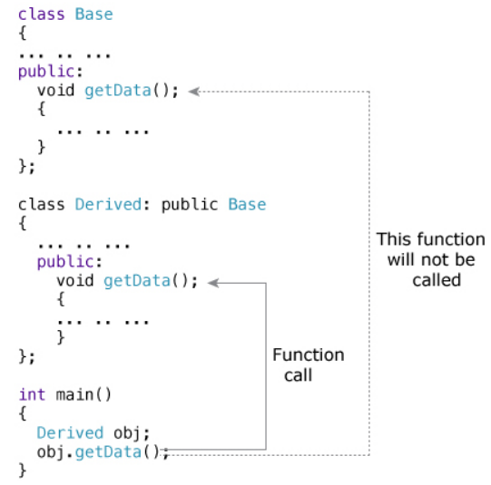
Function Overriding
If we inherit a class into the derived class and provide a definition for one of the base class's function again inside the derived class, then that function is said to be overridden, and this mechanism is called Function Overriding.

Slide 13
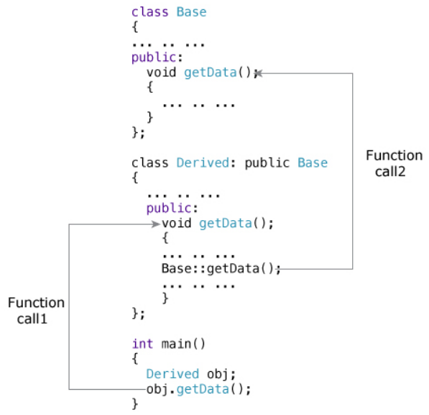
To access the overridden function of the base class from the derived class, scope resolution operator :: is used. For example

Slide 14
Pointers
We know that pointers is a derived data type that refers to another data variable by storing the variables memory address rather than data.
declaration: data-type *pointer-variable; int *ptr;
Pointer to functions:
Using function pointers, we can allow a c++ program to select a function dynamically at run time. We can also pass a function as an arguments to another function.
Two function pointers:
Function pointer to static member functions
Function pointer to non static member function
Function pointer to non static member function requires hidden arguments.

Slide 15
typeDeclaration:
data_type(*function_name)();
#include<iostream.h>
def void (*funptr)(int, int);
void add(int I, int j)
{
cout<<i<<“+”<<j<<“=“<<i+j;
}
Void subtrcat (int I, int j)
{
cout<<i<<“-”<<j<<“=“<<i-j; }
void main()
{
funptr ptr;
ptr = &add;
ptr(1,2);
ptr = subtract;
ptr (3,2);
}
Output:
1+2 =3;3-2 = 1

Slide 16
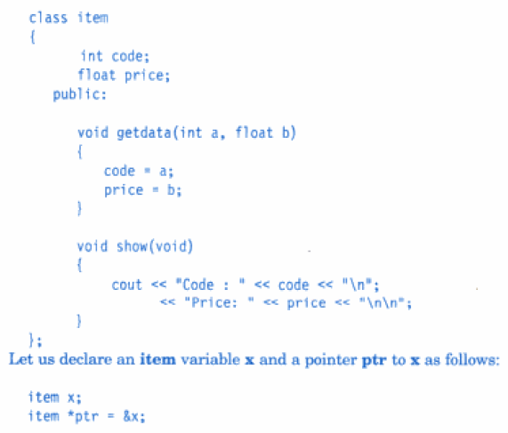
Pointers to objects
item *it_ptr here item is class and it_ptr is a pointer object.
Object pointers are useful in creating object at run time.
We can also use an object pointer to access the public members of an object.

Slide 17
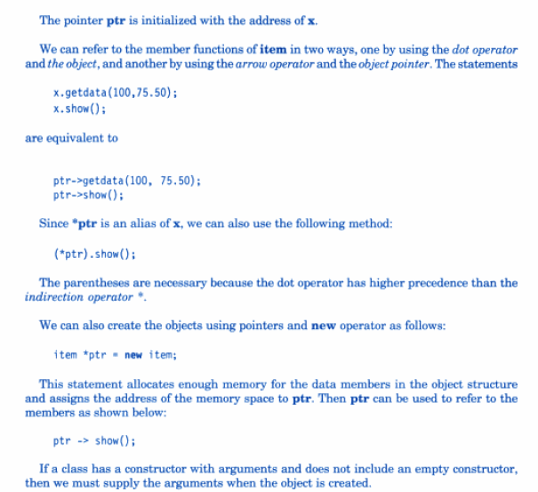

Slide 18
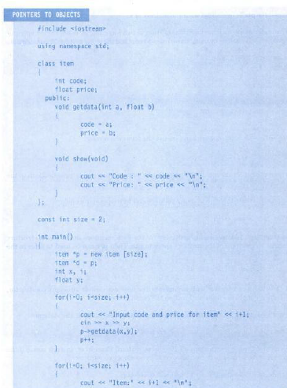

Slide 19
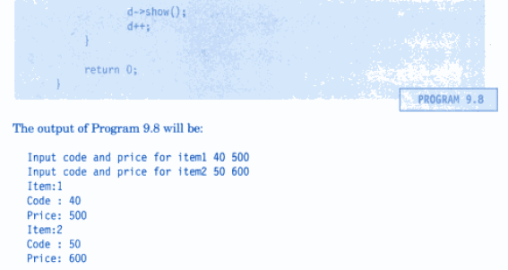

Slide 20
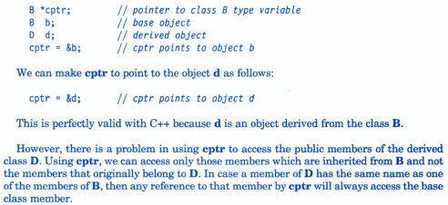
Pointers To Derived Classes

Slide 21
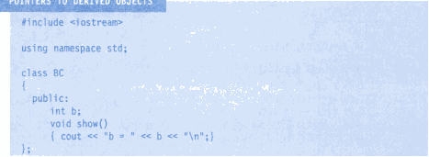
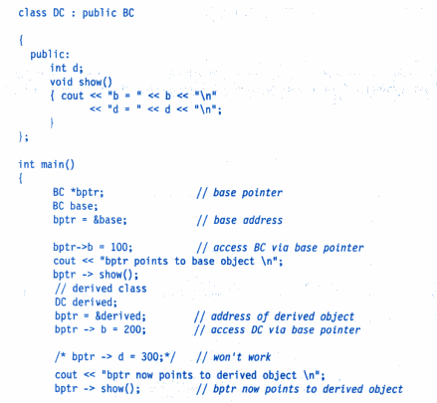

Slide 22
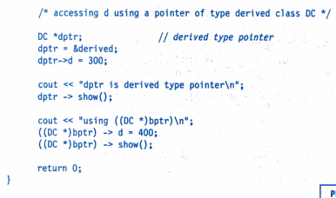
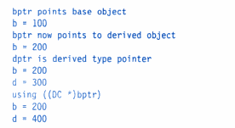
Output

Slide 23

Virtual Functions

Slide 24
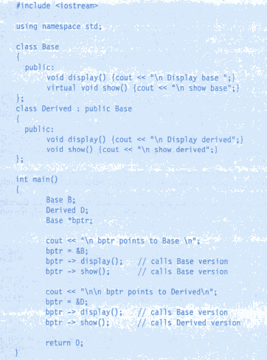

Slide 25
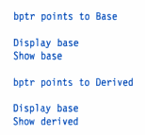
Virtual Functions

Slide 26
Virtual Functions
The virtual function must be members of some class.
They can not be static.
They are accessed by using object pointers.
A virtual function can be a friend of another class.
A virtual function must be defined in a base class.
The prototype of virtual function in base class and functions in derived class must be identical.
We cant have the virtual constructors, but may have virtual destructors.

Slide 27
Pure Virtual Functions and Abstract Base Classes
A pure virtual function is a function declared in a base class that has no definition relative to the base class.
Each derived class has to either define that function or redeclare it as pure virtual function.
e.g. virtual void display() = 0;
A class containing pure virtual functions cannot be used to create objects. Such classes are called abstract base classes..
The main objective of abstract base class is to provide some traits to derived class and to create a base pointer required for achieving run time polymorphism.

Slide 28
#include<iostream>
using namespace std;
class Base
{
int x;
public:
virtual void fun() = 0;
int getX() { return x; }
};
// This class ingerits from Base and implements fun()
class Derived: public Base
{
int y;
public:
void fun() { cout << "fun() called"; }
};
int main(void)
{
Derived d;
d.fun();
return 0;
}
Output
fun() called

Slide 29
Find the error in following program
#include <iostream>
using namespace std;
class A {
public:
void print(){cout<<"A::print()";}
};
class B:private A{
public:
void print(){cout<<"B::print()";}
};
class C:public B {
public:
void print(){A::print();}
};
int main()
{
C b;
b.print();
}

Slide 30
Find the error in following program
#include <iostream>
using namespace std;
class A {
public:
void print(){cout<<"A::print()";}
};
class B:private A{
public:
void print(){cout<<"B::print()";}
};
class C:public B {
public:
void print(){A::print();}
};
int main()
{
C b;
b.print();
}
Error: 'A' is not an accessible base of 'C'

Slide 31
#include <iostream>
using namespace std;
class base {
public:
virtual void show(){cout<<"In base";}
};
class derived:public base{
int x;
public:
void show(){cout<<"In derived";}
derived() { x=10;}
int getX() const { return x;}
};
int main()
{
derived d;
base *bp=&d;
bp->show();
cout<<bp->getX();
return 0;
}

Slide 32
#include <iostream>
using namespace std;
class base {
public:
virtual void show(){cout<<"In base";}
};
class derived:public base{
int x;
public:
void show(){cout<<"In derived";}
derived() { x=10;}
int getX() const { return x;}
};
int main()
{
derived d;
base *bp=&d;
bp->show();
cout<<bp->getX();
return 0;
}
error: 'class base' has no member named 'getX'

Slide 33
#include <iostream>
using namespace std;
class A {
public:
virtual void show(){cout<<"In A";}
};
class B:public A{
int x;
public:
virtual void show(){cout<<"In B";}
};
class C:public B
{
public:
virtual void show(){cout<<"In C";}
};
int main()
{
A *a = new C;
A *b = new B;
a->show();
b->show();
return 0;
}

Slide 34
#include <iostream>
using namespace std;
class A {
public:
virtual void show(){cout<<"In A";}
};
class B:public A{
int x;
public:
virtual void show(){cout<<"In B";}
};
class C:public B
{
public:
virtual void show(){cout<<"In C";}
};
int main()
{
A *a = new C;
A *b = new B;
a->show();
b->show();
return 0;
}
Output
In C In B

Slide 35
Q1. Define a class name PrimeN that stores a prime number. The default constructor should
set the prime number to 2. Add another constructor that allows the caller to set the
prime number. Also add a function to get the prime number.
Overload the prefix and postfix ++ and –- operator so that it returns a PrimeN object
that is the next largest prime number for ++ and the next smallest prime number for --.
For example if the object’s prime number is set to 13, then invoking ++ should return
PrimeN object whose prime number is set to 17. Create an appropriate main function to
Test the program.

Slide 36
int get()
{
return num;
}
PrimeNumber operator++(int )
{
int nextprime = num;
do
{
nextprime++;
}while(!isPrime(nextprime));
return PrimeNumber(nextprime);
}
PrimeNumber operator--(int){
int prevprime = num;
do
{
prevprime--;
if(prevprime<1)
{
return PrimeNumber(1);
}
}while(!isPrime(prevprime));
return PrimeNumber(prevprime);
}};
#include <iostream>
using namespace std;
class PrimeNumber
{
int num;
bool isPrime(int num)
{
for (int i=num-1;i>1;i--)
{
if(num%i==0)
return false;
}
return true;
}
public:
PrimeNumber (){
num=2;
};
PrimeNumber (int val)
{
num = val;
}

Slide 37
int main()
{
PrimeNumber p1, p2(13);
cout<<p1.get()<<endl;
cout<<p2.get()<<endl;
PrimeNumber p3 = p1++;
cout<<p3.get()<<endl;
PrimeNumber p4 = p2++;
cout<<p4.get()<<endl;
PrimeNumber p5 = p2--;
cout<<p5.get()<<endl;
}

Slide 38
using namespace std;
class Base1 {
public:
~Base1() { cout << " Base1's destructor" << endl; }
};
class Base2 {
public:
~Base2() { cout << " Base2's destructor" << endl; }
};
class Derived: public Base1, public Base2 {
public:
~Derived() { cout << " Derived's destructor" << endl; }
};
int main()
{
Derived d;
return 0;
}
Output:
Derived’s destructor
Base2’s destructor
Base1’s destructor
Important: Destructor called in reverse order of constructor

Slide 39
Find error
#include<iostream>
using namespace std;
class Base
{
public:
virtual void show() = 0;
};
int main(void)
{
Base b;
Base *bp; //Base &bp;
return 0;
}
Since Base has a pure virtual function,
it becomes an abstract class and an instance of it
cannot be created.
So there is an error in line “Base b”.
Note that there is no error in line “Base *bp;” or “Base &bp”.
We can have pointers or references of abstract classes.

