Slide 1
Signals and Systems
Response of LTI System-II

Slide 2
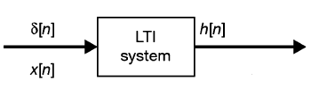
Response of a Discrete-time LTI System
Impulse Response:
The impulse response (or unit sample response) h[n] of a discrete-time (DT) LTI system (represented by T) is defined to be the response of the system when the input is 𝛿[n].
T

Slide 3
Cont..
Response to an Arbitrary Input x[n]
As we know, any DT signal x[n] can be expressed as:
Since the system is linear, the response y[n] of the system to the input x[n] will be

Slide 4
Cont..
Since the system is time-invariant, we can write
Using these equations, the response y[n] is
The above equation shows that a DT LTI system is completely characterized by its impulse response h[n].

Slide 5
Convolution Sum
The convolution of two sequences x[n] and h[n] is represented by
This equation is known as the convolution sum.
Therefore, the output of any DT LTI system is the convolution of the input x[n] with the impulse response h[n] of the system.

Slide 6
Cont..
The following figure demonstrates the definition of the impulse response h[n] and the relationship of convolution sum.

Slide 7

Cont..
Properties of Convolution Sum
1. Commutative:
2. Associative:
3. Distributive:

Slide 8
Cont..
Operation of Convolution Sum
Convolution sum
From the convolution sum equation, we observe that the convolution sum operation involves the following four steps:
1. The impulse response h[k] is time-reversed (reflected about the origin) to obtain h[-k] and then shifted by n to form h[n-k] = h[-(k-n)], which is a function of k with parameter n.

Slide 9
Cont..
2. The sequences x[k] and h[n-k] are multiplied together for all values of k with n fixed at some value.
3. The product x[k]h[n-k] is summed over all k to produce a single output sample y[n].
4. Steps 1 to 3 are repeated as n varies over -∞ to ∞ to produce the entire output y[n].

Slide 10
Cont..
If the commutative property of convolution is applied to the convolution sum equation, we can write
This equation may at times be easier to evaluate than the original/previous convolution sum equation.

Slide 11

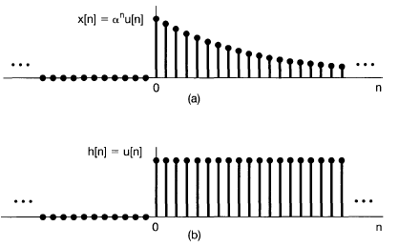
Example

Slide 12
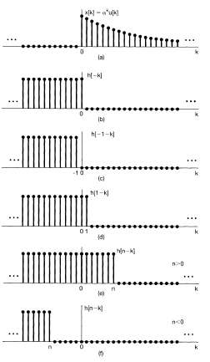
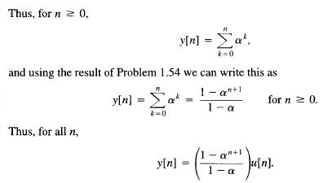
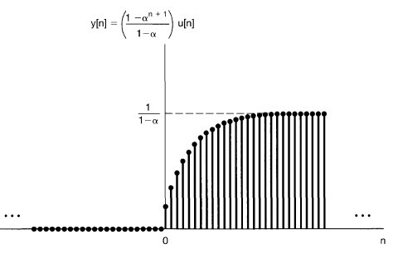

Slide 13
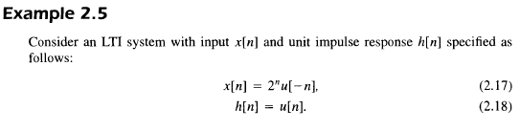
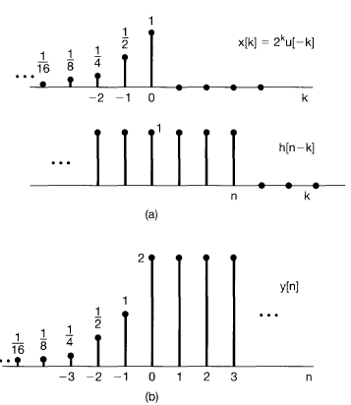
Cont..

Slide 14
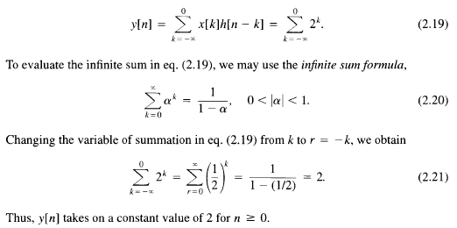
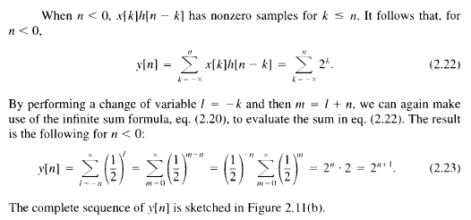
Cont..

Slide 15
Cont..

Slide 16
Thank You

