Slide 1
Signals and Systems
Response of LTI System-I

Slide 2

Response of a Continuous-time LTI System
If a system is both linear and time-invariant, it is called a linear time-invariant (LTI) system.
Impulse Response:
The impulse response h(t) of a continuous-time (CT) LTI system (represented by T) is defined to be the response of the system when the input is unit impulse signal 𝛿(t).
T

Slide 3
Cont..
Response to an Arbitrary Input x(t)
As we know, any CT signal x(t) can be expressed as:
Since the system is linear, the response y(t) of the system to the input x(t) will be

Slide 4
Cont..
Since the system is time-invariant, we can write
Using these equations, the response y(t) is
The above equation shows that a CT LTI system is completely characterized by its impulse response h(t).

Slide 5
Convolution Integral
The convolution of two CT signals x(t) and h(t) is represented by
This equation is known as the convolution integral.
Therefore, the output of any CT LTI system is the convolution of the input x(t) with the impulse response h(t) of the system.

Slide 6
Cont..
The following figure presents the definition of the impulse response h(t) and the relationship of convolution integral.

Slide 7

Cont..
Properties of Convolution Integral
1. Commutative:
2. Associative:
3. Distributive:

Slide 8
Cont..
Operation of Convolution Integral
Convolution integral
From the convolution integral equation, we observe that the convolution integral operation involves the following four steps:
1. The impulse response h(𝛕) is time-reversed (reflected about the origin) to obtain h(-𝛕) and then shifted by t to form h(t-𝛕) = h[-(𝛕-t)], which is a function of 𝛕 with parameter t.

Slide 9
Cont..
2. The signal x(𝛕) and h(t-𝛕) are multiplied together for all values of 𝛕 with t fixed at some value.
3. The product x(𝛕)h(t-𝛕) is integrated over all 𝛕 to produce a single output value y(t).
4. Steps 1 to 3 are repeated as t varies over -∞ to ∞ to produce the entire output y(t).

Slide 10
Cont..
If the commutative property of convolution is applied to the convolution integral equation, we have
This equation may at times be easier to evaluate than the original/previous convolution integral equation.

Slide 11

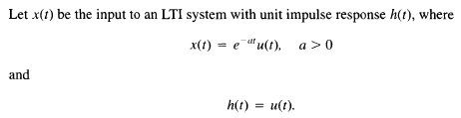
Cont..

Slide 12
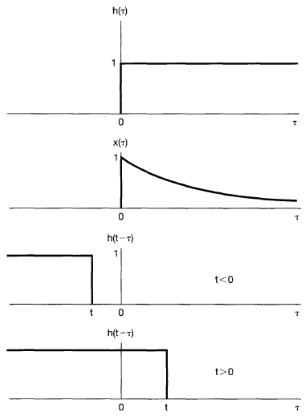
Cont..

Slide 13
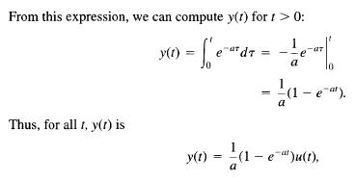
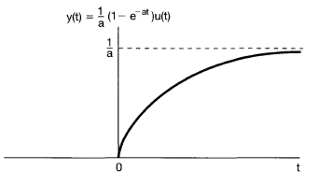
Cont..

Slide 14

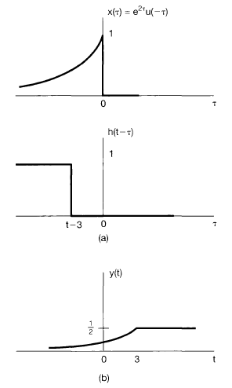
Cont..

Slide 15
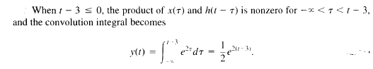
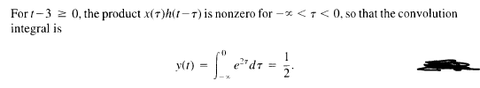
Cont..

Slide 16
Thank You

