Slide 1
EVS Lecture 1.4
Topic covered: Ecosystem functioning

Slide 2
What sustain life on earth??
The one-way flow of energy
The cycling of matter/ nutrients
Gravity
Allows the earth to hold onto its atmosphere
Causes the downward movement of nutrients
https://mio-ecsde.org/erasmus-IP-2014/trainers/day%2002-Ricard.pdf

Slide 3
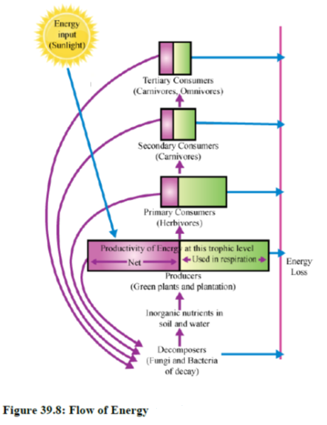
Flow of energy in an ecosystem
Energy flows through an ecosystem in only one direction. Energy is passed from organisms at one trophic level or energy level to organisms in the next trophic level.
Energy decreases as it moves up trophic levels because energy is lost as metabolic heat when the organisms from one trophic level are consumed by organisms from the next level.
https://www.ck12.org/earth-science/flow-of-energy-in-ecosystems/lesson/Flow-of-Energy-in-Ecosystems-HS-ES/

Slide 4
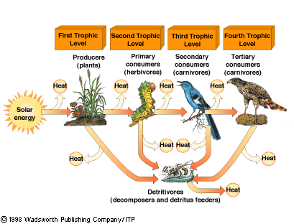
Uni-directional flow of energy

Slide 5
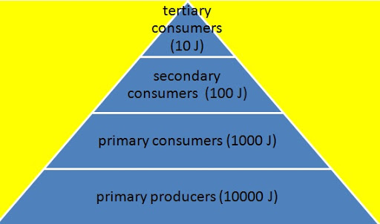
Lindeman’s law of energy transfer
Lindeman outlined the fundamental ecological concepts of energy flow in ecosystems.
At any trophic level, from producer to consumer, energy flow is mediated throng the individual organism.
Energy is consumed, some is lost as feces, urine, or gas, and part is assimilated and respired or need for the production and growth of new biomass. During each transfer from a lower to a higher trophic level, ~10% of the consumed biomass is directly converted to new biomass; the balance is respired (Smith, 1996).
https://www.cfc.umt.edu/research/biogeochemistry/files/publications/ehs.pdf
http://ivaglobe.com/how-law-of-thermodynamics-supports-vegetarianism/

Slide 6
Ecosystem Productivity
Primary Productivity
Secondary productivity
GPP (Gross Primary Productivity)
NPP (Net Primary Productivity): The portion of GPP not used up by the respiration
NPP = GPP – Rs
Rs (Respiration)
Biomass: Reflection of Secondary productivity
https://mio-ecsde.org/erasmus-IP-2014/trainers/day%2002-Ricard.pdf

Slide 7
Primary productivity: Production of organic compound by atmospheric CO₂ ₍Productivity of autotrophs such as plants)
Secondary productivity: Productivity of heterotrophs such as animals
GPP (Gross Primary Productivity): Rate at which producers capture and store chemical energy (biomass) in a given time (The photosynthesis carried out by all the plants in an ecosystem). About 48–60% of the GPP is consumed in plant respiration
NPP (Net Primary Productivity): GPP-Respiration: The portion of GPP not used up by the respiration
Biomass: Reflection of primary productivity

Slide 8
Energy at n(th) level =(energy given by sun)/(10)^(n+1).
Energy at n(Th) level =(energy given by plant)/(10)^(n-1)

Slide 9
Ecological pyramid
Graphical representations of trophic structures in an ecosystem
Ecological pyramids show the relative amounts of various parameters (such as number of organisms, energy, and biomass) across trophic levels. Ecological pyramids can also be called trophic pyramids or energy pyramids
Most ecological pyramids are large at the base and narrow at the top.
Types of Pyramids:
Pyramid of Biomass
Pyramid of Energy
Pyramid of Numbers
Less Energy
More Energy

Slide 10
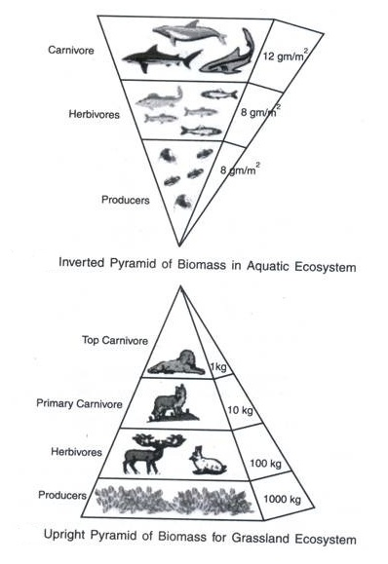
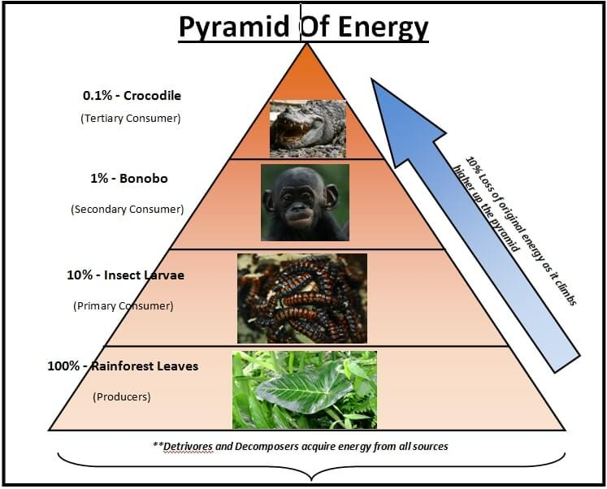
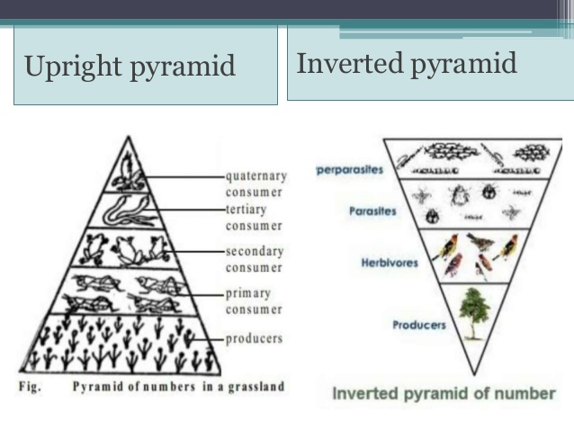
Pyramid of number
Pyramid of Biomass
Pyramid of Energy
Pyramids of numbers can be either upright or inverted, depending on the ecosystem.
Pyramid of numbers shows the relative number of organisms at each stage of a food chain
These are usually shaped like pyramids, as higher trophic levels cannot be sustained if there are more predators than prey
However, the shape may be distorted if a food source is disproportionately large in size / biomass compared to the feeder
For example, a large number of caterpillars may feed on a single oak tree and many fleas may feed off a single dog host
A pyramid of biomass shows the total mass of organisms at each stage of a food chain
These pyramids are almost always upright in shape, as biomass diminishes along food chains as CO2 and waste is released
An exception to this rule is found in marine ecosystems, where zooplankton have a large total biomass than phytoplankton
This is because phytoplankton replace their biomass at such a rapid rate and so can support a larger biomass of zooplankton
A pyramid of energy shows the amount of energy trapped per area in a given time period at each stage of a food chain
These pyramids are always upright in shape, as energy is lost along food chains (either used in respiration or lost as heat)
Each level in the pyramid will be roughly one tenth the size of the preceding level as energy transformations are ~10% efficient
https://ib.bioninja.com.au/standard-level/topic-4-ecology/42-energy-flow/ecological-pyramids.html
https://energy-101.org/biomass-pyramid/
https://www.pmfias.com/ecological-pyramids-pyramid-numbers-biomass-energy/

Slide 11
What is A Niche?
Set of conditions within which an organism can maintain a viable population
Multi-dimensional
with as many
dimensions as there
are limiting conditions
light intensity
ecological
niche
okay
salinity
temperature
https://mio-ecsde.org/erasmus-IP-2014/trainers/day%2002-Ricard.pdf

Slide 12
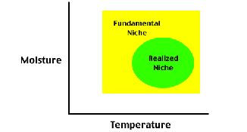
Habitat & Niche
Habitat: Place where a population (or an individual organism) typically lives
Characterized by physical conditions, e.g. salinity or temperature
Ecological niche:
The sum total of an organisms use of biotic & abiotic resources in its environment with unique ecological role
It is a term used for the position of a species within an ecosystem, describing both the range of conditions necessary for persistence of the species, and its ecological role in the ecosystem.
Fundamental Niche
full potential range of physical, chemical and biological factors a species could use if there were no competition
Realized Niche
The portion of the fundamental niche that a species actually occupies due to competition
https://qforquestions.com/ecological-niche/
https://www.sciencedirect.com/topics/earth-and-planetary-sciences/ecological-niche

