Slide 1
Theoretical Foundations of Computer Science (TFCS)
Chapter 1
Introduction to Discrete Mathematics and Set Theory

Slide 2
Mathematics
Classified Broadly into two categories :
Continuous Mathematics – It is based upon continuous number line or the real numbers. It is characterized by the fact that between two numbers, there are almost always an infinite set of numbers. e.g. a function in continuous mathematics can be plotted in a smooth curve without breaks.
Discrete Mathematics – It involves distinct values ; i.e. between any two points, there are a countable number of points. For example, if we have a finite set of objects, the function can be defined as a list of ordered pair having these objects, and can be presented as complete list of those pairs.

Slide 3
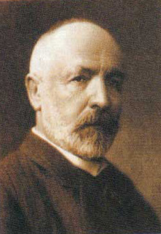
HISTORY OF SETS
The theory of sets was developed by German mathematician Georg Cantor (1845-1918). He first encountered sets while working on “Problems on Trigonometric Series” . SETS are being used in mathematics problem since they were discovered.

Slide 4
SETS
Collection of object of a particular kind, such as, a pack of cards, a crowed of people, a cricket team etc. In mathematics of natural number, prime numbers etc.

Slide 5
A set is a well defined collection of objects.
Elements of a set are synonymous terms.
Sets are usually denoted by capital letters.
Elements of a set are represented by small letters.

Slide 6
SETS REPRESENTATION
There are two ways to represent sets
Roster or tabular form.
Set-builder form.

Slide 7
ROSTER OR TABULAR FORM
In roster form, all the elements of set are listed, the elements are being separated by commas and are enclosed within braces { }.
e.g. : set of 1,2,3,4,5,6,7,8,9,10. {1,2,3,4,5,6,7,8,9,10}

Slide 8
SET-BUILDER FORM
In set-builder form, all the elements of a set possess a single common property which is not possessed by an element outside the set.
e.g. : set of natural numbers k
k= {x : x is a natural number}

Slide 9
EXAMPLE OF SETS IN MATHS
N : the set of all natural numbers
Z : the set of all integers
Q : the set of all rational numbers
R : the set of all real numbers
Z+ : the set of positive integers
Q+ : the set of positive rational numbers
R+ : the set of positive real numbers.

Slide 10
Cardinality of a Set
Cardinality of a set S, denoted by |S|, is the number of elements of the set. The number is also referred as the cardinal number. If a set has an infinite number of elements, its cardinality is ∞.
Countably Infinite
Uncountably Infinite
e.g. : |{1,4,3,5}| = 4, |{1,2,3,4,5,….}| = ∞
or
|{k= x : x is a natural number} | = ∞
|{k =x : x is a real number and 1<x<2}| = ∞
|{k = x : x is a natural number and 1<x<5}| = 3
Sets having same cardinality have called equivalent set

Slide 11
TYPES OF SETS
Empty sets.
Singleton Set or Unit Set
Finite &Infinite sets.
Equal sets vs. Equivalent sets.
Subset & Proper Subset.
Overlapping vs. Disjoint Set
Power set.
Universal set.

Slide 12
Singleton Set or Unit Set
THE EMPTY SET
A set which doesn't contains any element is called the empty set or null set or void set, denoted by symbol ϕ or { }.
e.g. : let R = {x : 1< x < 2, x is a natural number}
Singleton set or unit set contains only one element.
e.g. S= {x | xЄN, 7<x<9} = {8}

Slide 13
FINITE & INFINITE SETS
A set which is empty or consist of a definite numbers of elements is called finite otherwise, the set is called infinite.
e.g. : let k be the set of the days of the week. Then k is finite
let R be the set of points on a line. Then R is infinite

Slide 14
EQUAL SETS vs. EQUIVALENT SETS
Given two sets K & r are said to be equal if they have exactly the same element and we write K=R. otherwise the sets are said to be unequal and we write K=R.
e.g. : let K = {1,2,3,4} & R= {1,2,3,4}
then K=R

Slide 15
SUBSETS (SUPERSET) ⊆ and ⊇ AND
PROPER SUBSET(SUPER SET) ⊂ and ⊃
A set R is said to be subset of a set K if every element of R is also an element K.
R ⊂ K
This mean all the elements of R contained in K
Proper subset is a subset which is not equal and is denoted by R ⊆ K

Slide 16
SUBSETS OF R
The set of natural numbers N= {1,2,3,4,....}
The set of integers Z= {…,-2, -1, 0, 1, 2, 3,…..}
The set of rational numbers Q= {x : x = p/q, p, q ∈ Z and q ≠ 0
NOTE : members of Q also include negative numbers.

Slide 17
Overlapping vs. Disjoint Sets
Two sets that have at least one common element are called overlapping sets.
Two sets are called disjoint sets if they do not have even one element in common.

Slide 18
POWER SET
The set of all subset of a given set is called power set of that set.
The collection of all subsets of a set K is called the power set of denoted by P(K). In P(K) every element is a set.
e.g.
If K= [1,2}
P(K) = {ϕ, {1}, {2}, {1,2}}

Slide 19
UNIVERSAL SET
Universal set is set which contains all object, including itself.
e.g. : the set of real number would be the universal set of all other sets of number.
NOTE : excluding negative root

Slide 20
INTERVALS OF SUBSETS OF R
OPEN INTERVAL
The interval denoted as (a, b), a &b are real numbers ; is an open interval, means including all the element between a to b but excluding a &b.
CLOSED INTERVAL
The interval denoted as [a, b], a &b are Real numbers ; is an closed interval, means including all the element between a to b, including a &b.
TYPES OF INTERVALS
(a, b) = {x : a < x < b}
[a, b] = {x : a ≤ x ≤ b}
[a, b) = {x : a ≤ x < b}
(a, b]= {x : a < x ≤ b}

Slide 21
HISTORY OF VENN DIAGRAM
A Venn diagram or set diagram is a diagram that shows all possible logical relations between a finite collection of sets. Venn diagrams were conceived around 1880 by John Venn. They are used to teach elementary set theory, as well as illustrate simple set relationships in probability, logic, statistics linguistics and computer science.

Slide 22
Venn consist of rectangles and closed curves usually circles. The universal is represented usually by rectangles and its subsets by circle.

Slide 23
ILUSTRATION 1. in fig U= { 1, 2 , 3, ….., 10 } is the universal set of which A = { 2, 4, 3, ……, 10} is a subset.
. 1
. 5
. 9
. 2
. 4
. 8
.6
.10
. 3
. 7

Slide 24
ILLUSTRATION 2. In fig U = { 1, 2, 3, …., 10 } is the universal set of which A = { 2, 4, 6, 8, 10 } and B = { 4, 6 } are subsets, and also B ⊂ A
. 2 A
B
. 8 . 4
. 6
. 10
. 1
. 9
. 3
. 5
.7

Slide 25

OPERATIONS ON SETS
UNION OF SETS : the union of two sets A and B is the set C which consist of all those element which are either in A or B or in both.
PURPLE part is the union
A U B
(UNION)

Slide 26
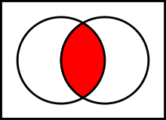
INTERSECTION OF SETS
the intersection A ∩ B of two sets A and B is the set that contains all elements of A that also belong to B (or equivalently, all elements of B that also belong to A), but no other elements.

Slide 27
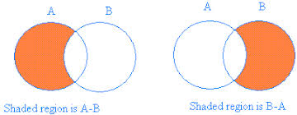
SET DIFFRENCES
The set difference is defined by
The symbol is sometimes also used to denote a set difference

Slide 28

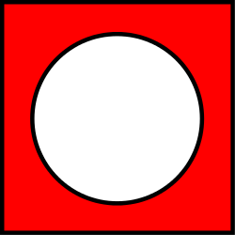
SET COMPLEMENT
In set theory, the complement of a set A refers to elements not in A.

Slide 29
Partitioning of a Set
Partitioning of a set, say S, is a collection of n disjoint subsets, say P₁,P₂,…P_{n},
that satisfies the following three conditions:
P_{i} does not contain the empty set.
The union of the subset must equal the entire original set.
The intersection of any two distinct sets is empty.
Bell Number B_{n}
Bell numbers give the count of the number of ways to partition a set.

Slide 30
The Bell numbers can easily be calculated by creating the so-called Bell triangle, also called Aitken's array or the Peirce triangle after Alexander Aitken and Charles Sanders Peirce.
Start with the number one. Put this on a row by itself.
Start a new row with the rightmost element from the previous row as the leftmost number.
Determine the numbers not on the left column by taking the sum of the number to the left and the number above the number to the left, that is, the number diagonally up and left of the number we are calculating.
Repeat step three until there is a new row with one more number than the previous row.
The number on the left hand side of a given row is the Bell number for that row.
Here are the first five rows of the triangle constructed by these rules:
1
1 2
2 3 5
5 7 10 15
15 20 27 37 52
The Bell numbers appear on both the left and right sides of the triangle

Slide 31
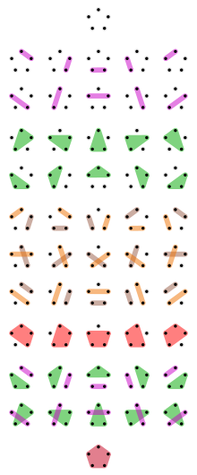
THE END

