Slide 1
Relations

Slide 2
Relations and their properties.
The most direct way to express a relationship between elements of two sets is to use ordered pairs.
For this reason, sets of ordered pairs are called binary relations.
Def 1
Let A and B be sets. A binary relation from A to B is
a subset R of A× B = { (a, b) : a∈A, b∈B }.
Example 1.
A : the set of students in your school.
B : the set of courses.
R = { (a, b) : a∈A, b∈B, a is enrolled in course b }
Ch8-<number>

Slide 3
Def 1’. We use the notation aRb to denote that (a, b)∈R, and aRb to denote that (a,b)∉R.
Moreover, a is said to be related to b by R if aRb.
Example 3. Let A={0, 1, 2} and B={a, b}, then {(0,a),(0,b),(1,a),(2,b)} is a relation R from A to B. This means, for instance, that 0Ra, but that 1Rb.
A
R ⊆ A×B = { (0,a) , (0,b) , (1,a)
(1,b) , (2,a) , (2,b)}
B
0
a
∈R
∈R
1
b
2
R
Ch8-<number>

Slide 4
Note. Relations vs. Functions
A relation can be used to express a 1-to-many
relationship between the elements of the sets
A and B.
Def 2. A relation on the set A is a subset of A × A
( i.e., a relation from A to A ).
Ch8-<number>

Slide 5
Example 4.
Let A be the set {1, 2, 3, 4}. Which ordered pairs are in the relation R = { (a, b)| a divides b }?
Sol :
1
1
2
2
3
3
4
4
R = { (1,1), (1,2), (1,3), (1,4),
(2,2), (2,4),
(3,3),
(4,4) }
Ch8-<number>

Slide 6
Example 5. Consider the following relations on Z.
R₁ = { (a, b) | a ≤ b }
R₂ = { (a, b) | a > b }
R₃ = { (a, b) | a = b or a = −b }
R₄ = { (a, b) | a = b }
R₅ = { (a, b) | a = b+1 }
R₆ = { (a, b) | a + b ≤ 3 }
Which of these relations
contain each of the pairs
(1,1), (1,2), (2,1), (1,−1),
and (2,2)?
Sol :
 | (1,1) | (1,2) | (2,1) | (1,−1) | (2,2)
R₁
R₂
R₃
R₄
R₅
R₆
●
●
●
●
●
●
●
●
●
●
●
●
●
●
●
Ch8-<number>

Slide 7
Example 6. How many relations are there on a set with n elements?
Sol :
A relation on a set A is a subset of A×A.
⇒ A×A has n² elements.
⇒ A×A has 2^{n2} subsets.
⇒ There are 2^{n2} relations.
Ch8-<number>

Slide 8
Def 3. A relation R on a set A is called reflexive if (a,a)∈R for every a∈A.
Properties of Relations
Example 7. Consider the following relations on
{1, 2, 3, 4} :
R₂ = { (1,1), (1,2), (2,1) }
R₃ = { (1,1), (1,2), (1,4), (2,1), (2,2), (3,3), (4,1), (4,4) }
R₄ = { (2,1), (3,1), (3,2), (4,1), (4,2), (4,3) }
which of them are reflexive ?
Sol :
R₃
Ch8-<number>

Slide 9
Example 8. Which of the relations from
Example 5 are reflexive?
R₁ = { (a, b) | a ≤ b }
R₂ = { (a, b) | a > b }
R₃ = { (a, b) | a = b or a = −b }
R₄ = { (a, b) | a = b }
R₅ = { (a, b) | a = b+1 }
R₆ = { (a, b) | a + b ≤ 3 }
Sol : R₁, R₃ and R₄
Example 9. Is the “divides” relation on the set of positive integers reflexive?
Sol : Yes.
Ch8-<number>

Slide 10
Def 4.
(1) A relation R on a set A is called symmetric
if for a, b∈A,
(a, b)∈R ⇒ (b, a)∈R.
(2) A relation R on a set A is called
antisymmetric if for a, b∈A,
(a, b)∈R and (b, a)∈R ⇒ a = b.
i.e., a≠b and (a,b)∈R ⇒ (b, a)∉R
Ch8-<number>

Slide 11
Example 10. Which of the relations from Example 7
are symmetric or antisymmetric ?
R₂ = { (1,1), (1,2), (2,1) }
R₃ = { (1,1), (1,2), (1,4), (2,1), (2,2), (3,3), (4,1), (4,4) }
R₄ = { (2,1), (3,1), (3,2), (4,1), (4,2), (4,3) }
Sol :
R₂, R₃ are symmetric
R₄ are antisymmetric.
Example 11. Is the “divides” relation on the set of positive integers symmetric? Is it antisymmetric?
Sol : It is not symmetric since 1|2 but 2 | 1.
It is antisymmetric since a|b and b|a implies a=b.
Ch8-<number>

Slide 12
antisymmetric vs symmetric
sym. ⇒ (b, a)∈R
∀(a, b)∈R, a≠b
antisym. ⇒ (b,a)∉R
eg. Let A = {1,2,3}, give a relation R on A s.t.
R is both symmetric and antisymmetric, but
not reflexive.
Sol :
R = { (1,1),(2,2) }
Ch8-<number>

Slide 13
Def 5. A relation R on a set A is called transitive if for a, b, c ∈A,
(a, b)∈R and (b, c)∈R ⇒ (a, c)∈R.
Example 15. Is the “divides” relation on the set of positive integers transitive?
Sol : Suppose a|b and b|c
⇒ a|c
⇒ transitive
Ch8-<number>

Slide 14
Example 13. Which of the relations in Example 7 are
transitive ?
R₂ = { (1,1), (1,2), (2,1) }
R₃ = { (1,1), (1,2), (1,4), (2,1), (2,2), (3,3), (4,1), (4,4) }
R₄ = { (2,1), (3,1), (3,2), (4,1), (4,2), (4,3) }
Sol :
R₂ is not transitive since
(2,1) ∈ R₂ and (1,2) ∈ R₂ but (2,2) ∉ R₂.
R₃ is not transitive since
(2,1) ∈ R₃ and (1,4) ∈ R₃ but (2,4) ∉ R₃.
R₄ is transitive.
Ch8-<number>

Slide 15
Example 16. How many reflexive relation are there on a set with n elements?
Sol : A relation R on a set A is a subset of A×A.
⇒ A×A has n² elements
⇒ R contains (a,a) ∀a∈A since R is reflexive
⇒ There are 2^{n2−n} reflexive relations.
Ch8-<number>

Slide 16
Combining Relations
Example 17. Let A = {1, 2, 3} and B = {1, 2, 3, 4}.
The relation R₁ = {(1,1), (2,2), (3,3)}
and R₂ = {(1,1), (1,2), (1,3), (1,4)} can be
combined to obtain
R₁ ∪ R₂ = {(1,1), (2,2), (3,3), (1,2), (1,3), (1,4)}
R₁ ∩ R₂ = {(1,1)}
R₁ － R₂ = {(2,2), (3,3)}
R₂ － R₁ = {(1,2), (1,3), (1,4)}
R₁ ⊕ R₂ = {(2,2), (3,3), (1,2), (1,3), (1,4)}
symmetric difference, (R₁∪R₂) – (R₁∩ R₂)
Ch8-<number>

Slide 17
Def 6. Let R be a relation from a set A to a set B and S a relation from B to a set C. The composite of R and S is the relation consisting of ordered pairs (a,c), where a∈A, c∈C, and for which there exists an element b∈B such that (a,b)∈R and (b,c)∈S. We denote the composite of R and S by S °R.
Example 20. What is the composite of relations R and S, where R is the relation from {1, 2, 3} to {1, 2, 3, 4} with R = {(1, 1), (1, 4), (2, 3), (3, 1), (3, 4)} and S is the relation from {1, 2, 3, 4} to {0, 1, 2} with S = {(1, 0),
(2, 0), (3, 1), (3, 2), (4, 1)}?
Sol. S °R is the relation from {1, 2, 3} to {0, 1, 2} with
S °R = {(1, 0), (1,1), (2, 1), (2, 2), (3, 0), (3, 1)}.

Slide 18
Def 7. Let R be a relation on the set A.
The powers R^{n}, n = 1, 2, 3, …, are defined recursively by R¹ = R and R^{n+1} = R^{n} °R.
Example 22. Let R = {(1, 1), (2, 1), (3, 2), (4, 3)}.
Find the powers R^{n}, n=2, 3, 4,….
Sol. R² = R °R = {(1, 1), (2, 1), (3, 1), (4, 2)}.
R³ = R² °R = {(1, 1), (2, 1), (3, 1), (4, 1)}.
R⁴ = R³ °R = {(1, 1), (2, 1), (3, 1), (4, 1)} = R³.
Therefore R^{n} = R³ for n=4, 5, ….
Thm 1. The relation R on a set A is transitive if and
only if R^{n} ⊆ R for n = 1, 2, 3, ….
Ch8-<number>

Slide 19
8.3 Representing Relations
Representing Relations using Matrices
Suppose that R is a relation from A={a₁, a₂, …, a_{m}}
to B = {b₁, b₂,…, b_{n} }.
The relation R can be represented by the matrix
M_{R} = [m_{ij}], where
1, if (a_{i},b_{j})∈R
m_{ij} =
0, if (a_{i},b_{j})∉R
Ch8-<number>

Slide 20

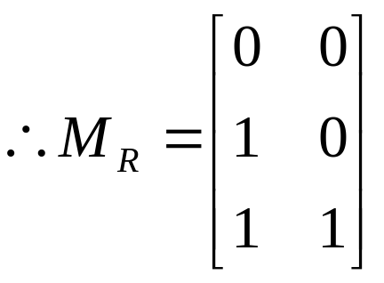
Example 1. Suppose that A = {1, 2, 3} and B = {1, 2}
Let R = {(a, b) | a > b, a∈A, b∈B}.
What is the matrix M_{R} representing R?
Sol :
R = {(2, 1), (3, 1), (3, 2)}
B
1
2
1
0
0
A
2
1
0
3
1
1
Ch8-<number>

Slide 21
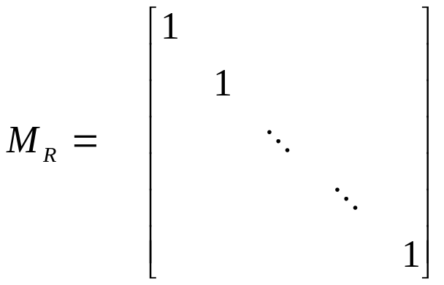
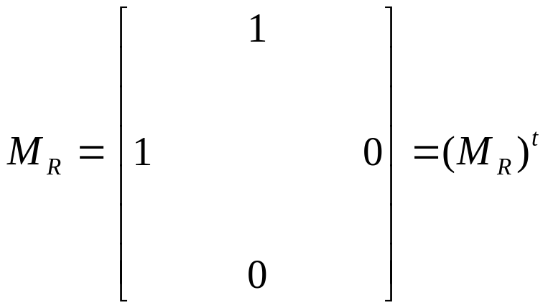
※ Let A={a₁, a₂, …,a_{n}}.
A relation R on A is reflexive iff (a_{i},a_{i})∈R,∀i.
i.e.,
a₁
a₂
…
…
a_{n}
a₁
a₂
:
:
a_{n}
※ The relation R is symmetric iff (a_{i},a_{j})∈R ⇒ (a_{j},a_{i})∈R.
This means m_{ij} = m_{ji}
Ch8-<number>

Slide 22
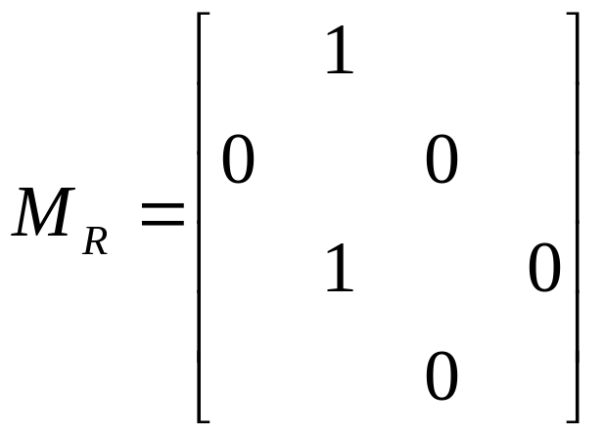
※ The relation R is antisymmetric iff
(a_{i},a_{j})∈R and i ≠ j ⇒ (a_{j},a_{i})∉R.
This means that if m_{ij}=1 with i≠j, then m_{ji}=0.
i.e.,
Ch8-<number>

Slide 23
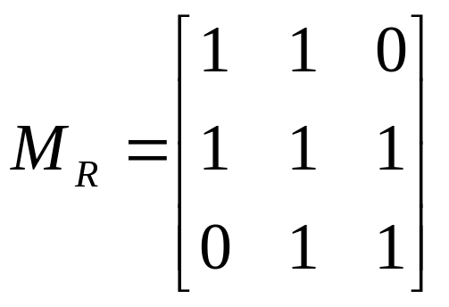
Example 3. Suppose that the relation R on a set is represented by the matrix
Is R reflexive, symmetric, and/or antisymmetric ?
Sol :
reflexive
symmetric
not antisymmetric
Ch8-<number>

Slide 24
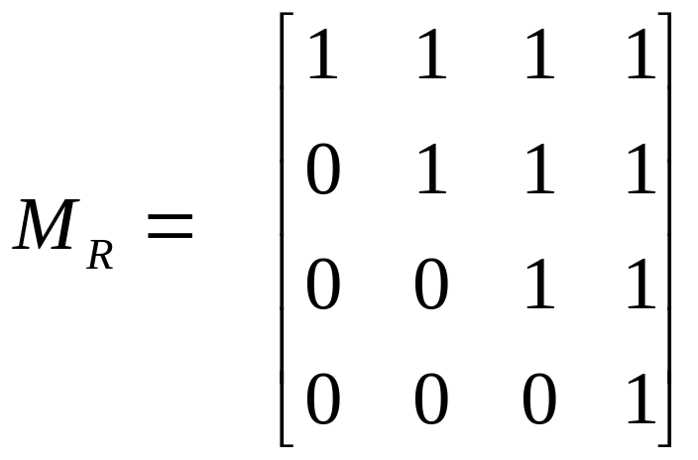
eg. Suppose that S={0, 1, 2, 3}. Let R be a relation
containing (a, b) if a ≤ b, where a ∈ S and b ∈ S.
Is R reflexive, symmetric, antisymmetric ?
Sol :
0
1
2
3
0
∴ R is reflexive and
antisymmetric,
not symmetric.
1
2
3
Def. irreflexive: (a,a)∉R, ∀a∈A
Ch8-<number>

Slide 25
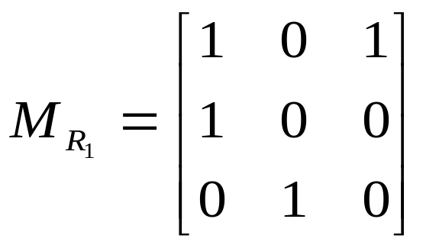
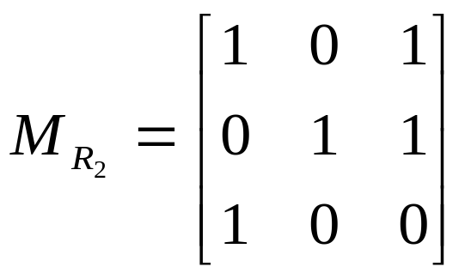
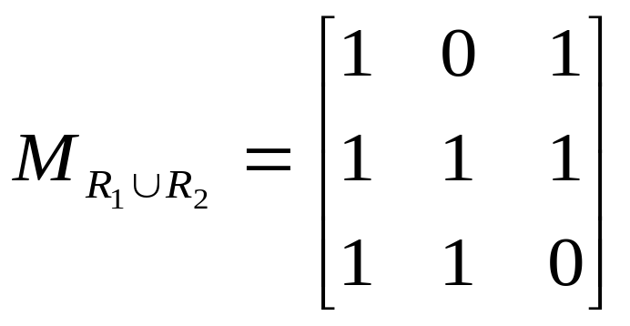
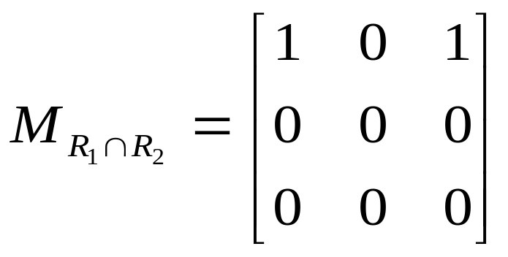
Example 4. Suppose the relations R₁ and R₂ on a set A are represented by the matrices
What are the matrices representing R₁ ∪ R₂ and
R₁ ∩ R₂?
Sol :
Ch8-<number>

Slide 26
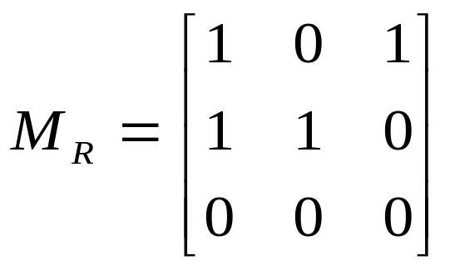
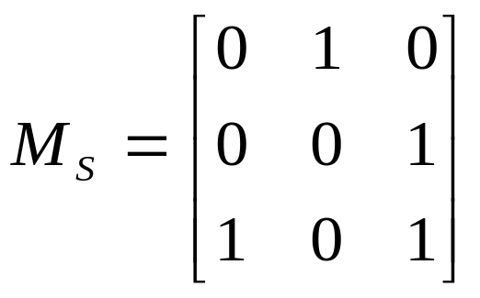
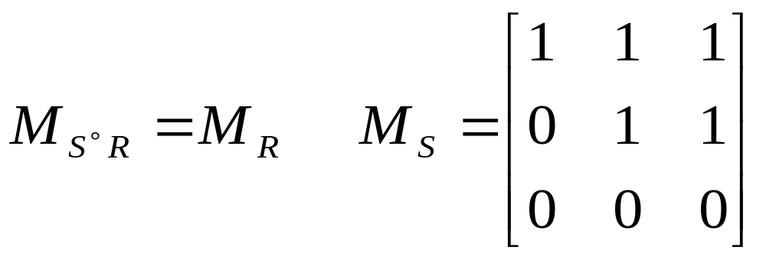
Example 5. Find the matrix representing the relation S°R, where the matrices representing R and S are
Sol :

M_{R}×M_{S}
Ch8-<number>

Slide 27
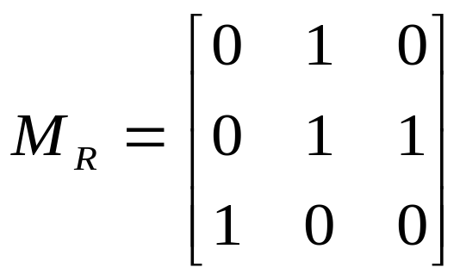
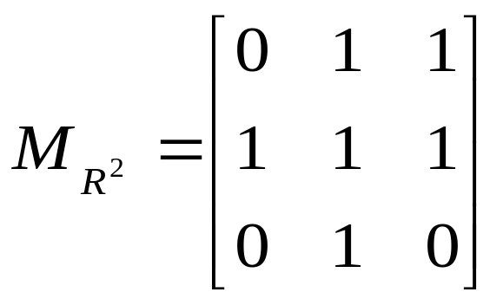
Example 6. Find the matrix representing the relation R², where the matrix representing R is
Sol :
Ch8-<number>

Slide 28
Representing Relations using Digraphs
Def 1. A directed graph (digraph) consists of a set V of vertices (or nodes) together with a set E of ordered pairs of elements of V called edges (or arcs).
Example 8. Show the digraph of the relation
R={(1,1),(1,3),(2,1),(2,3),(2,4), (3,1),(3,2),(4,1)} on the set {1,2,3,4}.
Sol :
1
2
vertex : 1, 2, 3, 4
edge : (1,1), (1,3),
(2,1), (2,3), (2,4),
(3,1), (3,2),
(4,1)
4
3
Ch8-<number>

Slide 29
※ The relation R is reflexive iff
for every vertex,
(loop)
※ The relation R is symmetric iff for any vertices x≠y, either
or
x
y
x
y
※ The relation R is antisymmetric iff for any x≠y,
or
or
x
y
x
y
x
y
Ch8-<number>

Slide 30
※ The relation R is transitive iff
for a, b, c ∈A,
(a, b)∈R and (b, c)∈R ⇒ (a, c)∈R.
This means:
a
b
a
b
⇒
d
c
d
c
Ch8-<number>

Slide 31
Example 10. Determine whether the relations R and S are reflexive, symmetric, antisymmetric, and/or transitive
b
a
Sol :
S
R :
a
reflexive,
not symmetric,
not antisymmetric,
not transitive
(a→b, b→c, a→c)
c
d
not reflexive,
symmetric
not antisymmetric
not transitive
(b→a, a→c, b→c)
b
c
Ch8-<number>

Slide 32
8.4 Closures of Relations
※ Closures
The relation R={(1,1), (1,2), (2,1), (3,2)} on the set A={1, 2, 3} is not reflexive.
Q: How to construct a smallest reflexive relation R_{r} such that R⊆ R_{r} ?
Sol: Let R_{r} = R ∪ {(2,2), (3,3)}.
i. e., R_{r} = R ∪ Δ, where Δ={(a, a)| a ∈ A}.
R_{r} is a reflexive relation containing R that is as small as possible. It is called the reflexive closure of R.
Ch8-<number>

Slide 33
Example 1. What is the reflexive closure of the relation R={(a,b) | a < b} on the set of integers ?
Sol : R_{r} = R ∪ Δ = {(a,b) | a < b} ∪ { (a, a) | a∈Z }
= { (a, b) | a ≤ b, a, b∈Z }
Example :
The relation R={ (1,1),(1,2),(2,2),(2,3),(3,1),(3,2) } on the set A={1,2,3} is not symmetric. Find a smallest symmetric relation R_{s} containing R.
Sol : Let R⁻¹={ (b, a) | (a, b)∈R }
Let R_{s}= R∪R⁻¹={ (1,1),(1,2),(2,1),(2,2),(2,3),
(3,1),(1,3),(3,2) }
R_{s} is called the symmetric closure of R.
Ch8-<number>

Slide 34
Example 2. What is the symmetric closure of the relation R={(a, b) | a > b } on the set of positive integers ?
Sol :
R∪{ (b, a) | a > b } = { (c, d) | c ≠ d }
Ch8-<number>

Slide 35
Def :
1.(reflexive closure of R on A)
R_{r}=the smallest reflexive relation containing R.
R_{r}=R∪{ (a, a) | a∈A , (a, a)∉R}
2.(symmetric closure of R on A)
R_{s}=the smallest symmetric relation containing R.
R_{s}=R∪{ (b, a) | (a, b)∈R and (b, a) ∉R}
3.(transitive closure of R on A)
R_{t}=the smallest transitive relation containing R.
R_{t}=R∪{(a, c) | (a, b)∈R_{t} and (b, c)∈R_{t}, but (a, c)∉R_{t}}(repeat)
Note. There is no antisymmetric closure

Slide 36
Example. Let R be a relation on a set A, where
A={1,2,3,4,5}, R={(1,2),(2,3),(3,4),(4,5)}.
What is the transitive closure R_{t} of R ?
Sol :
1
∴R_{t} = R ∪ R² ∪ R³ ∪ R⁴ ∪ R⁵
= {(1,2),(2,3),(3,4),(4,5),
(1,3), (2,4), (3,5),
(1,4), (2,5),
(1,5)}
3
5
2
4
Ch8-<number>

Slide 37
Theorem 1 Let R be a relation on a set A. There is a path of length n, where n is a positive integer, from a to b if and only if (a,b) ∈ R^{n}
Definition 2 Let R be a relation on a set A. The connectivity relation R* consist of the pairs (a,b) such that there is a path of length at least one from a to b in R.
Theorem 2 The transitive closure of a relation R equals the connectivity relation R*.
Ch8-<number>

Slide 38
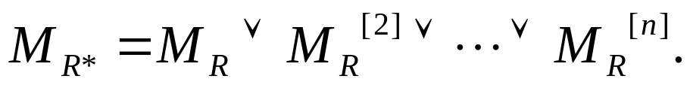
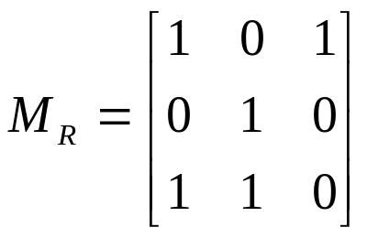
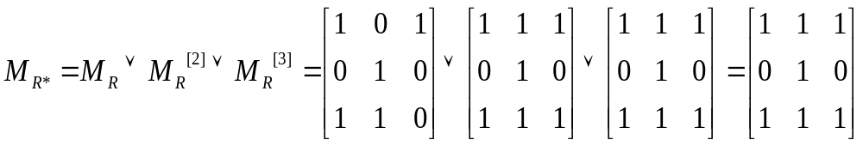
Theorem 3 Let M_{R} be the zero-one matrix of the relation R on a set with n elements. Then the
zero-one matrix of the transitive closure R* is
Example 7. Find the zero-one matrix of the transitive closure of the relation R where
Sol :
Ch8-<number>

Slide 39
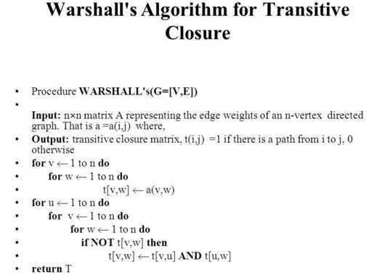
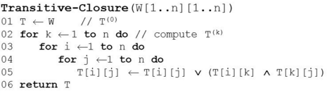
Ch8-<number>

Slide 40
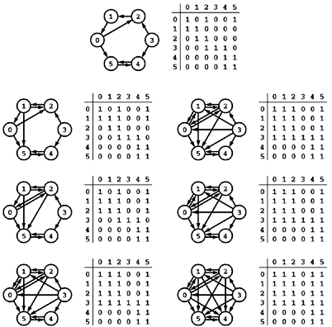
Ch8-<number>

Slide 41
8.5 Equivalence Relations
Def 1. A relation R on a set A is called an equivalence relation if it is reflexive, symmetric, and transitive.
Example 1.
Let R be the relation on the set of integers such that aRb if and only if a=b or a=−b. Then R is an equivalence relation.
Example 2.
Let R be the relation on the set of real numbers such that aRb if and only if a−b is an integer.
Then R is an equivalence relation.
Ch8-<number>

Slide 42
Example 3. (Congruence Modulo m)
Let m ∈ Z and m > 1. Show that the relation
R={ (a,b) | a≡b (mod m) } is an equivalence relation on the set of integers.
( a is congruent to b modulo m)
Sol :
Note that a≡b(mod m) iff m | (a−b).
∵① a≡a (mod m) ⇒ (a, a)∈R ⇒ reflexive
② If a≡b(mod m), then a−b=km, k∈Z
⇒ b−a= (−k)m ⇒ b≡a (mod m) ⇒ symmetric
③ If a≡b(mod m), b≡c(mod m)
then a−b=km, b−c=lm
⇒ a−c=(k+l)m ⇒ a≡c(mod m) ⇒ transitive
∴ R is an equivalence relation.
Ch8-<number>

Slide 43
Example 4.
Let l(x) denote the length of the string x.
Suppose that the relation
R={(a,b) | l(a)=l(b), a,b are strings of English letters }
Is R an equivalence relation?
Sol :
① (a,a)∈R ∀string a ⇒ reflexive
② (a,b)∈R ⇒ (b,a)∈R ⇒ symmetric
Yes.
③ (a,b)∈R,(b,c)∈R ⇒ (a,c)∈R ⇒ transitive
Ch8-<number>

Slide 44
Example 7.
Let R be the relation on the set of real numbers such that xRy if and only if x and y differ by less than 1, that is |x− y| < 1. Show that R is not an equivalence relation.
Sol :
① xRx ∀x since x− x =0 ⇒ reflexive
② xRy ⇒ |x− y| < 1 ⇒ |y− x| < 1 ⇒ yRx
⇒ symmetric
③ xRy, yRz ⇒ |x− y| < 1, |y− z| < 1 ⇒ |x− z| < 1
⇒ Not transitive
Ch8-<number>

Slide 45
Equivalence Classes
Def 3.
Let R be an equivalence relation on a set A.
The equivalence class of the element a∈A is
[a]_{R} = { s | (a, s)∈R }
For any b∈[a]_{R} , b is called a representative of this equivalence class.
Note:
If (a, b)∈R, then [a]_{R}=[b]_{R}.
Ch8-<number>

Slide 46
Example 9.
What are the equivalence class of 0 and 1
for congruence modulo 4 ?
Sol :
Let R={ (a,b) | a≡b (mod 4) }
Then [0]_{R} = { s | (0,s)∈R }
= { …, −8, −4, 0, 4, 8, … }
[1]_{R} = { t | (1,t)∈R } = { …,−7, −3, 1, 5, 9,…}
Ch8-<number>

Slide 47
Equivalence Classes and Partitions
Def.
A partition of a set S is a collection of disjoint nonempty subsets A_{i} of S that have S as their union.
In other words, we have A_{i} ≠∅, ∀i,
A_{i}∩A_{j} = ∅ , for any i≠j, and ∪A_{i} = S.
Thm 2.
Let R be an equivalence relation on a set A.
Then the equivalence classes of R form a partition of A.

Slide 48
Example 13.
List the ordered pairs in the equivalence relation R
produced by the partition A₁={1, 2, 3}, A₂={4, 5}, and
A₃={6} of S={1, 2, 3, 4, 5, 6}.
Sol :
R={ (a, b) | a, b∈ A₁}∪ { (a, b) | a, b∈ A₂}
∪ { (a, b) | a, b∈ A₃}
={(1, 1), (1, 2), (1, 3), (2, 1), (2, 2), (2, 3), (3, 1), (3, 2),
(3, 3), (4,4), (4, 5), (5,4), (5, 5), (6, 6)}

Slide 49
Example 14.
The equivalence classes of the congruence modulo 4 relation form a partition of the integers.
Sol :
[0]₄ = { …, −8, −4, 0, 4, 8, … }
[1]₄ = { …, −7, −3, 1, 5, 9, … }
[2]₄ = { …, −6, −2, 2, 6, 10, … }
[3]₄ = { …, −5, −1, 3, 7, 11, … }

Slide 50
8.6 Partial Orderings
Def 1. A relation R on a set S is called a partial ordering or partial order if it is reflexive, antisymmetric, and transitive. A set S together with a partial ordering R is called a partially ordered set, or poset, and is denoted by (S, R).
Example 1.
Show that the “greater than or equal” (≥) is a partial ordering on the set of integers.
Sol :
① x ≥ x ∀x∈Z ⇒ reflexive
② If x ≥ y and y ≥ x then x = y. ⇒ antisymmetric
③ x ≥ y, y ≥ z ⇒ x ≥ z ⇒ transitive

Slide 51

Def 2.
The elements a and b of a poset (S, ) are called comparable if either a b or b a. When a and b are elements of S such that neither a b or b a, a and b are called incomparable.
Example 5.
In the poset (Z⁺, |), are the integers 3 and 9 comparable? Are 5 and 7 comparable?
Sol :
3|9 ⇒ comparable
5 | 7 and 7 | 5 ⇒ incomparable
Ch8-<number>

Slide 52
Def 3. If (S, ) is a poset and every two elements of S are comparable, S is called a totally ordered or linearly ordered set, and is called a total order or a linear order. A totally ordered set is also called a chain.
Example 6.
The poset (Z, ≤) is totally ordered, because a ≤ b or
b ≤ a whenever a and b are integers.
Example 7.
The poset (Z⁺, |) is not totally ordered.
Ch8-<number>

Slide 53
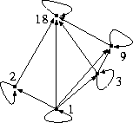
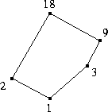
Hasse Diagrams
Graphical presentation of partial order relations
omit all loops,
omit all arrows that can be inferred from transitivity,
draw arrows without heads,
understand that all arrows point upwards,
Let A ={ 1,2,3,9,18} and for any (a,b) A, a ≤ b .

Slide 54
Example 12.
Draw the Hasse diagram representing the partial ordering {(a, b) | a divides b} on {1, 2, 3, 4, 6, 8, 12}.
Sol :
8
12
4
6
2
3
1
Ch8-<number>

Slide 55
Example 13.
Draw the Hasse diagram for the partial ordering
{(A, B) | A ⊆ B} on the power set P(S) where S={a, b, c}.
Sol :
{a, b, c}
{a, b}
{a, c}
{b, c}
{a}
{b}
{c}
∅

Slide 56
Practice Examples.
E1: [{1,2,3,4,5}, ≤]
E2: [{1,2,3,4,5}, | ]
E3:[{2, 4, 5, 10, 12, 20, 25}, |]
Ch8-<number>

Slide 57
Maximal and Minimal Elements
Def.
An element a∈S is maximal in the poset (S, ) if there is no b∈S such that a b. Similarly, an element a∈S is minimal if there is no b∈S such that b a.
a is the greatest element of the poset (S, ) if b a
for all b∈S. a is the least element of (S, ) if a b
for all b∈S.
8
12
Example 12 中
8, 12 maximal，
1least & minimal，
NO greatest element
4
6
2
3
1

Slide 58
Def.
Let A be a subset of a poset (S, ). If u is an element of S such that a u for all elements a∈A, then u is called an upper bound of A.
If l is an element of S such that l a for all elements a∈A, then l is called an lower bound of A.
Ex
8
12
A={2, 6}
upper bound of A: 6, 12
4
6
lower bound of A: 1, 2
2
3
1
Ch8-<number>

Slide 59
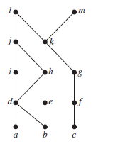
A={J,K}
upper bound of A:?
lower bound of A:?
a)Find the maximal elements.
b) Find the minimal elements.
c) Is there a greatest and least element?
Ch8-<number>

Slide 60
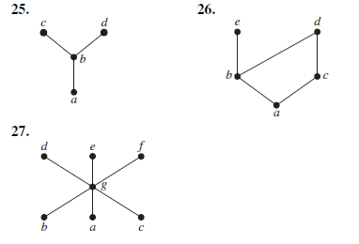
a)Find the maximal elements.
b) Find the minimal elements.
c) Is there a greatest element?
Ch8-<number>

Slide 61
Def.
Let A be a subset of a poset (S, ). An element x is called the least upper bound of A if x is an upper bound of A and x z whenever z is an upper bound of A.
Let A be a subset of a poset (S, ). An element x is called the greatest lower bound of A if x is a lower bound of A and y x whenever y is a lower bound of A.
Ex
g
A₁={d, e}, A₂={b, c}
f
least upper bound of A₁= f
d
e
A₁ has no greatest lower bound
b
c
A₂ has no least upper bound
a
greatest lower bound of A₂= a
z
Ch8-<number>

Slide 62
Lattices
Def. A partially ordered set in which every pair of elements has both a least upper bound and a greatest lower bound is called a lattice.
Example 21.
Determine whether the following posets are lattices.
(a) (b) (c)
f
f
h
d
e
e
e
f
g
c
d
b
c
b
c
d
b
a
a
a
yes
(b,c) l.u.b. ⇒ no
yes
Ch8-<number>

Slide 63
Example 22.
Is the poset (Z⁺, |) a lattice?
Sol :
For any a, b∈Z⁺,
gcd(a,b) is the greatest lower bound of a, b. lcm(a,b) is the least upper bound of a, b.
⇒ Yes
Example 23.
Determine whether the posets ({1, 2, 3, 4, 5}, |) and ({1, 2, 4, 8, 16}, |) are lattices.
Sol :
In ({1, 2, 3, 4, 5}, |), 2 and 3 has no l.u.b. ⇒ No.
In ({1, 2, 4, 8, 16}, |),
any a, b has l.u.b. and g.l.b. ⇒ Yes.

Slide 64
Topological Sorting
Suppose that a project is made up of 20 different tasks. Some tasks can be completed only after others have been finished. How can an order be found for these tasks?
Def.
A total ordering is said to be compatible with the partial ordering R if a b whenever aRb.
Constructing a compatible total ordering from a partial ordering is called topological sorting.
Lemma 1.
Every finite nonempty poset (S, ) has at least one minimal element.

Slide 65
Example 26.
Find a compatible total ordering for the poset
({1, 2, 4, 5, 12, 20}, | ).
Sol :
12
20
1
2
5
4
12
20
4
2
5
1

