Slide 1


Slide 2
Outline
Introduction:
  Modeling a vending machine
Finite-State Machines with Output
  Definition
  Examples

Slide 3
Introduction
Vending Machine Specification:
  A vending machine accepts: Nickels, dimes, quarters.
  When 30¢ or more are deposited, then
    Return amount in excess of 30¢,
    If orange button is then pushed: Give orange juice
    If red button is then pushed: Give apple juice
Modeling:
  States: s₀, s₅, s₁₀, s₁₅, s₂₀, s₂₅, s₃₀
  Inputs: 5¢, 10¢, 25¢, orange button (O), red button (R)
  Outputs: nothing (n), 5¢, 10¢, 15¢, 20¢, 25¢, OJ, AJ
  State transitions when input is received.

Slide 4
Vending Machine – cont.
Example:
  A student puts a dime,
  followed by a quarter, receives 5 cents back, and then
  pushes the orange button to get an orange juice.
  Machine starts in state s₀ (start state),
    1st input is 10¢: change to state s₁₀, with no output
    2nd input is 25¢: change to state s₃₀, and gives back 5¢.
    Last input is orange button: change to state s₀, gives OJ.

Slide 5
Vending Machine: State Table
Next state Output
Input Input
State 5¢ 10¢ 25¢ O R 5¢ 10¢ 25¢ O R
s₀ s₅ s₁₀ s₂₅ s₀ s₀ n n n n n
s₅ s₁₀ s₁₅ s₃₀ s₅ s₅ n n n n n
s₁₀ s₁₅ s₂₀ s₃₀ s₁₀ s₁₀ n n 5¢ n n
s₁₅ s₂₀ s₂₅ s₃₀ s₁₅ s₁₅ n n 10¢ n n
s₂₀ s₂₅ s₃₀ s₃₀ s₂₀ s₂₀ n n 15¢ n n
s₂₅ s₃₀ s₃₀ s₃₀ s₂₅ s₂₅ n 5¢ 20¢ n n
s₃₀ s₃₀ s₃₀ s₃₀ s₀ s₀ 5¢ 10¢ 25¢ OJ AJ

Slide 6
Vending Machine: Alternative State Table
Next state / Output
Input
State 5¢ 10¢ 25¢ O R
s₀ s₅ /n s₁₀ /n s₂₅ /n s₀ /n s₀ /n
s₅ s₁₀ /n s₁₅ /n s₃₀ /n s₅ /n s₅ /n
s₁₀ s₁₅ /n s₂₀ /n s₃₀ /5¢ s₁₀ /n s₁₀ /n
s₁₅ s₂₀ /n s₂₅ /n s₃₀ /10¢ s₁₅ /n s₁₅ /n
s₂₀ s₂₅ /n s₃₀ /n s₃₀ /15¢ s₂₀ /n s₂₀ /n
s₂₅ s₃₀ /n s₃₀ /5¢ s₃₀ /20¢ s₂₅ /n s₂₅ /n
s₃₀ s₃₀ /5¢ s₃₀ /10¢ s₃₀ /25¢ s₀ /OJ s₀ /AJ

Slide 7
Finite-State Machines with Output
Definition. A finite-state machine M=(S,I,O,f,g,s₀) consists of:
  a finite set S of states, with an initial state s₀,
  a finite input alphabet I,
  a finite output alphabet O,
  a transition function f : S×I → S, which assigns a new state to each state and input pair, and
  an output function g: S×I → O, which assigns an output to each state and input pair.
A state table, or a state diagram can be used to represent values of the functions f, and g.

Slide 8
Finite-State Machines – cont.
An input string takes the starting state through a sequence of states, as determined by transition function.
As the input string is read symbol by symbol (from left to right), each input symbol takes the machine from one state to another.
An input string produces an output string.

Slide 9
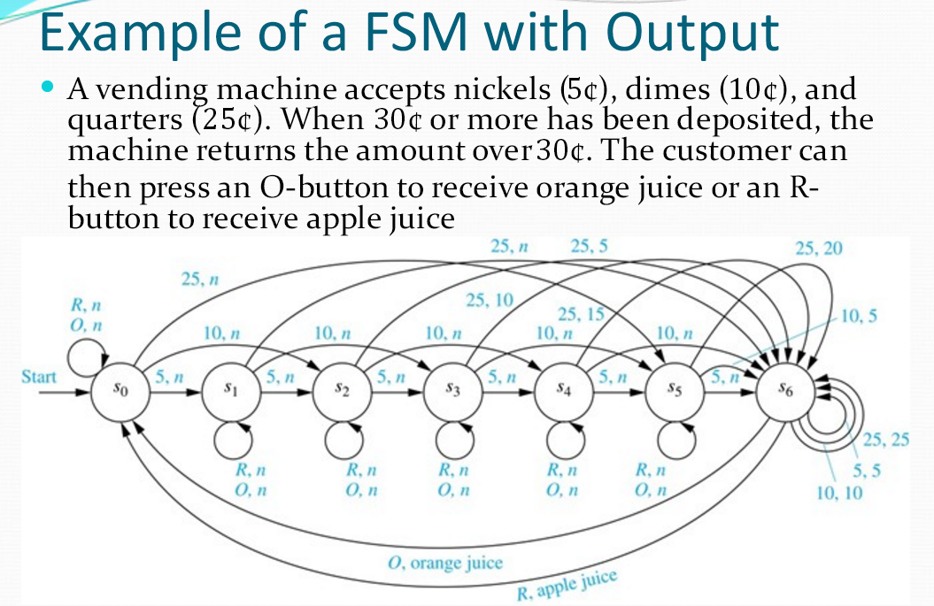

Slide 10
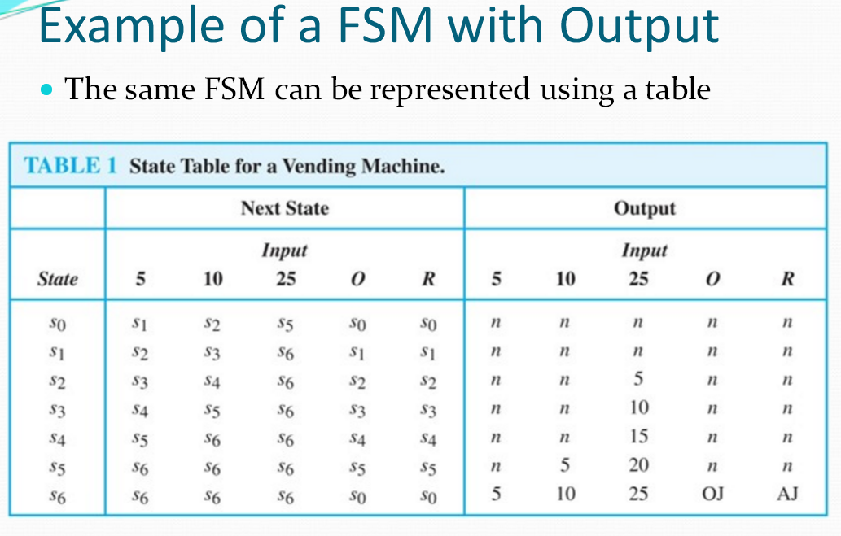

Slide 11
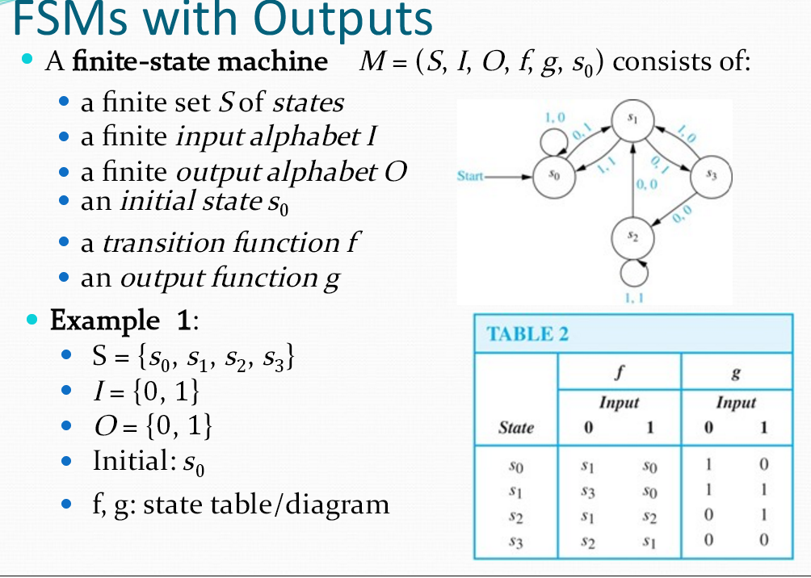

Slide 12
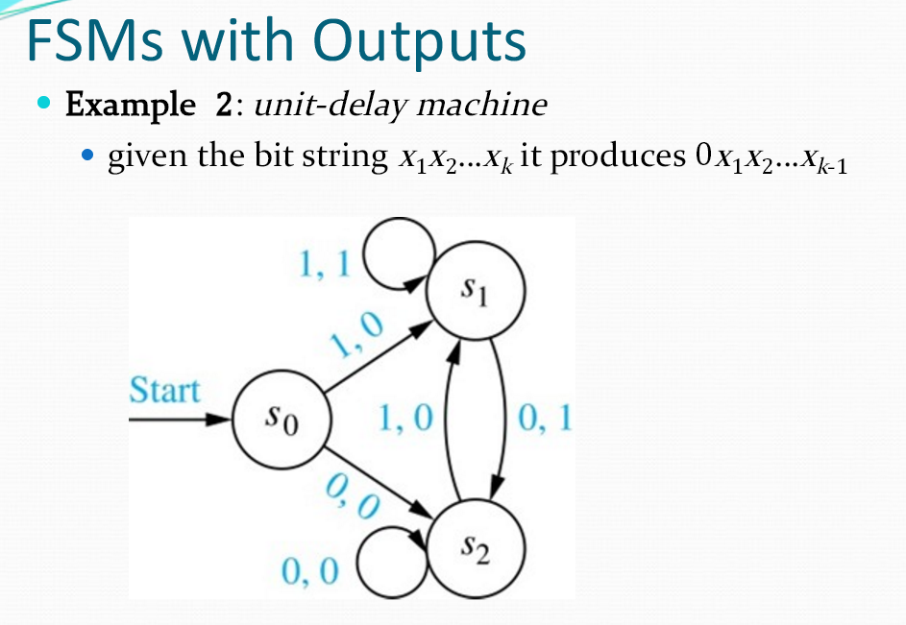

Slide 13
