Slide 1
Languages and Grammars

Slide 2
Modeling Computation
Given a task:
Can it be performed by a computer?
We learned earlier the some tasks are unsolvable.
For the tasks that can be performed by a computer, how can they be carried out?
We learned earlier the concept of an algorithm.
  A description of a computational procedure.
How can we model the computer itself, and what it is doing when it carries out an algorithm?
Models of Computation –
we want to model the abstract process of computation itself.

Slide 3
We’ll cover three types of structures used in modeling computation:
Grammars
  Used to generate sentences of a language and to determine if a given sentence is in a language
  Formal languages, generated by grammars, provide models for programming languages (Java, C, etc) as well as natural language --- important for constructing compilers
Finite-state machines (FSM)
  FSM are characterized by a set of states, an input alphabet, and transitions that assigns a next state to a pair of state and an input. We’ll study FSM with and without output. They are used in language recognition (equivalent to certain grammar)but also for other tasks such as controlling vending machines
Turing Machine – they are an abstraction of a computer; used to compute number theoretic functions

Slide 4
Early Models of Computation
Recursive Function Theory
  Kleene, Church, Turing, Post, 1930’s (before computers!!)
Turing Machines – Turing, 1940’s (defined: computable)
RAM Machines – von Neumann, 1940’s (“real computer”)
Cellular Automata – von Neumann, 1950’s
(Wolfram 2005; physics of our world?)
Finite-state machines, pushdown automata
  various people, 1950’s
VLSI models – 1970s ( integrated circuits made of thousands of transistors form a single chip)
Parallel RAMs, etc. – 1980’s

Slide 5
Computers as Transition Functions
A computer (or really any physical system) can be modeled as having, at any given time, a specific state s∈S from some (finite or infinite) state space S.
Also, at any time, the computer receives an input symbol i∈I and produces an output symbol o∈O.
  Where I and O are sets of symbols.
    Each “symbol” can encode an arbitrary amount of data.
A computer can then be modeled as simply being a transition function T:S×I → S×O.
  Given the old state, and the input, this tells us what the computer’s new state and its output will be a moment later.
Every model of computing we’ll discuss can be viewed as just being some special case of this general picture.

Slide 6
Language Recognition Problem
Let a language L be any set of some arbitrary objects s which will be dubbed “sentences.”
  “legal” or “grammatically correct” sentences of the language.
Let the language recognition problem for L be:
  Given a sentence s, is it a legal sentence of the language L?
    That is, is s∈L?
Surprisingly, this simple problem is as general as our very notion of computation itself! Hmm…
Ex: addition ‘language’ “num1-num2-(num1+num2)”

Slide 7
  Languages and Grammars
  Finite-State Machines with Output
  Finite-State Machines with No Output
  Language Recognition
  Turing Machines
Notes:
CHAPTER 5
BCT2083 DISCRETE STRUCTURE & APPLICATIONS

Slide 8
Languages & Grammars
Phrase-Structure Grammars
Types of Phrase-Structure Grammars
Derivation Trees

Slide 9
Intro to Languages
English grammar tells us if a given combination of words is a valid sentence.
The syntax of a sentence concerns its form while the semantics concerns
its meaning.
e.g. the mouse wrote a poem
From a syntax point of view this is a valid sentence.
From a semantics point of view not so fast…perhaps in Disney land
Natural languages (English, French, Portguese, etc) have very complex rules of syntax and not necessarily well-defined.

Slide 10
Formal Language
Formal language – is specified by well-defined set of rules of syntax
We describe the sentences of a formal language using a grammar.
Two key questions:
1 - Is a combination of words a valid sentence in a formal language?
2 – How can we generate the valid sentences of a formal language?
Formal languages provide models for both natural languages and programming languages.

Slide 11
Grammars
A formal grammar G is any compact, precise mathematical definition of a language L.
  As opposed to just a raw listing of all of the language’s legal sentences, or just examples of them.
A grammar implies an algorithm that would generate all legal sentences of the language.
  Often, it takes the form of a set of recursive definitions.
A popular way to specify a grammar recursively is to specify it as a phrase-structure grammar.

Slide 12

Grammars (Semi-formal)
Example: A grammar that generates a subset of the English language

Slide 13
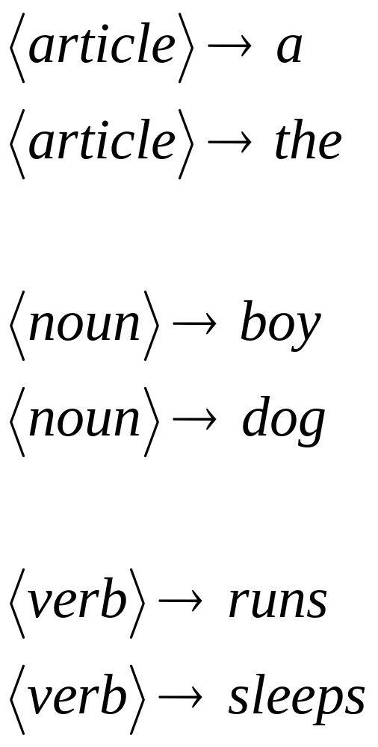

Slide 14
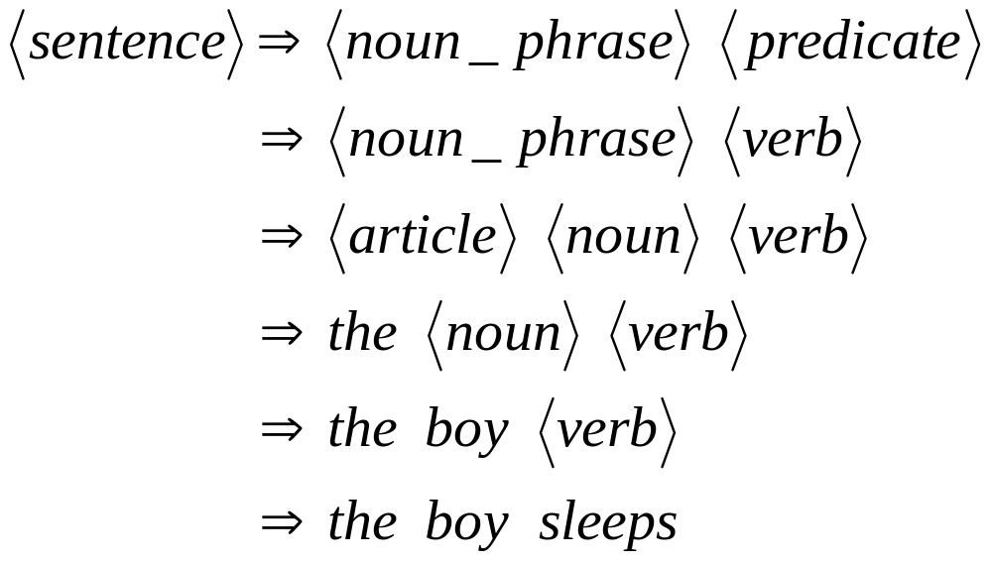
A derivation of “the boy sleeps”:

Slide 15
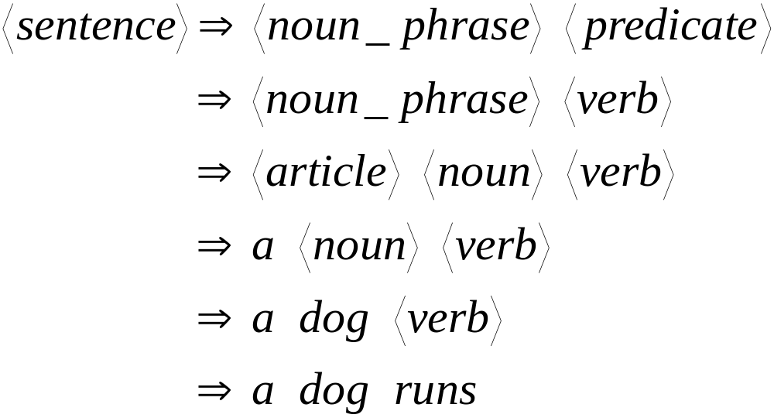
A derivation of “a dog runs”:

Slide 16
Language of the grammar:
L = { “a boy runs”,
“a boy sleeps”,
“the boy runs”,
“the boy sleeps”,
“a dog runs”,
“a dog sleeps”,
“the dog runs”,
“the dog sleeps” }

Slide 17
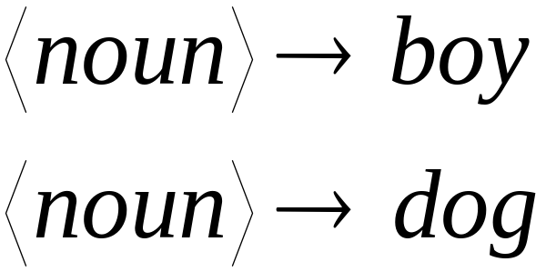
Notation
Variable
or
Non-terminal
Symbols of
the vocabulary
Terminal
Symbols of
the vocabulary
Production
rule

Slide 18
Basic Terminology
  A vocabulary/alphabet, V is a finite nonempty set of elements called symbols.
    Example: V = {a, b, c, A, B, C, S}
  A word/sentence over V is a string of finite length of elements of V.
    Example: Aba
  The empty/null string, λ is the string with no symbols.
  V* is the set of all words over V.
    Example: V* = {Aba, BBa, bAA, cab …}
  A language over V is a subset of V*.
    We can give some criteria for a word to be in a language.
Notes:
CHAPTER 5
BCT2083 DISCRETE STRUCTURE & APPLICATIONS

Slide 19
Phrase-Structure Grammars
A phrase-structure grammar (abbr. PSG)
G = (V,T,S,P) is a 4-tuple, in which:
  V is a vocabulary (set of symbols)
    The “template vocabulary” of the language.
  T ⊆ V is a set of symbols called terminals
    Actual symbols of the language.
    Also, N :≡ V − T is a set of special “symbols” called nonterminals. (Representing concepts like “noun”)
  S∈N is a special nonterminal, the start symbol.
    in our example the start symbol was “sentence”.
  P is a set of productions (to be defined).
    Rules for substituting one sentence fragment for another
    Every production rule must contain at least one nonterminal on its left side.

Slide 20
Phrase-structure Grammar
  EXAMPLE:
Let G = (V, T, S, P),
where V = {a, b, A, B, S}
T = {a, b},
S is a start symbol
P = {S → ABa, A → BB, B → ab, A → Bb}.
    G is a Phrase-Structure Grammar.
What sentences can be generated with this grammar?
Notes:
CHAPTER 5
BCT2083 DISCRETE STRUCTURE & APPLICATIONS

Slide 21
Derivation
Definition
Let G=(V,T,S,P) be a phrase-structure grammar.
Let w₀=lz₀r (the concatenation of l, z₀, and r) w₁=lz₁r be strings over V.
If z₀ → z₁ is a production of G we say that w1 is directly derivable from w0 and we write w_{o} => w₁.
If w₀, w₁, …., w_{n} are strings over V such that w₀ =>w₁,w₁=>w₂,…, w_{n-1} => w_{n}, then we say that w_{n} is derivable from w₀, and write w₀=>*w_{n}.
The sequence of steps used to obtain w_{n} from w_{o} is called a derivation.

Slide 22
Productions
A production p∈P is a pair p=(b,a) of sentence fragments a, b (not necessarily in L), which may generally contain a mix of both terminals and nonterminals.
  We often denote the production as b → a.
    Read “replace b by a”
  Call b the “before” string, a the “after” string.
  It is a kind of recursive definition meaning that
  If lbr ∈ L^{T}, then lar ∈ L^{T}. (L^{T} = sentence “templates”)
    That is, if lbr is a legal sentence template, then so is lar.
    That is, we can substitute a in place of b in any sentence template.

Slide 23
Languages from PSGs
The recursive definition of the language L defined by the PSG: G = (V, T, S, P):
  Rule 1: S ∈ L^{T} (L^{T} is L’s template language)
    The start symbol is a sentence template (member of L^{T}).
  Rule 2:
  ∀(b→a)∈P: ∀l,r∈V*: lbr ∈ L^{T} → lar ∈ L^{T}
    Any production, after substituting in any fragment of any sentence template, yields another sentence template.
  Rule 3: (∀σ ∈ L^{T}: ¬∃n∈N: n∈σ) → σ∈L
    All sentence templates that contain no nonterminal symbols are sentences in L.
Abbreviate
this using
lbr ⇒ lar.
(read, “lar is
directly
derivable from lbr”).

Slide 24
Language
Let G(V,T,S,P) be a phrase-structure grammar. The
language generated by G (or the language of G)
denoted by L(G) , is the set of all strings of terminals
that are derivable from the starting state S.
L(G)= {w ∈ T* | S =>*w}

Slide 25
Language L(G)
  EXAMPLE:
Let G = (V, T, S, P), where V = {a, b, A, S}, T = {a, b}, S is a start symbol and P = {S → aA, S → b, A → aa}.
The language of this grammar is given by L (G) = {b, aaa};
we can derive aA from using S → aA, and then derive aaa using A → aa.
We can also derive b using S → b.
Notes:
CHAPTER 5
BCT2083 DISCRETE STRUCTURE & APPLICATIONS

Slide 26





Another example
Grammar:
Derivation of sentence :
G=(V,T,S,P)
T={a,b}
P =
V={a,b,S}

Slide 27



Grammar:
Derivation of sentence :

Slide 28

Other derivations:
So, what’s the language of the grammar with the productions?

Slide 29

Language of the grammar with the productions:

Slide 30
PSG Example – English Fragment
We have G = (V, T, S, P), where:
V = {(sentence), (noun phrase),
(verb phrase), (article), (adjective),
(noun), (verb), (adverb), a, the, large,
hungry, rabbit, mathematician, eats, hops,
quickly, wildly}
T = {a, the, large, hungry, rabbit, mathematician,
eats, hops, quickly, wildly}
S = (sentence)
P = (see next slide)

Slide 31
Productions for our Language
P = { (sentence) → (noun phrase) (verb phrase),
(noun phrase) → (article) (adjective) (noun),
(noun phrase) → (article) (noun),
(verb phrase) → (verb) (adverb),
(verb phrase) → (verb),
(article) → a, (article) → the,
(adjective) → large, (adjective) → hungry,
(noun) → rabbit, (noun) → mathematician,
(verb) → eats, (verb) → hops,
(adverb) → quickly, (adverb) → wildly }

Slide 32
A Sample Sentence Derivation
(sentence)
(noun phrase) (verb phrase)
(article) (adj.) (noun) (verb phrase)
(art.) (adj.) (noun) (verb) (adverb)
the (adj.) (noun) (verb) (adverb)
the large (noun) (verb) (adverb)
the large rabbit (verb) (adverb)
the large rabbit hops (adverb)
the large rabbit hops quickly
On each step,
we apply a production to a fragment of the previous sentence template to get a new sentence template. Finally, we end up with a sequence of terminals (real words), that is, a sentence of our language L.

Slide 33
Another Example
V
T
Let G = ({a, b, A, B, S}, {a, b}, S,
{S → ABa, A → BB, B → ab, AB → b}).
One possible derivation in this grammar is:
S ⇒ ABa ⇒ Aaba ⇒ BBaba ⇒ Bababa
⇒ abababa.
P

Slide 34
Derivability
Recall that the notation w₀ ⇒ w₁ means that ∃(b→a)∈P: ∃l,r∈V*: w₀ = lbr ∧ w₁ = lar.
  The template w₁ is directly derivable from w₀.
If ∃w₂,…w_{n-1}: w₀ ⇒ w₁ ⇒ w₂ ⇒ … ⇒ w_{n}, then we write w₀ ⇒* w_{n}, and say that w_{n} is derivable from w₀.
  The sequence of steps w_{i} ⇒ w_{i+1} is called a derivation of w_{n} from w₀.
Note that the relation ⇒* is just the transitive closure of the relation ⇒.

Slide 35
A Simple Definition of L(G)
The language L(G) (or just L) that is generated by a given phrase-structure grammar G=(V,T,S,P) can be defined by:
L(G) = {w ∈ T* | S ⇒* w}
That is, L is simply the set of strings of terminals that are derivable from the start symbol.

Slide 36
Defining the PSG Types
Type 0: Phase-structure grammars – no restrictions on the production rules
Type 1: Context-Sensitive PSG:
  All after fragments are either longer than the corresponding before fragments, or empty:
  if b → a, then |b| < |a| ∨ a = λ .
Type 2: Context-Free PSG:
  All before fragments have length 1 and are nonterminals:
  if b → a, then |b| = 1 (b ∈ N).
Type 3: Regular PSGs:
  All before fragments have length 1 and nonterminals
  All after fragments are either single terminals, or a pair of a terminal followed by a nonterminal.
  if b → a, then a ∈ T ∨ a ∈ TN.

Slide 37
Types of Grammars -
Chomsky hierarchy of languages
Venn Diagram of Grammar Types:
Type 0 – Phrase-structure Grammars
Type 1 –
Context-Sensitive
Type 2 –
Context-Free
Type 3 –
Regular

Slide 38
Classifying grammars
Given a grammar, we need to be able to find the smallest class in which it belongs. This can be determined by answering three questions:
Are the left hand sides of all of the productions single non-terminals?
If yes, does each of the productions create at most one non-terminal and is it on the right?
Yes – regular No – context-free
If not, can any of the rules reduce the length of a string of terminals and non-terminals?
Yes – unrestricted No – context-sensitive

Slide 39
A regular grammar is one where each production takes one of the following forms: (where the capital letters are non-terminals and w is a non-empty string of terminals):
S → Λ,
S → w,
S → T,
S → wT.
Therefore, the grammar: S → 0S1, S → λ
is not regular, it is context-free
Only one nonterminal can appear on the right side and it must be at the right end of the right side.
Therefore the productions
A → aBc and S → TU
are not part of a regular grammar,
but the production A → abcA is.

Slide 40


Definition: Context-Free Grammars
Grammar
Vocabulary
Terminal
symbols
Start
variable
Productions of the form:
Non-Terminal
String of variables
and terminals

Slide 41
Derivation Tree of A Context-free Grammar
  Represents the language using an ordered rooted tree.
  Root represents the starting symbol.
  Internal vertices represent the nonterminal symbol that arise in the production.
  Leaves represent the terminal symbols.
  If the production A → w arise in the derivation, where w is a word, the vertex that represents A has as children vertices that represent each symbol in w, in order from left to right.
Notes:
CHAPTER 5
BCT2083 DISCRETE STRUCTURE & APPLICATIONS

Slide 42
Language Generated by a Grammar
Example: Let G = ({S,A,a,b},{a,b}, S,
{S → aA, S → b, A → aa}). What is L(G)?
Easy: We can just draw a tree
of all possible derivations.
  We have: S ⇒ aA ⇒ aaa.
  and S ⇒ b.
Answer: L = {aaa, b}.
S
aA
b
Example of a
derivation tree
or parse tree
or sentence
diagram.
aaa

Slide 43
Example: Derivation Tree
  Let G be a context-free grammar with the productions P = {S →aAB, A →Bba, B →bB, B →c}. The word w = acbabc can be derived from S as follows:
  S ⇒ aAB →a(Bba)B ⇒ acbaB ⇒ acba(bB) ⇒ acbabc
  Thus, the derivation tree is given as follows:
S
a
A
B
B
b
a
b
B
c
c
Notes:
CHAPTER 5
BCT2083 DISCRETE STRUCTURE & APPLICATIONS

Slide 44
Generating Infinite Languages
A simple PSG can easily generate an infinite language.
Example: S → 11S, S → 0 (T = {0,1}).
The derivations are:
  S ⇒ 0
  S ⇒ 11S ⇒ 110
  S ⇒ 11S ⇒ 1111S ⇒ 11110
  and so on…
L = {(11)*0} – the
set of all strings
consisting of some
number of concaten-
ations of 11 with itself,
followed by 0.

Slide 45
Another example
Construct a PSG that generates the language L = {0^{n}1^{n} | n∈N}.
  0 and 1 here represent symbols being concatenated n times, not integers being raised to the nth power.
Solution strategy: Each step of the derivation should preserve the invariant that the number of 0’s = the number of 1’s in the template so far, and all 0’s come before all 1’s.
Solution: S → 0S1, S → λ.

Slide 46
Context-Sensitive Languages
The language { a^{n}b^{n}c^{n} | n ≥ 1} is context-sensitive but not context free.
A grammar for this language is given by:
S → aSBC | aBC
CB → BC
aB → ab
bB → bb
bC → bc
cC → cc
Terminal
and
non-terminal

Slide 47
A derivation from this grammar is:-
S ⇒ aSBC
⇒ aaBCBC (using S → aBC)
⇒ aabCBC (using aB → ab)
⇒ aabBCC (using CB → BC)
⇒ aabbCC (using bB → bb)
⇒ aabbcC (using bC → bc)
⇒ aabbcc (using cC → cc)
which derives a²b²c².

