Slide 1

Signals and Systems
Signals and their classifications-I
By: Dr. Ajay Kumar

Slide 2
Signals and Systems Defined
A signal is any physical phenomenon which conveys information
Systems respond to signals and produce new signals
A signal is a function representing a physical quantity or variable, and typically it contains information about the behavior or nature of the phenomenon. For instance, in a RC circuit the signal may represent the voltage across the capacitor or the current flowing in the resistor. Mathematically, a signal is represented as a function of an independent variable t. Usually t represents time. Thus, a signal is denoted by x(t).

Slide 3
CLASSIFICATION OF SIGNALS
Continuous-time & Discrete-time Signals
Analog & Digital Signals
Real and Complex Signals
Deterministic & Random Signals
Even and Odd Signals
Periodic & Aperiodic Signals
Energy & Power Signals

Slide 4
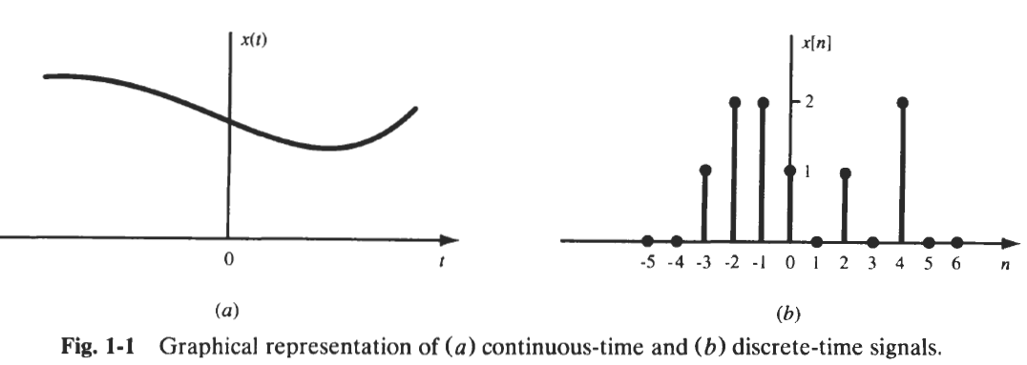
Continuous-time & Discrete-time Signals
A signal x(t) is a continuous-time signal if t is a continuous variable. If t is a discrete variable, that is, x(t) is defined at discrete times, then x(t) is a discrete-time signal. Since a discrete-time signal is defined at discrete times, a discrete-time signal is often identified as a sequence of numbers, denoted by {x_{n}} or x[n], where n = integer. Illustrations of a continuous-time signal x(t) and of a discrete-time signal x[n] are shown in Fig. 1-1.

Slide 5
Cont..
A discrete-time signal x[n] may represent a phenomenon for which the independent variable is inherently discrete. For instance, the daily closing stock market average is by its nature a signal that evolves at discrete points in time (that is, at the close of each day). On the other hand a discrete-time signal x[n] may be obtained by sampling a continuous-time signal x(t) such as
x(t_{o}), x(t₁), ……., x(t_{n}),…

Slide 6
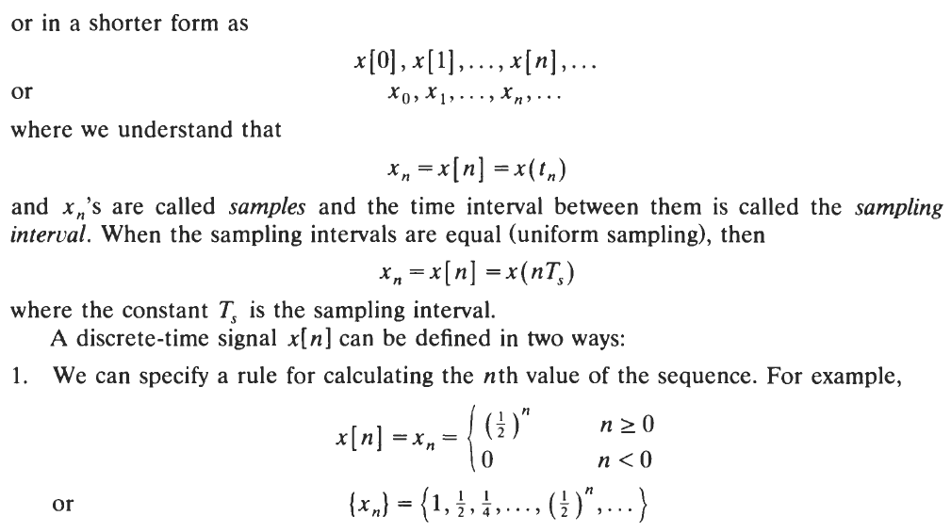
Cont..

Slide 7
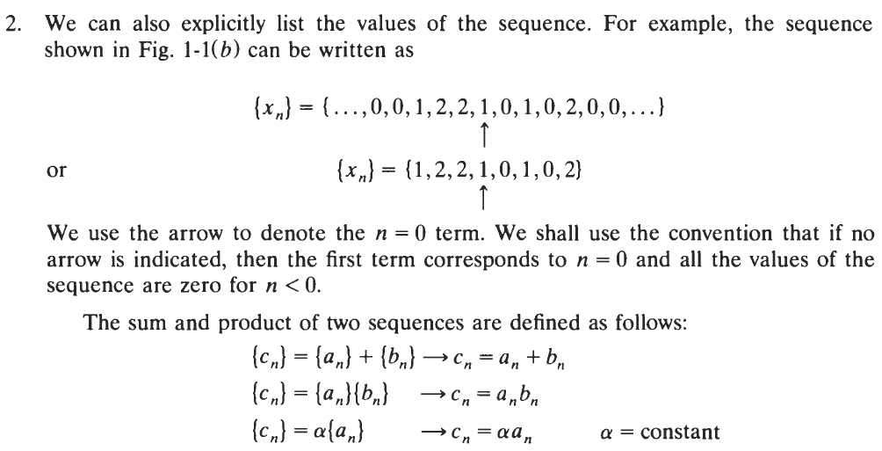
Cont..

Slide 8
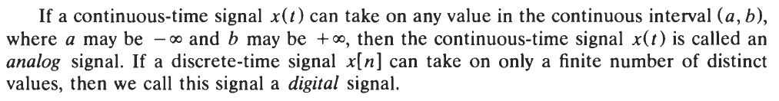
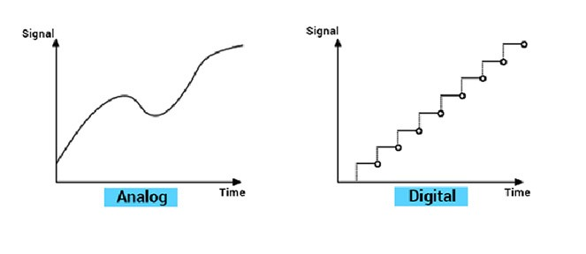
Analog & Digital Signals

Slide 9
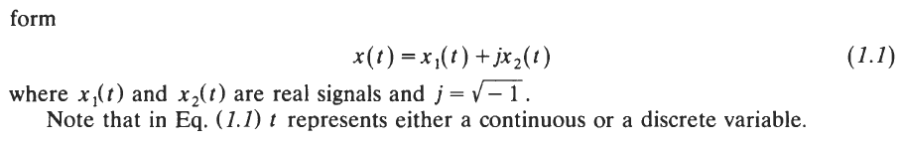
Real and Complex Signals

Slide 10
Thank You

