Slide 1
Signals and Systems
Linear Time-Invariant (LTI) Systems

Slide 2
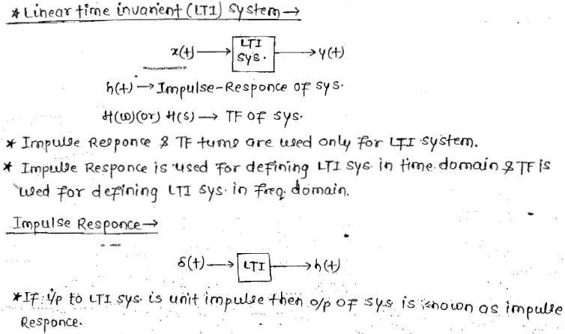
Linear Time-Invariant (LTI) Systems

Slide 3
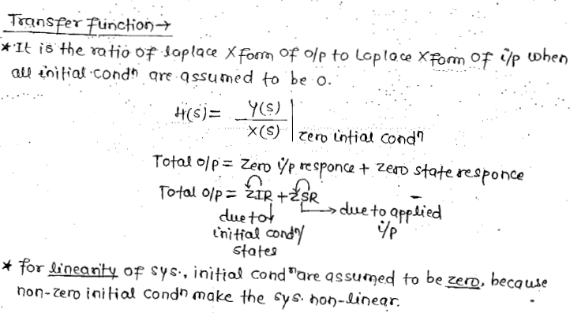
Cont..

Slide 4


Cont..

Slide 5
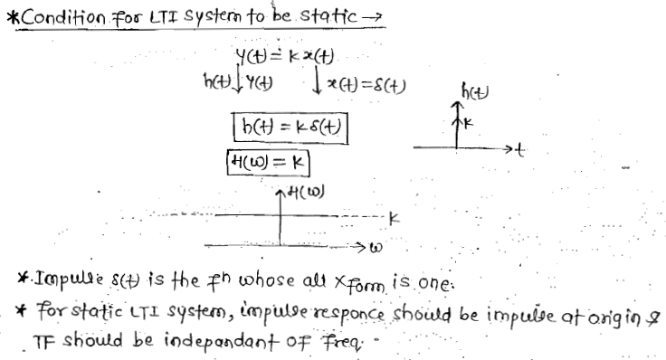
Cont..

Slide 6
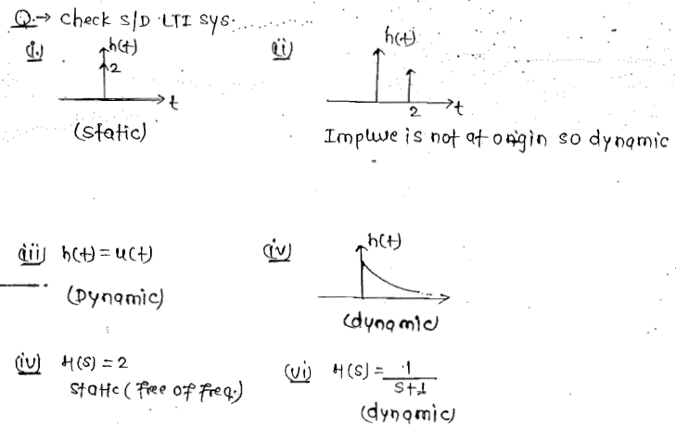
Cont..

Slide 7
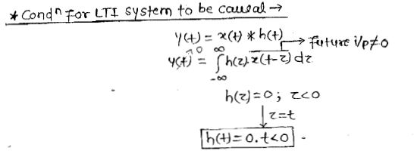
Cont..

Slide 8
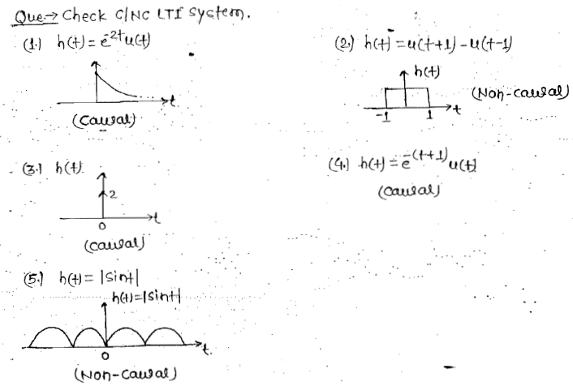
Cont..

Slide 9
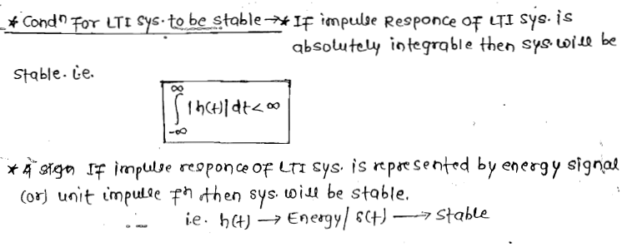
Cont..

Slide 10
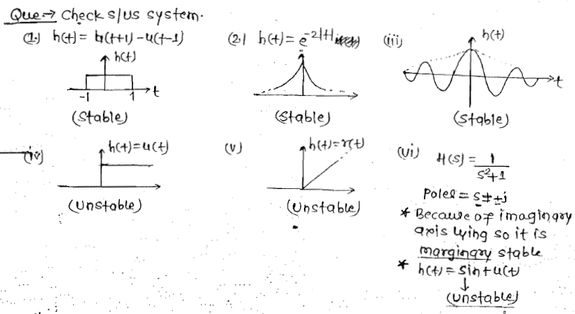
Cont..

Slide 11
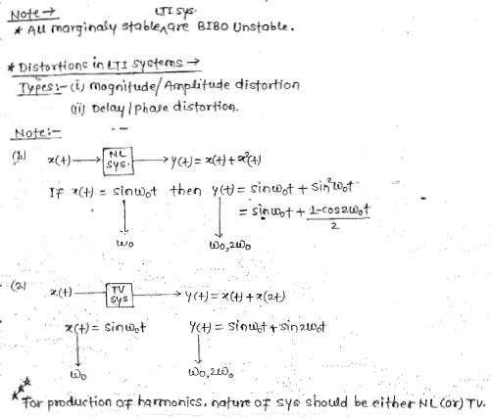
Cont..

Slide 12
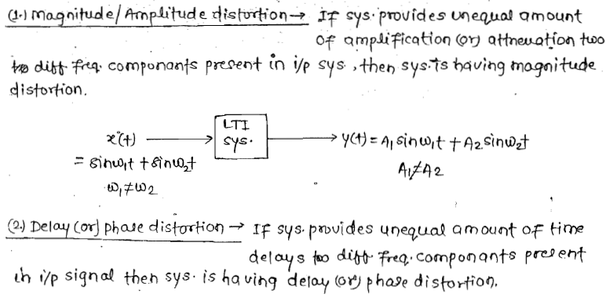

Cont..

Slide 13
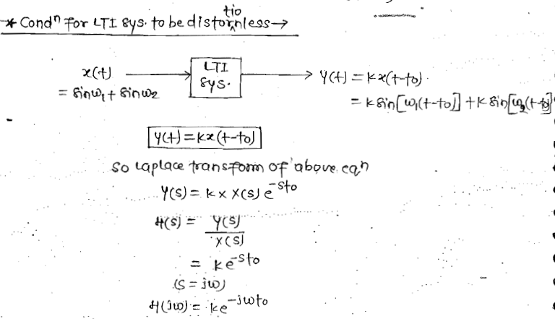
Cont..

Slide 14
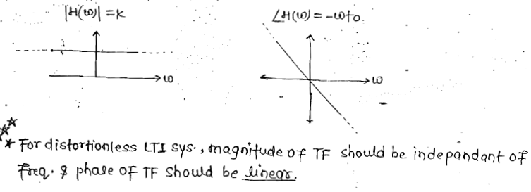
Cont..

Slide 15


Cont..

Slide 16
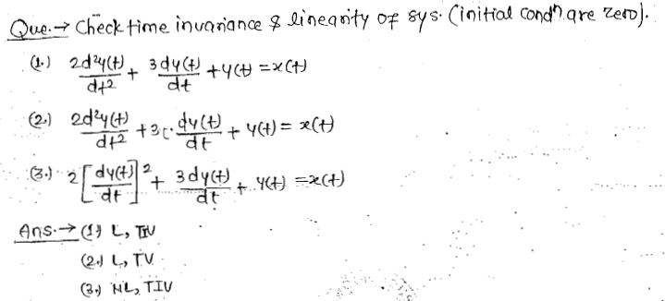
Cont..

Slide 17
Thank You

