Slide 1
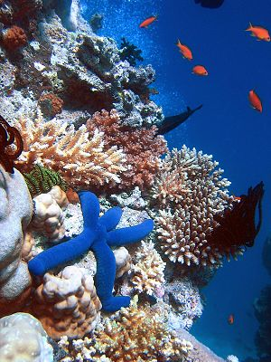
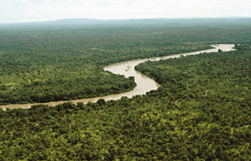
EVS Lecture 1.3
Module: 1
Topics covered: Types of Ecosystems, World Biomes

Slide 2
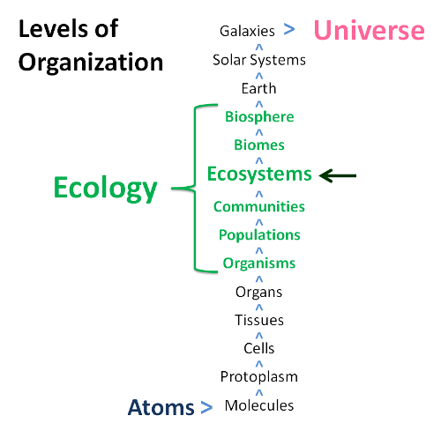
https://images.app.goo.gl/CjC3RQ7iawnPRyaR9

Slide 3
Terminology
Environment: Surroundings of an organism where they live
Ecology: Discipline which deals with the study of relationship between organisms and in relation to the surroundings in which they live
Autecology: Study of ecology of single species
Synecology: Study of ecology of community of organisms
https://www.researchgate.net/publication/285561193_Analyzing_Ecological_Systems_Using_Network_Analysis

Slide 4
Basics of Ecosystem
Term coined by Arthur Tansley in 1935
Ecosystem : all living organisms (biotic) in a particular area and associated physico-chemical environment (abiotic)
Community: All organisms inhabiting a particular ecosystem constitutes
Biotic components includes producers, consumers, decomposers)
Abiotic components includes air, soil, Water, sunlight, climate, topography (height & shape of land) etc.
Biosphere
  Part of the earth inhabited by living organisms. It is sum total of all the ecosystems on the planet
Biome
  Larger Areas of predominant flaura & fauna
  Biomes are defined as "the world's major communities, classified according to the predominant vegetation and characterized by adaptations of organisms to that particular environment" (Campbell 1996).
https://nptel.ac.in/content/storage2/courses/122103039/pdf/mod6.pdf

Slide 5
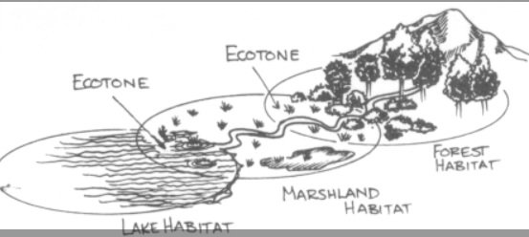
Ecotone
Areas of transition between two different patches of lands such as forest or grasslands (ecological communities)
May vary in size
Very rich in biodiversity and known for species richness
Generally sensitive to climate changes and anthropogenic activities
https://neostencil.com/ecotone

Slide 6
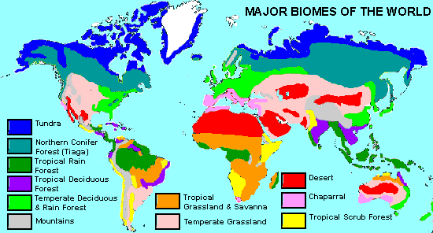
World Biomes
https://i.pinimg.com/originals/cc/32/32/cc3232f4ef062585d98728e9ce4d80e7.gif

Slide 7
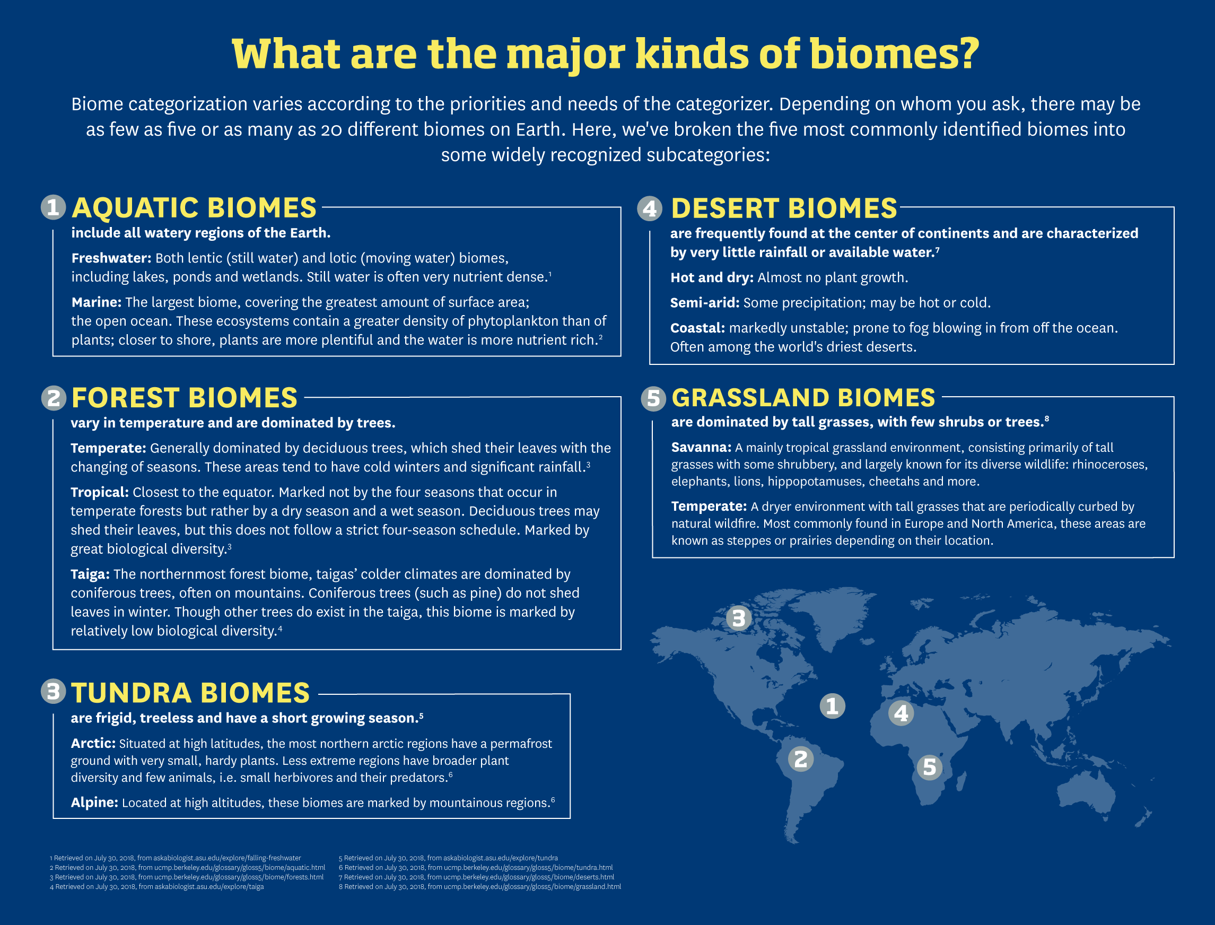
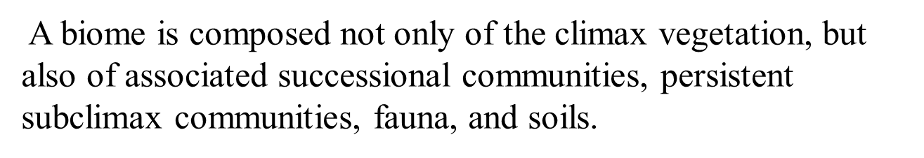
https://onlinedegrees.kent.edu/geography/geographic-information-science/community/biomes-types-and-human-impact

Slide 8
Types of Ecosystems
Natural Ecosystem
Artificial Ecosystem
e.g. Aquarium, Garden, spacecraft
Terrestrial Ecosystem
e.g. Forest
Aquatic Ecosystem
e.g. Ocean
Lentic ecosystem: ecosystem of lake, pond
Lotic ecosystem: ecosystem of river, stream
Depending upon the size of ecosystem
Nanoecosystem – Drop of Water
Microecosystem – Pond
Macroecosystem – Forest
Megaecosystem – Ocean
https://nptel.ac.in/content/storage2/courses/122103039/pdf/mod6.pdf

Slide 9
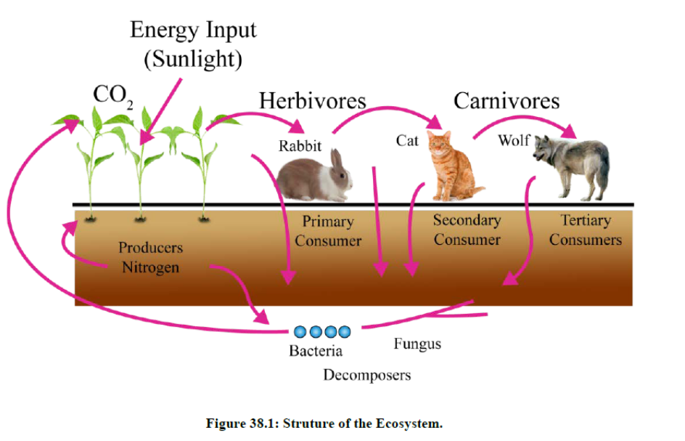
Ecosystem Structure
BIOTIC COMPONENTS
Producer (autotrophs): The role of producers is to prepare food to provide nutrition to the other organisms present in the ecosystem. There are two types of producers; photoautotrophs and chemotrophs. e.g. plants, algae
Consumer (heterotrophs): They are unable synthesize their own food and depends on producers.e.g. animals
Decomposer: These are mainly bacteria and fungi. Their primary purpose in the ecosystem is to decompose the complex organic material into the simple inorganic material so that it can be use for producers to prepare food. Eg. bacteria and fungi
Classes of Consumers
Primary consumer (Herbivores)– eat plants
Secondary consumer (Carnivores)– meat eaters; eat herbivores
Tertiary consumers– feed on carnivores
Omnivores – eat plants/animals
https://mio-ecsde.org/erasmus-IP-2014/trainers/day%2002-Ricard.pdf

Slide 10
ABIOTIC COMPONENTS
These factors include the non-living physiochemical factors of the environment. Abiotic factors are as follows:
Inorganic substances: Inorganic substances like carbon, nitrogen, oxygen, water, carbon di-oxide, calcium, phosphorus and their inorganic compounds. These are available as free form or dissolved in water and may be adsorbed on the soil particles.
Organic compounds: These are carbohydrates, proteins, lipids, nucleic acids etc. This material is present in dead organic matter. These are broken into the simple compounds by decomposers in ecosystem for recycling of matter.
Climatic factors: These are factors present in the environment such as temperature, humidity, light, wind, rainfall an atmospheric gaseous etc.

Slide 11
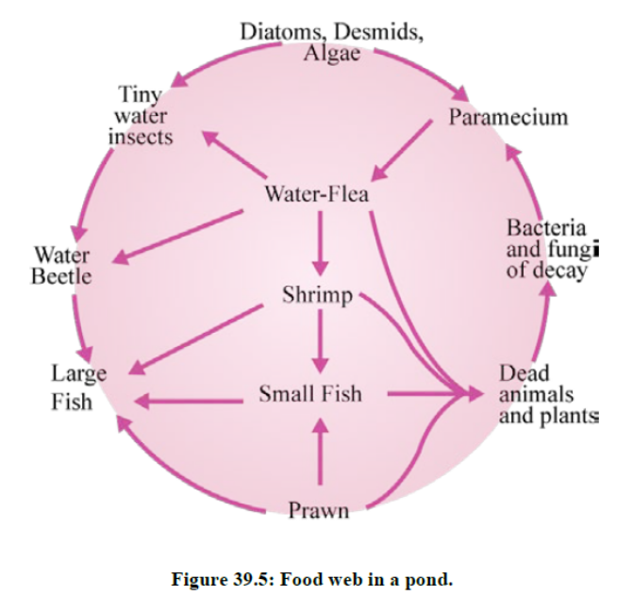
Food chain
  Path of energy exchange/A series of steps in which organisms transfer energy by eating and being eaten.
  Food webs
  Interconnected feeding relationships in an ecosystem
Trophic level
  Feeding relationships
  Individuals position
Recyclers of biosphere: Decomposers- these are fungi/bacteria which decompose organic matter and convert it into inorganic matter that can be used as food by producers. Thus recycling the matter.

