Slide 1
Natural resources
Land and food
Module 2.3

Slide 2
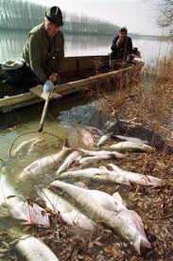
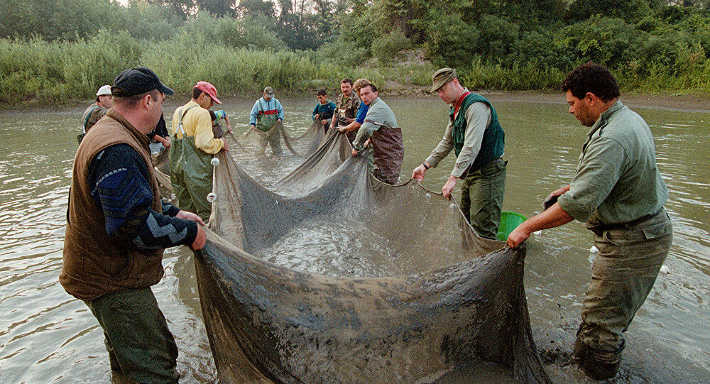
The cost of fancy yellow metal
January 30, 2000 - night
a dam holding contaminated waters burst at a mining works in Bozinta Mare, Romania, and 100,000 cubic meters of cyanide-contaminated water
Watch https://www.youtube.com/watch?v=25CnKmMatt0
Baia Mare Cyanide Spill
https://www.google.com/search?q=Baia+Mare+Cyanide+Spill+black+hills&tbm=isch&ved=2ahUKEwidkJrViM_rAhWLFnIKHdAxD_oQ2-cCegQIABAA&oq=Baia+Mare+Cyanide+Spill+black+hills&gs_lcp=CgNpbWcQAzoECAAQHjoGCAAQBRAeOgQIABAYUL-YCFiVsAhg57EIaABwAHgAgAGlAYgBuguSAQQwLjEymAEAoAEBqgELZ3dzLXdpei1pbWfAAQE&sclient=img&ei=zfhRX931AYutyAPQ47zQDw&bih=920&biw=1920&rlz=1C1CHBF_enIN805IN805#imgrc=m_tCFq5-Tok4GM
https://www.google.com/search?q=Baia+Mare+Cyanide+Spill+black+hills&tbm=isch&ved=2ahUKEwidkJrViM_rAhWLFnIKHdAxD_oQ2-cCegQIABAA&oq=Baia+Mare+Cyanide+Spill+black+hills&gs_lcp=CgNpbWcQAzoECAAQHjoGCAAQBRAeOgQIABAYUL-YCFiVsAhg57EIaABwAHgAgAGlAYgBuguSAQQwLjEymAEAoAEBqgELZ3dzLXdpei1pbWfAAQE&sclient=img&ei=zfhRX931AYutyAPQ47zQDw&bih=920&biw=1920&rlz=1C1CHBF_enIN805IN805#imgrc=_bkD7Kn-pHHy2M&imgdii=uxYdJScfu_M73M

Slide 3
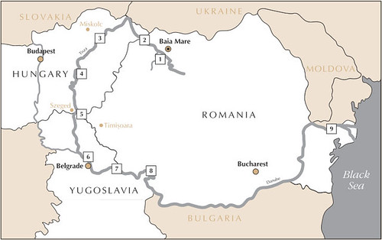
Journey - entered the Sasar River - Somes River, -crosses into Hungary, - Tisa River and the Danube.
Entered Hungary - Yugoslavia (Serbia) further it flowed into the Danube - returned to Romania, finally entering - Black Sea.
https://www.google.com/search?q=Baia+Mare+Cyanide+Spill&rlz=1C1CHBF_enIN805IN805&source=lnms&tbm=isch&sa=X&ved=2ahUKEwjkxP6JiM_rAhXSe30KHYmiAjAQ_AUoAXoECBcQAw&biw=1920&bih=920#imgrc=y3kmqVYupioc1M

Slide 4
Hunt Oil – texas based oil company
Hunt Oil
A major fundraiser for President Bush, known to have close ties to the Bush administration.
The crisis
Lot 76 - the Amarakaeri Communal Reserve.
The 400,000 hectare reserve was created in 2002 to protect the flora and fauna of the area, as well as to safeguard watersheds of particular importance to indigenous groups in the region.
Despite its protected status, in 2006 the Peruvian government granted concessions within the reserve to two oil companies, Hunt Oil and the Spanish company Repsol

Slide 5

Hunt Oil company
The oil company Hunt Oil start pumping oil directly from the cultural region of Manu National Park, specifically from the Communal reserve of Amarakaeri, where more than 10 native communities are living.
hydrocarbon operations involve air and surface water pollution, threatening the survival of plants and animals. In addition, hydrocarbon operations involve the destruction of the forest opening the paths to drill the nearly 20,000-holes in the seismic phase.

Slide 6
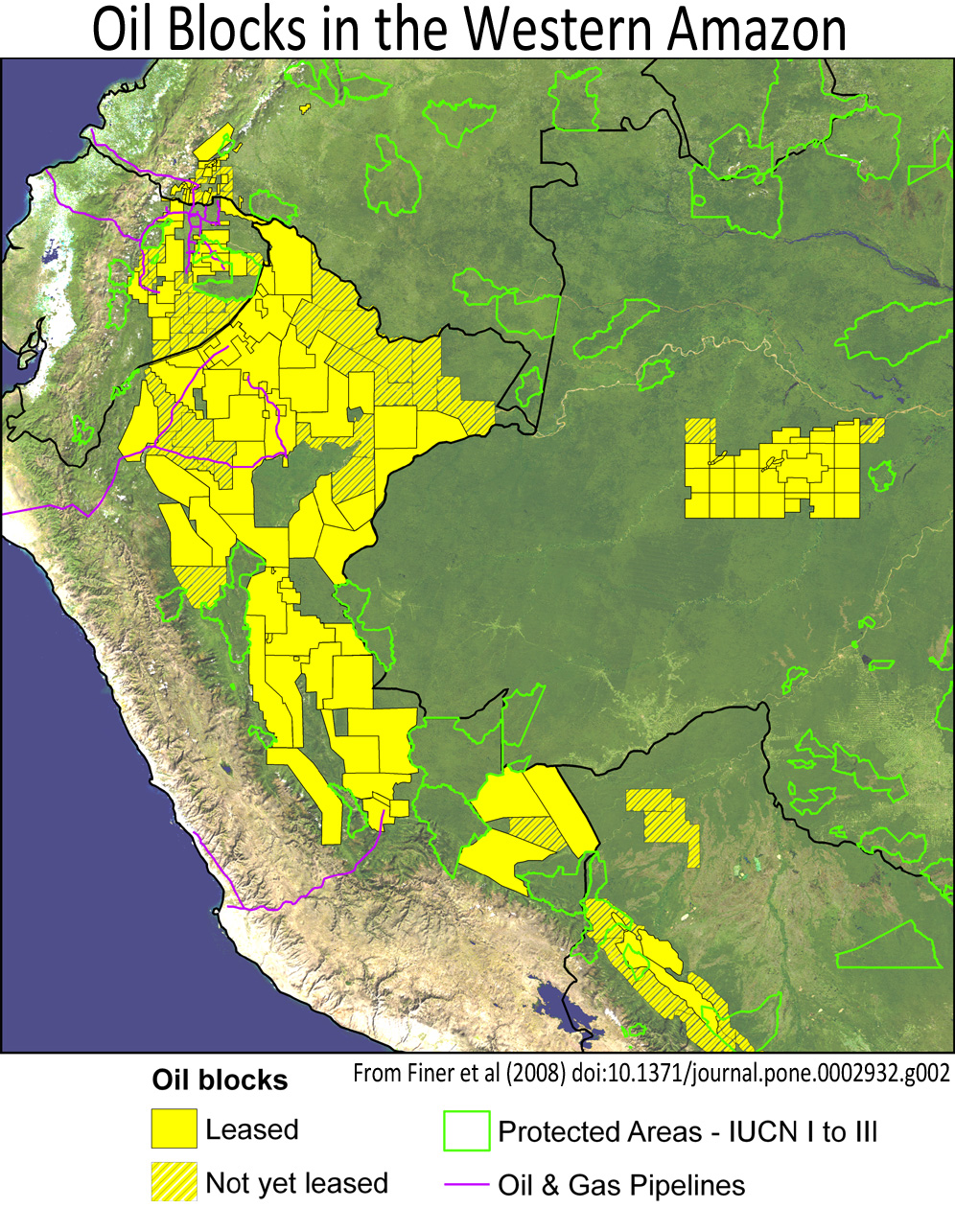
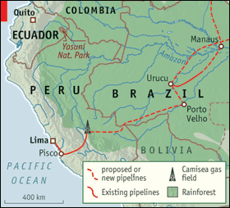

Slide 7
“Environmental impact report” – Hunt oil
Claims that, for now, they simply want to poke around in the woods to see if there’s anything of interest to them.
What does this innocent-sounding “poking around in the woods” involve ?
According to their own estimates
Blazing some 300 miles of “seismic testing trails” through the trackless wilderness,
Detonating more than 12,000 explosive charges, and
Carving more than 100 helicopter landing pads out of the virgin rainforest.

Slide 8
Effects of deforestation
:
Destruction of biodiversity
Desiccation of previously moist soil
Desertification
Urbanisation (Heat island effect)- Average temperature of an area is higher than nearby rural areas. The primary cause of the heat island effect is the conversion of space into an urban environment that absorbs more sunlight and stores it in large thermal masses
Green house effect
No recycling of water
Soil erosion

Slide 9
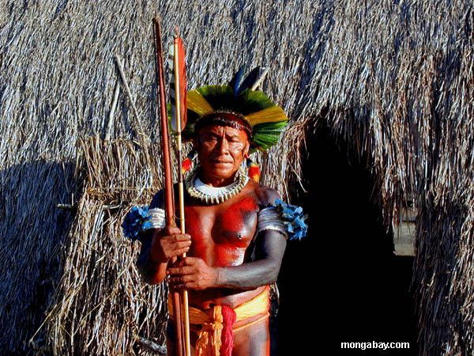
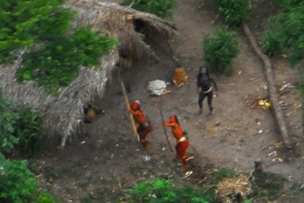
AVTAAR
Reality or fantasy....?

Slide 10
Local upraising
"The result – irreparable impact - most vulnerable ecological and cultural areas are now being invaded by seismic lines
Harakmbut - indigenous community
Surface and underground hydrological system have great cultural significance
Overall Impact on - greater population of the Amazon Basin,"

Slide 11
Case studies on deforestation & Mining in Amazon basin
http://www.youtube.com/watch?v=zOYRMRqfrPQ&safety_mode=true&noredirect=1
http://www.youtube.com/watch?v=2d5d1Z6AFH4
http://www.youtube.com/watch?v=F5bDHpQCcqM&feature=related
http://news.mongabay.com/2009/0803-hambone_peru.html

Slide 12
Food security: Ability of all people at all time to access enough food for healthy life
Conditions for food security
Availability: domestic production or import
Access: depends on household income
Utilization-Inadequate knowledge of nutritional fact may prevent the best use of food
Adverse effect of modern agriculture on soil & water resources
Soil erosion
Surface run off (nutrient loss)
Water logging (result of over irrigation)
Salinity: over irrigation leads to ↑evaporation leaving behind ↑ salt
Fertilizers: Leads to EUTROPHICATION ( ↑algae in waterbodies)
Pesticides

Slide 13
Alternative strategies & Sustainable agriculture
Practice:
Crop rotation
Alternate Planting times
Agroforestry
Intercropping
Avoid Monoculture
Crossbreeding – Selection
Variation helps cross fertilization to evolve more tolerant varieties
Organic farming:
Is an ecological production management system that promotes and enhances biodiversity, biological cycles and soil biological activity
USES BIOFERTILISERS & BIOPESTICIDES resulting in decreased chemical input in soils
Genetic engineering
Producing new varieties of crop species E.g. BT-Brinjal, BT-Cotton

