Slide 1
EVS LECTURE 1.2
Need for Public Awareness and Case Studies

Slide 2
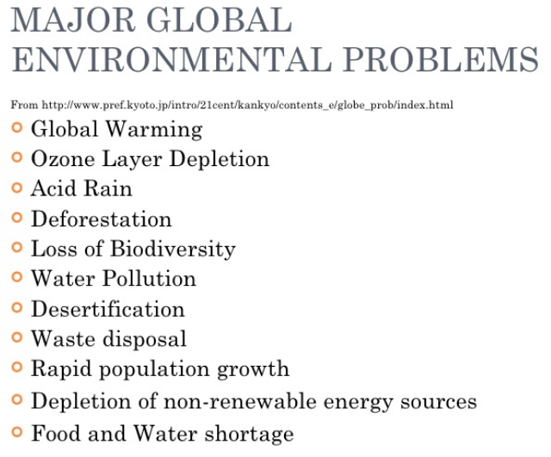

Slide 3
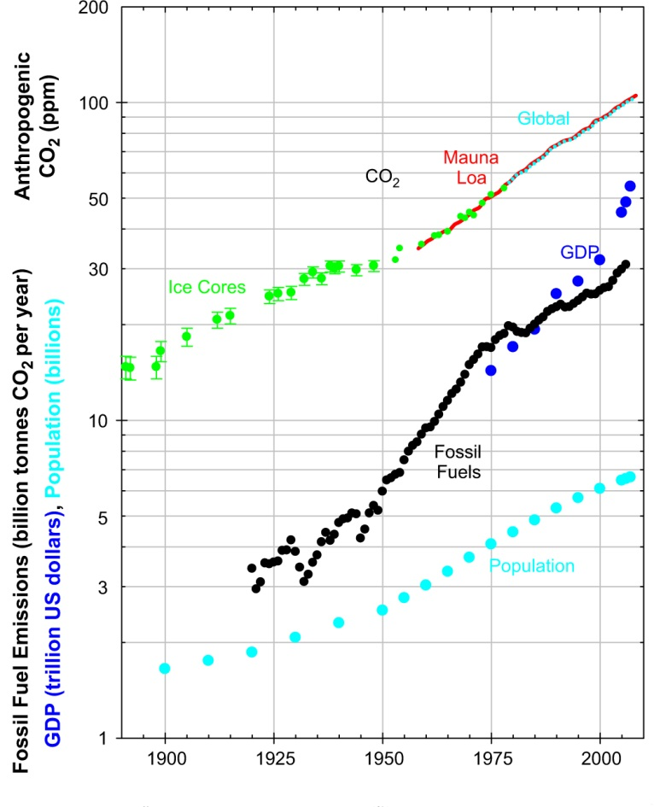

Slide 4
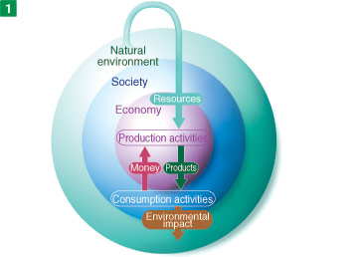
Where and how did the problem arise….?
Industrial revolution
Green revolution
  Mass production
  Mass consumption
  Mass disposal

Slide 5
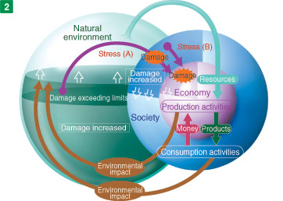
Where and how did the problem arise….?
Industrial revolution
Green revolution
  Mass production
  Mass consumption
  Mass disposal

Slide 6
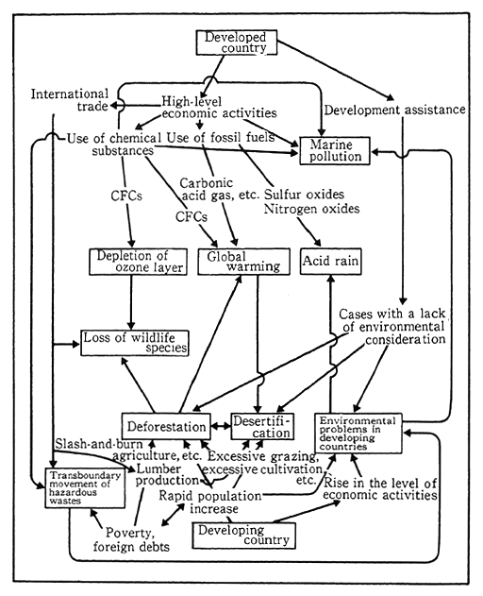
“Developing” or the “Developed”……….
Who is responsible?

Slide 7
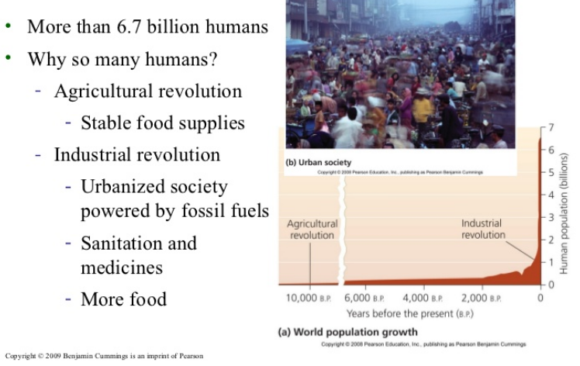

Slide 8
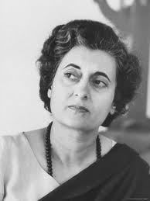
Awareness in India
1972-Stocklom convention
attended by late Prime minister Mrs.Indira Gandhi
Need felt for Institutional frame work
  Department of Environment was created.
Need felt for legal/Regulatory frame work
  Control & Prevention of pollution Act-1974
  Central Pollution Control Board set up
  State pollution control board set up

Slide 9
Global commitment
In the words of The Norwegian Nobel Committee
  “We honour the earth; for bringing forth flowers and food – and trees… is committed to the protection of the earth. This commitment is our vision – deeply felt and connected to human rights and peace”.
Honouring the IPCC through the grant of the Nobel Peace Prize in 2007 – A Clarion call for the protection of the earth

Slide 10
Noble speech….
This choice is, an acknowledgement of 3 important realities ……
  The power and promise of collective scientific endeavour,
  The role of knowledge in shaping public policy and guiding global affairs for the sustainable development of human society.
  An acknowledgement of the threats to stability and human security inherent in the impacts of a changing climate and, therefore, the need for developing an effective rationale for timely and adequate action to avoid such threats in the future.

Slide 11
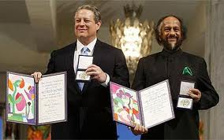
The Nobel Peace Prize 2007
Al Gore, Ex.VP, USA & R K Pachouri representing IPCC as it’s Chairman

Slide 12
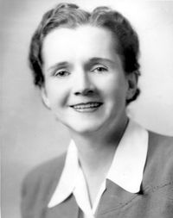

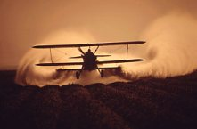
The whistle blowers
1873 – first synthetic insecticide
Paul Herman Muller- 1939
1948 – US / Nobel
1962 - Publication
1972 - Ban
2000 – Stockholm convention
Crop dusting – National archives

Slide 13
The Stockholm Convention on Persistent Organic Pollutants, the International Program on Chemical Safety
The dirty dozen: UNEP
Insecticides & Pesticides: Aldrin, Chlordane, DDT, Dieldrin, Endrin, Heptachlor, Hexachlorobenzene, Mirex
Toxaphene, Hexachlorobenzene
Industrial Chemicals
Polychlorinatedbiphenyls,Dioxins
Furans

Slide 14
Nine new chemicals have been added to the list
On 8 May 2009, the Conference of the Parties (COP) added nine more chemicals as persistent organic pollutants.
Pesticides: - 1.chlordecone, 2.lindane, 3.pentachlorobenzene;
4.alpha hexachlorocyclohexane and beta hexachlorocyclohexane,
Industrial chemicals:-5.hexabromobiphenyl ( hexabromodiphenyl ether and heptabromodiphenyl ether), 6.pentachlorobenzene, 7.perfluorooctane sulfonic acid, its salts and 8. perfluorooctane sulfonyl fluoride, 9.tetrabromodiphenyl ether and pentabromodiphenyl ether; and
By-products: - alpha hexachlorocyclohexane, beta hexachlorocyclohexane and pentachlorobenzene
Short-chained chlorinated paraffins ,Endosulfan, and Hexabromocyclododecane may be added to this list. Still debatable.

Slide 15
International Environmentalists
Charles Darwin-
Ralph Emerson
Henry Thoreau
John Muir
Aldo Leopold
Rachel Carson
EO Wilson

Slide 16







Organizations working for Environment
World Wide Fund (WWF)
Centre for Science and Environment (CSE)
Central Pollution Control Board (CPCB)
Wildlife Institute of India (WII)
United Nations Environment Program (UNEP)

Slide 17
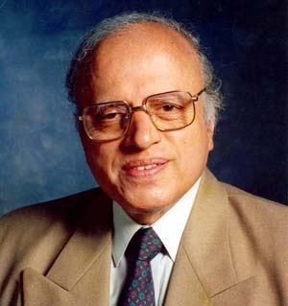
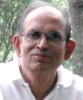

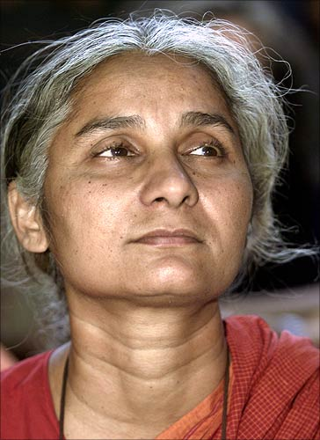
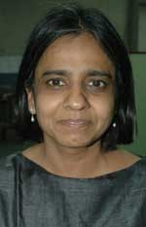
Indian Environmentalists

Slide 18
Some Indian environmentalists
Salim Ali - Orinthology
Indira Gandhi - Played an important role in preserving wild life
SP Godrej - Padma Bhusan
MS Swaminathan - Agricultural scientist
Madhav Gadgil - Ecologist
MC Mehta - Environmentalist Lawyer
Anil Agarwal - Journalist
Medha patekar - Narmada dam
Sunderlal Bahugana - Chipko Movement

Slide 19
When we permit the destruction of environment
and
Do not protest / raise our voce against it,
We are denying our future generations
the use of this valuable resource…
‘THE BIOSPHERE’

