Slide 1
Signals and Systems
Fourier analysis of Continuous time signal and system-I

Slide 2
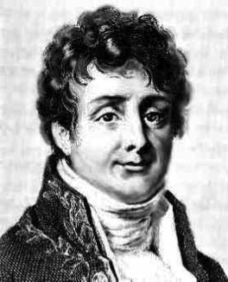
Jean Baptiste Joseph Fourier
3/21/1768 - 5/16/1830

Slide 3
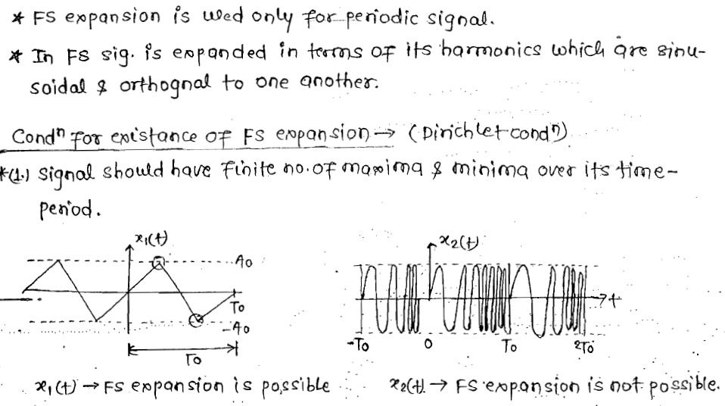
Fourier Series

Slide 4
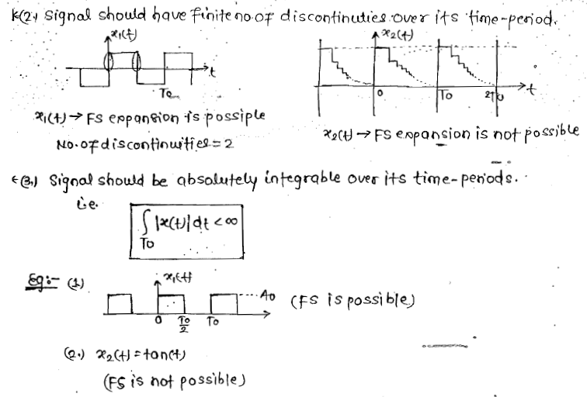
Cont..

Slide 5
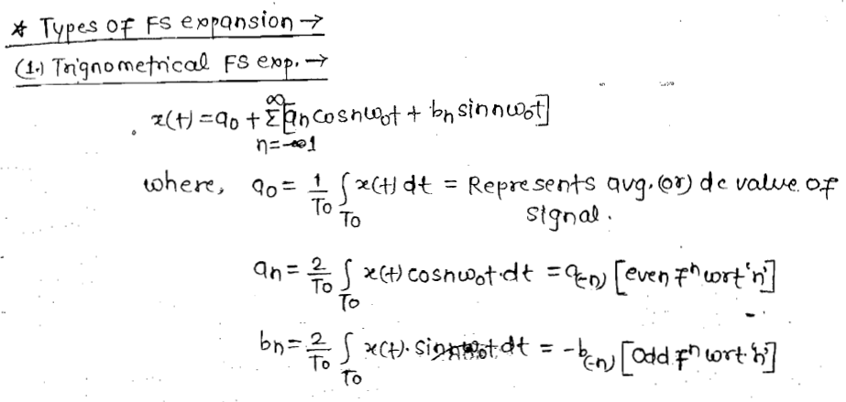
Cont..

Slide 6
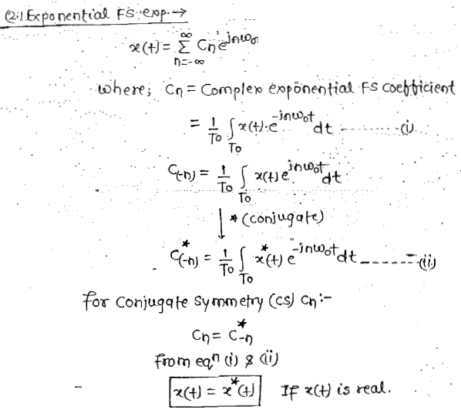
Cont..

Slide 7
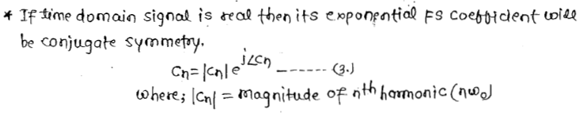
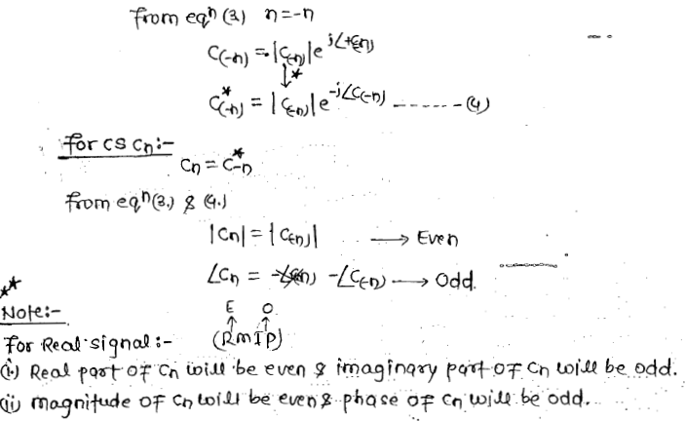
Cont..

Slide 8
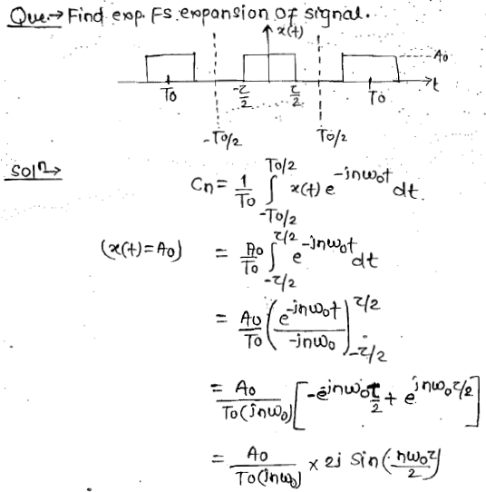
Cont..

Slide 9
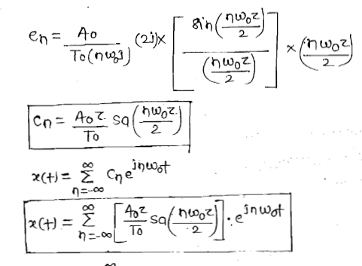
Cont..

Slide 10
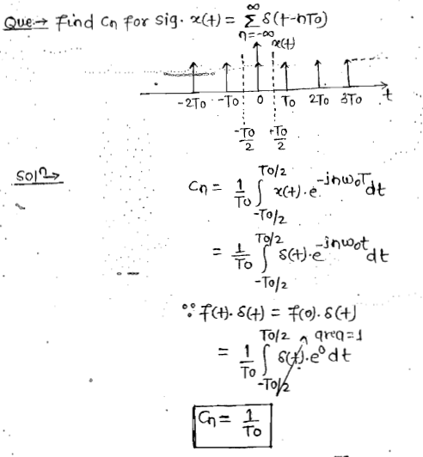
Cont..

Slide 11
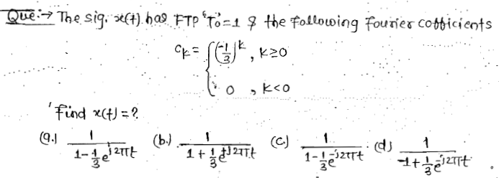
Cont..

Slide 12
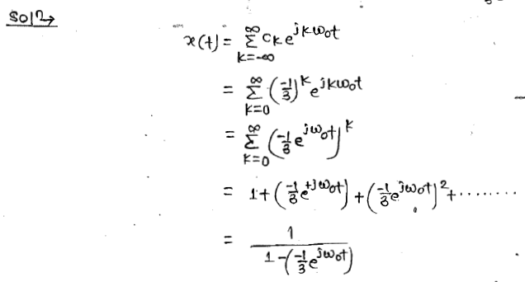
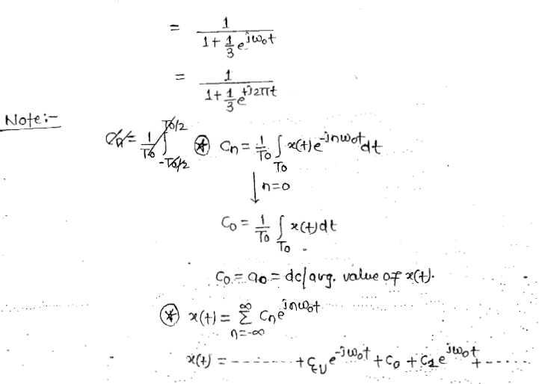
Cont..

Slide 13
Cont..

Slide 14
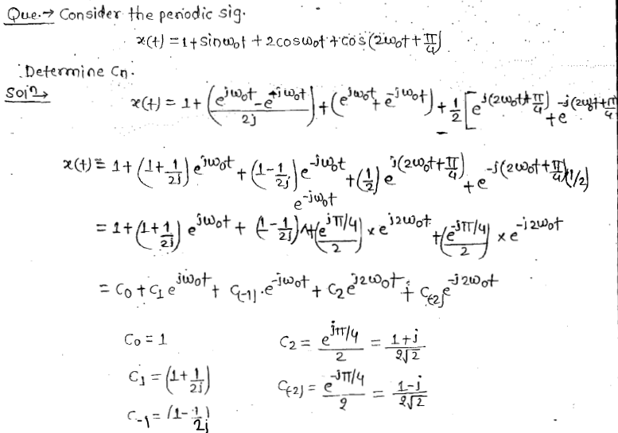
Cont..

Slide 15
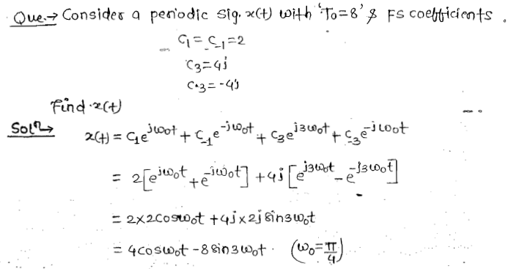
Cont..

Slide 16
Thank You

