Slide 1
Natural resources
Module 2.7
Energy

Slide 2


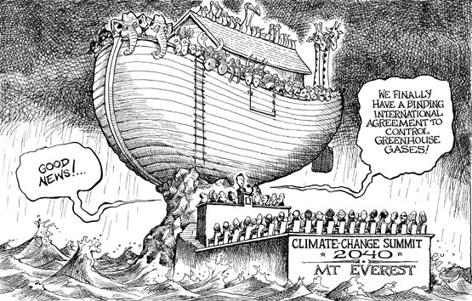
FAILED TO DELIVER TO THE EXPECTATIONS…?
STARTING AN YEAR OF GLOBAL POLITICAL CLIMATE DEBATE WITH MIXED FEELINGS……
IF THIS ‘NO SOLUTION’ STATE CONTINUES, WE MAY AS WELL EXPECT…..

Slide 3
United Nations Climate Change Conference
2010
Cancún, Mexico
Called for a large "Green Climate Fund", and a "Climate Technology Centre" and network
2011
Durban, South Africa,
Legally binding deal comprising all countries, by 2015, to take effect in 2020.
Creation of a Green Climate Fund (GCF) -US$100 billion per year
https://unfccc.int/process-and-meetings/conferences/glasgow-climate-change-conference

Slide 4
India "will never be intimidated by any threat or pressure” – Jayanthi Natarajan
…….“We have shown more flexibility than virtually any other country. But equity is the centrepiece, it cannot be shifted. This is not about India. Does fighting climate change mean we have to give up on equity? We have agreed to protocol and legal instrument. What's the problem in having one more option? India will never be intimidated by any threat or any kind of pressure. What's this legal instrument? How do I give a blank cheque? We're talking of livelihoods and sustainability here. I'm not accusing anybody, but there are efforts to shift the (climate) problem to countries that have not contributed to it. If that is done, we're willing to reopen the entire Durban Package. We did not issue a threat. But are we being made into a scapegoat? Please don't hold us hostage”…………..

Slide 5
Kyoto protocol failure understanding
https://muse.jhu.edu/article/493430/pdf#:~:text=At%20the%20end%20of%202012,with%20respect%20to%20emissions%20reduction.

Slide 6
Why the Kyoto agreement failed
The US political system and the way the US Congress is organized and functions.
The US Congress unanimously adopted a resolution stating that the US should not be a signatory to any agreement that would mandate new commitments to limit or reduce greenhouse gas emissions only in industrialised countries or that would result in serious harm to the US economy.
The first time Barack Obama voted against the Kyoto Protocol was in 1998 when he was still a State Legislator, because it did not have meaningful and achievable emissions targets
Bill Clinton came to Kyoto to take part in the negotiations, they had already given up hope of achieving an agreement that would be acceptable to the Senate
According to some US delegates to Kyoto, the US negotiators believed it was possible to get the Senate’s support for an agreement that committed the US to a zero per cent increase in emissions from 1990 to 2012. But when Al Gore arrived at the table, he said the US had to give more, and consequently the delegation ended up committing the Americans to a seven per cent reduction in emissions.
According to President Bush, his specific complaints about the Kyoto Treaty include, “a serious harm to the U.S. economy,” which would cause a “more dramatic shift from coal to natural gas for electric power generation: Coal generates more than half of America’s electricity supply and lack of commercially available technologies for removing and storing carbon dioxide

Slide 7
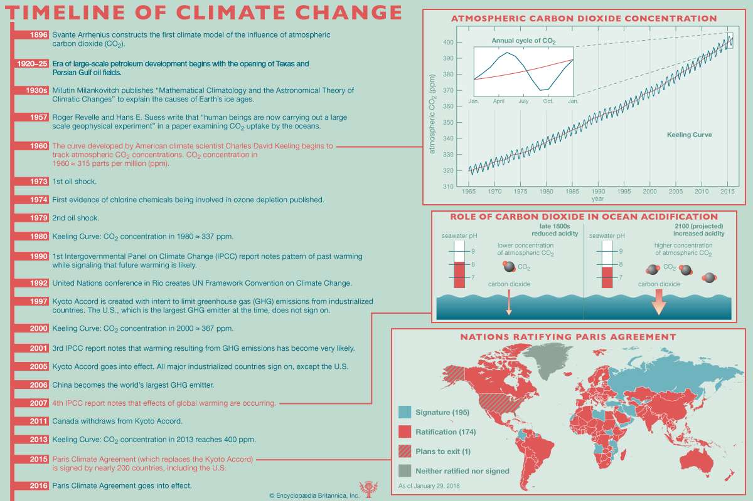
https://unfccc.int/process/the-paris-agreement/status-of-ratification
https://treaties.un.org/Pages/ViewDetails.aspx?src=IND&mtdsg_no=XXVII-7-d&chapter=27&clang=_en
References for material covered:
https://www.climatechangenews.com/2020/08/13/countries-yet-ratify-paris-agreement/

Slide 8
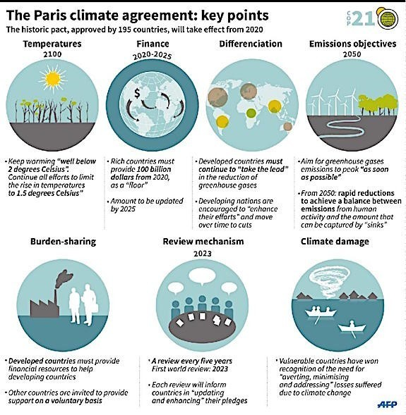
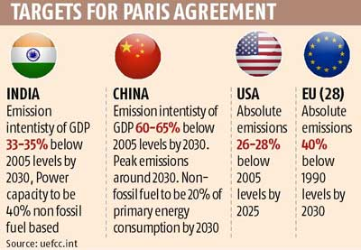
Paris Climate Agreement 2015 Driving emissions reductions post-2020
21st COP held on Dec 11, 2015 in Paris, France
Aim is to strengthen the global response to the threat of climate change by keeping a global temperature rise this century well below 2 degrees
174 Parties have ratified of 197 Parties to the Convention
Entered into force on 4 November 2016

Slide 10
Source of renewable energy
Solar: Photo voltaic cells, Solar thermal. Solar air heating
Wind
Denmark, California
India stands 3rd
Impacts
Geothermal
Hydro-electric
Marine
New RS
Biomass : quick growing crops
Hydrogen: fuel cells to produce: water, electricity
Alcohol
https://www.renewableresourcescoalition.org/alternative-energy-sources/
https://www.nrdc.org/stories/renewable-energy-clean-facts

Slide 11
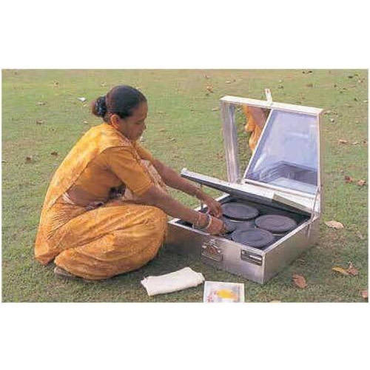
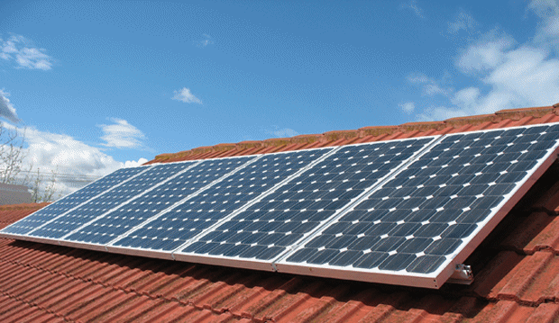
Alternative sources – Solar Energy
Sun -The ultimate source
75,000 X 10¹¹ KW/DAY
Cell-Module-Array
Photo voltaic cell
https://www.intersolarsystems.com/wp-content/uploads/2019/09/Solar-Panel-Dealers-In-Haldwani.png
Solar cooker
https://5.imimg.com/data5/HK/LH/MY-3970662/domestic-solar-cooker-500x500.jpg

Slide 12
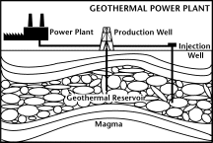
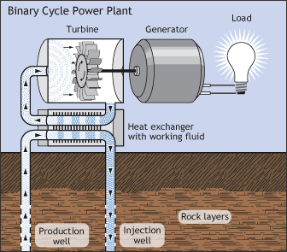
Geothermal
Magma
Geothermal reserves
Iceland, Japan, New zealand
https://www.irena.org/geothermal#:~:text=Geothermal%20energy%20is%20heat%20derived,harnessed%20to%20generate%20clean%20electricity.

Slide 13
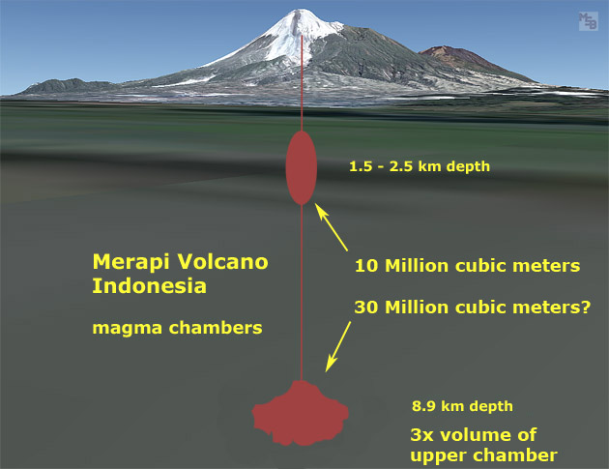
Other untapped energy sources
1. Ocean Thermal Energy Conversion: OTEC – DOD, India (Department of Ocean development)
2. Methyl hydrates
3. Volcanic magma
Ocean Thermal Energy Conversion (OTEC) uses the temperature difference between cooler deep and warmer shallow or surface ocean waters to run a heat engine and produce useful work, usually in the form of electricity. However, the temperature differential is small and this impacts the economic feasibility of ocean thermal energy for electricity generation.
https://www.eia.gov/energyexplained/hydropower/ocean-thermal-energy-conversion.php

Slide 14
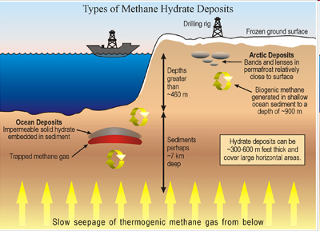
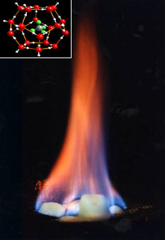
Methyl hydrates (The Gas Resource of the Future):
Methane hydrate is a cage-like lattice of ice inside of which are trapped molecules of methane, the chief constituent of natural gas.
If methane hydrate is either warmed or depressurized, it will revert back to water and natural gas. When brought to the earth's surface, one cubic meter of gas hydrate releases 164 cubic meters of natural gas.
https://www.bbc.com/news/business-27021610#:~:text=By%20lowering%20the%20pressure%20or,a%20highly%20energy-intensive%20fuel.

Slide 15
Research for Energy efficient technologies
Alternate Hydrogen Energy Centre (AHEC) -IIT, Roorkee
established by Ministry of Non-Conventional Energy Sources, GOI in the year 1982
promotes power development through the integration of renewable energy and through the development of Small Hydro Power Technologies etc.
imparts training to the field personnels via short term & long training courses in this thrust area field of renewable energy.
From 1989 Technical Education Deptt., UP Govt. maintains its establishment on net deficit financing under Non Plan.
an apex technical institute in the field of small hydro power development.
Areas of Research
Small Hydro Power Development
Power System Planning and Operation
Biomass Energy
Solar & Wind Energy

Slide 16
Fuel cells
Hydrogen fuel cell
Microbial fuel cell
https://studentenergy.org/map/?gclid=EAIaIQobChMI8dbLvYDX6wIVECUrCh3sQg1NEAAYASAAEgJjJ_D_BwE
https://www.anthropocenemagazine.org/2016/12/battery-vs-fuel-cell-electric-vehicles/?gclid=EAIaIQobChMI8dbLvYDX6wIVECUrCh3sQg1NEAAYAiAAEgLcrfD_BwE
https://www.energy.gov/eere/fuelcells/fuel-cells
https://www.hydrogenics.com/technology-resources/hydrogen-technology/fuel-cells/

Slide 17
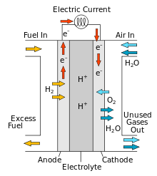
Hydrogen cell
H₂+O₂=H₂O+electricity
Like a battery
Recharge: with fuels
Less environment impact
Handling hydrogen

Slide 18
Microbial fuel cells
M. Potter was the first to perform work on the subject in 1911
a device that converts chemical energy to electrical energy by the catalytic reaction of microorganisms
anode and cathode compartments separated by a cation (positively charged ion) specific membrane.
anode compartment: fuel is oxidized by microorganisms, generating CO₂, electrons and protons.
Electrons are transferred to the cathode compartment through an external electric circuit,
while protons are transferred to the cathode compartment through the membrane.
Electrons and protons are consumed in the cathode compartment, combining with oxygen to form water

Slide 19
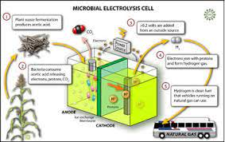
https://www.nsf.gov/news/mmg/media/images/biohydrogen_f2.jpg

Slide 20
Biomass energy
Raw material: agricultural, forestry and agro-industrial residues into electric power.
Biomass converted to energy in three ways: thermal conversion, chemical conversion, and biochemical conversion
traditional cook stoves with low efficiency
kerosene and wick lamps, for lighting
which emit smoke into kitchen, leads to low quality of life for most rural women
Fresh biomass
Denmark
Urban waste
Japan
https://energypedia.info/wiki/Portal:Solid_Biomass

Slide 21


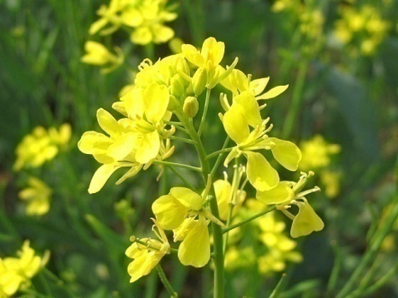


Biodiesel
vegetable oil- or animal fat-based diesel fuel
consisting of alkyl (methyl, propyl or ethyl) esters.
made by chemically reacting lipids (e.g., vegetable oil, animal fat) with an alcohol producing fatty acid esters
Energy plantations / Energy farms - PETRO-PLANTS
Jatropa, Acacia, Albizzia, Cassia, Ficus, Sunflower
Forms
Liquid
Brazil (fibrous waste of sugar industry)
Gaseous

Slide 22
Biodiesel
Process
Advantages
Clean
SO₂
Cetane number
lubrication
Damage to Ozone layer
PAH reduction
Net zero carbon emissions
Negative effects:
Clearing forest to farm
Rising price of vegetable oil is causing problems
Farmers may switch from producing food crops to producing biofuel crops to make more money, even if the new crops are not edible.
The law of supply and demand predicts that if fewer farmers are producing food the price of food will rise. It may take some time,
https://afdc.energy.gov/fuels/biodiesel.html

Slide 23
Biodiesel
Blends : "B" factor to state the amount of biodiesel in any fuel mix
100% biodiesel - referred to as B100
20% biodiesel, 80% petrodiesel - labeled B20
5% biodiesel, 95% petrodiesel - labeled B5
2% biodiesel, 98% petrodiesel - labeled B2

Slide 24
Biogas - Biogas:decentralised energy system
Anearobic digestion (Organic polymers)
Hydrolysis
Monomers
Acidogenesis
VFA’s, Acetate, Formate
Methanogenesis
Methane
https://www.homebiogas.com/Blog/142/What_is_Biogas%7Cfq%7C_A_Beginners_Guide
https://studentenergy.org/map/?gclid=EAIaIQobChMIlqGCwIHX6wIVQx0rCh3F-w6IEAAYASAAEgIYMfD_BwE

Slide 25
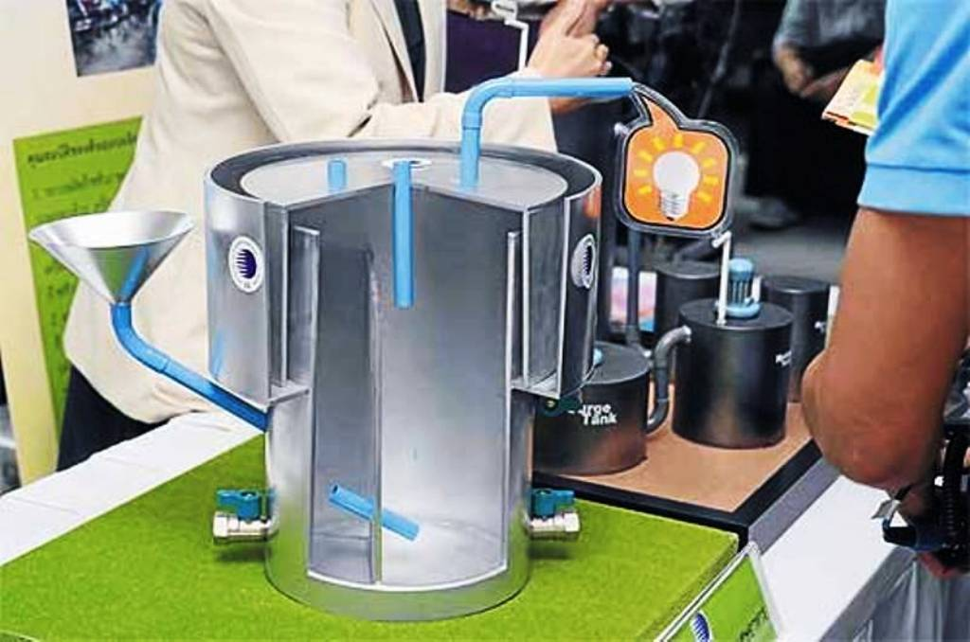
Biogas Gas produced by biological breakdown of organic matter in the absence of O₂
Sources:
Agriculture waste
Cow dung
CO₂+CH₄+H₂S
Digester Waste / Sediment: fertilizer
Biogas composition:
Methane-50-68%
CO₂ – 25%
H₂-5%
N₂-2-7%
O₂-0.1%
https://www.build-a-biogas-plant.com/wp-content/uploads/2014/09/new-biogas-plant.jpg

Slide 26
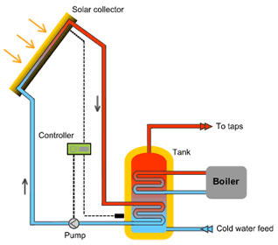
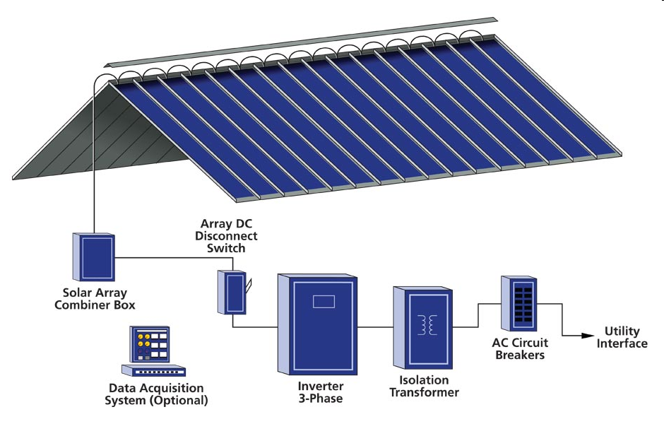
Sustainable strategies
https://studentenergy.org/map/?gclid=EAIaIQobChMIn9vj8IHX6wIVmQVyCh3i9Q6_EAAYAiAAEgISl_D_BwE
STE (Solar thermal energy) technology for harnessing solar energy for thermal energy (heat).)
The solar challenger
Mirrors/reflector energy
BIPV: Building-integrated photovoltaics
PV modules & arrays
Energy plantations
JFM :Joint Forest Management : partnerships between fringe forest user groups and the Forest Department
Social forestry: management and protection of forests and afforestation on barren lands with the purpose of helping in the environmental, social and rural development
Agroforestry

Slide 27
Indian Oil Corporation limited (IOCL)
Green Fuel Alternatives
Indian Oil is focussing on CNG (compressed natural gas), Autogas (LPG), ethanol blended petrol, bio-diesel, and Hydrogen energy.
A joint venture between Indian Oil and Chhattisgarh Renewable Energy Development Agency (CREDA) - Indian Oil – CREDA Biofuels Ltd.
Envisages production of 30,000 metric tonnes (MT) of biodiesel per annum from energy crop plantation on 30,000 hectare of revenue wasteland.
Energy crop plantations (Jatropha, Pongamia etc.) on revenue wasteland in various districts of Chhattisgarh.

Slide 28
Measures taken by Indian government to enhance Energy Security
The Integrated Energy Policy - Adopted in December 2008.
A comprehensive policy on Energy drafted to explore alternative technologies and possible synergies that would increase energy system efficiency and meet requirement for energy services.
To reliably meet the demand for energy services of all sectors including the lifeline energy needs of vulnerable households in all parts of the country with safe, clean and convenient energy at the least cost.
Goal: To provide energy security to all.
Expected to bring in a level playing field for all energy players large or small, public or private, domestic or foreign.
It would allow for relative pricing of different fuels taking into account both their efficiency in use and convenience as well as the amount of pollution they generate.
Policy envisages a competitive energy market and market-determined energy pricing
https://www.iea.org/policies/1590-integrated-energy-policy

Slide 29
Jawaharlal Nehru National Solar Mission (JNNSM): Launched in November 2009.
Policy framework for the deployment of 20,000 MW of solar power by 2022.
Scale up off –grid solar applications by installing another 2,000 MW capacity by 2022
Aggressive R&D to reduce the cost and improve the over all performance.
National Biofuel Policy - November 2009,
Directive issued - mandatory for all oil-marketing companies - Petrol mixed with 5% ethanol.
an indicative target of 20% by 2017 for the blending of biofuels – bioethanol and bio-diesel
http://manireda.com/?page_id=82

Slide 30
National Mission for Enhanced Energy Efficiency:
Creating an energy efficiency market
Cut down the country’s annual energy usage by 5% by 2015, and carbon dioxide emissions by 100 million tonne every year.
Perform, Achieve and Trade (PAT) mechanism
Set targets on energy efficiency improvement for energy-intensive industries and encourage trade of energy savings certificates - ESCerts
Wind Energy:
A cumulative capacity of 10,900 MW has been set up
Voluntary Emission Reduction:
India on 3 December 2009 offered to voluntarily reduce its carbon intensity by 20-25% by 2020 from 2005 levels through policy interventions, including mandatory fuel efficiency standards for all vehicles (by 2011). This would be a domestic commitment and not legally binding internationally.

Slide 31
GOLDEN RULE OF ENERGY SECURITY
IT’S CHEAPER TO SAVE THAN TO GENERATE

