Slide 1

LECTURE – 1.6
BIODIVERSITY
Diversity of flora and fauna.
Species and wild life diversity.
Biodiversity – Importance and its loss

Slide 2
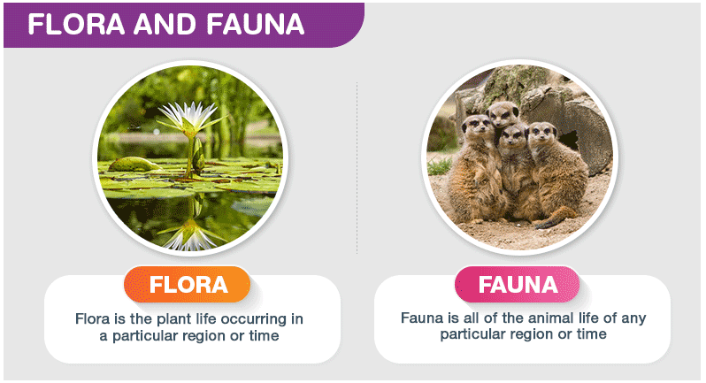
DIVERSITY OF FLORA AND FAUNA
Ecosystem is a complex, interconnected network based on biotic and abiotic elements.
Out of these biotic components majorly consist of either plant or animal life – Flora and fauna respectively.
Importance of flora and fauna – maintains ecological balance, aesthetic balance, expanded economies.
Factors affecting the diversity of flora and fauna
Land/natural vegetation (Fertility, Farming)
Soil - different types of vegetation (Mangrove vegetation, thorny, arid veg.)
Temperature and Humidity
Photoperiod (Sunlight)
Precipitation
Ecosystem
Ref:http://faunaofindia.nic.in/PDFVolumes/spb/028/index.pdf

Slide 3
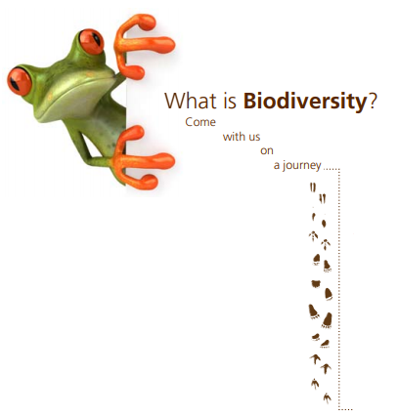
BIODIVERSITY
Degree of variations amongst all life forms from all sources including terrestrial, marine, and other aquatic ecosystems
It can be explained as the diversity of life in all its forms – species, genetic and ecosystem variations.
From the hot arid deserts of the Sahara, through the lush green rainforests of the Amazon, to the ocean depths and bright corals, our natural world is a marvel of different landscapes, materials, colours and textures.
The land, air and seas of our planet are home to the tiniest insects and the largest animals, which make up a rich tapestry of interconnecting and interdependent forces.
This is life, this is biodiversity.
Biodiversity found on Earth today consists of many millions of distinct biological species, the product of four billion years of evolution.
However, the word “Biodiversity” is relatively new, and is thought to have first been coined as a contraction of the term “biological diversity” in 1985 and then popularised by a number of authors.
Biodiversity is the variety of life on Earth, it includes all organisms, species, and populations; the genetic variation among these; and their complex assemblages of communities and ecosystems. It also refers to the interrelatedness of genes, species, and ecosystems and in turn, their interactions with the environment.
Ref: https://www.unesco.pl/fileadmin/user_upload/pdf/BIODIVERSITY_FACTSHEET.pdf

Slide 4
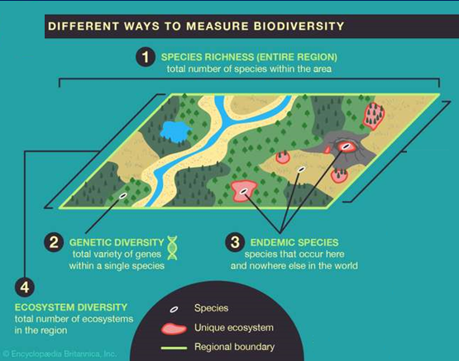
Degree of nature’s variety in Biological diversity
This variety can be observed at three levels;
Genetic diversity
variation of genes within species
constitutes distinct population of the same species
Species diversity
variety of species within a region.
can be measured as number of species in a region
Ecosystem diversity
Variety of ecosystems/ communities in various ecological niches within an ecosystem.
Examples for richest biodiversity.
Tropical Rain forests
Coral reefs
Ref: Encyclopædia Britannica, Inc./Patrick O'Neill Riley

Slide 5
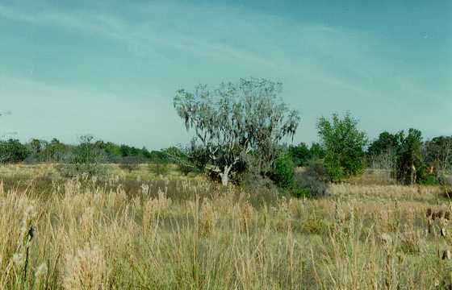
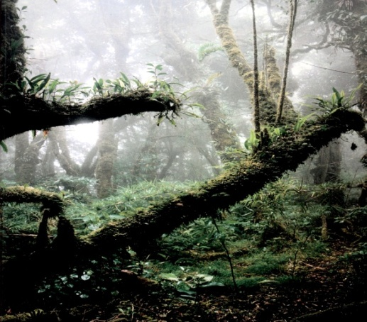


Diversity of ecosystems
Different habitats, niches & species interactions
Natural
Forests, grasslands, deserts, mountains, Aquatic (rivers, lakes, seas)
Modified
Artificial (grazing, farmland
Overuse or misuse = loss of productivity = degradation
Alpha diversity: The diversity within a particular area or ecosystem; usually expressed by the number of species (i.e., species richness) in that ecosystem
Beta diversity: Comparison of diversity between ecosystems, usually measured as the amount of species change between the ecosystems
Prairies
Rain Forest
Coral reeves
Mangroves

Slide 6
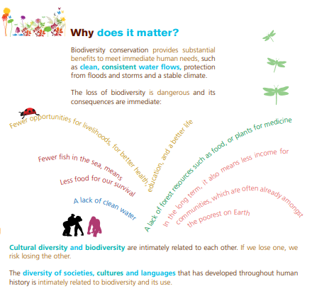
IMPORTANCE OF BIODIVERSITY
The United Nations has declared the year 2010 as the ‘International Year of Biodiversity’
Increase ecosystem productivity; each species in an ecosystem has a specific niche—a role to play.
Support a larger number of plant species and, therefore, a greater variety of crops.
Protect freshwater resources.
Promote soils formation and protection.
Provide for nutrient storage and recycling.
Aid in breaking down pollutants.
Contribute to climate stability.
Speed recovery from natural disasters.
Provide more food resources.
Provide more medicinal resources and pharmaceutical drugs.
Offer environments for recreation and tourism.
Ref: http://ete.cet.edu/gcc/?/biodiversity_importance/

Slide 7
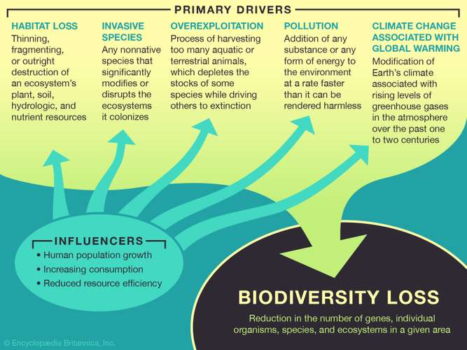
BIODIVERSITY LOSS
Biodiversity, the diversity of life on Earth, is essential to the healthy functioning of ecosystems.
Habitat loss and overexploitation, driven by our rapid population growth, are the primary causes of biodiversity loss which is now happening up to ten thousand times faster than for millions of years before.
"We are in a bottleneck of overpopulation and wasteful consumption that could push half of Earth’s species to extinction in this century."
– E.O. Wilson
Ref: https://populationmatters.org/the-facts/biodiversity?gclid=EAIaIQobChMIpuGhvsi96wIV5MEWBR2IxA4tEAAYASAAEgIDY_D_BwE

Slide 8
Biogeographic classification of India
Biogeographic zone- A large distinctive zone of similar ecology, biome, community and species.
Trans-Himalayan region
Himalayan ranges & valleys
Terai
Gangetic & Brahmaputra plains
Thar desert
Semi-arid grasslands
North-Eastern states
Western Ghats
Andaman & Nicobar islands
Western & Eastern coastal belt
Ref: https://www.ugc.ac.in/oldpdf/modelcurriculum/Chapter4.pdf

Slide 9
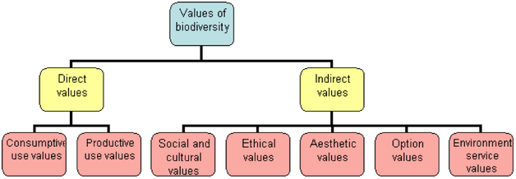
Biodiversity has Intrinsic Value
Intrinsic value is the value that an entity has in itself, for what it is, or as an end. Something has intrinsic value if it is valued for what it is, rather than for what it can bring about.
There is an altruistic or non-humanistic value to support the intrinsic value of biodiversity: life forms should be conserved simply because they exist: they are the product of a long history of continuing evolution by means of ecological processes, and so they have the right to a continued existence.
Ref: https://conservationscienceblog.wordpress.com/2016/10/14/why-do-we-conserve-biodiversity/

Slide 10
1. Consumptive value
Maintenance of Global food supply
Sources are Animals, fish, plants
Food crops
Only a very small portion of world's plants have been utilized as food on global scale.
10- 50,000 are edible ones but only 150 are used as human food
Today, 90% of world’s food comes from 15 species (Wheat, corn and rice forms 2/3rd)
Danger of relying only on few food crops- Great Irish Famine (potato monoculture) –Irish people became dependent on this crop, when Potato blight fungus caused complete failure of potato starvation, ~ 1 million people died of starvation.
2. Productive use value
Bioprospecting–Exploration, extraction and screening of biodiversity for commercially valuable resources - Caffeine, menthol, penicillin.
Biopiracy-theft or illegal seizure of genetic materials especially plants and other biological materials by the patent process.
e.g POD-NERS yellow beans from Mexico-
1994- President of US seed company POD-NERS bought yellow beans in Mexico and took them back to US and produced stable variety with yellow seeds. 1999- Granted US patent for the same. 1999- Company was suing Mexican bean exporters for patent infringement.
Biopesticides-plants producing chemicals that deter herbivores.
Methyl carbamate insecticides, Pyrethrin, neem bark
Ref: https://www.ugc.ac.in/oldpdf/modelcurriculum/Chapter4.pdf

Slide 11
Productive use value
Biotechnologist → Bioprospection
Pharmacist → Raw material to develop new drugs
Industrialist → New product development
Agri. Scientist → Use wild relatives to develop better crops

Slide 12

Medicines / drugs from plants
~121 prescription drugs from plants
Anticancer compounds (from):
Vincristine, Vinblastine (Rosy Periwinkle), Colchicine (autumn crocus), Indicine N-oxide (Heliotropium indicum), Monocrotaline (Crotolaria), Taxol (Pacific Yew)
Analgesics (from):
Cocaine (Cocoa), Codeine, Morphine (Opium)

Slide 13
Plant name | Botanical Name | Medicinal Use
Amla | Emblica officinalis | Vitamin C, Cough, Diabetes, cold, Laxative, hyper acidity.
Aswagandha | Withania somnifera | Restorative Tonic, stress, nervous disorder, aphrodasiac.
Brahmi | Bacopa monnieri | Nervous, Memory enhancer, mental disorder.
Long pepper | Peeper longum | Appetizer, enlarged spleen, Bronchitis, Cold, antidote.
Sandal Wood | Santalum album | Skin disorder, Burning, sensation, Jaundice, Cough.
Sarpa Gandha | Rauwolfia serpentina | Hyper tension, insomnia.
Tulsi | Ocimum sanctum | Cough, Cold, bronchitis,expectorand.
Pippermint | Mentha pipertia | Digestive, Pain killer
Henna | Lawsennia iermis | Burning, Steam, Anti Inflamatary.
Gritkumari | Aloe verra | Laxative, Wound healing, Skin burns & care,Ulcer.
Sada Bahar | Vinca rosea/ | Leukemia, Hypotensiv, Antispasmodic , Antidot.
Neem | Azardirchata indica | Sedative, analgesic, epilepsy, hypertensive.
Dalchini | Cinnamomum zeylanicum | Bronchitis, Asthma, Cardiac, Disorder, Fever.

Slide 14
Environmental value
Protection of land and water resource
Nutrient storage & cycling
Pollution control
Ecosystem stability
Social / ethical / moral value
Natural environment provides many of inspirational, aesthetic, spiritual and educational needs of people, of all cultures.
Appreciation of biodiversity through cultural and religious sentiments
Sacred groves are gene banks for wild plants
patches of forests or natural vegetation – from a few trees to forests of several acres – that are usually dedicated to local folk deities for religion purpose
Option value
Keeping future possibilities open for their use
Which of our resources will be of greatest use in future? Impossible to predict but return to original wild types for improvement of existing cultivars is certain
Aesthetic value
Appreciation of inherent value & beauty
Travel & Tourism – 5.6% GDP
Employment, Exports
Ref: https://www.ugc.ac.in/oldpdf/modelcurriculum/Chapter4.pdf

Slide 15
Objective Questions
1. Biodiversity is a measure of variation at the ___ level.
(A) Genetic
(B) Species
(C) Ecosystem
(D) All of the above
2. How many bio-geographical regions are present in India?
5
7
2
10
3. From his long term ecosystem experiments, David Tilman showed that (A)Decreased diversity contributed to higher productivity (B) Decreased diversity contributed to decreased productivity (C) Increased diversity contributed to increased productivity (D) Increased diversity contributed to decreased productivity
4. The enormous number of varieties of mango in India represents (A) Genetic diversity (B) Species diversity 1 (C) Ecological diversity (D) Hybridisation programmes

Slide 16
Subjective Questions
Q1. Differentiate between species diversity and ecosystem diversity?
Q2. What are the major causes for loss of biodiversity?
Q3. Cite some important reasons for biodiversity conservation?
Q4. Discuss the intrinsic value of biodiversity?

