Slide 1
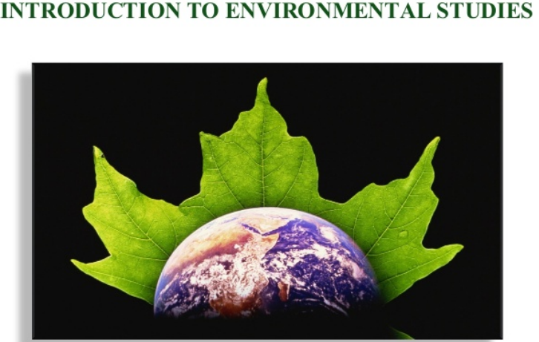
EVS LECTURE MODULE.1.1

Slide 2
EVS LECTURE MODULE.1.1
Definition, scope and importance

Slide 3
What is Environment
The Environment is the sum total of the elements , factors and conditions in the surroundings which may have an impact on the development, action or survival of an organism or group of organism, such as, human beings.
Or
It can also be defined as external surroundings and conditions which directly or indirectly affects the living organism.

Slide 4
Reasons to study
Clarifies modern environmental concepts
Equitable resources utilization
Sustainability
To change the way we view environment.
To create concern for environment

Slide 5
Environment
The physical and biotic habitat that surrounds us

Slide 6
Environmental Studies
The study of the environment, its living and nonliving components, and the interactions of these components
The discipline deals with the social, political, philosophical and ethical issues concerning man's interactions with the environment

Slide 7
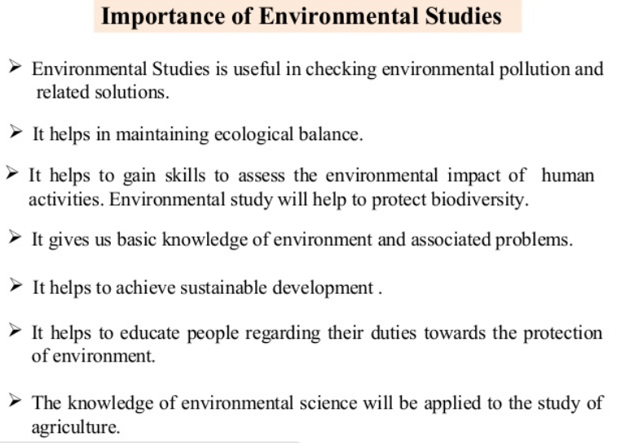

Slide 8
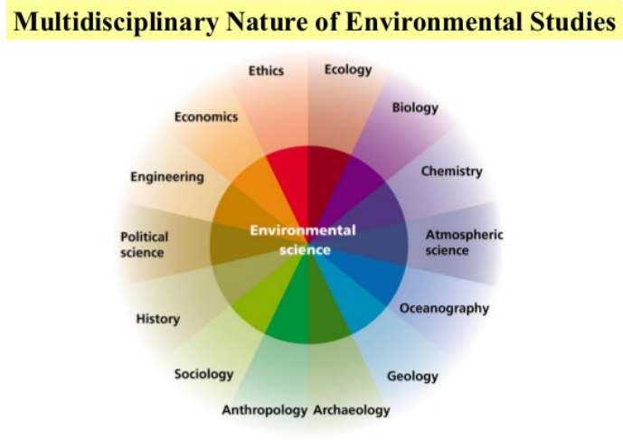
The multidisciplinary integration of sciences and engineering in order to utilize the huge biochemical potential of microorganisms, plants and parts thereof for the restoration and preservation of the environment and for the sustainable use of resources

Slide 9
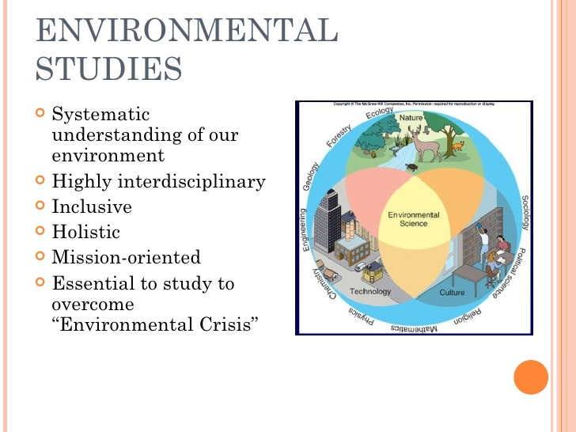

Slide 10
Why is the importance…?
“The earth provides enough to satisfy every persons need but not greed”-MG
The “Laws of nature” have not been repealed
Man and his power to alter the nature’s course have multiplied
We the human race is only one amongst millions of different kinds of organisms that share the planet with

Slide 11
Awareness is the Need of the hour….
Environmental Literacy
Arise consciousness
Environmentally appropriate
Ecological interdependence of economic, social and political factors with environment
Capacity building for
Analyze
Synthesis
Evaluate
Predict
Informed decision

Slide 12
Rights vs Responsibilities Conflict of development strategies with environmental protection
Many technological advances stem from the scientific study of life and to devise tools for creating and maintaining human civilization
Tools to create and maintain the quality of human civilization have become indispensable
Man being part of nature, it is all the more important to study the structure and function of nature

Slide 13
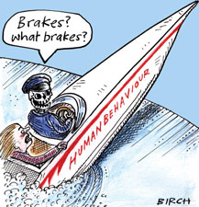
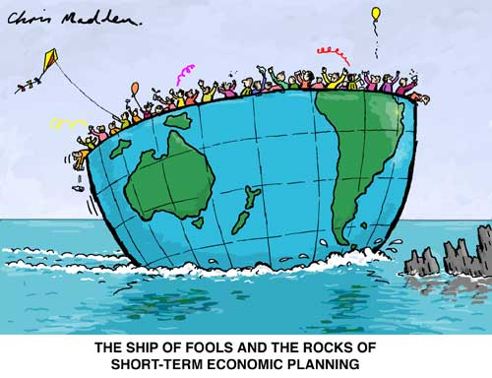
Environmental damage

Slide 14
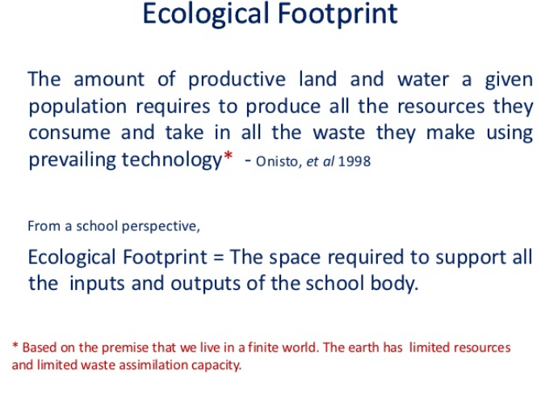

Slide 15
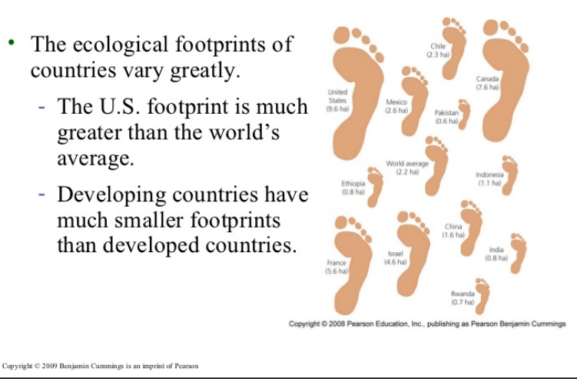

Slide 17
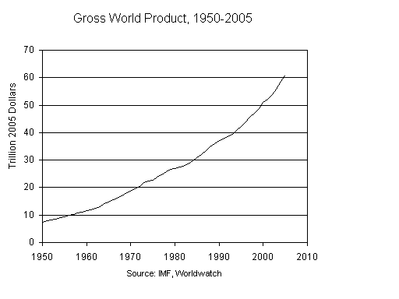
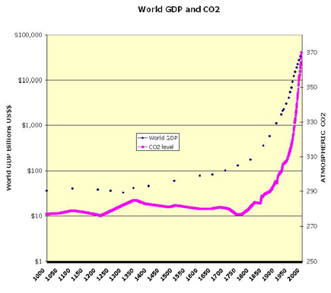
Economic Growth vs Environment

