Slide 1
Natural resources Module 2.4
Land and food

Slide 2
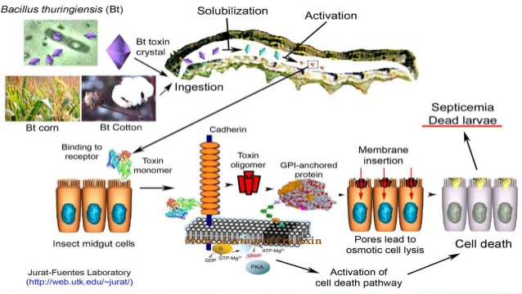
Bt- Brinjal
https://www.slideshare.net/manojsiddartha/bt-crops-ppt
Transgenic brinjal created by inserting a gene cry1AC from the soil bacterium Bacillus thuringiensis into Brinjal.
Induces the plant to produce its own Bt toxin
Bt toxin binds to mid gut surface, disrupts digestive processes and thus kills the insects

Slide 3
Benefits of GM crops
Tolerance / Resistant to:
Pests (less pesticides used)
Herbicides
Diseases
Cold
Drought
Salinity
Increases survival of crops → Higher crop yield
More crops can be grown in less arable land
Increased nutritional value

Slide 4
Controversies
Safety is a major issue in this controversy.
Might pose health risks to consumers though none of such cases have been documented.
Effects on ecosystems
Reducing the numbers of pest insects in farmland and impacting biodiversity
The risk and effects of horizontal gene transfer have also been cited as concerns, with the possibility that genes might spread from modified crops to wild relatives
Scientists and pressure groups such as Greenpeace and WWF insist that there is no guarantee.

Slide 5
Mining
The act of extracting ores
Types:
Metallic
Non-metallic
In exhaustible and Non renewable
Role of microbes
Biomining:
application of biotechnology in recovery of various minerals from ore
extraction of specific metals from their ores through biological means usually Bacteria, rather than the traditional methods of extreme heat or toxic chemicals, which have a deleterious effect on the environment.
Thiobacillus ferrooxidans

Slide 6
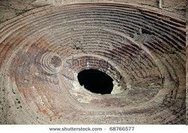
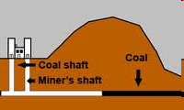
Mining & Concerns
Open-pit mining: a method of extracting rock or minerals from the earth by their removal from an open pit or borrow.
Deep Shaft mining: Deep Shaft Mining is two tunnels going deep underground, on tunnel for the miners to come up and down and the other for the coal to be lifted up to the ground
https://www.google.com/search?q=deep+shaft+mining&rlz=1C1CHBF_enIN805IN805&source=lnms&tbm=isch&sa=X&ved=2ahUKEwjRz6LKms_rAhWBe30KHZW1DSkQ_AUoAXoECBIQAw&biw=1920&bih=920#imgrc=4UFnm9u3p5j79M

Slide 7
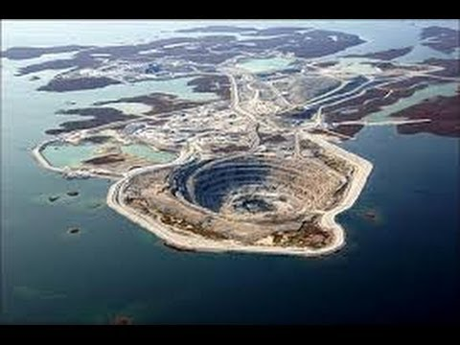
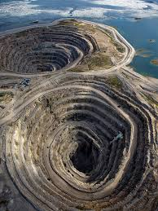
OPEN PIT mining
Advantages
Less expensive than underground mining.
Better ventilation (open-air).
New mines must follow much stricter environmental, safety and health guidelines
https://www.google.com/search?q=open+pit+mining&rlz=1C1CHBF_enIN805IN805&tbm=isch&source=iu&ictx=1&fir=zFWxowpBIG1W2M%252CBNfQNkv9smgsdM%252C%252Fm%252F01dlxy&vet=1&usg=AI4_-kTBB5Yu87KfjNmBA6T7HctrVEb_Ow&sa=X&ved=2ahUKEwiEg9T4m8_rAhWMaCsKHUt3BlAQ_B16BAgMEAM#imgrc=rGOWKzUo4PXulM
Mining Diamonds in the Canadian Arctic: Related images
Disadvantages
HUGE footprint
Enormous waste rock piles
Re mediation is extremely costly and time consuming. Groundwater restoration can be extremely costly.
Mine workers’ and nearby communities health can be compromised due to dust, noise and radon exposure
https://www.google.com/search?q=open+pit+mining&rlz=1C1CHBF_enIN805IN805&tbm=isch&source=iu&ictx=1&fir=zFWxowpBIG1W2M%252CBNfQNkv9smgsdM%252C%252Fm%252F01dlxy&vet=1&usg=AI4_-kTBB5Yu87KfjNmBA6T7HctrVEb_Ow&sa=X&ved=2ahUKEwiEg9T4m8_rAhWMaCsKHUt3BlAQ_B16BAgMEAM#imgrc=DJ37XH_OjHwFcM&imgdii=0UZILiPnGpmhFM

Slide 8
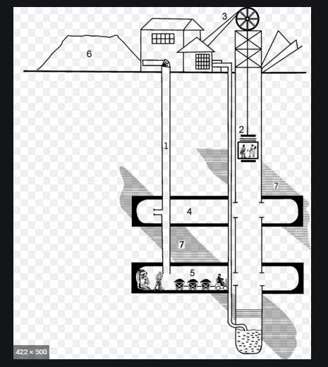
Deep Shaft mining
Advantages
Has a smaller surface footprint.
Less waste rock.
Advances in mining technology (better ventilation systems, possible robotic mining) and safety monitoring limits many of the radiation/health issues.
Disadvantages
Expensive.
Potential to seriously impact local aquifers and expensive to remediate.
In old underground mines, dust, radon and diesel fumes were a serious threat to miners’ health because of poor ventilation
https://www.google.com/search?q=deep+shaft+mining&rlz=1C1CHBF_enIN805IN805&source=lnms&tbm=isch&sa=X&ved=2ahUKEwjRz6LKms_rAhWBe30KHZW1DSkQ_AUoAXoECBIQAw&biw=1920&bih=920#imgrc=4UFnm9u3p5j79M&imgdii=FgbiEIsVlP_q_M

Slide 9
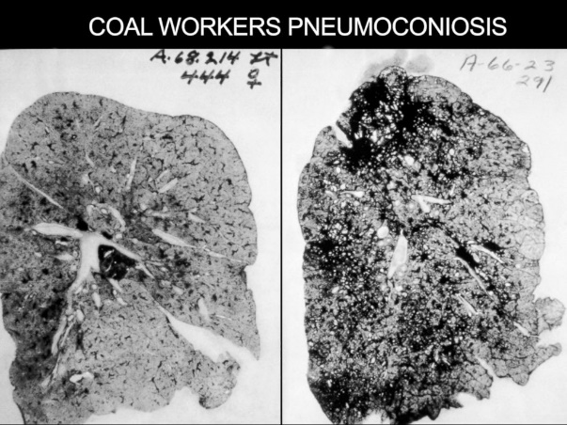
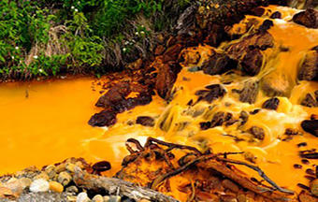
Environmental Impact of mining
Acid Mine drainage
Surface water or groundwater that is highly acidic due to oxidation of sulfide minerals at a mineral mine.
Erosion
Sedimentation
Acid rain
Dust storms
Appropriation of land belonging to locals
https://abcnews.go.com/Health/black-lung-basics-inside-miners-malady/story?id=20718855
Acid mine drain
https://www.usgs.gov/mission-areas/water-resources/science/mine-drainage?qt-science_center_objects=0#qt-science_center_objects

Slide 10
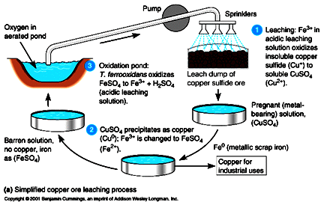

Slide 11
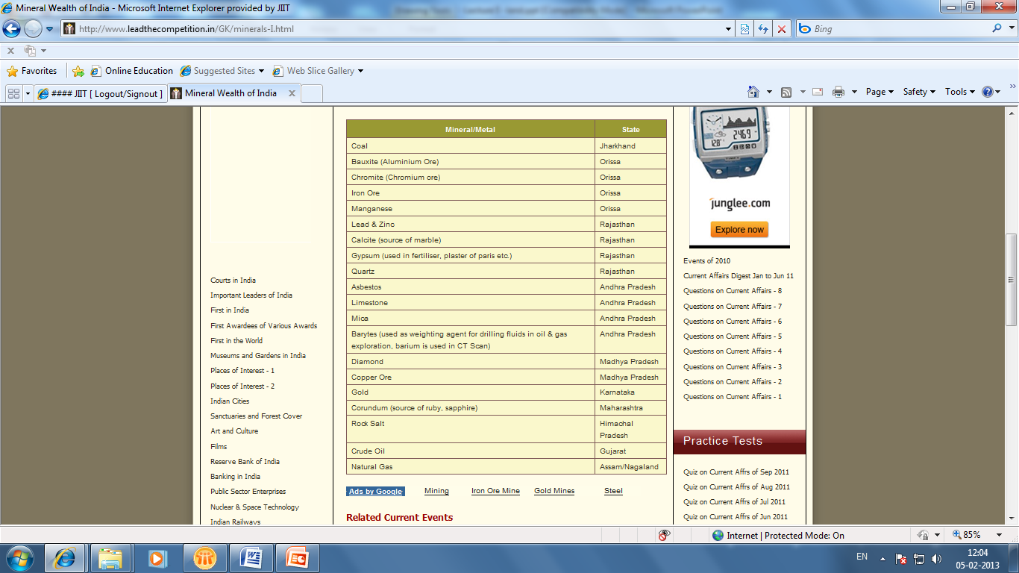
India’s Global position in Mineral wealth
India-
Chromite, Barytes – Second
Coal , Lignite, Bauxite – third
Iron, Steel – Fourth
Mica - Eleventh

Slide 12
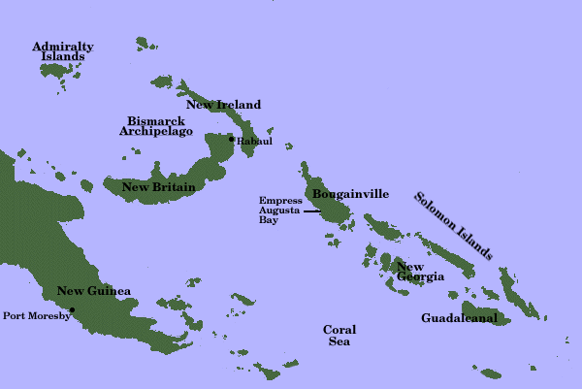
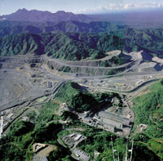

Bougainville copper mine - PANGUNA
Solomon islands
Compensation
Jaba river
Most serious conflicts of 1990’s

Slide 13
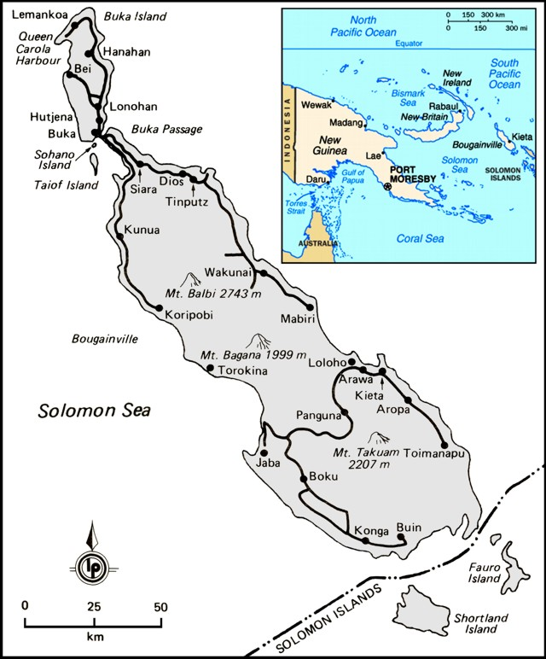
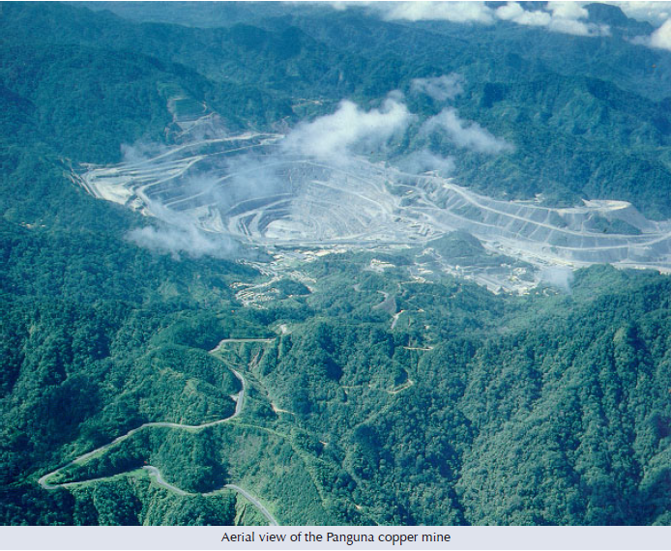
Bougainville copper mine – PANGUNA
Bougainville Copper Ltd - Australian copper, gold, and silver mining company
operates the Panguna open cut mine on the island of Bougainville in Papua New Guinea (PNG).
world's largest open-pit mines.
vitally important to the economy of Papua New Guinea,
Bougainvillean leaders alleged - mine had devastating environmental consequences for the island.
poisoning -Jaba River
birth defects,
extinction of the flying fox on the island.
mine closed in 1989 - of sabotage by the Bougainville Revolutionary Army and associated forces, which sought Bougainville's succession from PNG and an end to the mining on environmental grounds.
The mine nowadays remains closed

Slide 14
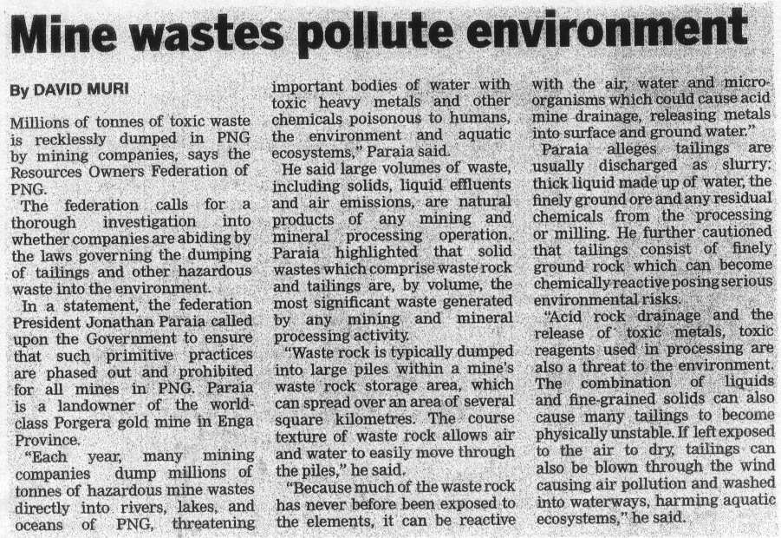

Slide 15
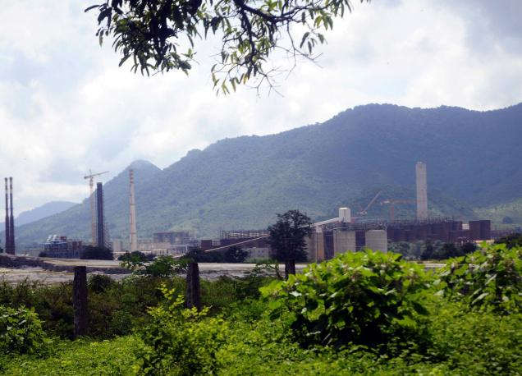
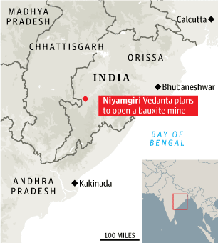
Environmental squabble forces Vedanta to look for new mines
The Odisha Mining Corporation Limited (OMC) and Sterlite Industries-
Indian arm of Vedanta,
proposed to mine bauxite from 660 hectares (ha) of forestland on Niyamgiri hills (Kalahandi district)for Vedanta’s alumina refinery in nearby Lanjigarh.
Vedanta Alumina set up one million tonne alumina refinery in the area,
Orissa State Pollution Control Board - people reported dust from the plant settling on clothes, crops and food.
environmental inspection –
water pollution
increasing the pH value of the river Vamshadhara
high level of SPM in the stack emissions.
Niyamagiri hills - thick forest area - housing many exquisite flora and fauna - danger to the ecology.

Slide 16
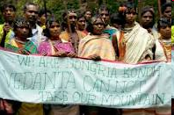
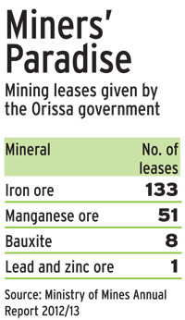
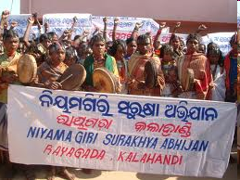
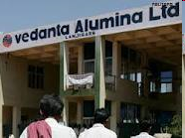
The Union Environment Ministry - August 2010 rejected earlier clearances granted to a joint venture
The government is planning - more transparent mining policy to
Avoid episodes such as the recent ban on mining at Niyamgiri in Orissa
Avoid hurt om expansion plans of companies located in such areas.

Slide 17
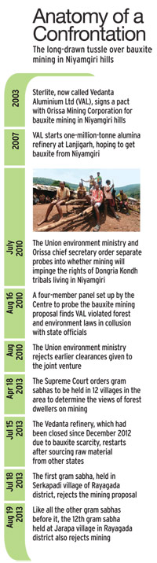
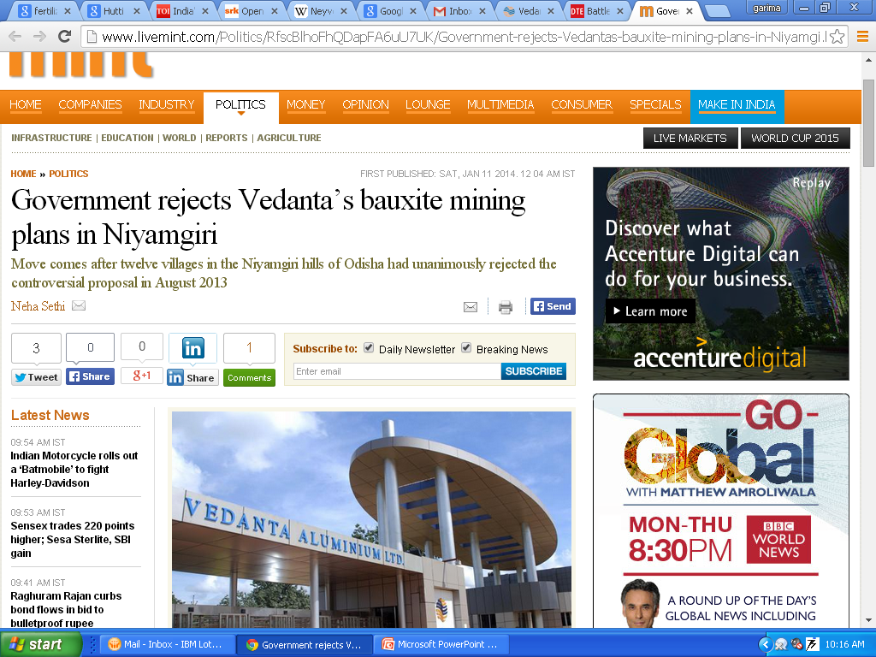
Government rejects Vedanta’s bauxite mining plans in Niyamgiri
Move comes after twelve villages in the Niyamgiri hills of Odisha had unanimously rejected the controversial proposal in August 2013
The MoEF has rejected the stage-II approval under the Forest (Conservation) Act, 1980. This prevents diversion of more than 660 hetares of forest land in the two districts of Odisha for mining.

Slide 18
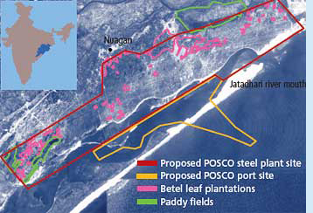
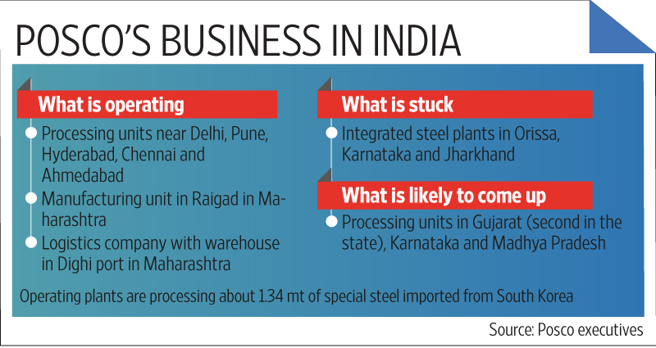
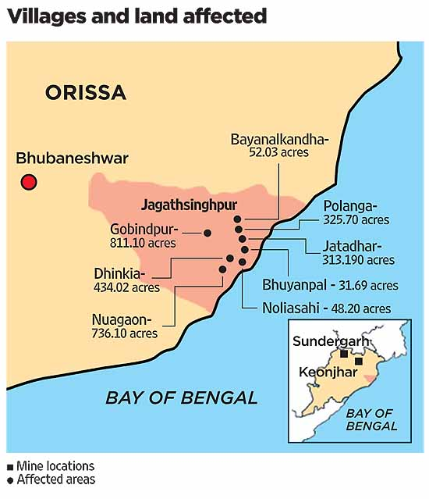

Slide 19
POSCO mines in Orrisa
POSCO - India Private Limited, a subsidiary of Pohang Steel Limited of South Korea, was expected to be the largest foreign investment project in India.
Pohang Steel Company or Posco, had planned to set up a 12 MT steel plant in Orissa’s Jagatsinghpur district entailing an investment of over Rs 52,000 crore.
2005- MoU between Ministry of Environment and Forest (MoEF) and POSCO -a final forest clearance to commence the construction, despite breach of laws in India and foreseeable damage to the forest.
First, the US12.1 billion steel project requires 4004 acres of land out of which 3,700 acres are forest land being cultivated by people who grow betel leaves since 1920. POSCO steel plant will kill about 1,800 betel farms, which provides Rs. 300,000-500,000 (approximately USD 6,000-10,000) annual income to 2,500 farmers.
The POSCO steel plant, to be completed in two phases by 2016, with a capacity of 12 million tones will require water supply from the Mahanandi River. This will heavily affect the current water supply for domestic use and irrigation in the city and farm lands of Cuttack, Puri and Jagatsinghpur districts of Orissa.
The Khandadhar hills, where the iron mines allotted to POSCO spreads over 6000 hectares, are covered with forests and inhabited by a wide variety of wildlife. The iron mining will affect 10,000 hectares of forest and displace more than 50 tribal villages in Lahunipada block in Sundargarh district. In August 2011, 600,000 trees were chopped down. These well-known “cyclone savers” protected villagers from a cyclone in 1999.
Moreover, the construction of a captive port will disturb the water flow in the Jatadhar River, resulting in water-logging, while the expected contamination of the port will affect livelihood of approximately 30,000 fishermen. The port proposed to be established on the banks of Bay of Bengal would violate the Costal Regulation Zone and threaten the nesting habitat of the endangered Olive Ridley turtles.

Slide 20
Timeline
05 June MoU signing between POSCO and Govt of Odisha
’07 July Environmental Clearance for setting up the steel plant
’08 August Supreme Court’s approval for Forest diversion of plant site
’09 January State Govt.’s recommendation of PL for Khandadhar Mines to Centre
’10 May Land evacuation and Removal of betel vines started
’10 July Odisha Govt lost the case of mines recommendation at Odisha HC
’10 August MoEF stopped land evacuation work by Odisha Govt
’11 January MoEF’s conditional approval after the Meena Gupta Committee report
’11 May MoEF’s final approval for “Forest conversion”
’11 September Odisha High Court ordered Status Quo on Private land acquisition
’12 March NGT suspended additional conditions of Jan ’11 on the ECs but kept the ECs intact
As of June 2012, controversies and regulatory delays have prevented Posco India's Odisha project to proceed beyond the concept. Posco India has no mining or manufacturing operations in Odisha
’13 February Odisha Govt. resumed Land evacuation of Govt land (later stopped in July ‘13)
’13 May Final Verdict on PL case by Hon’ble Supreme Court in favor of Odisha Govt and POSCO (Central Govt’s Approval in-progress now)
Apr 7, 2014- Orissa unable to finalise mining area for Posco steel plant, more delays expected
Mar-July 2015- Report Suggest POSCO may walk out

Slide 21
Solutions for sustainability
Usage economy
Long life of finished goods
Re-use & re-cycle
Efficient recovery methods
Alternates/substitutes

Slide 22
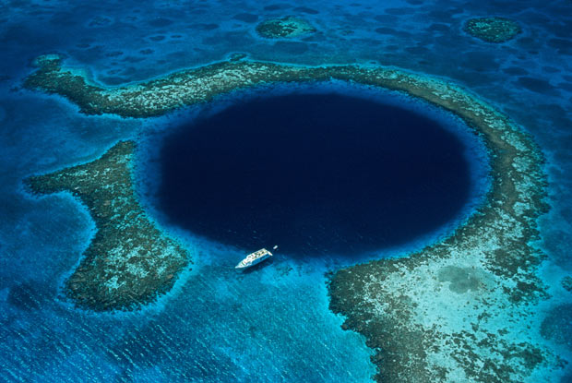
The largest underwater sinkhole is The Great Blue Hole, popular diving site, at Lighthouse Reef, Belize, in the Caribbean. 300 metres (984 ft) across and 125 metres (410 ft) deep, formed due to limestone cave's roof collapsed
The Great Blue Hole
https://www.businessinsider.com/richard-branson-dives-into-sinkhole-to-prove-effects-of-climate-change-2018-12?IR=T

Slide 23
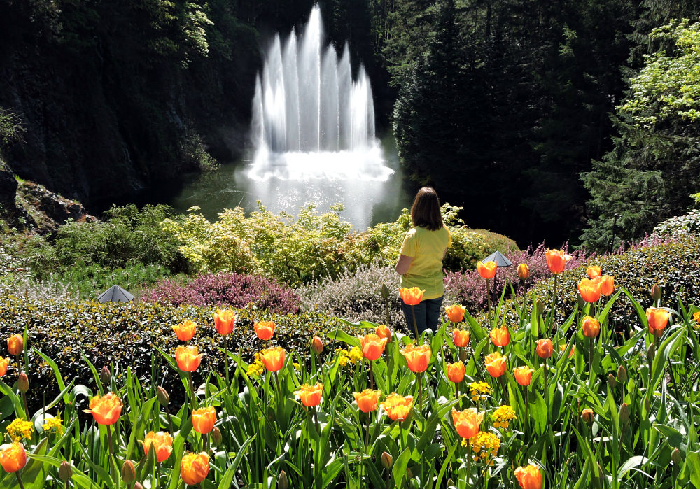
Butchart Gardens
Reclaimed from a quarry
Butchart Gardens on Vancouver Island, Canada
Mined for limestone - Portland Cement Company
Reclamation efforts:
Filled the quarry with topsoil
The fifty-acre “Sunken Garden” transformed into a Japanese Garden, Italian Garden, and Rose Garden.
Now serves as the premier garden on the West Coast, admitting over one million visitors a year
http://www.travelingislanders.com/world-renowned-butchart-gardens-on-vancouver-island/
Watch video: https://youtu.be/J55mVCe_gy4

Slide 24
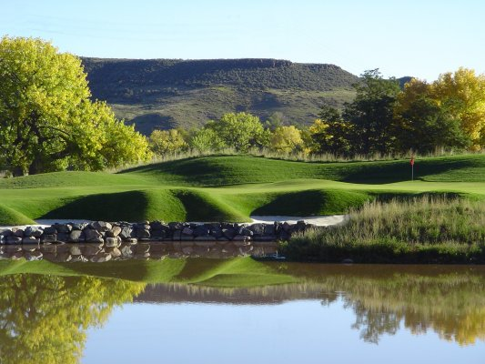
at the Fossil Trace Golf Club - Colorado
The Perfect Clay Pits in Colorado - large amounts of clay in the 1900's.
During mining, many fossils emerged from the walls of the pit.
Lagoons also appeared, created when mining pits filled with water.
landscape of the pit created a perfect setting for a golf course.
The lagoons - water holes,
the fossil walls - landscape that only exists at the Fossil Trace Golf Club,
topography creates - challenging course layout.

