Slide 1

Subject Name- Environmental Studies (19B13BT211-ODD Semester, Course Introduction)

Slide 2
At the end of this course students are able to learn about
 | COURSE OUTCOMES | COGNITIVE LEVELS
CO205.1 | Explain diversity of environment, ecosystem resources and conservation . | Understand Level (C2)
CO205.2 | Identify various pollution related hazard and their safe management | Apply Level(C3)
CO205.3 | Apply modern techniques for sustainable Urban planning and Disaster management | Apply Level(C3)
CO205.4 | Recall Government regulations, Environmental Policies, Laws & ethics | Understand Level (C2)
CO205.5 | Survey ground situation on specific environmental aspects, examine risks involved, make a field report and present the findings | Analyzing Level(C4)

Slide 3
PO,PSO
COs | PO 1 | PO 2 | PO 3 | PO 4 | PO 5 | PO 6 | PO 7 | PO 8 | PO 9 | PO 10 | PO 11 | PO 12 | PSO1 | PSO2 | PSO3
CO205.1 | 2 | 1 |  |  |  | 1 |  |  |  |  |  | 2 | 1
CO205.2 | 2 | 2 | 1 |  | 1 | 2 | 1 | 1 |  |  |  | 2 | 2 | 2 | 1
CO205.3 | 2 | 2 | 3 | 1 | 1 | 2 | 3 | 1 |  |  |  | 2 | 2 | 2 | 1
CO205.4 |  | 2 |  |  |  |  | 2 | 2 |  |  |  | 2 | 2 |  | 1
CO205.5 | 1 | 1 | 1 | 1 |  | 1 | 2 | 1 | 2 | 2 |  |  | 1 | 1

Slide 4
Detail Syllabus of Environment Studies
Module No. | Subtitle of the Module
1. | The Multidisciplinary nature of environment, Biodiversity | Definition, scope and importance, Need for public awareness, Types of Ecosystems, World Biomes, Ecosystem functioning, Diversity of flora and fauna, species and wild life diversity, Biodiversity hotspots, threats to biodiversity, Case studies.
2. | Natural resources, Energy consumption & conservation | Water, Land, Energy (Renewable, non-renewable, wind, solar, hydro, Biomass), Mineral, Forest, & Food resources, Global Conventions on Energy, Kyoto protocol, Case studies.
3. | Pollution, hazardous waste management | Air, Water & Land, chemical, noise pollution, sources & causes, effects, Electronic waste, nuclear hazards, Case studies.

Slide 5
4. | Urban planning, human communities, Disaster management | Sustainable building, Disaster Management and Contingency Planning, human population, resettlement, rehabilitation environmental movements, environmental ethics, Critical issues concerning Global environment Urbanization, population growth, global warming, climate change, acid rain, ozone depletion etc Case studies.
5. | Environmental Policies, Laws, Regulations & ethics | Regulation of technology and innovation, Policy and laws, Different Acts such as: Environmental Protection Act, Air and Water Acts, Wildlife and Forest Acts), US-EPA, National Environmental Policy; Function of pollution control boards (SPCB and CPCB), their roles and responsibilities, Case studies.

Slide 6
6. | Field Work | Explore the current environment related occurrences at national and international level, Study of successful sustainable measures, a know-how of industries in local region and their possible effects, measure of water, air and land quality, Visit to a local polluted site-Urban/Rural /Industrial / Agricultural, Study of simple ecosystems.

Slide 7
Recommended Reading material:
1. | Chiras D D.(Ed.). 2001. Environmental Science – Creating a sustainable future. 6th ed. Jones & Barlett Publishers.
2. | Joseph, B., 2005, Environmental Studies, Tata McGraw Hill, India
3. | Textbook of Environmental Studies for UG Courses - Erach Bharucha, University Press
4. | Issues of the Journal: Down to Earth, published by Centre for Science and Environment

Slide 8
Evaluation Scheme:
Mid Semester Examination - 30 marks (To be held along with T-2 Exam)
End Semester Examination - 40 marks
Teachers Assessment (TA) - 30 marks
Field Work (20)
Assignments (10)

Slide 9
Mid Semester Examination Course (30):
EVS Audit Module 1.1
EVS Audit Module 1.2
EVS Audit Module 1.3
EVS Audit Module 2.1
EVS Audit Module 2.2
End Semester Examination Course (40):
EVS Audit Module 2.3
EVS Audit Module 3.1
EVS Audit Module 3.2
EVS Audit Module 3.3
EVS Audit Module 4.1

Slide 10
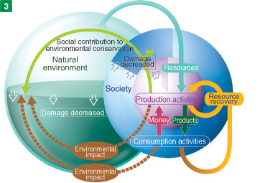
Course objective
Awaken Eco - ‘logical’ sense and trigger pro environmental approach in action, incorporating simple solutions in day to day developments

Slide 11
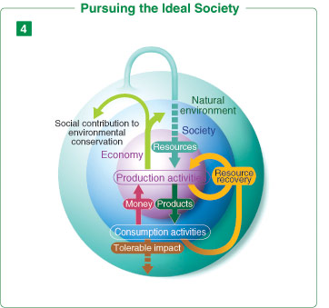
The ideal scenario

