Slide 1

ECONOMICS
15B11HS211
B.Tech
Second Semester
2018

Slide 2
Title: Economics
Course Code: 15B11HS211 (2 – 1 – 0)
Objective
The course is designed to enable students to understand the concepts of economics and to appreciate the application of these concepts in the real world. It allows them to evaluate economics of business objectives, market structure, business forecasting, costs and make effective economic decisions. The course also aims to make the students understand the basic macro-economic concepts.
Learning Outcomes
Studying Economics will enable students to understand:
How demand, supply and their elasticities interact in the market and determine price and quantity of a good.
The links between production, cost, profit and break even analysis.
The major characteristics of different market structures and the implications for the behavior of the firm.
The basics of national income accounting.
The causes and consequences of business cycles
The roles of fiscal and monetary policy in fighting recessions and inflation

Slide 3
Methodology
The course will commence with making the students understand the basic economic theories and subsequently learn about practices followed by the organizations. The tutorials focus on the core topics, articles on these topics and make use of IT tools.
Books
Text Book
Managerial Economics, (Fourth edition) H.Craig Petersen, W. Cris Lewis
Reference books
Managerial economics in a global economy, Dominick Salvatore
Managerial economics, Damodaran, Suma
Managerial economics, Dwivedi, D.N.
Managerial economics, H.L.Ahuja
Managerial economics, Truett Lila J.
Managerial economics, Hirschey, Mark
Modern Economic Theory, K.K.Dewitt & Navalkur
S.K. Misra & V. K. Puri, Indian Economy, Himalaya Publishing House, 2011.

Slide 4
Course Content
1. | Introduction
2 | Basics of Demand, Supply and Equilibrium
3 | Theory of Consumer Choice
4 | Demand forecasting
5 | Production theory and analysis
6 | Cost Theory and Analysis
7 | Market Structure
8 | National Income Accounting
9 | Macro Economics Issues

Slide 5
Evaluation Scheme
Exam | % of Marks | Duration | Coverage
T-1 | 20 | 1 hr | Syllabi covered up-to T-1.
T-2 | 20 | 1hr | Syllabi covered between T-1 & T-2.
End Sem. Exam | 35 | 2 hr | Full Syllabi
Assignments Tutorials, Projects, Quizzes & Regularity in attendance. | 25 | Entire Semester | As decided and announced by the teacher concerned in the class at the beginning of the course

Slide 6
Economics
Economy – A system that provides living to the people.
Economic activity – any activity performed for earning money for the satisfaction of human wants.
Economics is the social science that seeks to describe the factors which determine the production, distribution and consumption of goods and services.

Slide 7
Economics
A social science concerned with those aspects of social behavior and those institutions which involve the allocation of scarce resources among unlimited and competing uses, to produce and distribute goods and services in the satisfaction of human wants, which are innumerable and insatiable.
Scarce Resources
Unlimited Wants
Alternative uses of resources
Produce & distribute goods & services

Slide 8
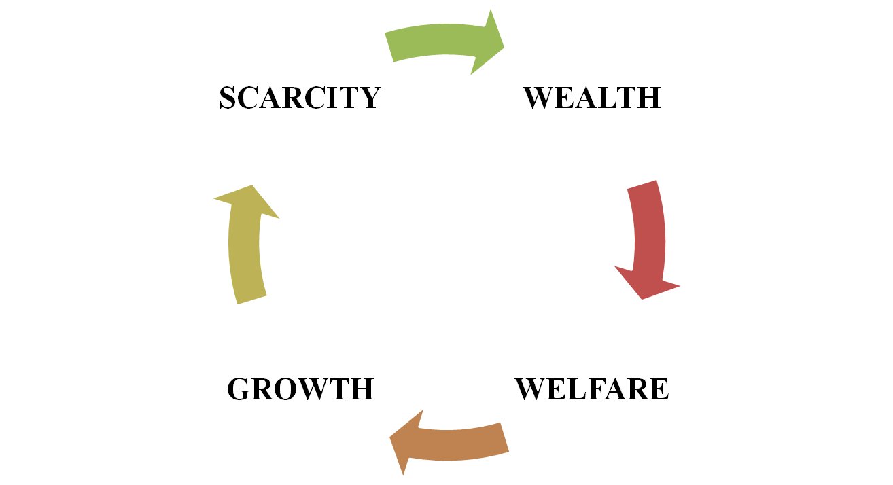
Origin and Scope of Economics

Slide 9
Wealth Definition by Adam Smith
  a science which studies the nature, causes and growth of the wealth of nations
  Adam Smith – Father of economics
Criticism
  No attention was paid to man for whom wealth is really meant.

Slide 10
Welfare Definition by Alfred Marshall
  study of mankind in the ordinary business of life; it examines that part of individual and social action which is most closely connected with the use of the material requisites of well being. Thus it is, on the one side, a study of wealth; and on the other, and more important side the study of man.
Criticism
  Non-material goods are not acknowledged by Marshall.
  Limited to those activities which increase human welfare.

Slide 11
Scarcity Definition by Lionel Robbins
  is the science which studies human behavior as a relationship between ends and scarce means which have alternative uses.
Four characteristics
  Man has unlimited wants or ends.
  The means or resources to satisfy them are limited.
  These resources are not specific & have alternate uses.
  Man has therefore to choose between wants.
Criticism
  Aggregates of the entire economy (national income, total output etc.) and the problem of unemployment and instability are not covered
  The causes and growth patterns of national income and per capita income are left untouched.

Slide 12
Growth Definition by Paul A. Samuelson
  is a study of how man and society choose, with or without the use of money, to employ scarce productive resources which could have alternate uses, to produce various commodities over time and distribute them for consumption now and the future among various people and groups of society.

Slide 13
Concerns & Significance of Modern Economics
  Allocation of society’s resources among alternative uses
  Efficiencies and inefficiencies of economic system
  Distribution of the society’s output among individuals and groups
  Ways in which production and distribution change over time
  Very useful for Consumers, Producers, Administrators, Planners and Academicians

Slide 14
Micro Economics
Micro Economics studies individual units like individual household, pricing of a firm, wages of a worker, profits of an entrepreneur, and so on.
It helps us understand the micro economics issues like:
  choices: what, how and for whom
  the concept of opportunity cost
  rational economic decision making: marginal costs and marginal benefits
  microeconomic objectives of efficiency & equity
  Covers : Theory of Demand, Theory of Production, Price determination in Commodity market and Price determination in Factor market.

Slide 15
Macro Economics
Macro Economics deals with the average and aggregates of the system rather than the particular items in it, and attempts to define these aggregates in a useful manner and examines their relationship.
  Theory of National Income: GDP/GNP/NDP
  Theory of Employment: Unemployment, its types and rate
  Theory of Money: Commodity money (barter), modern money (paper), banking and insurance, interest rates.
  Theory of General Price Level: Wholesale Price index, consumer price index
  Theory of International Trade: Balance of payment, foreign exchange rate and purchasing power parity theory
  Economics of Growth: Four factors – human resource, natural resource, capital formation and technological changes and innovation
  Macroeconomic issues: growth, unemployment, inflation, balance of payments problems, cyclical fluctuations

Slide 16
Examples of microeconomic and macroeconomic concerns
 | Production | Prices | Income | Employment
Micro Economics | Production/Output in Individual Industries and Businesses How much steel How many offices How many cars | Price of Individual Goods and Services Price of medical care Price of gasoline Food prices Apartment rents | Distribution of Income and Wealth Wages in the auto industry Minimum wages Executive salaries Poverty | Employment by Individual Businesses & Industries Jobs in the steel industry Number of employees in a firm
Macro Economics | National Production/Output Total Industrial Output Gross Domestic Product Growth of Output | Aggregate Price Level Consumer price index Producer Price index Rate of Inflation | National Income Total wages and salaries Total corporate profits | Employment and Unemployment in the Economy Total number of jobs Unemployment rate

Slide 17
Production Possibility Curve
Illustrates the principles of constrained choice, opportunity cost and scarcity.
A graph that shows all the combinations of goods and services that can be produced if all of society’s resources are used efficiently

Slide 18

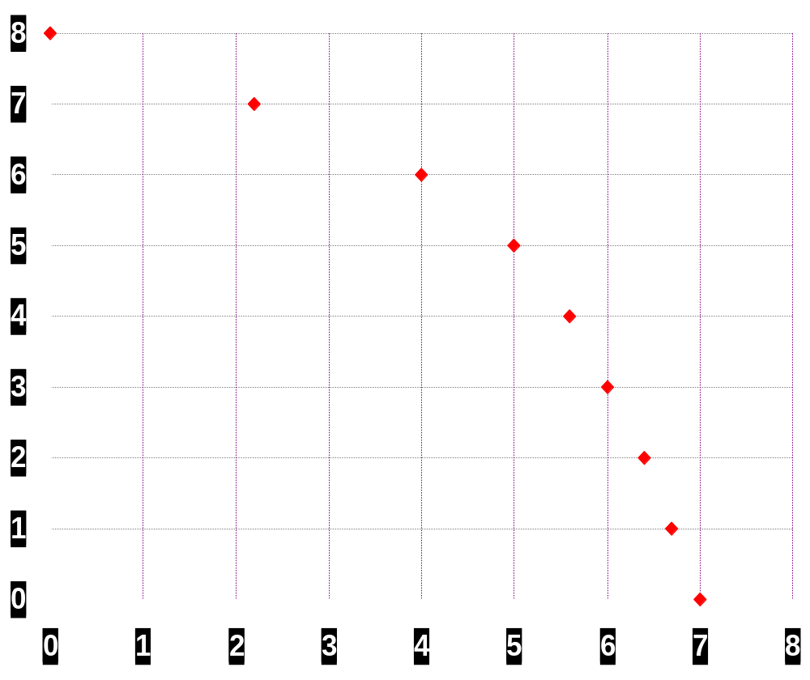

A production possibility curve
a
Units of food Units of clothing
a 8m 0.0
7m 2.2m
6m 4.0m
5m 5.0m
4m 5.6m
3m 6.0m
2m 6.4m
1m 6.7m
0 7.0m
Units of food (millions)
Units of clothing (millions)

Slide 19
A production possibility curve
x
Units of food (millions)
Units of clothing (millions)

Slide 20
A production possibility curve
w
x
Units of food (millions)
Units of clothing (millions)

Slide 21
Making a fuller use of resources
Production inside
the production
possibility curve
Food
v
O
Clothing

Slide 22
Making a fuller use of resources
x
y
Food
v
O
Clothing

Slide 23
Growth in potential output
Food
Now
O
Clothing

Slide 24
Growth in potential output
5 years’ time
Food
Now
O
Clothing

Slide 25
CIRCULAR FLOW OF ECONOMIC ACTIVITY
Households
  The consuming units in an economy
Firms
  The producing units in an economy
Product or Output markets
  The market in which goods and services are exchanged
Input or Factor markets
  The markets in which the resources used to produce products are exchanged
  Labor market
  Capital market
  Land market

Slide 26
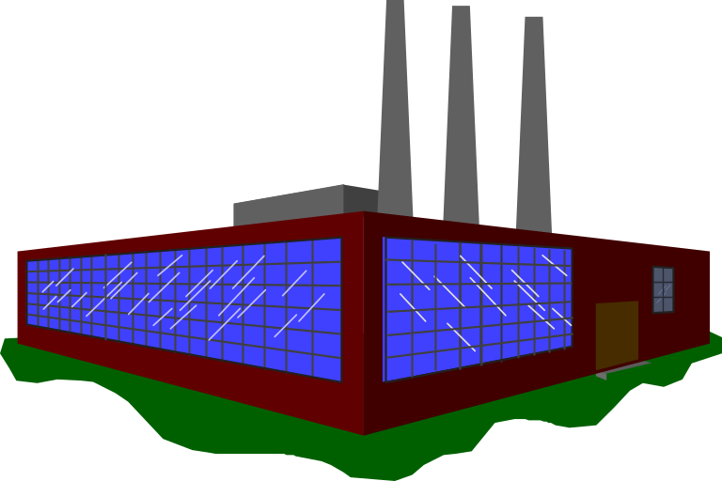

The circular flow of goods and incomes

Slide 27
The circular flow of goods and incomes
Goods and services

Slide 28
Goods and services
Consumer
expenditure

Slide 29
Goods and services
Consumer
expenditure
Wages, rent
dividends, etc.
Services of factors of production (labour, etc)

Slide 30
The circular flow of goods and incomes
Goods and services
Consumer
expenditure
GOODS MARKETS
FACTOR MARKETS
Wages, rent
dividends, etc.
Services of factors of production (labour, etc)

Slide 31
NATURE AND FUNCTION OF PROFIT
Difference between the revenues earned from the sale of goods and services and the costs incurred in earning these revenues
Profit = Revenues – Costs

Slide 32
Revenues, Costs, Profit
Revenue is the income earned by a firm through its normal course of business
Costs –
  Explicit costs are the actual out of pocket expenditures of the firm to purchase/ hire the inputs it requires in production
  Implicit costs refer to the value of the inputs owned and used by the firm in its own production processes
Accounting/Business Profit: Total revenue minus the explicit or accounting costs of production.
Economic Profit: Total revenue minus the explicit and implicit costs of production.

Slide 33
Example:
A graduate turns down a job offer at Rs. 60,000 per year to start his own venture. He is considering investing Rs. 200000 of his own money, which has been in a bank account earning 5% per year. The projected income statement for the year as prepared by an accountant is:
Income statement prepared by an accountant:
(in Rs)
Sales 90,000
Less cost of goods sold 40,000
Gross Profit 50,000
Less: Advertising 10,000
Depreciation 10,000
Utilities 3,000
Property Tax 2,000
Misc. expenses 5,000 30,000
Net accounting profit 20,000

Slide 34

Implicit costs
Rs.200000 invested in business can earn interest in the bank account @ 5% per year
Annual wage of a graduate being Rs.60000 per year

Slide 35
Why should engineers study economics?
Engineering is a great applied science that studies how to make solutions to practical scientific problems.
  While engineering deals with how to solve these problems, economics is the complementary science of how to optimize these solutions.
  Economics analyses production mathematically and statistically. For engineering, microeconomics is the invaluable tool to determine optimization with given resource constraints
  The best solutions in engineering are not always the best-designed or the ones of highest quality but also the ones which are cost-effective and efficient given constraints. Economics can master these concepts.

