Slide 1
Natural resources Module 2.2
Land & Food

Slide 2
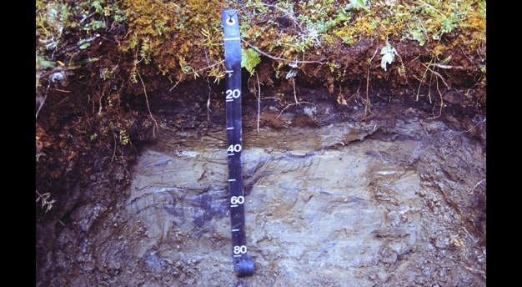
Soil
Dynamic and diverse natural systems that lie at the interface between earth, air, water, and life.
They are critical ecosystem service providers for the sustenance of humanity.
https://www.nature.com/scitable/knowledge/library/what-are-soils-67647639/

Slide 3
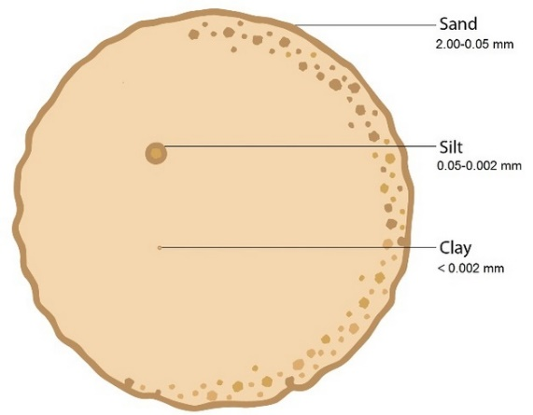
Composition of soil
Composed of five ingredients
minerals,
soil organic matter,
living organisms,
gas,
water
Soil minerals— clay, silt, and sand
Soil organic matter is plant, animal, and microbial residues in various states of decomposition; -critical ingredient
https://www.nature.com/scitable/knowledge/library/what-are-soils-67647639/

Slide 4
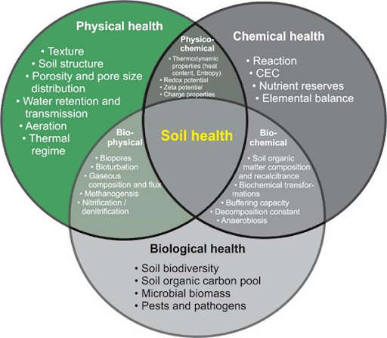
Soil health
http://www.fertilizer.co.za/knowledge-centre/sustainability/263-soil-health-looking-beyond-soil-fertility

Slide 5
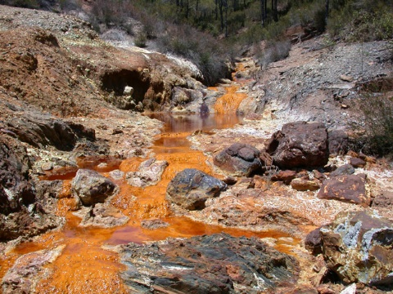
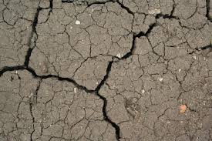
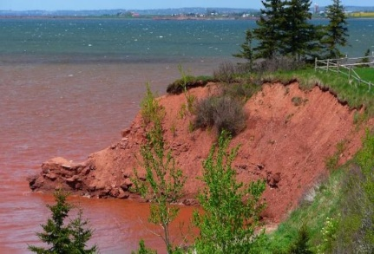
Land / Soil degradation
Mismatch: land quality vs. land use
Mechanisms
Physical
Crusting, erosion, desertification, anaerobism, pollution
Chemical
Acidification , leaching, decreased cation retention capacity, fertility decline
Biological
Biomass
Biodiversity decline
https://www.google.com/search?q=Soil+degradation+acid&tbm=isch&ved=2ahUKEwj6wKnV4s7rAhXZhUsFHYKEBf8Q2-cCegQIABAA&oq=Soil+degradation+acid&gs_lcp=CgNpbWcQAzoCCAA6BAgAEEM6BAgAEBhQi98FWP3qBWC-7gVoAHAAeACAAaUBiAHvBZIBAzAuNZgBAKABAaoBC2d3cy13aXotaW1nwAEB&sclient=img&ei=9NBRX_r2LNmLrtoPgomW-A8&bih=920&biw=1920&rlz=1C1CHBF_enIN805IN805#imgrc=g65CuEC5ixoLtM
https://www.google.com/search?q=Soil+erosion&rlz=1C1CHBF_enIN805IN805&stick=H4sIAAAAAAAAAONgecS4mJFb4OWPe8JSMxknrTl5jXESIxdXcEZ-uWteSWZJpZAWFxuUpcDFL8Wtn65vaGRUYWGalKLBIMXLhSygFGHks-vStHNsboIMQFD1NMBBSlNLiIvds9gnPzkxR_DA___7__9_b68lzMURkliRn5efWwlWysDwwV6JjxNIN6yXaLC3BYloMTTtW3GIjYWDUYCBZxErT3B-Zo5CalF-cWZ-HgCjiAEsuAAAAA&source=lnms&tbm=isch&sa=X&ved=2ahUKEwiB44qQ4s7rAhVXcCsKHR3rDOUQ_AUoAXoECBMQAw&biw=1920&bih=920#imgrc=ctmp88wMyIDepM
https://www.google.com/search?q=Soil+erosion&rlz=1C1CHBF_enIN805IN805&stick=H4sIAAAAAAAAAONgecS4mJFb4OWPe8JSMxknrTl5jXESIxdXcEZ-uWteSWZJpZAWFxuUpcDFL8Wtn65vaGRUYWGalKLBIMXLhSygFGHks-vStHNsboIMQFD1NMBBSlNLiIvds9gnPzkxR_DA___7__9_b68lzMURkliRn5efWwlWysDwwV6JjxNIN6yXaLC3BYloMTTtW3GIjYWDUYCBZxErT3B-Zo5CalF-cWZ-HgCjiAEsuAAAAA&source=lnms&tbm=isch&sa=X&ved=2ahUKEwiB44qQ4s7rAhVXcCsKHR3rDOUQ_AUoAXoECBMQAw&biw=1920&bih=920#imgrc=IOm4vclWVqsGqM

Slide 6
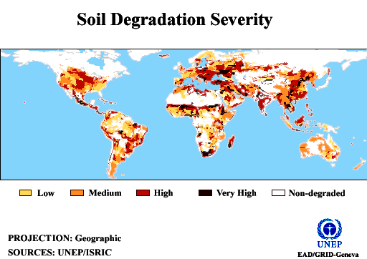

Slide 7
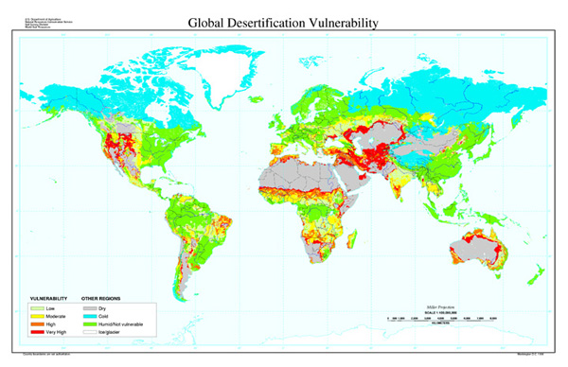

Slide 8
Forests
Intercepts rain water
Filters toxins
Wealth of biodiversity
Moderate air temperature
Carbon sequestration: Capture carbon from atmosphere
Check Erosion
Ecotourism

Slide 9
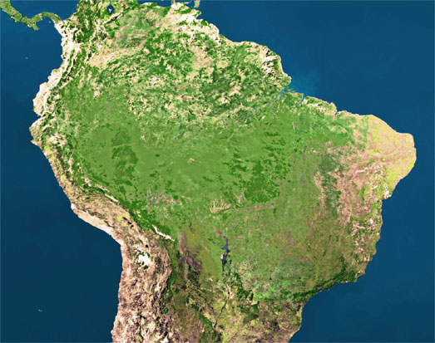
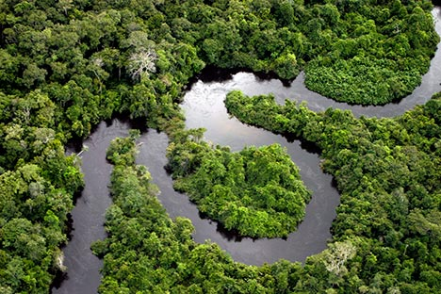
Deforestation
Grand Carajas Project- Development of Amazon basin
Causes – Case study
Economy tight spots
Rain forests: 4,26,372 sp.
587,000 km² – lost in less than one decade (>30%)
Carbon sequestration - 1.1 × 10¹¹ metric tonnes of carbon
Brazil
Development of Amazon basin - Grand Carajas project

Slide 10
Grand Carajas Project- Development of Amazon basin
Initiated by Brazilian Govt, located in northern Brazil
Covers an area of 90,000 square kms
The Grand Carajas is the largest iron ore mine in the world (66% of iron)
Main purpose : Huge milling development to provide cheap raw material to world
Main type of mining is the iron ore
Extensive deforestation, affecting 23 tribal groups, soil erosion and water pollution

Slide 11
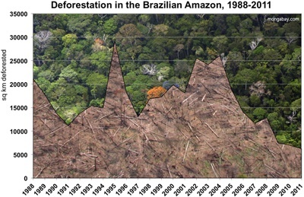

Slide 12
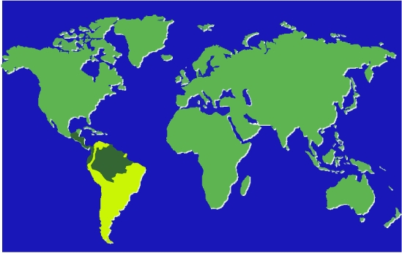
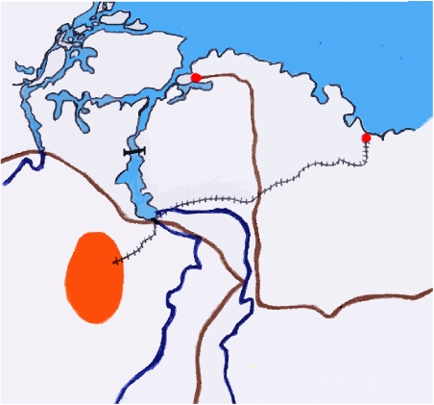
Carajas Project
Belem
Sao Luis
Tucurui
rail link
iron ore, copper, manganese, nickel, bauxite, gold, tin, lead, zinc
Carajas
TransAmazonian Highway
0
100km

Slide 13
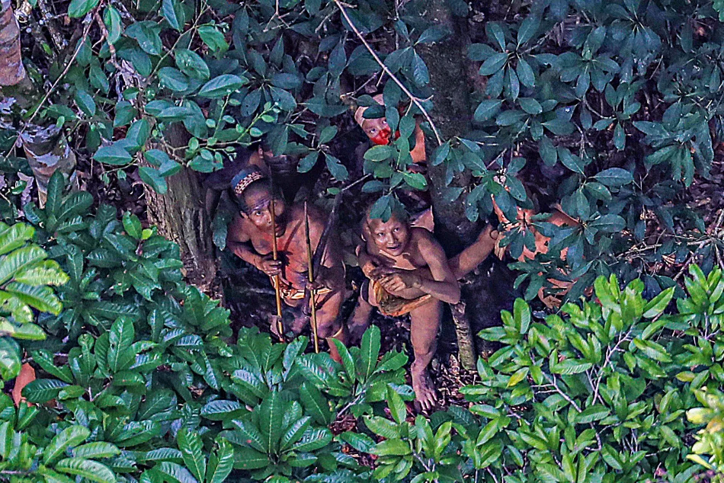
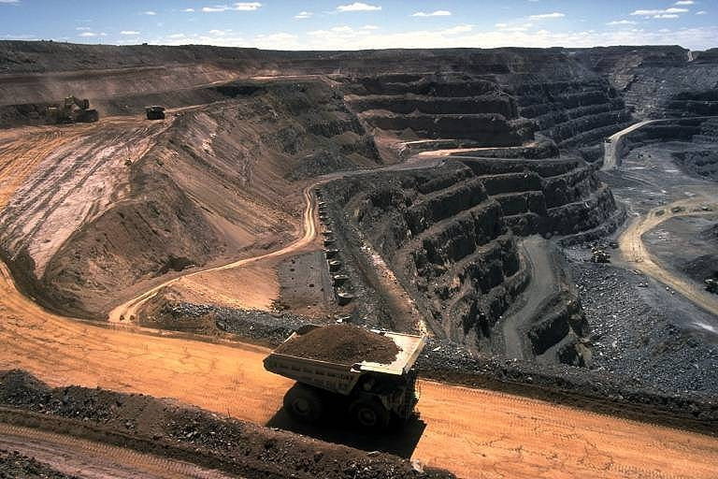
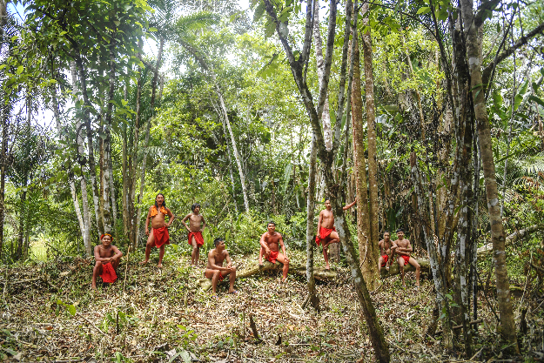
https://www.google.com/search?q=+amazon+forest+mines&tbm=isch&ved=2ahUKEwjVsN6Lhs_rAhVLgEsFHcEKAxgQ2-cCegQIABAA&oq=+amazon+forest+mines&gs_lcp=CgNpbWcQDFDe6wJY3usCYJX4AmgAcAB4AIABrwGIAa8BkgEDMC4xmAEAoAEBqgELZ3dzLXdpei1pbWfAAQE&sclient=img&ei=GvZRX9W7BcuArtoPwZWMwAE&bih=969&biw=1920&rlz=1C1CHBF_enIN805IN805#imgrc=8ebKdZTMDf2joM
https://www.google.com/search?q=+amazon+forest+mines&tbm=isch&ved=2ahUKEwjVsN6Lhs_rAhVLgEsFHcEKAxgQ2-cCegQIABAA&oq=+amazon+forest+mines&gs_lcp=CgNpbWcQDFDe6wJY3usCYJX4AmgAcAB4AIABrwGIAa8BkgEDMC4xmAEAoAEBqgELZ3dzLXdpei1pbWfAAQE&sclient=img&ei=GvZRX9W7BcuArtoPwZWMwAE&bih=969&biw=1920&rlz=1C1CHBF_enIN805IN805#imgrc=o5joiqmRjRxunM&imgdii=DOqb3_Vao13AMM
https://www.google.com/search?q=+amazon+forest+mines&tbm=isch&ved=2ahUKEwjVsN6Lhs_rAhVLgEsFHcEKAxgQ2-cCegQIABAA&oq=+amazon+forest+mines&gs_lcp=CgNpbWcQDFDe6wJY3usCYJX4AmgAcAB4AIABrwGIAa8BkgEDMC4xmAEAoAEBqgELZ3dzLXdpei1pbWfAAQE&sclient=img&ei=GvZRX9W7BcuArtoPwZWMwAE&bih=969&biw=1920&rlz=1C1CHBF_enIN805IN805#imgrc=ueTcRxB9qW3dsM

