Slide 1

Weights & Biases Demo
Jennifer D. Davis, Ph.D.
December 20, 2022

Slide 2
Agenda
Overview of Weights and Biases
Demonstration
Computer Vision Example
Setting up an experiment in a Collab Notebook
Using the W&B Dashboards
Creating a Report to download or share
Code walk-through – setting up tracking and sweeps

Slide 3
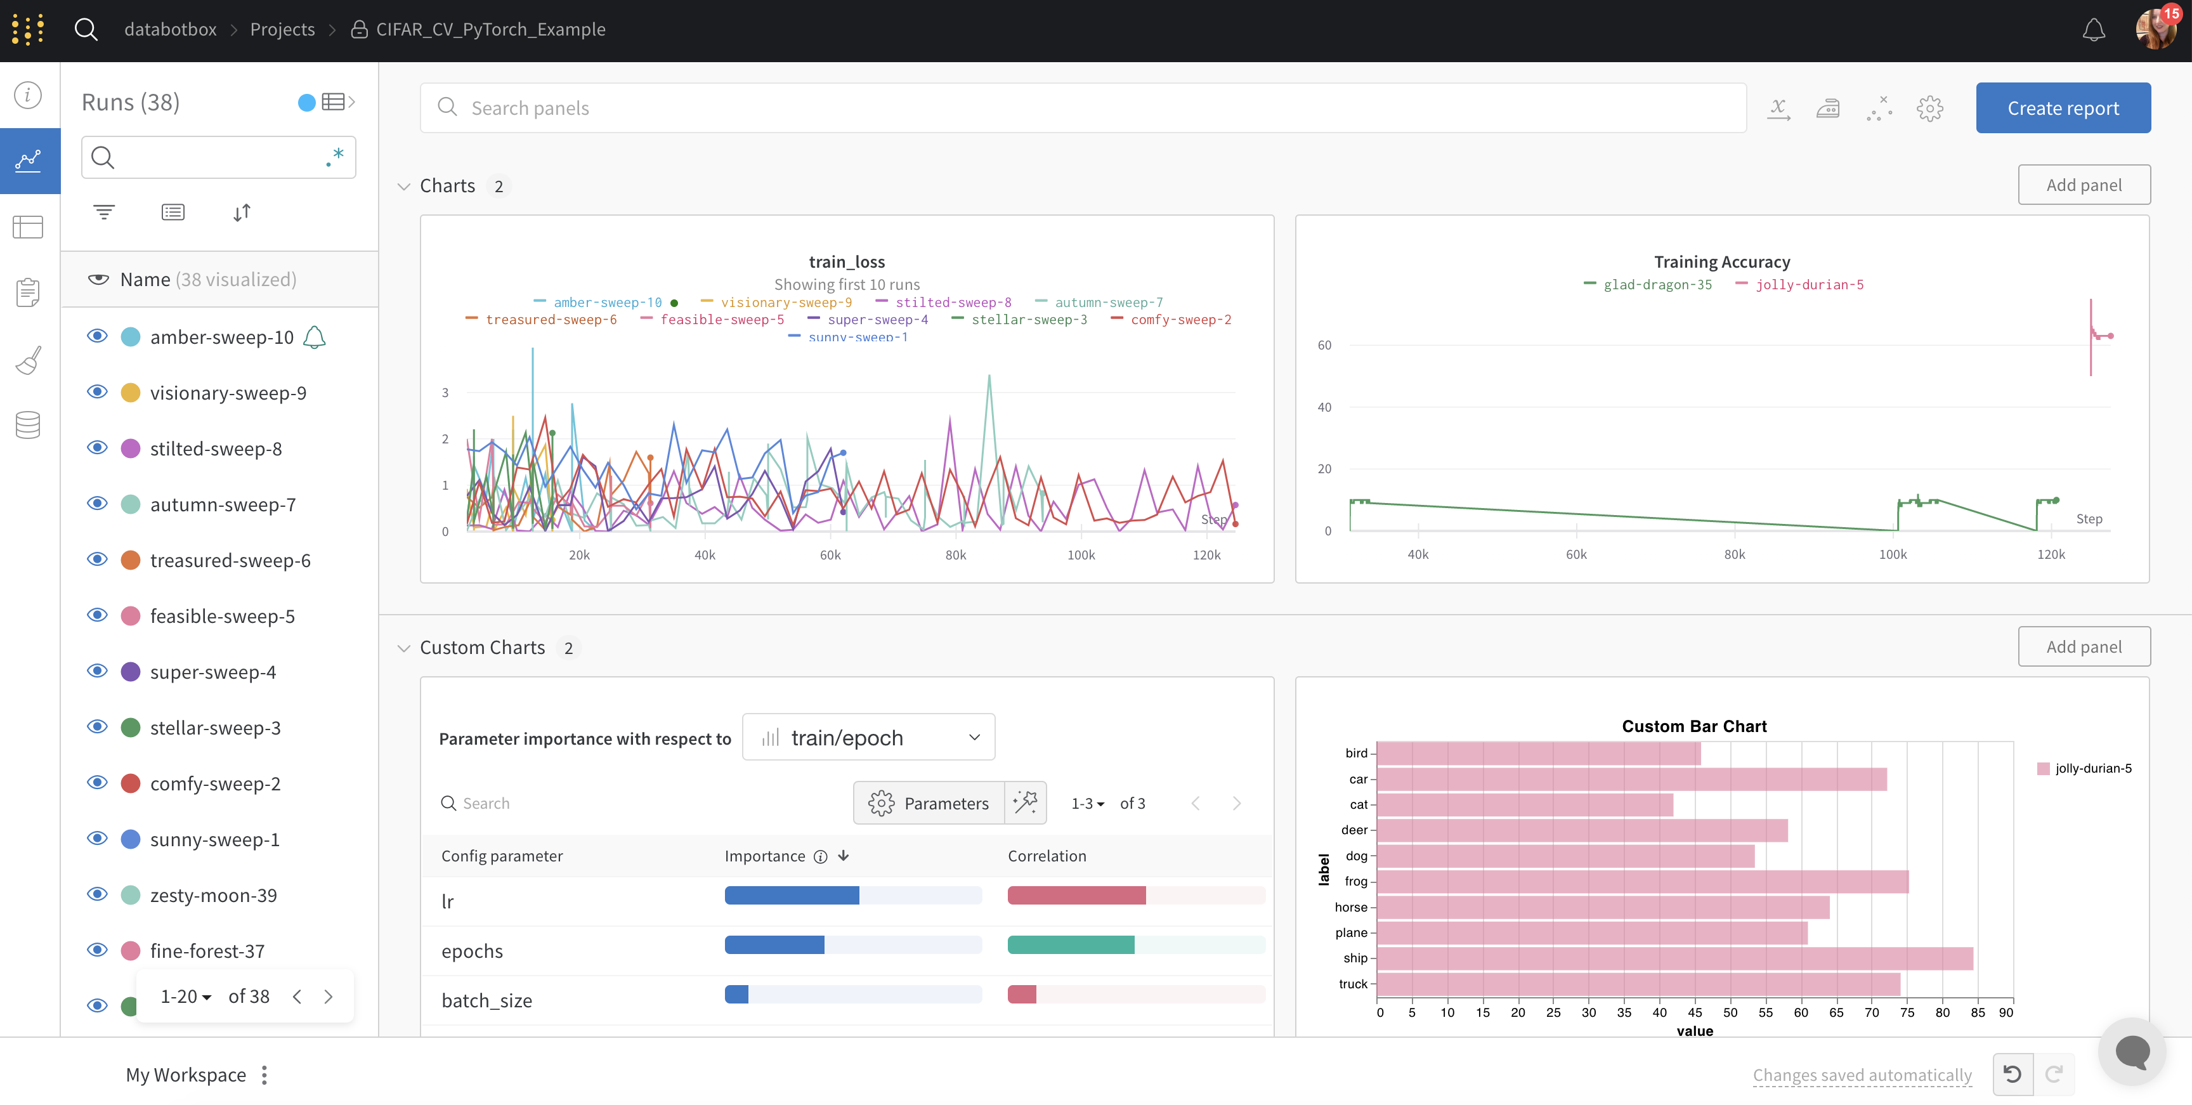
What can you do with Weights & Biases: MLOps Platform?
Experiment Tracking
Dataset versioning
Model Optimization and Management
Collaboration & Reproducibility
Production Monitoring

Slide 4







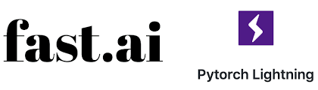


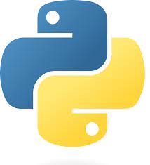
Use Open-Source Frameworks

Slide 5


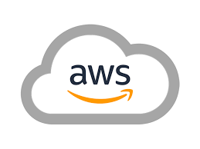

Runs On-Prem + Private Cloud

Slide 6
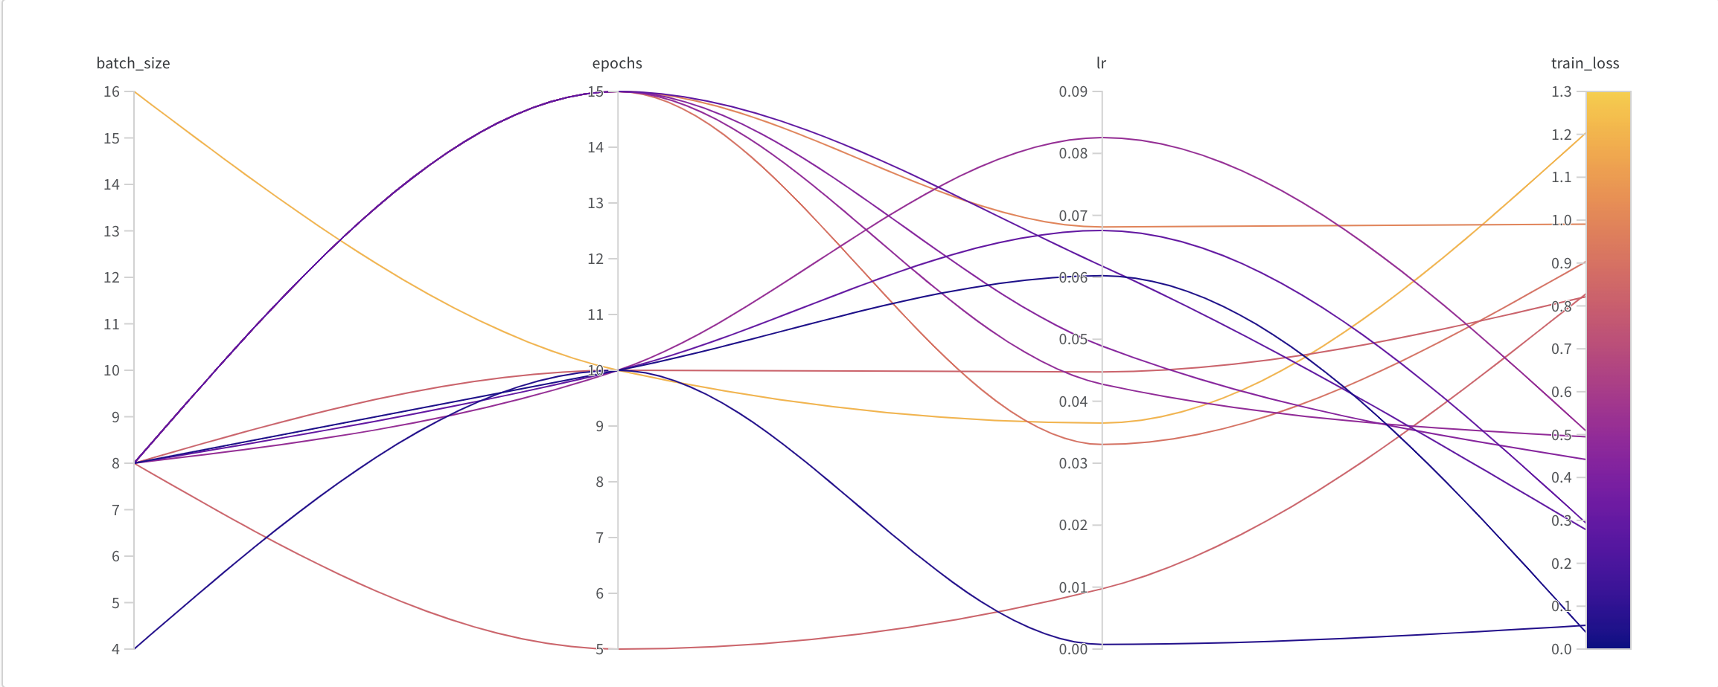
Hyper-parameter Tuning with Sweeps
Tune many hyper-parameters at once
Visually, interactively inspect results

Slide 7
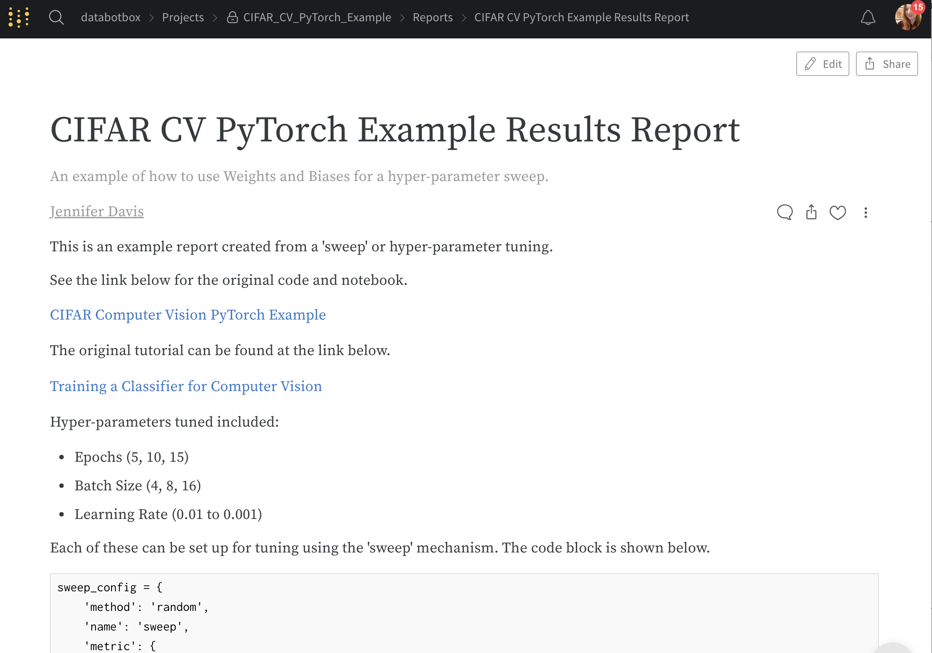
Reporting

Slide 8
Demonstration
Computer Vision Pipeline for Labeling Images

