Slide 1
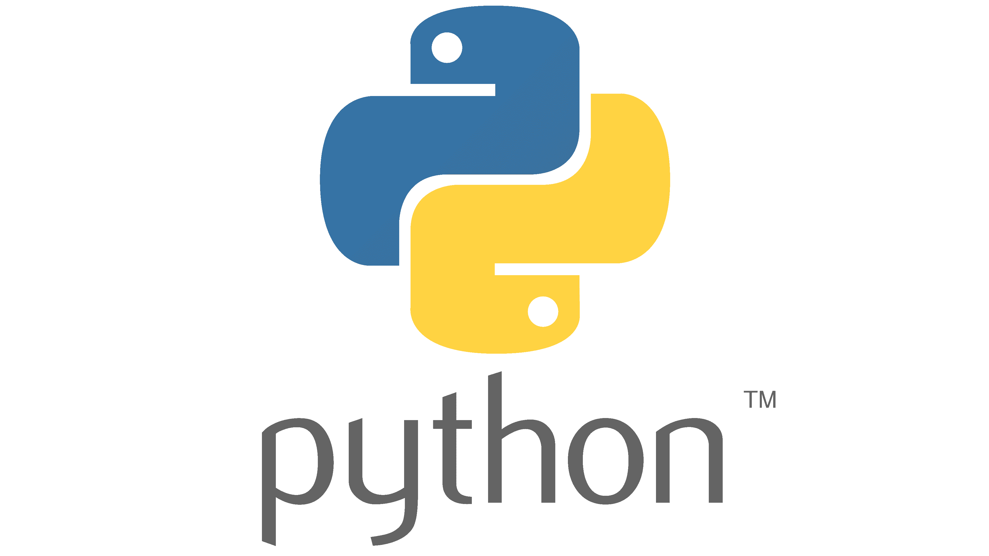
Python for Data Processing

Slide 2
What is Python?
Python is a programming language: talk with your computer
With Python, you can do anything
As with any language: you cannot learn it during a course
Practice, practice, practice!

Slide 3
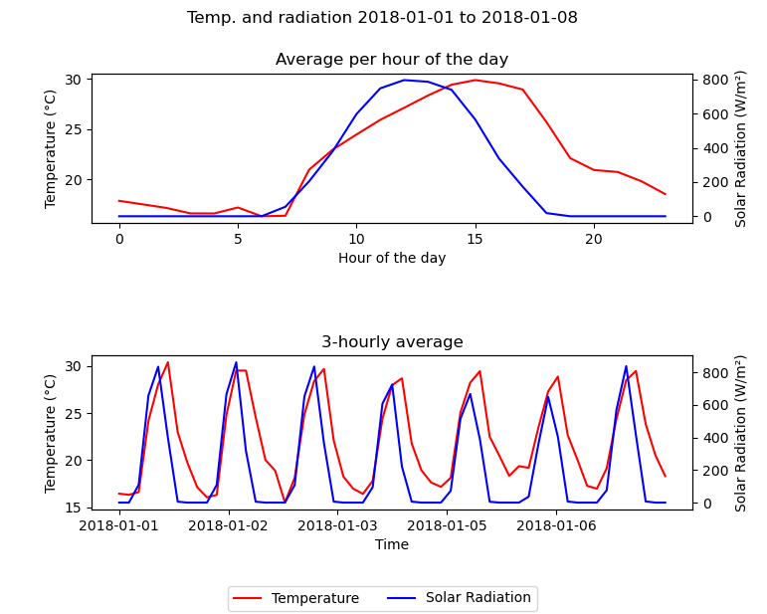
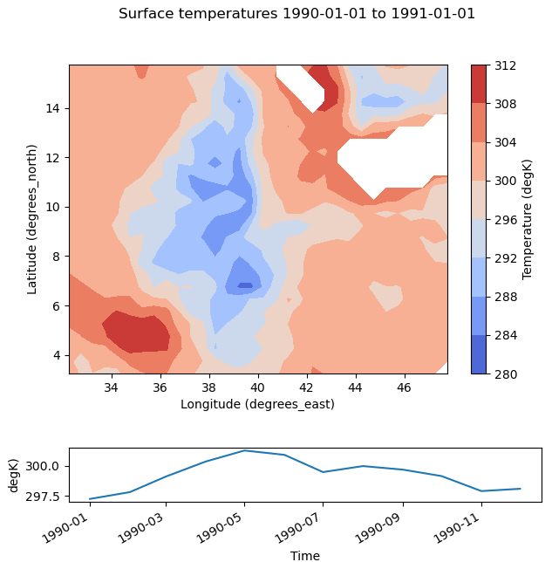
What can Python do? – Examples

Slide 4
This training
Basic Python for Data Processing
Goal: application in your work field (basics)
Introducing myself
Name: Nimrod de Wit
Background: Molecular Life Sciences
Expertise: Bioinformatics
Python experience: courses and genetics research
Demiso and Israël will be assisting in this course

Slide 5


Python is like exercising – you need practice!

Slide 6
Training structure
Every morning:
Short lecture
Practicing
It is a hands on/interactive course! So be active and creative!
Focus on the logic of Python

Slide 7
Training outline
Module 1: Python basics (part 1)
Module 2: Python basics (part 2)
Module 3: Importing, changing and exporting data
Module 4: Visualizing data
Module 5: Multidimensional data (NetCDF)

Slide 8
How to make the training successful
Attend all classes
Actively engage during the morning sessions
Carefully read the text
Try things out, try to understand
Practice in your own time (a language isn’t learned in 10 mornings)
Certificate:
At the end there will be a test
You need to pass the test to earn a certificate
→ Extra motivation to practice a lot

Slide 9
Training schedule
2 mornings per week
5 weeks
Test afterwards
Practice on your own
Upon interest: practice afternoons with assistance

Slide 10
Questions?

Slide 11
Module 1 Python basics (part 1)
Python for Data Processing (basics)

Slide 12
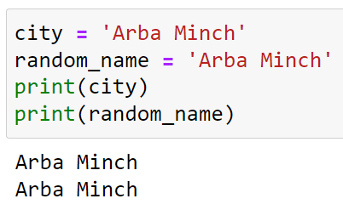
Variables
Variables are containers for storing data values
They have a name and a value
A variable is created the moment you first assign a value to it
Using the equal sign: =

Slide 13

Variables
Rules:
Give logical and meaningful names
Names cannot start with a number, don’t do this:
There are multiple types of variables, this morning we will discuss:
Strings
Numbers
Booleans
Lists

Slide 14
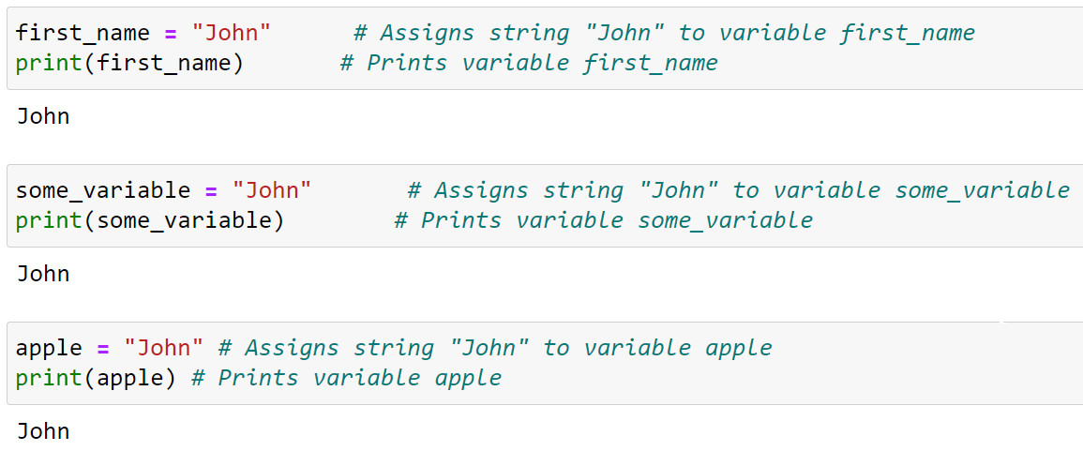
Strings

Slide 15
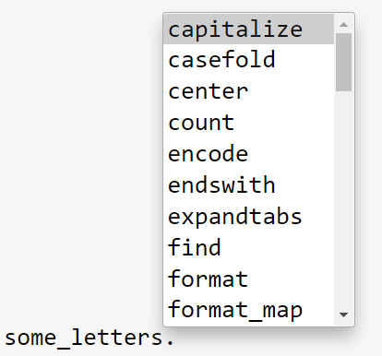
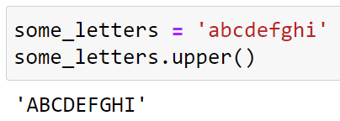

Strings – Methods
You can apply different methods to a string
After the variable put a . the method name and brackets ()
There are many different methods, for example:
.upper() .lower() .capitalize() .islower() .startswith() .replace()
There are many more! Try using tab
To get information on a method, type ? behind it:

Slide 16

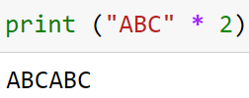
Strings – Operators
Operators can be used to perform "mathematics" with words
+ joins/concatenates two strings together
* repetition of a string

Slide 17
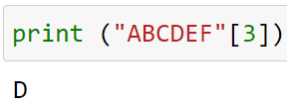

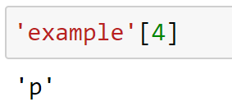
Strings – Operators
A string is a list of characters, which can be selected using square brackets [ ]
Trick question:
Python indexing
Python starts counting at 0

Slide 18
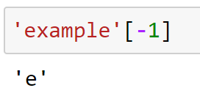
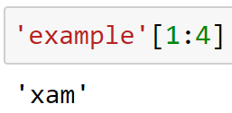
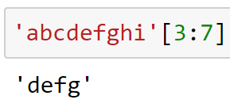
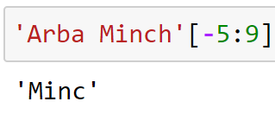
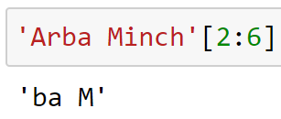
Strings – Operators
Accessing multiple characters: slicing → [start:end]

Slide 19
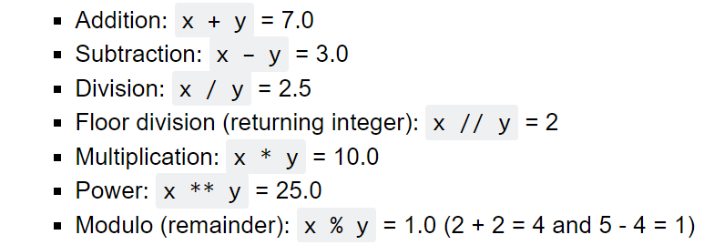
Numbers
There are two types of numbers
Integers: whole numbers (e.g., 1, 20, 100)
Floats: numbers with decimals (e.g., 1.5, 32.6, 0.99)
Python can do math (x = 5.0 and y = 2.0):

Slide 20
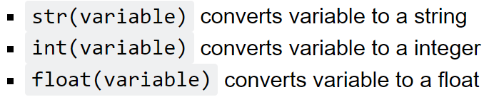
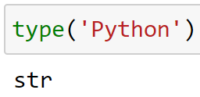
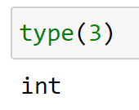
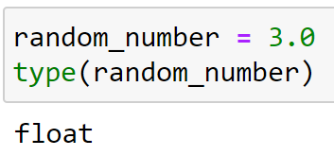
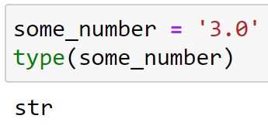
Data types
If needed, we can change the data type of a variable

Slide 21
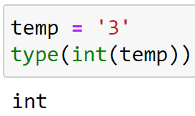
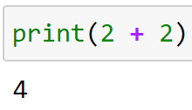
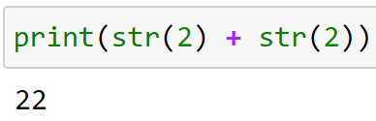
Data types
If needed, we can change the data type of a variable

Slide 22
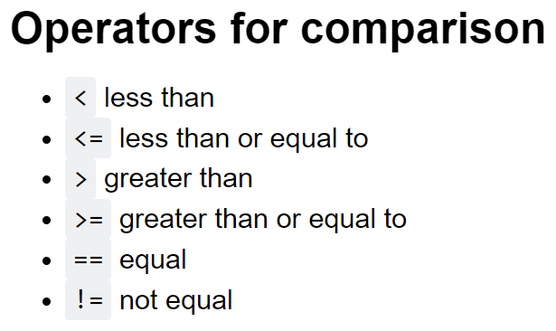
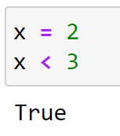
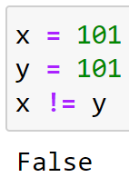
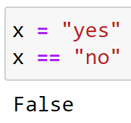
Booleans
Booleans represent one of two values: True or False
For expression that are true or false, e.g.:
3 > 2 True
4 < 2 False

Slide 23
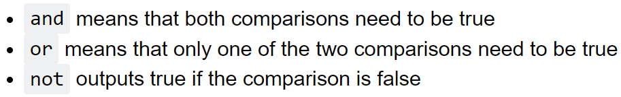
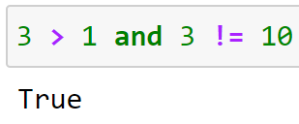
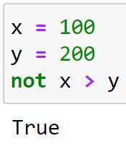
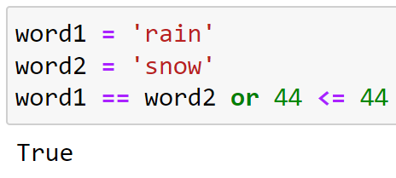
Booleans
You can also combine or change expressions/booleans by using:

Slide 24
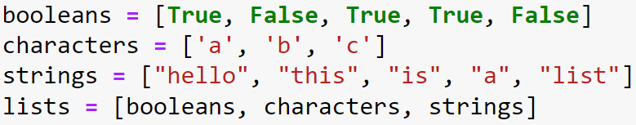

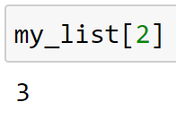
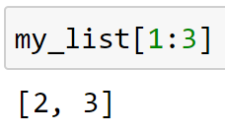
Lists
Another type of sequence: list
Start and end it with square brackets [ ]
Separate the different elements with a comma ,
Can contain all types
You can access it in the same way as a string

Slide 25
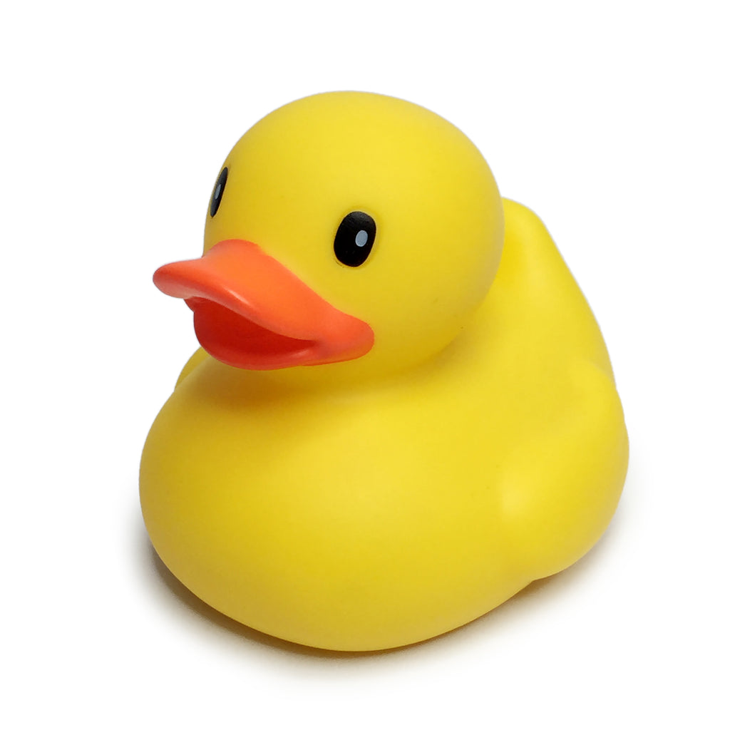
Exercises
Writing a script is solving a problem step by step
Try to understand what is happening
Try to do it yourself, experiment and play around
When the code does not work:
Try to understand the error message
Check code line by line: rubberducking
Check parts in a new cell
Ask a neighbour
Ask the teacher or assistant

Slide 26

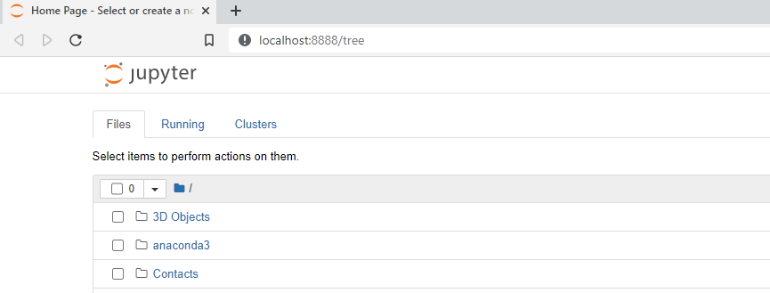
Jupyter Notebook
First, start Jupyter Notebook
Option 1: start button → Jupyter Notebook (or taskbar: )
Option 2: Anaconda Prompt →
It should open some page in your webbrowser, with your files
Open: Module1_Exercises.ipynb

Slide 27
Jupyter Notebook
First, start Jupyter Notebook
Then, open a .iypnb file inside the Jupyter browser window
Python_training folder stored on another Disk/Drive? In the Anaconda Promt instead run: jupyter-notebook --notebook-dir=D:/
(if your Python_training folder is on the D:/ drive)
Open: Module1_Exercises.ipynb

Slide 28

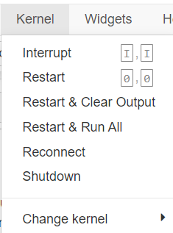



Jupyter Notebook
Running a cell: CTRL + ENTER or (on top of page)
When a cell has not yet run:
When a cell has run:
When a cell is stuck:
Restart the kernel: Kernel → Restart

Slide 29
Good luck!

Slide 30
You did a great job!
Try to finish the exercises before the next training
Next training:
Door open at 2:00 Ethiopian time / 8:00 western time
Until 2:30 there is time to practice and ask questions
At 2:30 we will start the new module
Training on Thursday is moved to Saturday
The slides and exercises of module 2 are already uploaded

