Slide 1
Module 2 Python basics (part 2)
Python for Data Processing

Slide 2
Module 2 – Contents
Conditions
Loops
Lists
Dictionaries

Slide 3
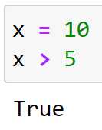
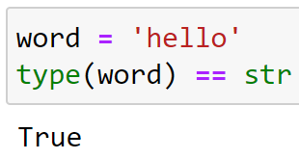
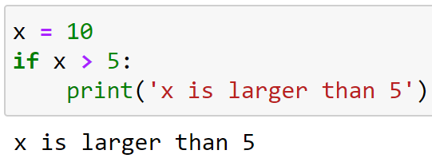
Conditions – if / elif / else
With if, elif, and else we can control the execution of certain parts of a program
Execute some code if some condition is True
Remember booleans?

Slide 4
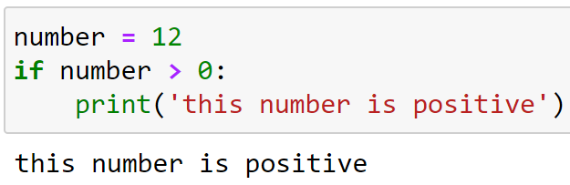
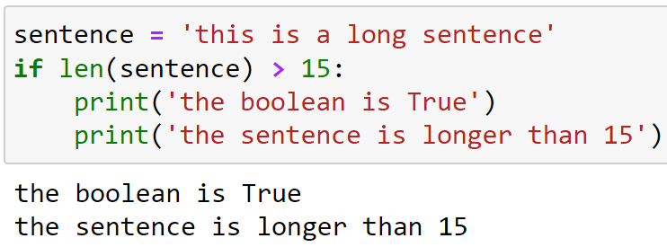
Conditions – if / elif / else
Some more examples:
If statements end with a :
The code should be indented with a tab

Slide 5
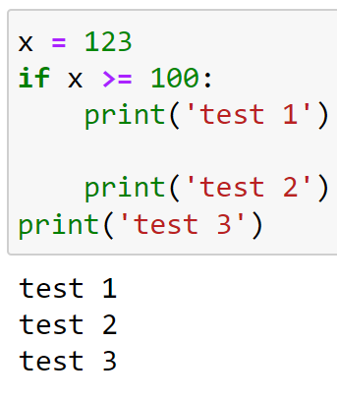
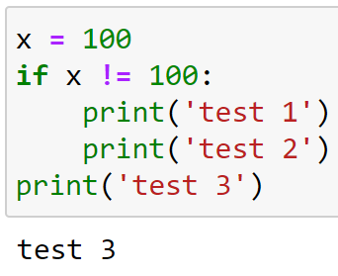
Conditions – if / elif / else
The code after the if statement should be indented with a tab

Slide 6
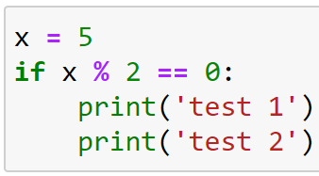
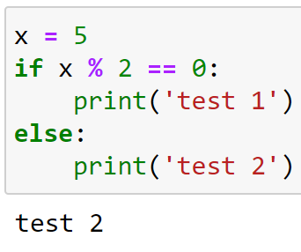
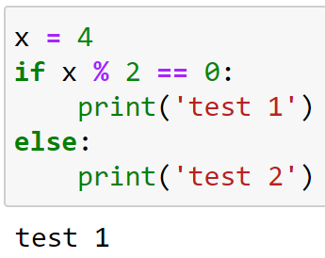
Conditions – if / elif / else
With the if statement, the code is run if some condition is True
With the else statement, the code is run if the condition in the if statement is False

Slide 7
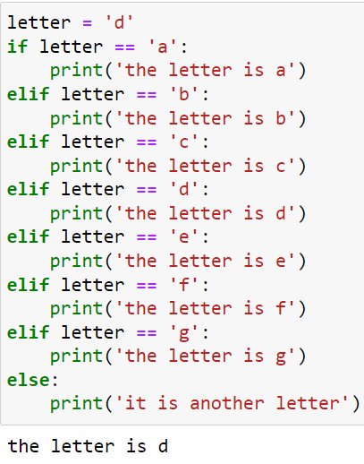
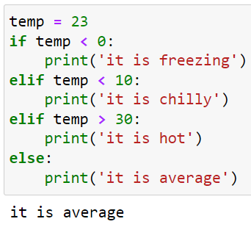
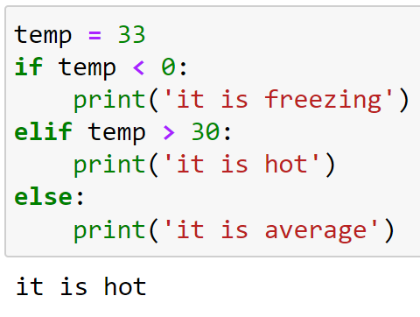
Conditions – if / elif / else
With the elif (else if) statement you can add extra conditions in between if and else

Slide 8
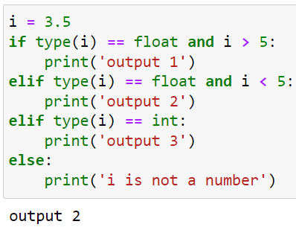
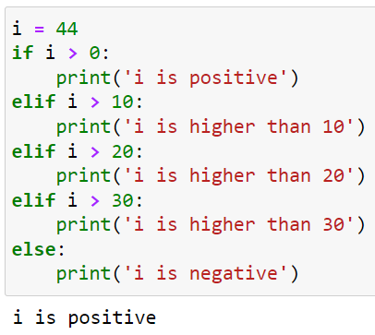
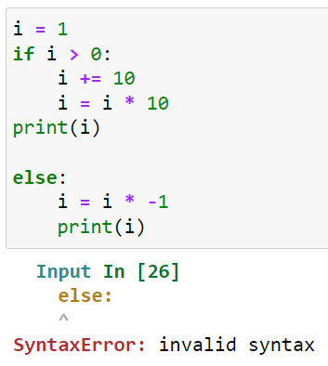
Conditions – if / elif / else
Some more examples:

Slide 9
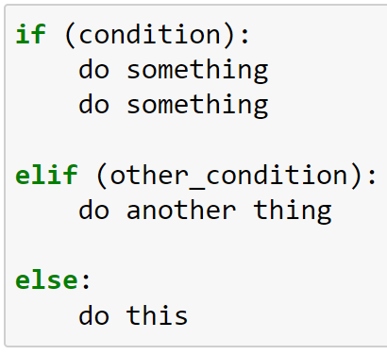
Conditions – if / elif / else – Summary
Three options: if / elif / else
Colon :
Indentation
Only one part is executed

Slide 10
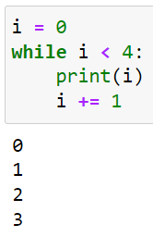
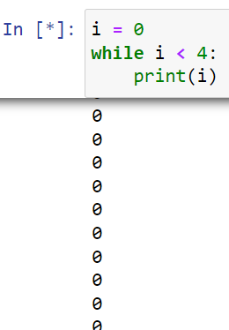
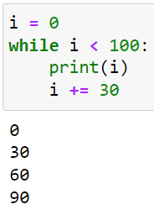
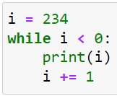
Loops – while / for
A loop is a part of code that is repeated multiple times
The first type of loop is a while loop
The code is repeated while a condition is true:

Slide 11
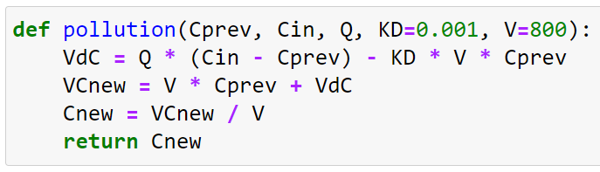
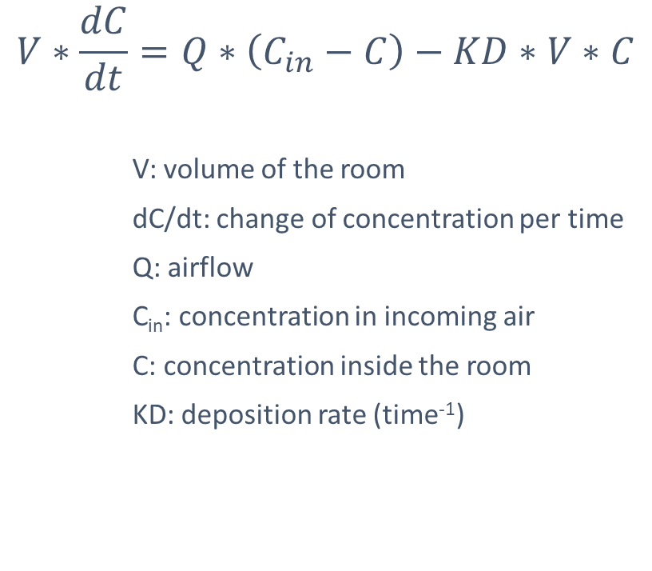
While loop – Air pollution example
$$V∗\frac{dC}{dt}=Q∗\left(C_{in}−C\right)−KD∗V∗C$$
V: volume of the room
dC/dt: change of concentration per time
Q: airflow
C_{in}: concentration in incoming air
C: concentration inside the room
KD: deposition rate (time⁻¹)

Slide 12
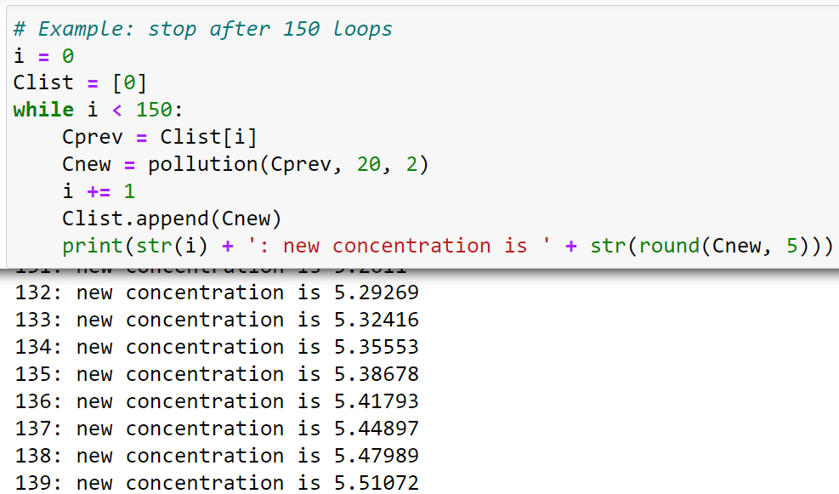
While loop – Air pollution example

Slide 13
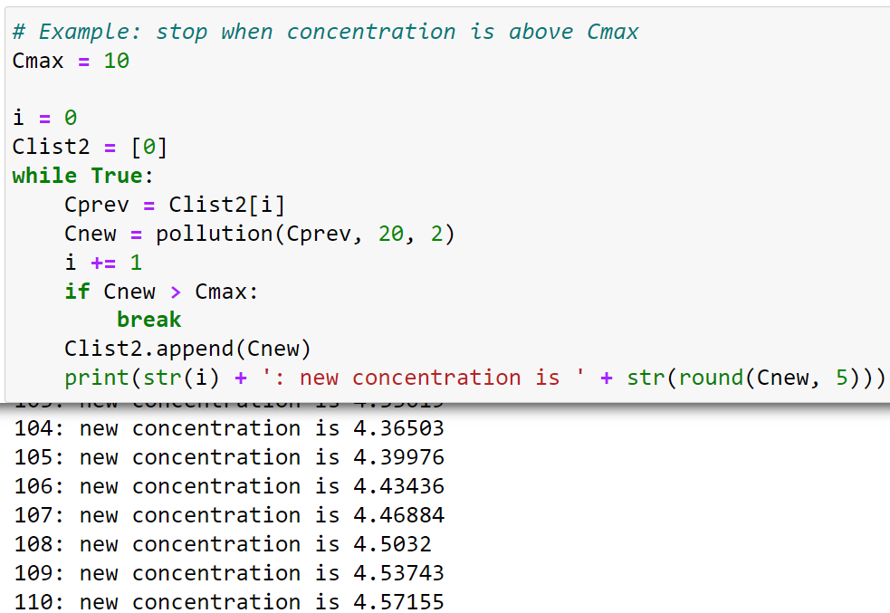
While loop – Air pollution example

Slide 14
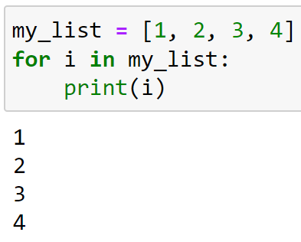
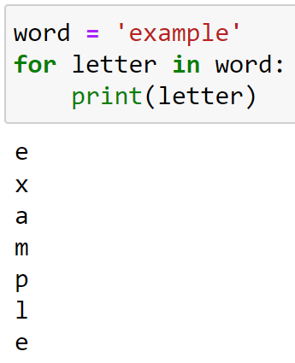
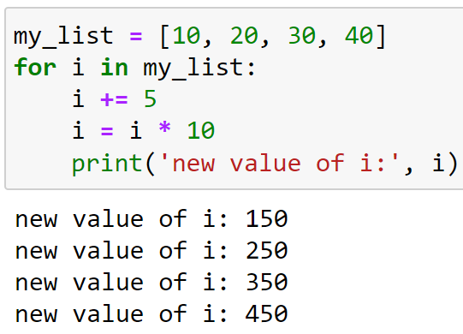
Loops – while / for
Another type of loop is the for loop
While loop: repeats while a condition is True
For loop: repeats code for every value in list (or str or …)
The current value can be used in the code

Slide 15
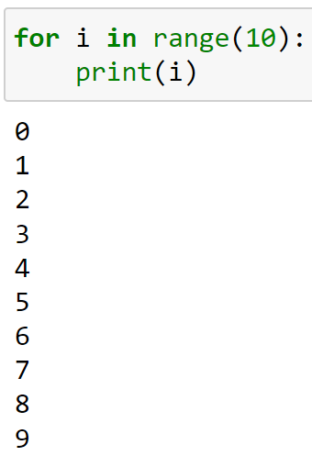
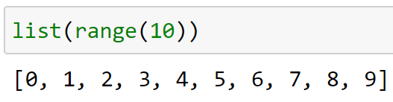
Loops – the function range()
The function range() is an easy way create a list of numbers
It starts at 0
It ends at input number – 1
Range() is useful for a for loop:

Slide 16

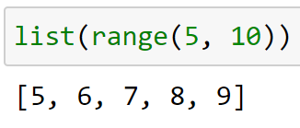
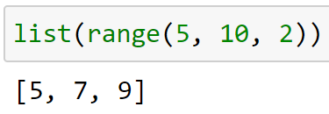
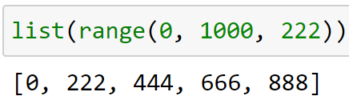
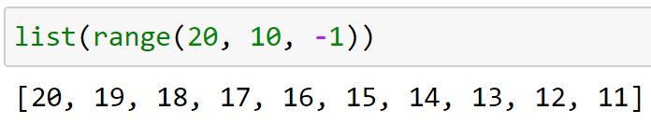
Loops – the function range()
The function range can also take two or three arguments

Slide 17
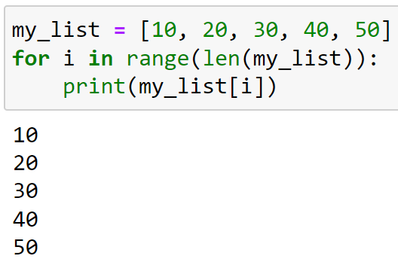
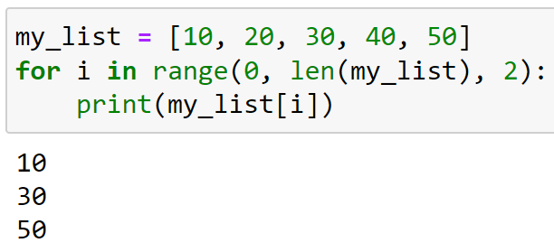
Loops – using range() in a for loop
The range() function is useful for looping over the index of a list

Slide 18
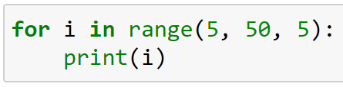
Do you understand the logic?
What will be the value of i in the first iteration?
And in the fourth?
How many iterations will there be?
What will the be the final value of i?

Slide 19
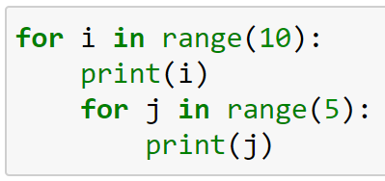
Do you understand the logic?
What will be the value of i in the first iteration? And of j?
What will be the fourth printed number?
How many number will be printed?
What will the be the final value of i? And of j?

Slide 20

Good luck!

Slide 21
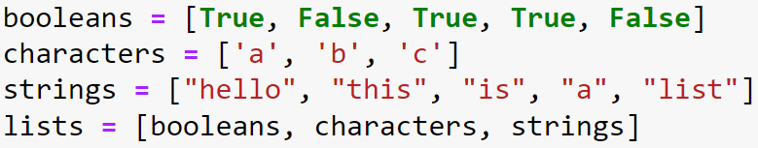

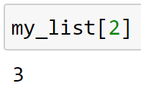
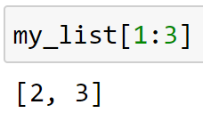
Lists
Start and end it with square brackets [ ]
Separate the different elements with a comma ,
Can contain all types
You can access it in the same way as a string

Slide 22
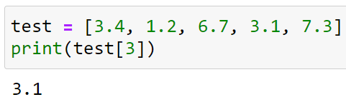
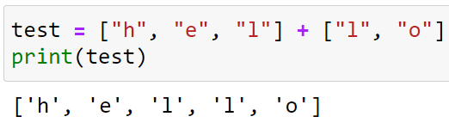
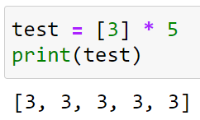
Lists – Operations
Lists can be modified just like strings
Access
Concatenate
Multiply

Slide 23

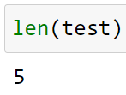
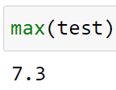
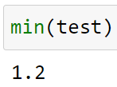
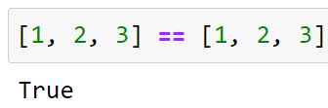
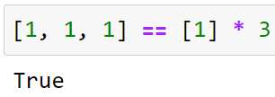
Lists – Operations
Get the length of a list: len()
Get the maximum value of a list: max()
Get the minimum value of a list: min()
Compare two lists: ==
v
v

Slide 24
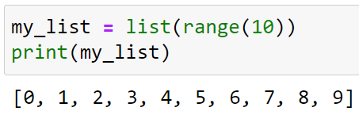




Lists – Modifying
Add an item to a list: .append()
Change an item in a list: .insert()
Remove an item from a list: .remove()
Sort the values in a list: .sort()

Slide 25

Lists – Examples

Slide 26

Lists – Examples

Slide 27

Lists – Examples

Slide 28
Dictionaries
A dictionary is a list, but with another value as index. This value is called the key.
A dictionary can be created by listing key-value pairs
Inside curly braces {}
Items are separated by a comma ,
Key-value pairs are connected by a colon :
Can hold al datatypes

Slide 29



Dictionaries – Accessing
Values in a dictionary can be accessed by using square brackets
Same as lists, although now using the key instead of index
You can access the keys all at once using .keys()
You can access the values all at once using .values()

Slide 30



Dictionaries – Modifying
Changing a value
Adding a key-value pair
Deleting a key-value pair

Slide 31



Dictionaries – Looping
You can loop over dictionaries
Looping over the dictionary gives the keys
But there are multiple ways to get the values

Slide 32
Good luck!

