Slide 1
Module 3.2 Pandas DataFrame
Python for Data Processing (basics)

Slide 2
Content
Pandas dataframes
Creating a dataframe
Selecting data from a dataframe (using booleans)
Changing a dataframe
Pandas for meteorology data
Arba Minch University | Python training

Slide 3
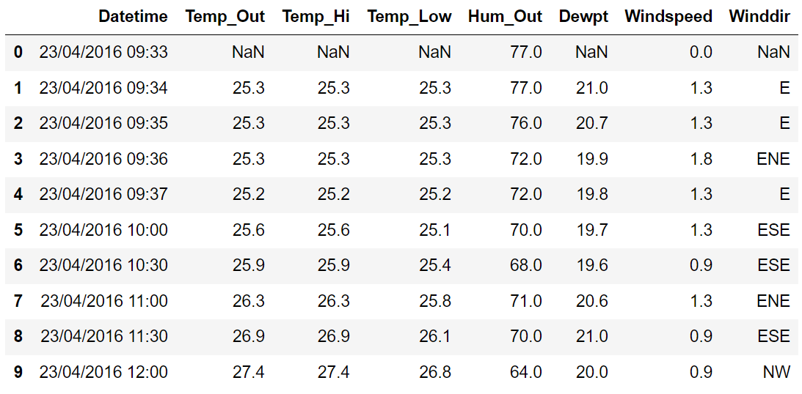
Pandas – DataFrame
We covered: lists, dictionaries, np.arrays
This module: pd.DataFrame
2-dimensional
Column names
Row names

Slide 4
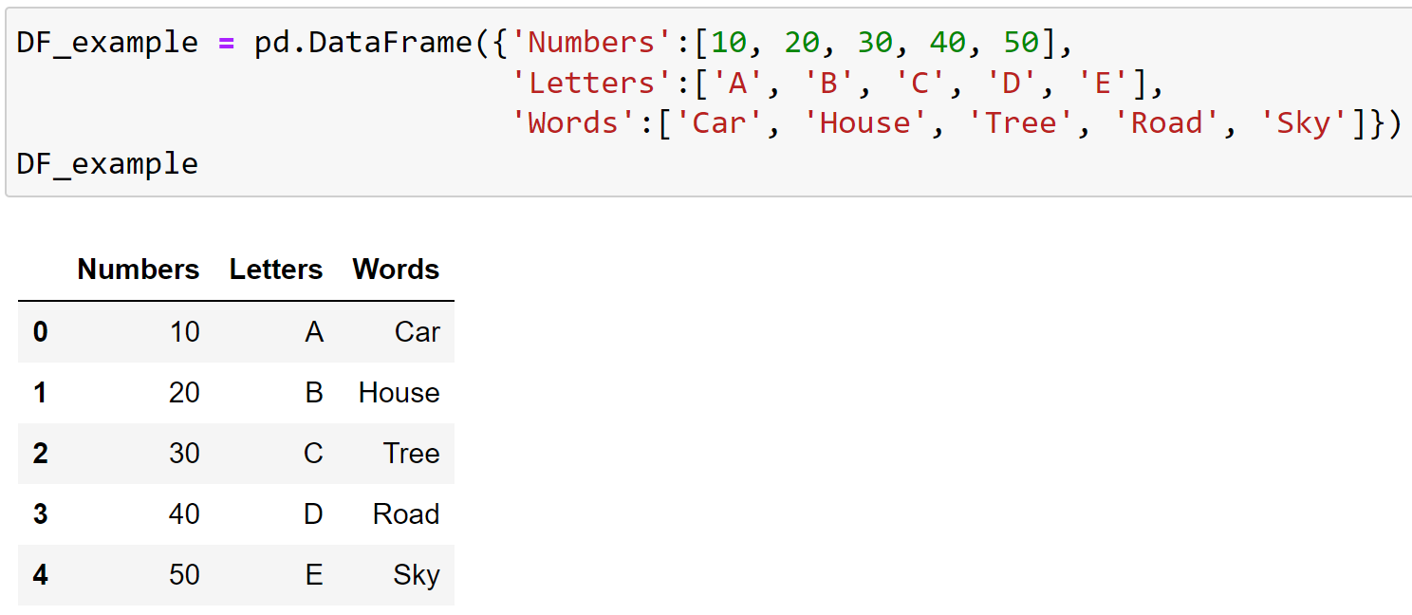
Creating a dataframe
Creating a dataframe can be done by:
Loading a datafile (next session)
Using a dictionary
pd.DataFrame(YOUR_DICTIONARY)

Slide 5
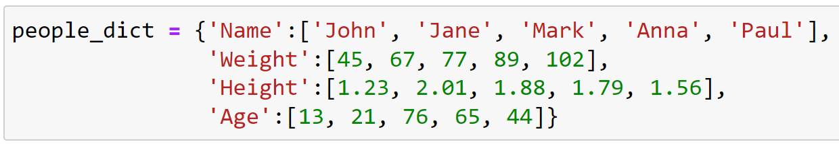
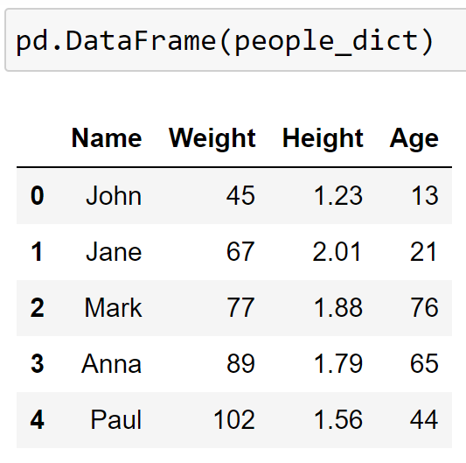
Creating a dataframe
Function to create a dataframe?
What are the column names?

Slide 6
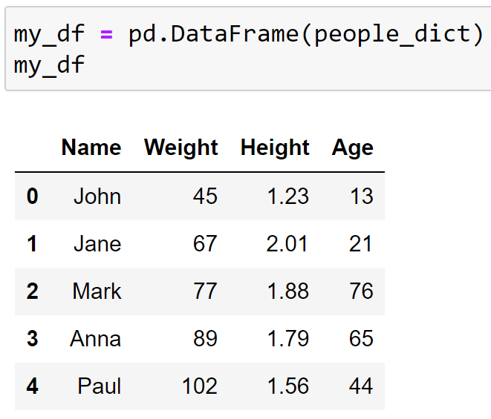
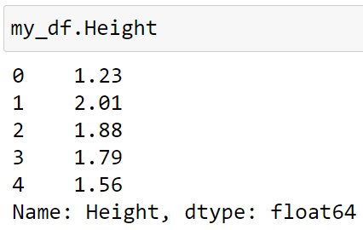
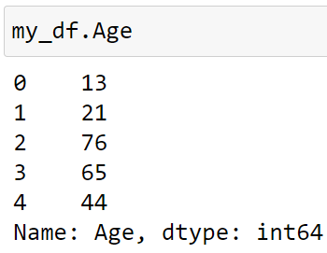
Selecting data from a dataframe
df.column_name to select a single column

Slide 7
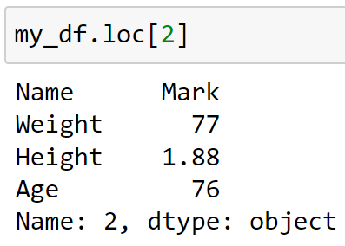
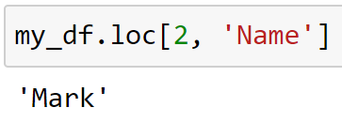
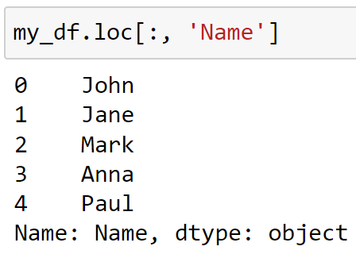
Selecting data from a dataframe
.loc[ ] to select rows and columns using the labels/names

Slide 8
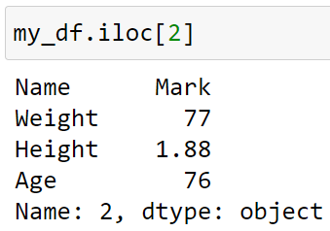
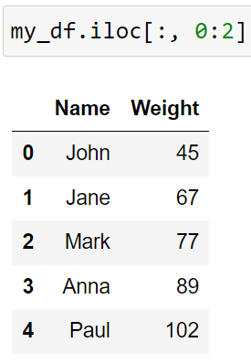
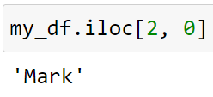
Selecting data from a dataframe
.loc[ ] to select rows and columns using the labels/names
.iloc[ ] to select rows and columns using indexes

Slide 9
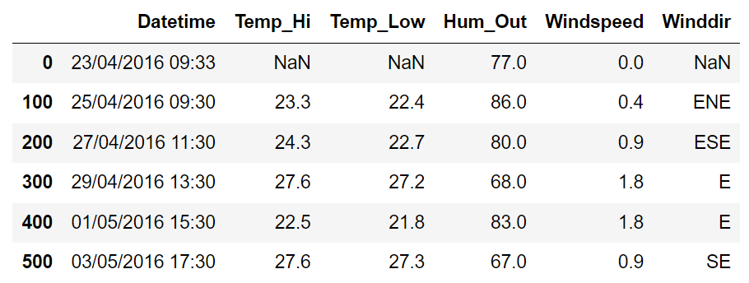
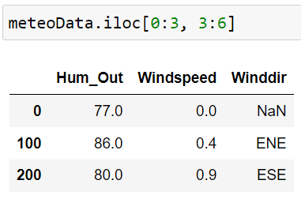
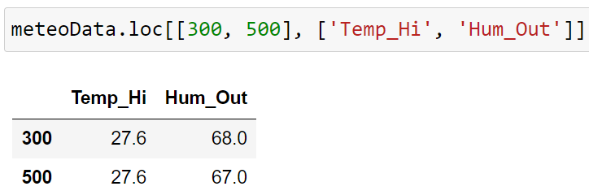
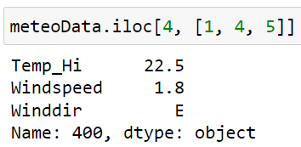
Selecting data from a dataframe

Slide 10
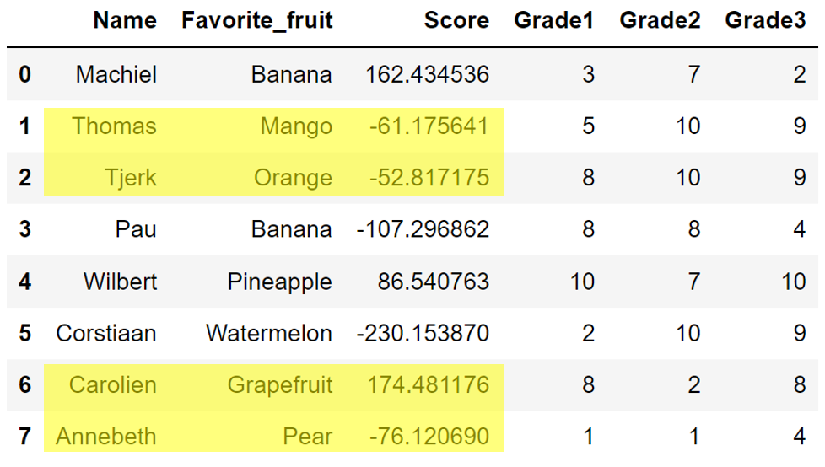
Selecting data from a dataframe

Slide 11
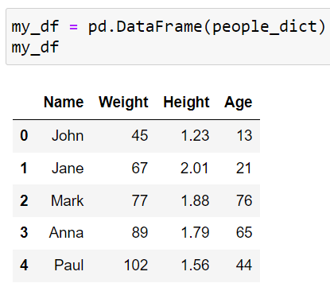
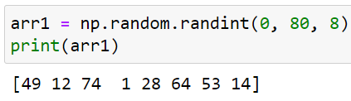
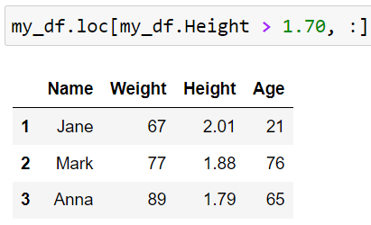


Boolean slicing
Boolean slicing also works with dataframes
Remember boolean slicing?

Slide 12
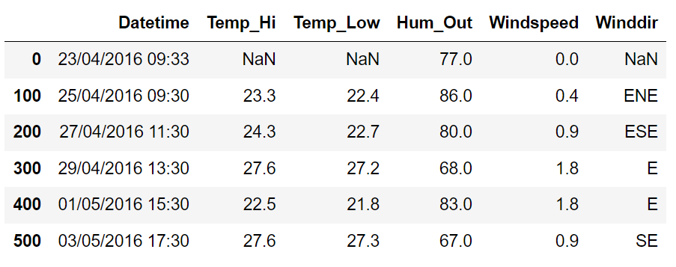
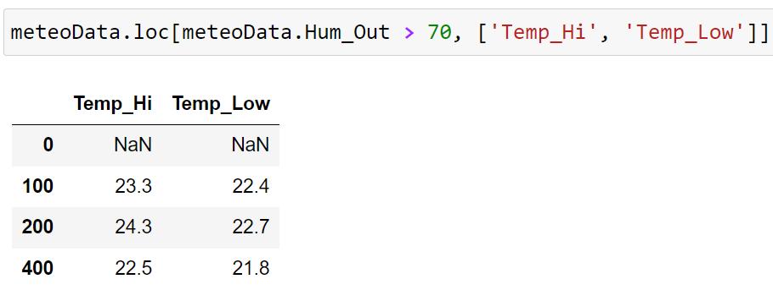
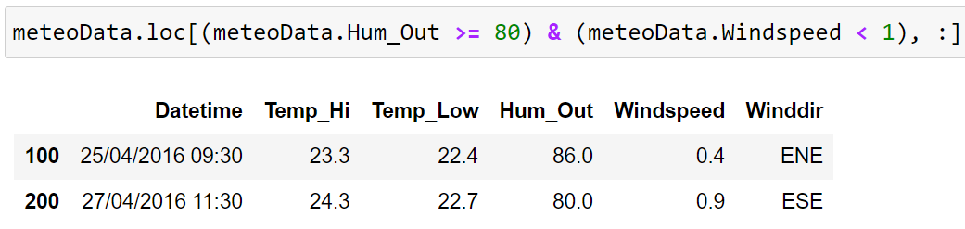
Boolean slicing
Examples

Slide 13
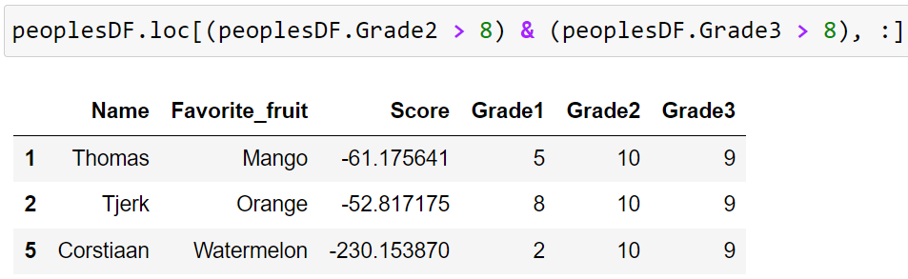
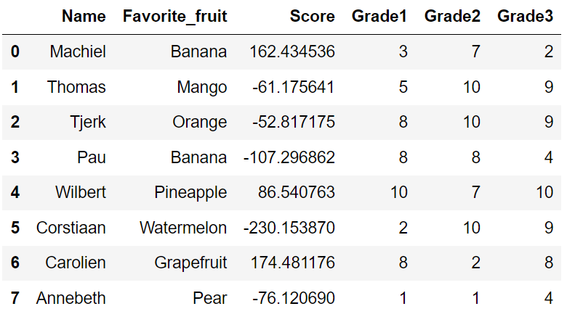
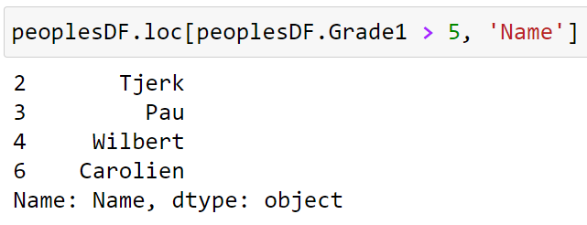
Boolean slicing
Rows where Grade2 and Grade3 are higher than 8
Examples
Names of the people with Grade1 higher than 5

Slide 14
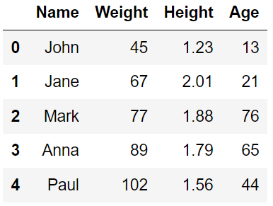
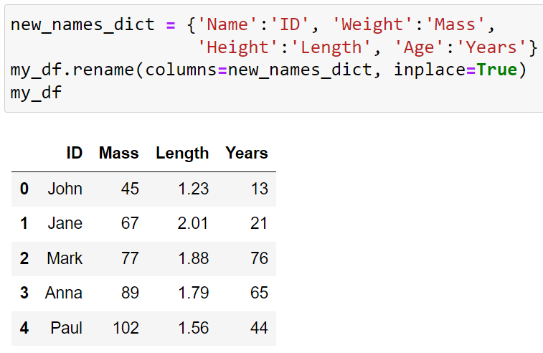
Changing a dataframe
Renaming columns
Use the function .rename()
Use a dictionary with old names as keys and new names as values
Use inplace=True
Remove columns
Adding columns
Changing columns

Slide 15
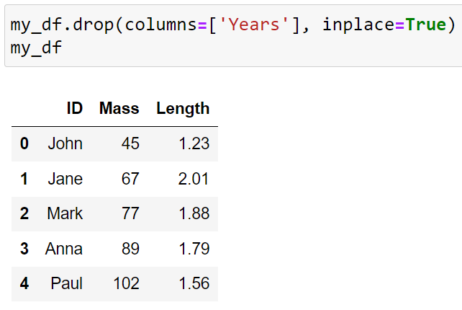
Changing a dataframe
Renaming columns
Removing columns
Use the function .drop()
Use a string or list of strings with column names
Adding columns
Changing columns

Slide 16
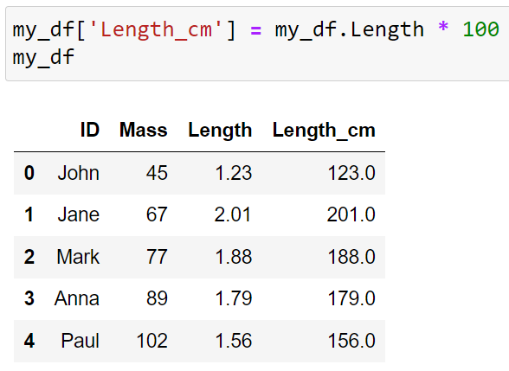
Changing a dataframe
Renaming columns
Removing columns
Adding columns
The same as adding a key:value pair to a dictionary
You can use other columns
Changing columns

Slide 17
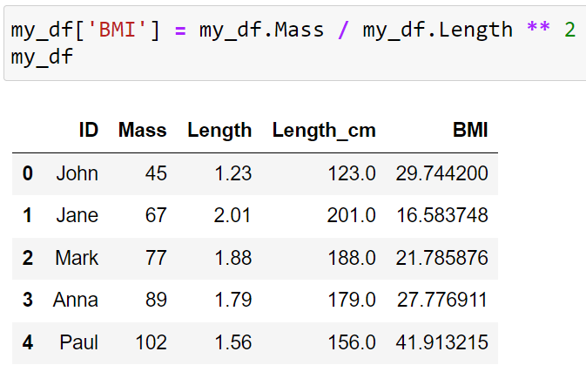
Changing a dataframe
Renaming columns
Removing columns
Adding columns
The same as adding a key:value pair to a dictionary
You can use other columns
Changing columns

Slide 18
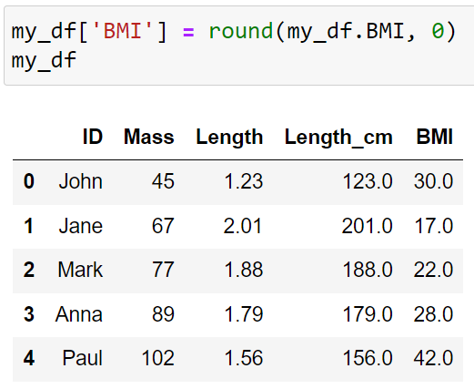
Changing a dataframe
Renaming columns
Removing columns
Adding columns
Changing columns
The same as changing values in a dictionary

Slide 19
Pandas dataframes – Summary
Creating a dataframe
pd.DataFrame(YOUR_DICTIONARY)
Selecting data from a dataframe
.loc[ ] and .iloc[ ]
Selecting data using booleans
Changing a dataframe
.rename(), .drop(), inplace=True
Arba Minch University | Python training

Slide 20

Good luck!

