Slide 1
Module 3.3 Pandas for Meteorology Data
Python for Data Processing

Slide 2
Contents
Loading data
Timestamps
Grouping data
Exporting data

Slide 3

Loading data
Pandas can load several types of files
.csv / .txt / .xlsx / …
We will import the file meteoData.csv using pd.read_csv()
Make sure file are in the same folder as the notebook
Else, give full file path

Slide 4


Loading data
pd.read_csv() has some useful settings:
sep How are values seperated?
header Column names inside file?
names Use own column names?
Excel files have specific pandas function: pd.read_excel()
Explore yourself!

Slide 5
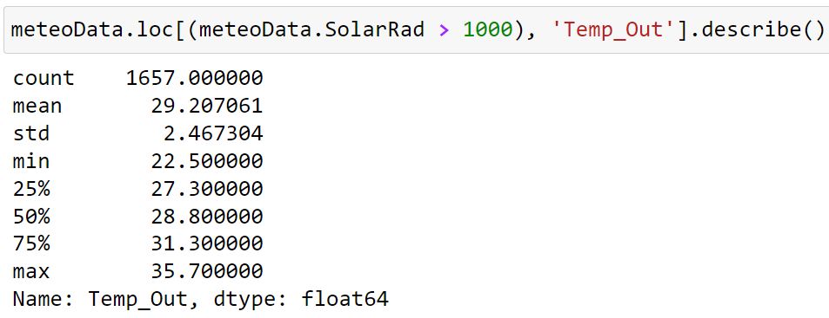
Get information from a dataframe
You can use functions on your data selection
.mean()
.max()
.min()
.describe()

Slide 6
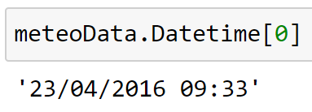
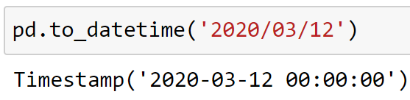
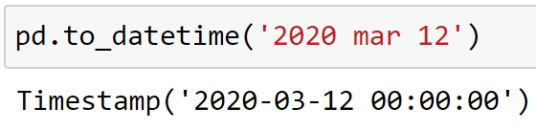
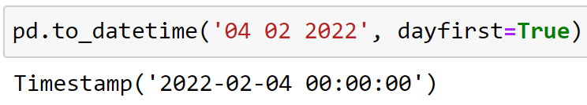
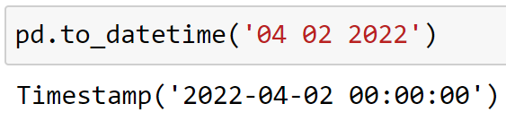
Time – Timestamps
meteoData.Datetime is a collection of strings
This needs to be changed so that Python knows it is dealing with time
Pandas has a function to change a timedata string into a timestamp: pd.to_datetime()
Important: dayfirst=True if the format of the string is DD/MM/YYYY

Slide 7
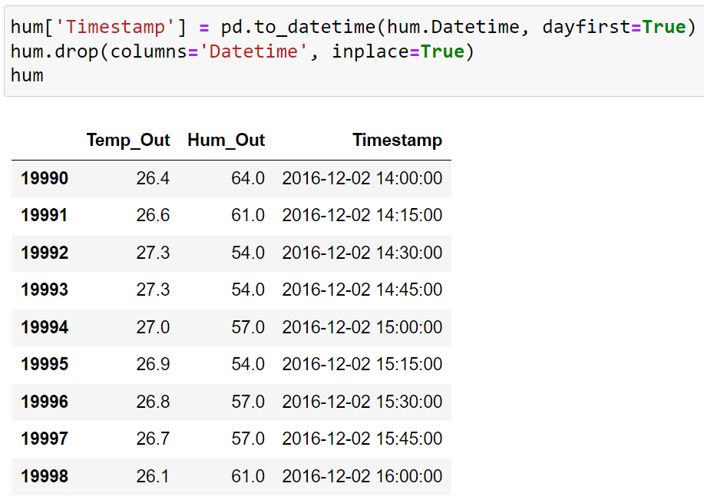
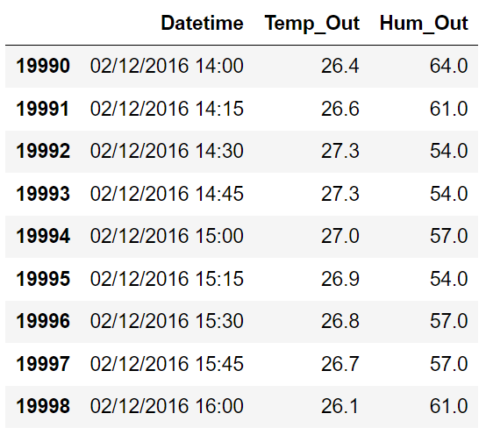
Time – Example

Slide 8
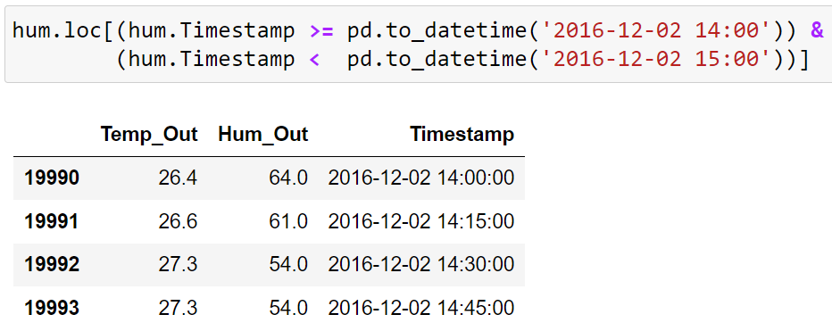
Time – Example

Slide 9


Time – Examples
Get the data for September 2016
Get the data for the years 2016 up to and including 2018
Get the data for the years 2018 up to and including 2019
Get the data for the first day of 2019

Slide 10
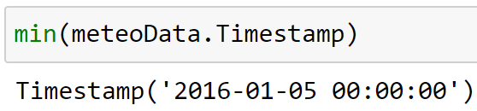
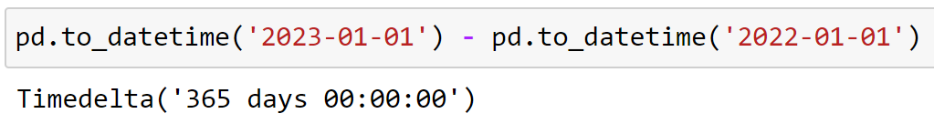
Time – Timedelta
Timestamps work similar to numbers
You can use max() and min() on a column of timestamps
When subtracting timestamps, you get a timedelta

Slide 11
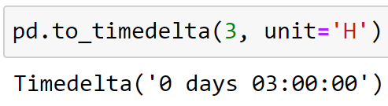
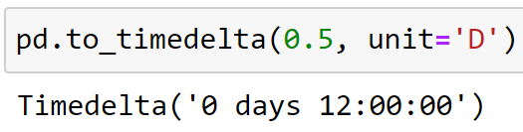
Time – Timedelta
Timedelta’s can also be created using the function pd.to_timedelta()
Two inputs:
The number of units
The type of units

Slide 12
Timedelta – Examples
Get the data of the first 3 weeks of 2017
Get the data of the first 3 hours of September 11, 2017

Slide 13
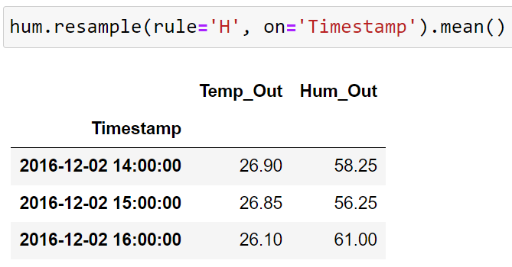
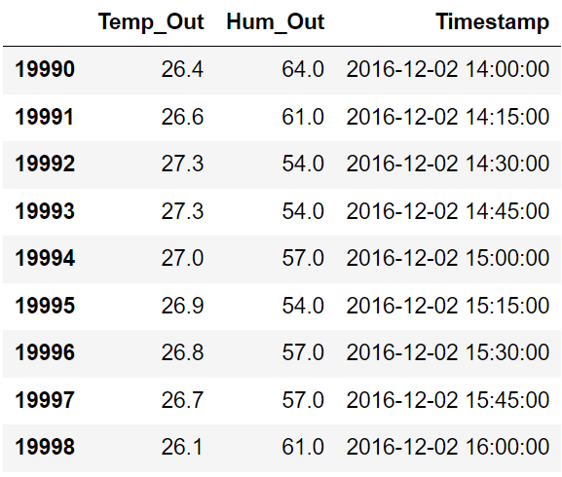
Time – .resample()
Pandas' .resample() function is useful for changing data to a different time period
We aggregate the data based on time

Slide 14
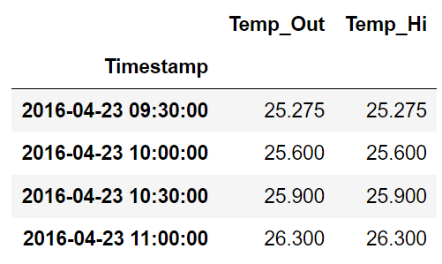
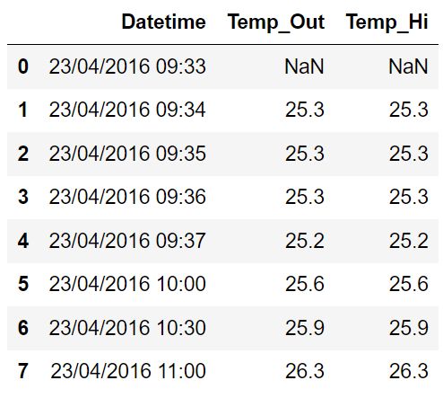
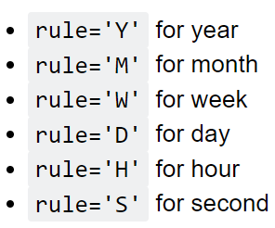
Time – .resample()
When the timesteps between datapoints are varying, we can aggregate the data by doing a resample

Slide 15
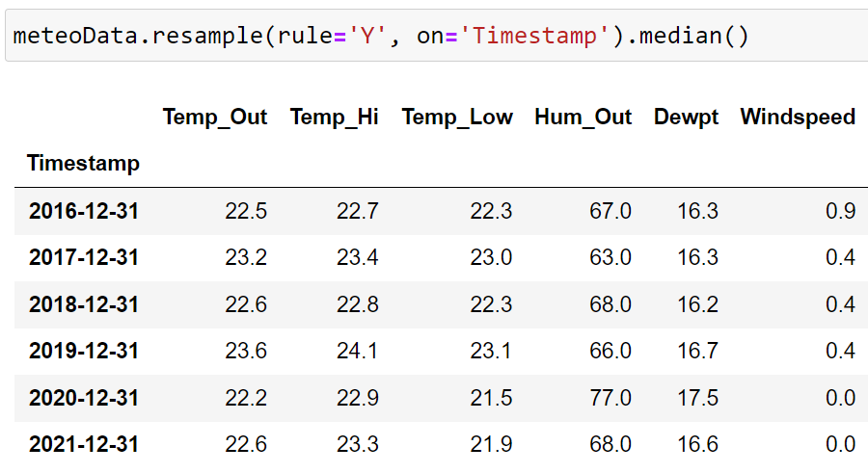
Time – .resample()
You always must set the method by which you want to aggregate
.max(), .min(), .mean(), etc.

Slide 16
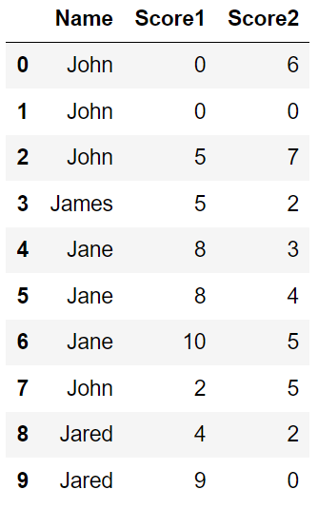
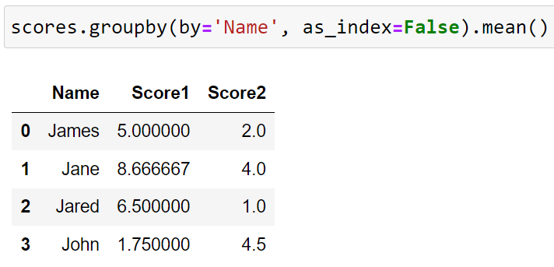
.groupby()
.resample() groups data based on time
.groupby() groups data based on other identifiers
by= column with identifiers
as_index= keep identifiers column and original indexes

Slide 17
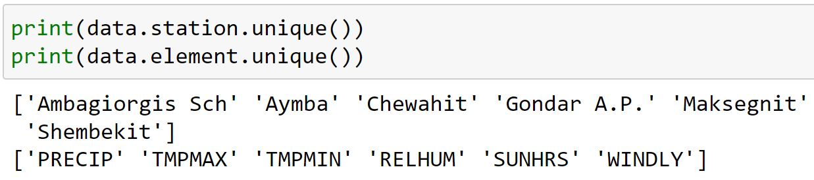
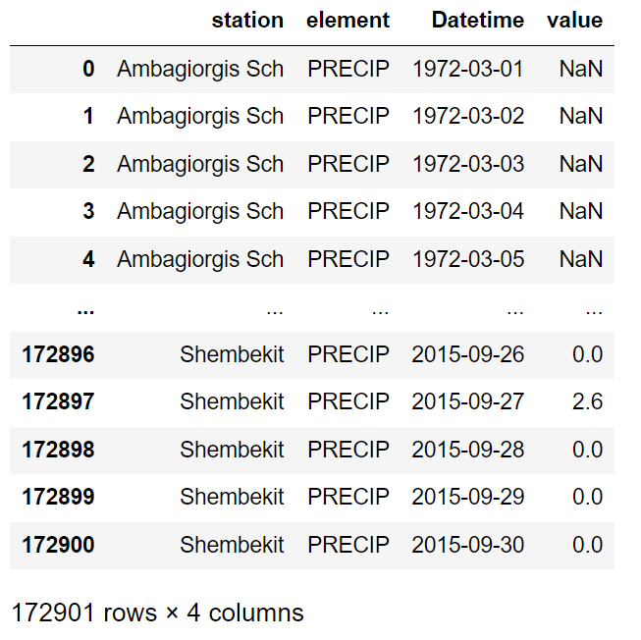
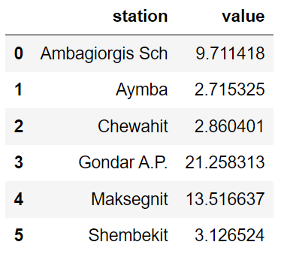
.groupby()

Slide 18
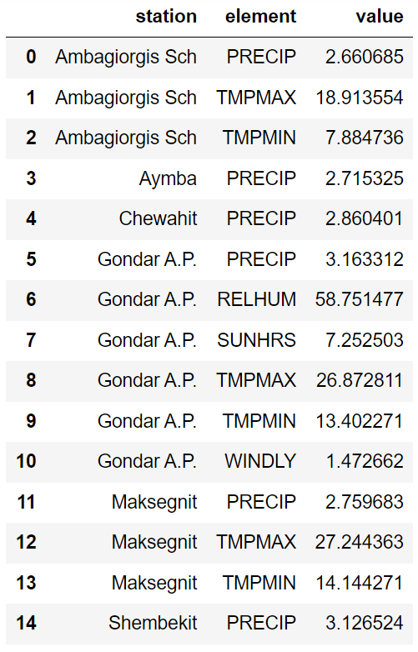
.groupby()

Slide 19
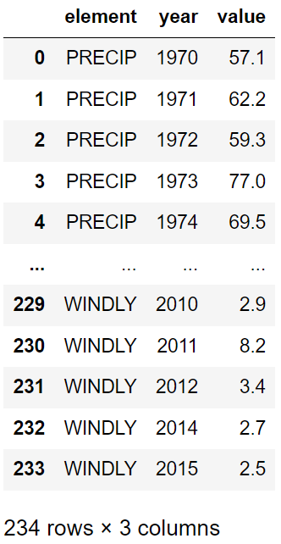
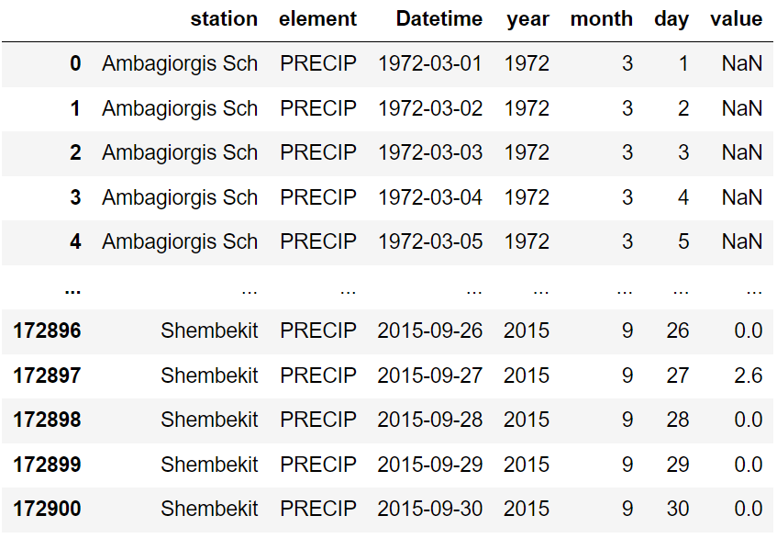
.groupby()

Slide 20
Exporting a dataframe
Data can be exported (written to some file) with built-in DataFrame methods
Exporting to a csv file: dataframe.to_csv(FILEPATH)
Exporting to an Excel file: dataframe.to_excel(FILEPATH)
Be careful: existing files with similar filename will be overwritten!

Slide 21
Pandas for Meteorology Data – Summary
Loading data
pd.read_csv(), pd.read_excel()
Timestamps
pd.to_datetime(), pd.to_timedelta()
Grouping data
df.resample(), df.groupby()
Exporting data
df.to_csv(), df.to_excel()
Arba Minch University | Python training

Slide 22

Good luck!

