Slide 1
Module 4 Visualizing Data
Python for Data Processing

Slide 2
Contents
Creating a basic plot
Saving your figure
Line visuals
Legend, ticks and secondary axis
This lecture will only scatch the surface. More information will be inside the exercises notebook.

Slide 3


Matplotlib.pyplot
matplotlib.pyplot is a python module for plotting data
When you want to use this module, you have to import it
A plot can be created using the function plt.subplots()
Assign the output of the function to fig and ax

Slide 4
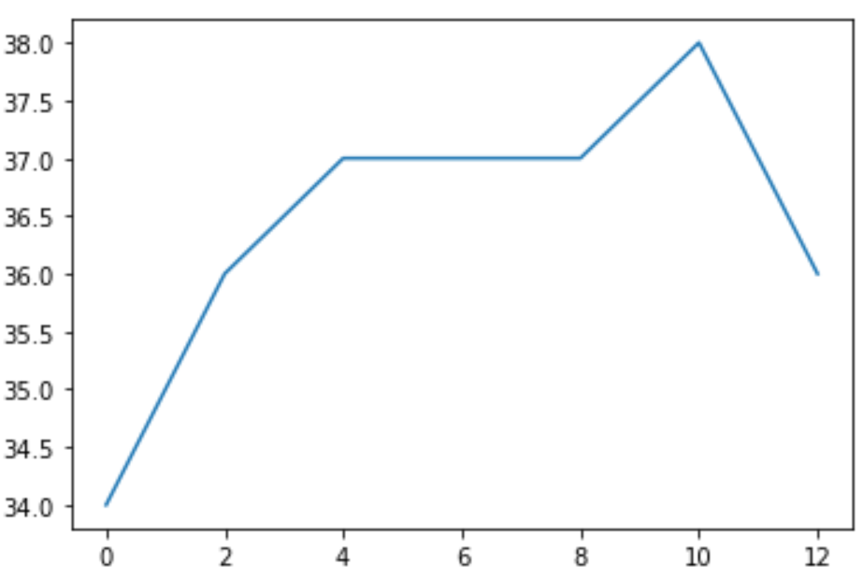
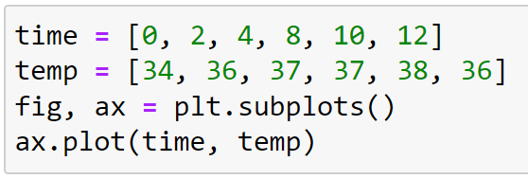
Matplotlib.pyplot
Let’s create our first plot
Use the function ax.plot(x, y)

Slide 5
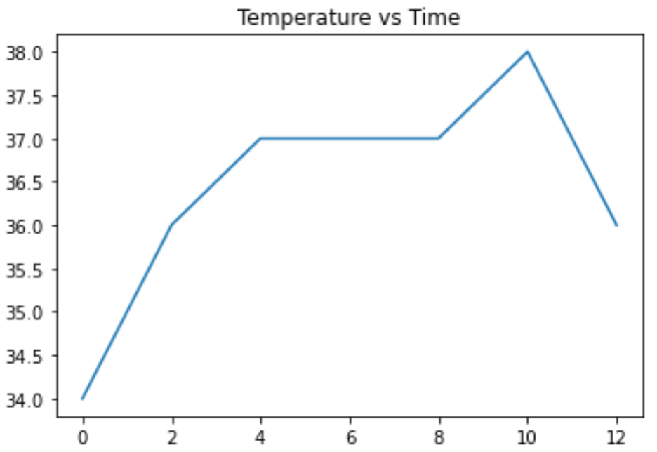

Matplotlib.pyplot
This plot looks too simple
Let’s improve it step by step using variations of the function ax.set_
Let’s add a title

Slide 6
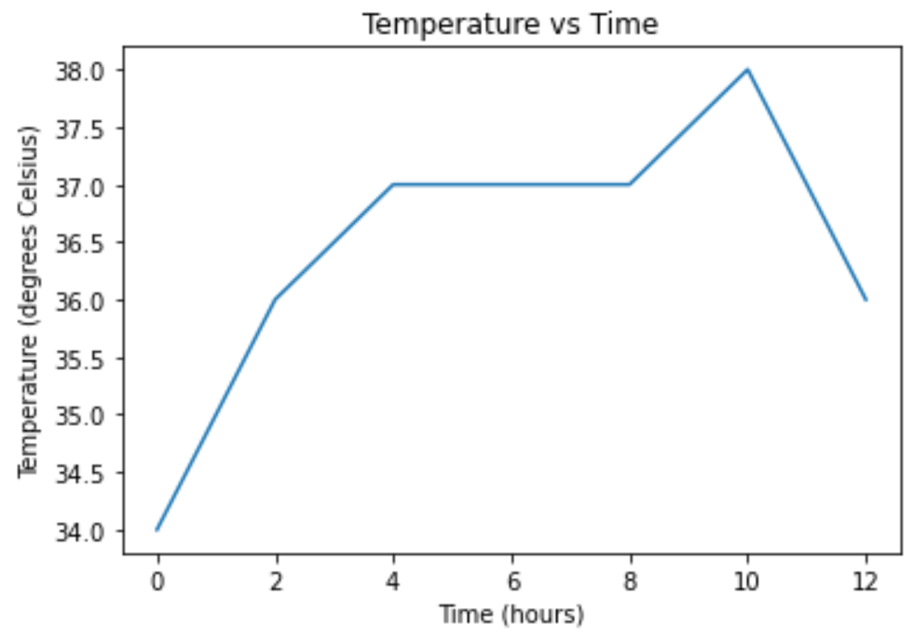
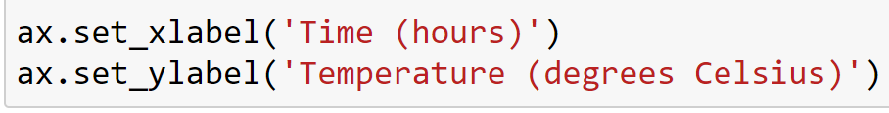
Matplotlib.pyplot
Let’s add labels to the x-axis and y-axis

Slide 7
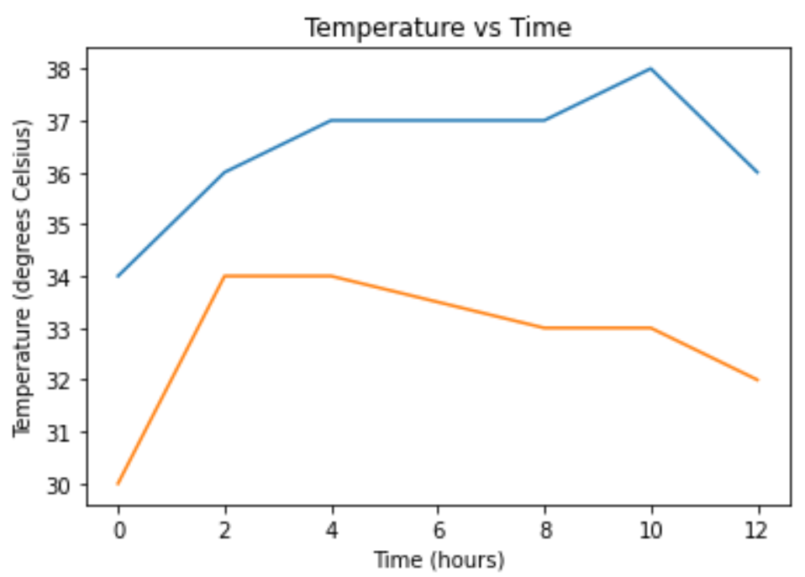
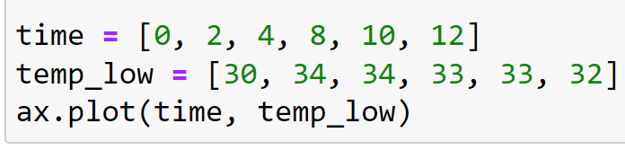
Matplotlib.pyplot
We can also add more lines to the plot
Let’s add the values for temp_low
We do this by repeating the ax.plot(x, y) command

Slide 8
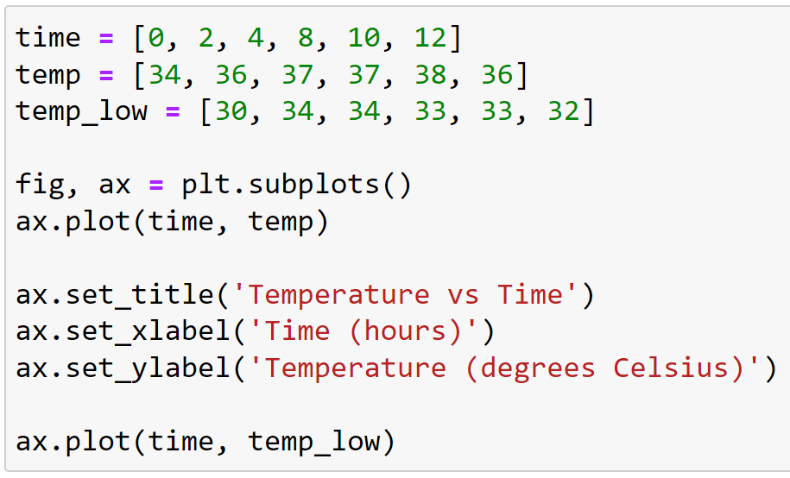
Matplotlib.pyplot
End result

Slide 9
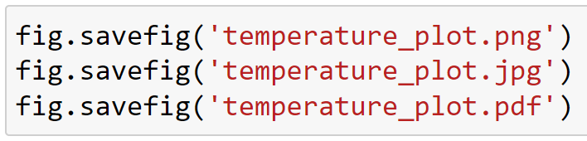
Saving a plot
If you want, you can save the plot
You can save to different file types
When you want to publish your plot, use PDF format

Slide 10
Line visuals
When plotting a line, you can change how the line looks
4 basic things you can change:
Color (c)
Linestyle (ls)
Linewidth (lw)
Marker
These are arguments of the .plot() function

Slide 11
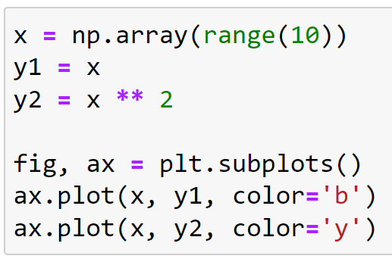
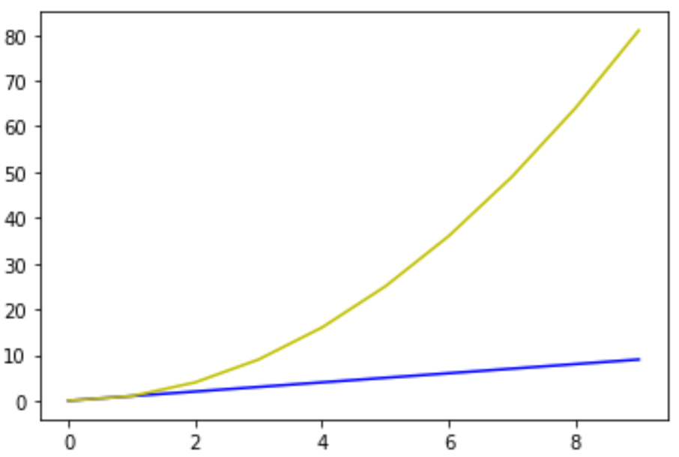
Line visuals
When plotting a line, you can change how the line looks
4 basic things you can change:
Color (c)
Linestyle (ls)
Linewidth (lw)
Marker
These are arguments of the .plot() function

Slide 12
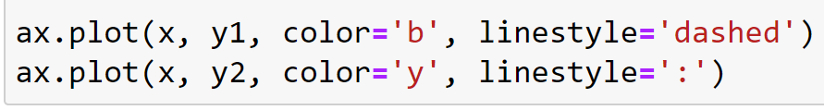
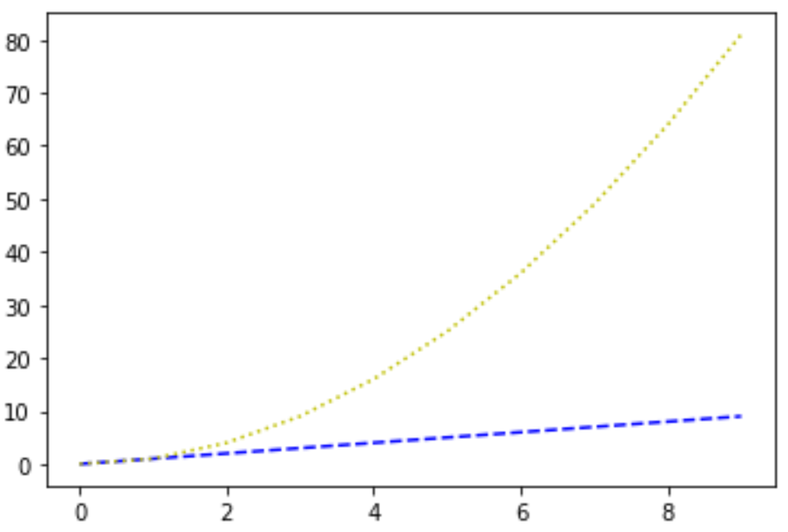
Line visuals
When plotting a line, you can change how the line looks
4 basic things you can change:
Color (c)
Linestyle (ls)
Linewidth (lw)
Marker
These are arguments of the .plot() function

Slide 13
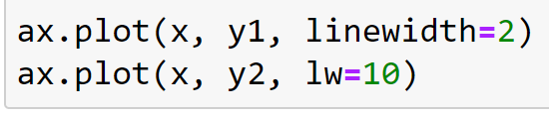
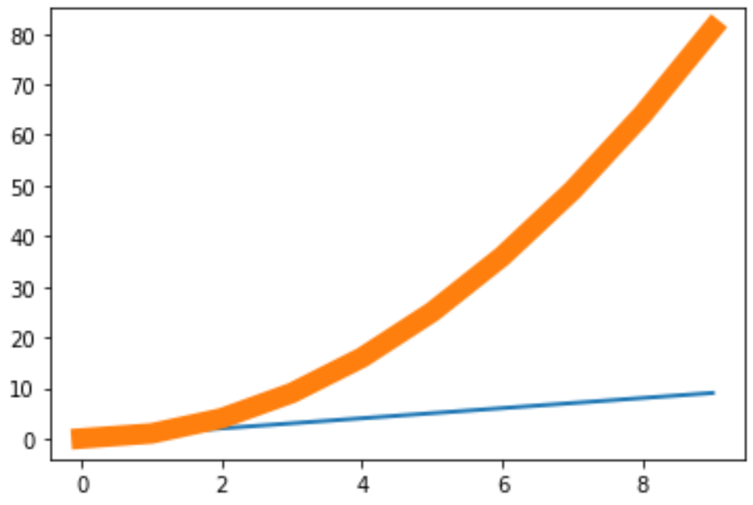
Line visuals
When plotting a line, you can change how the line looks
4 basic things you can change:
Color (c)
Linestyle (ls)
Linewidth (lw)
Marker
These are arguments of the .plot() function

Slide 14
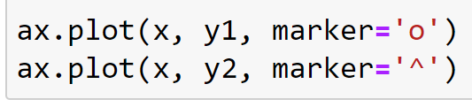
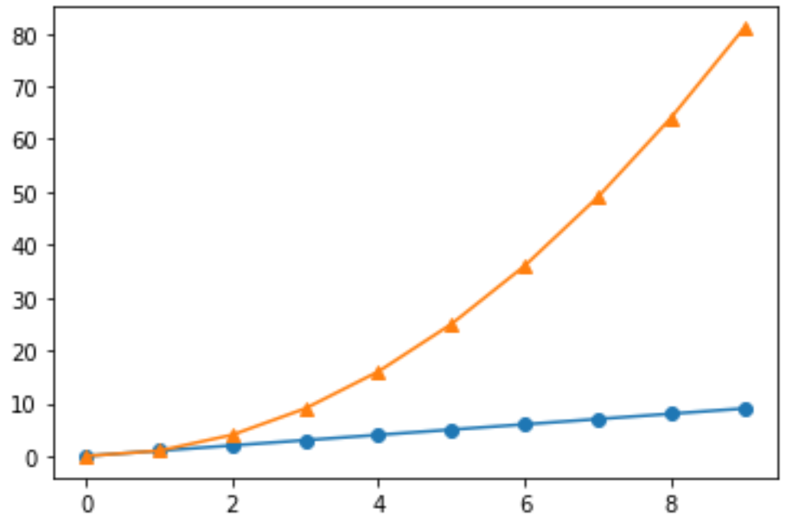
Line visuals
When plotting a line, you can change how the line looks
4 basic things you can change:
Color (c)
Linestyle (ls)
Linewidth (lw)
Marker
These are arguments of the .plot() function

Slide 15
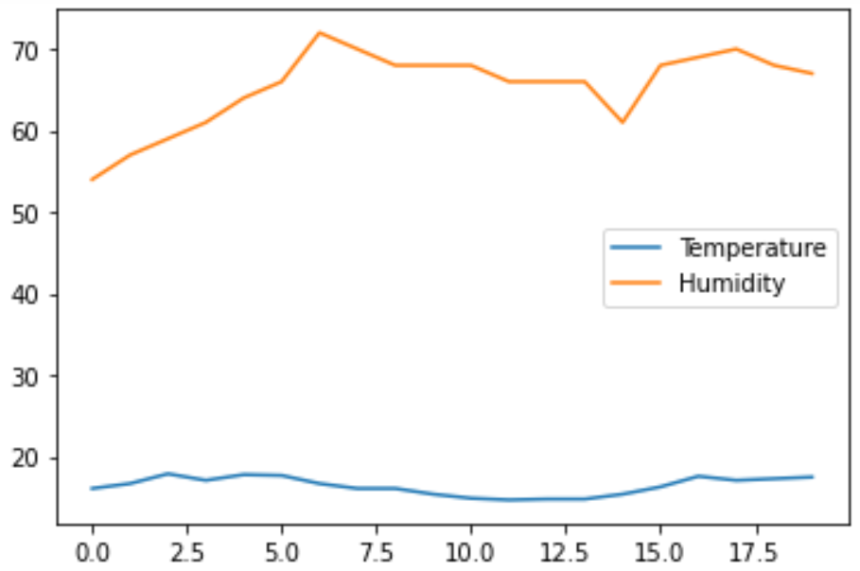
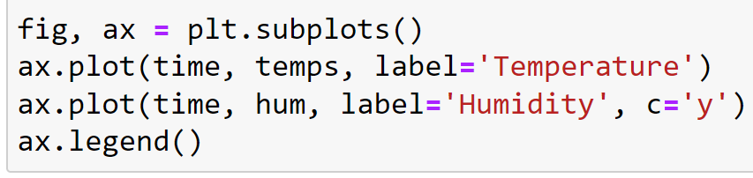
Line labels and a legend
When plotting a line you can give it a label
When lines have labels you can add a legend to the plot

Slide 16
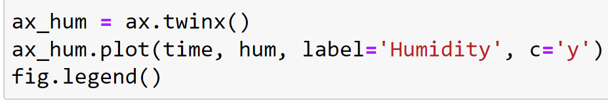
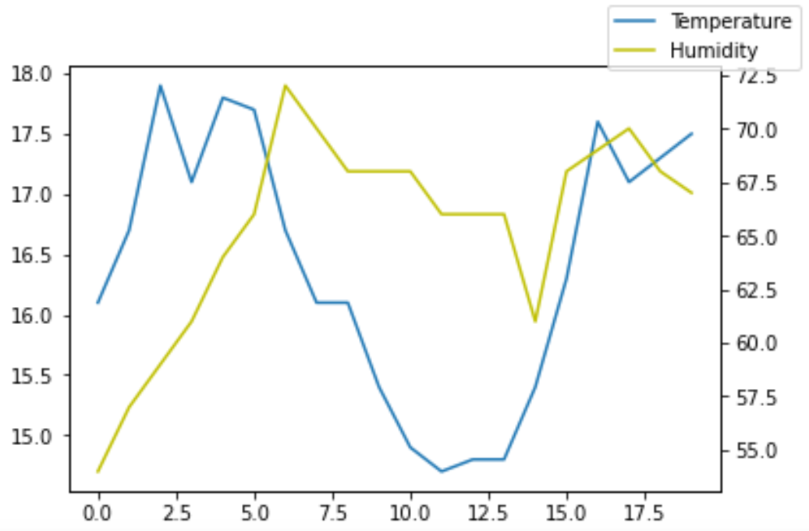
Secondary axis
Temperature and humidity are plotted on the same y-axis
However, the range of values is different
Instead of plotting them on the same axis, we can create a secondary axis
(Because we have two axes, we need to add the legend to fig)

Slide 17
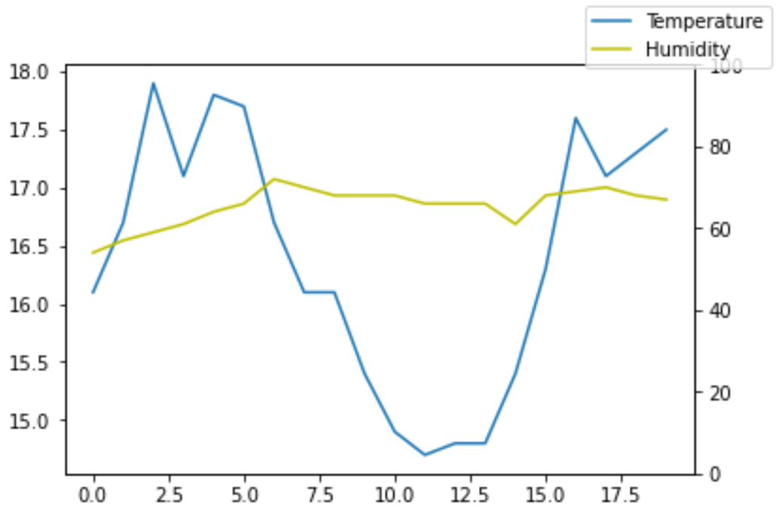

Setting axis limit
The range of the humidity y-axis is 53-73
We can change this to 0-100 by setting the y limit

Slide 18
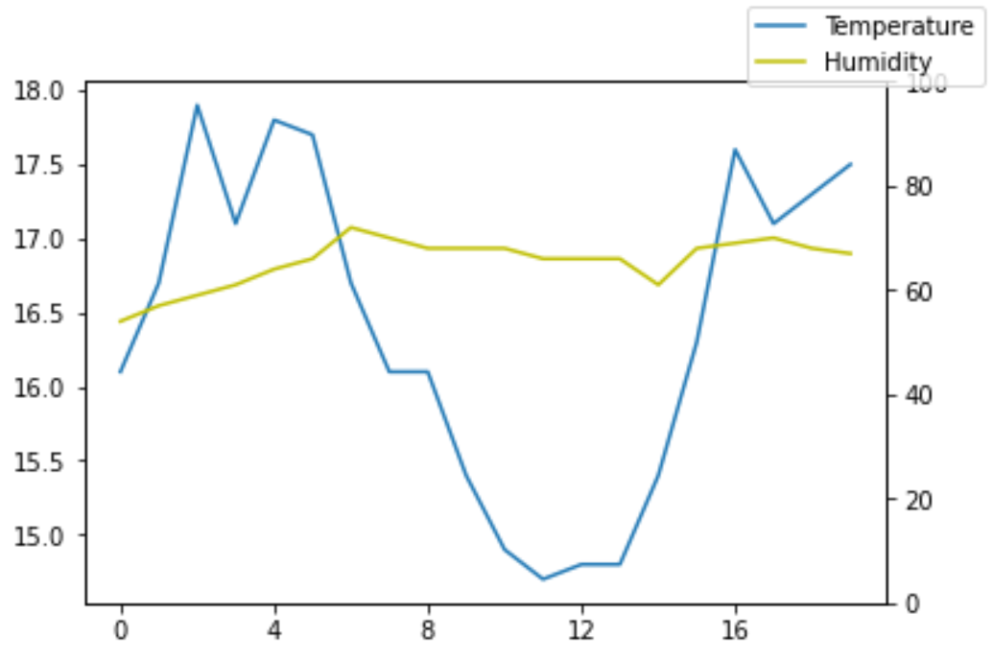
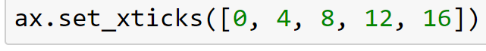
Changing ticks and tick labels
Also the ticks on the x-axis and y-axis can be changed
Let’s change the ticks on the x-axis to [0, 4, 8, 12, 16]

Slide 19
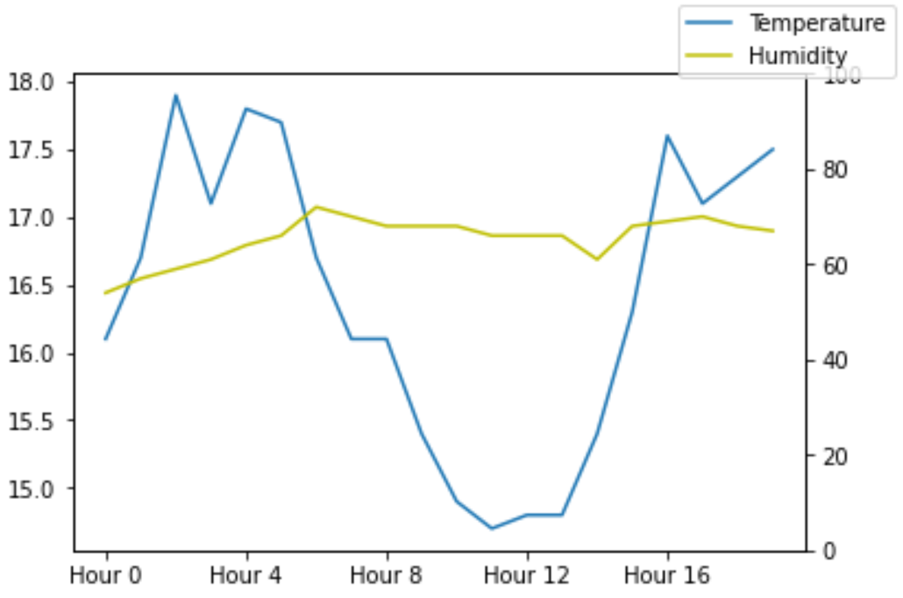
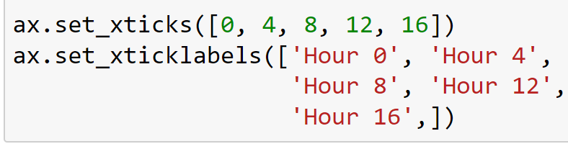
Changing ticks and tick labels
Now that we have set the axis ticks, we can also add tick labels

Slide 20
Plotting – Summary
Creating a plot
plt.subplots(), ax.plot(x, y)
Adding to your plot
ax.set_...
Saving your plot
fig.savefig(YOUR_FILEPATH)
Line visuals
color, linestyle, linewidth, marker
Arba Minch University | Python training

Slide 21
Two final remarks
Search on the internet and take a look at the matplotlib.pyplot documentation
Every part of a plot can be changed! Unlimited possibilities!
If you want to know how: ask the internet
Use TAB and ? to get to know and understand functions
The exercise notebooks contain more theory than usual
Carefully read through it
Try to understand the example code
Try to predict the output of the example code before you run the cell
Try to change some settings and see what happens!

Slide 22

Good luck!

