Slide 1
Module 4.2 Visualizing Meteorology Data
Python for Data Processing

Slide 2
Contents
Multiple axes
Adding text to a plot
Scatter plot
This lecture will only scatch the surface. More information will be inside the exercises notebook.

Slide 3

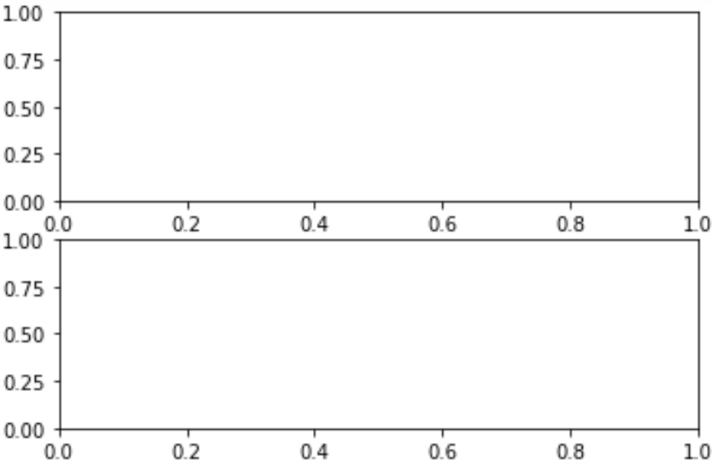


Multiple axes
Until now we always created only one axes
However, we can also create multiple axes in a single figure
This is done by using dimensions as input to the function

Slide 4
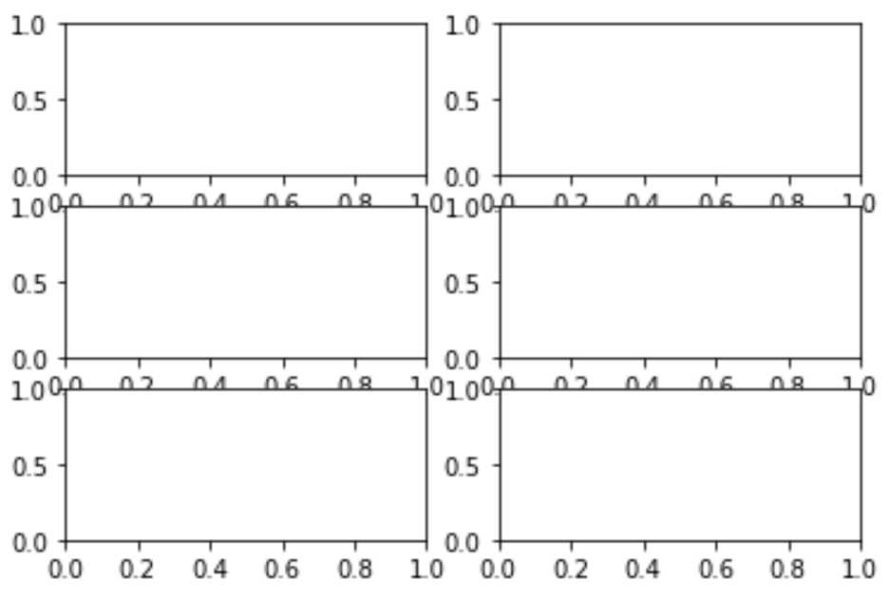
Multiple axes
We need to create an ax variable per axes

Slide 5
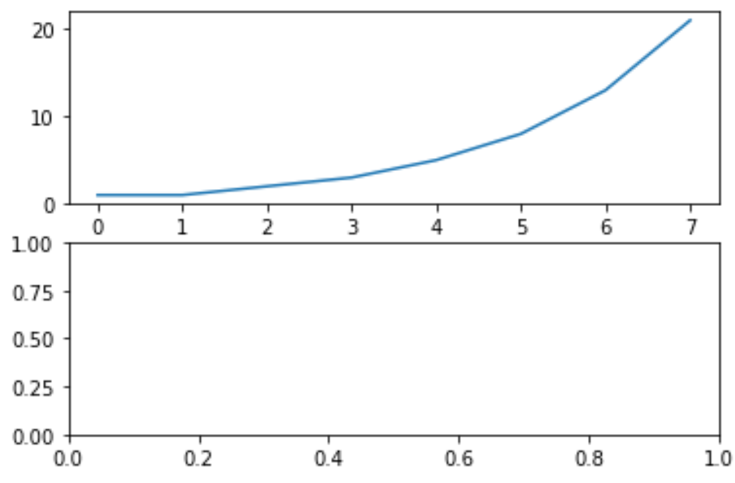
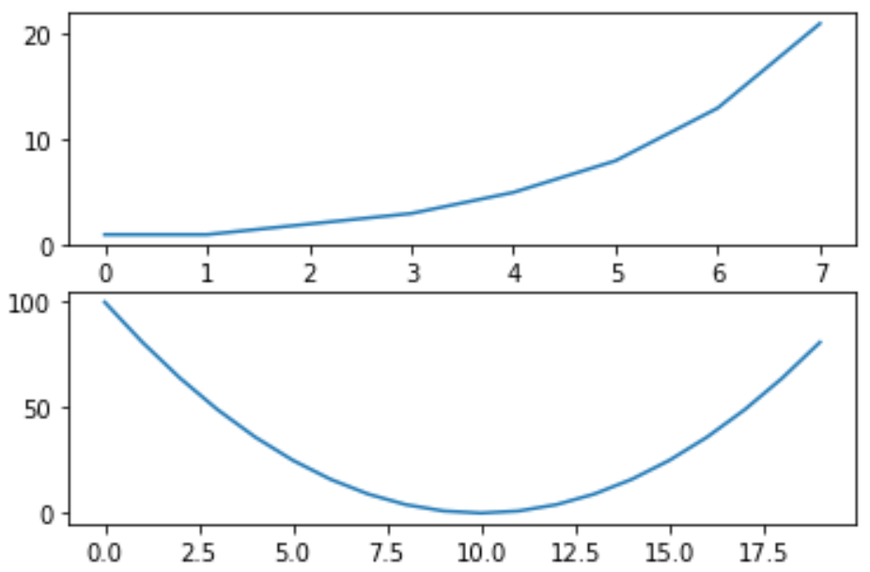
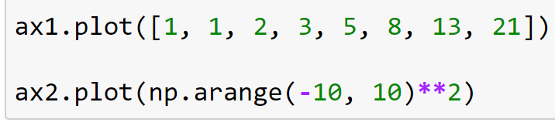
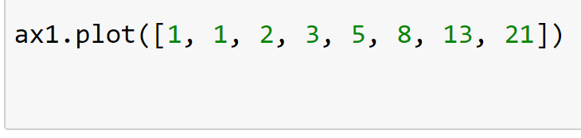
Multiple axes
We need to create an ax variable per axes
These ax variables we can use to plot on specific axes

Slide 6
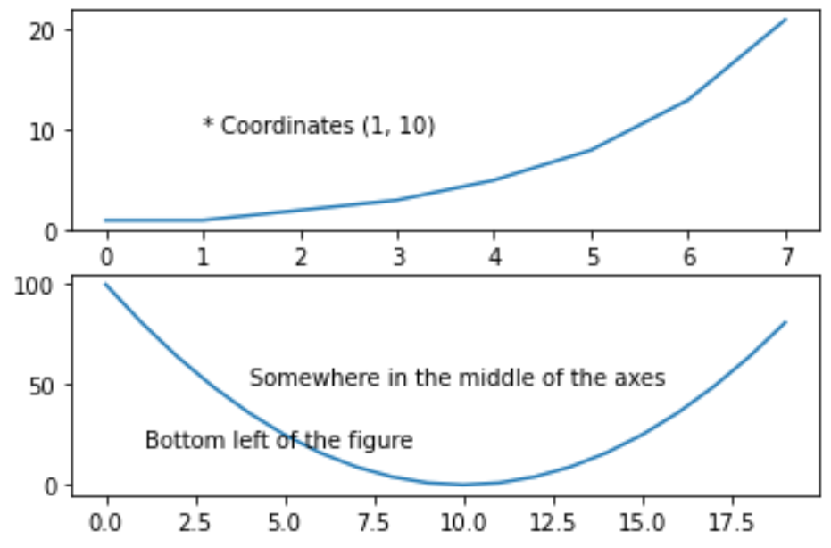
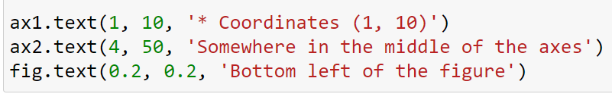
Adding text to a plot
You can add text to a plot
This is done by the function .text(x, y, ‘text’)
You can add text either to the figure or to one of the axes

Slide 7
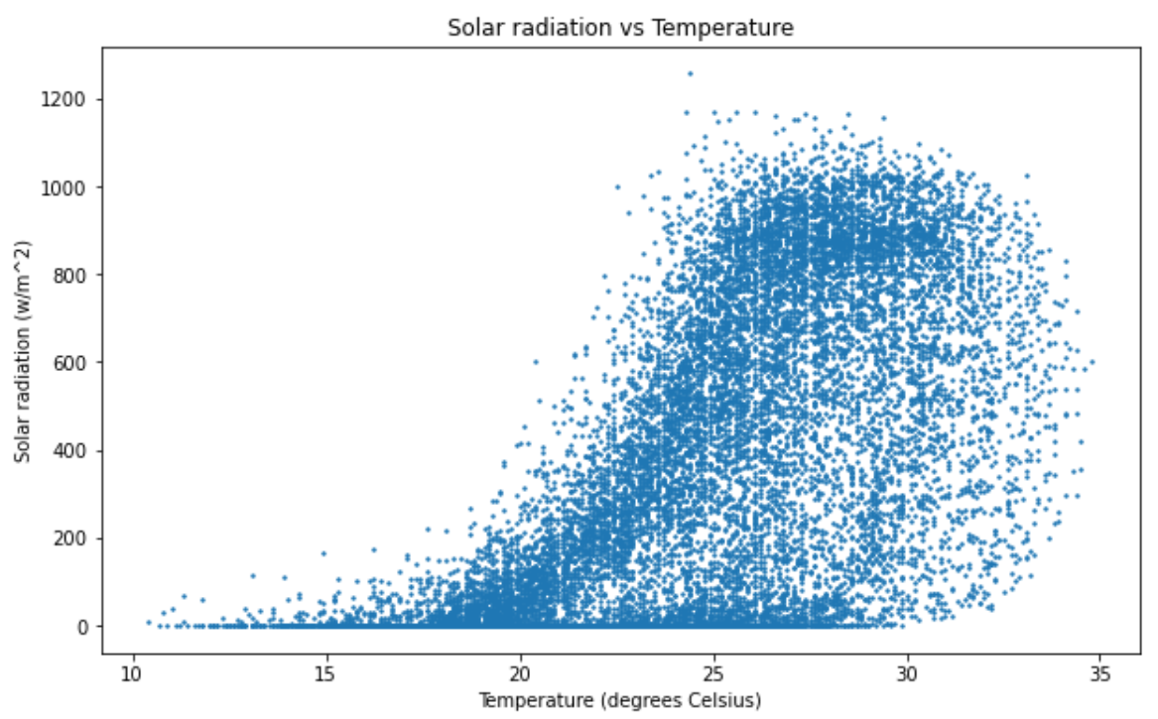
Scatter plot
Until now we have always plotted a line plot
However, this is only useful for plotting time series
For some data it is better to make a scatterplot
This can be done using the function ax.scatter()

Slide 8
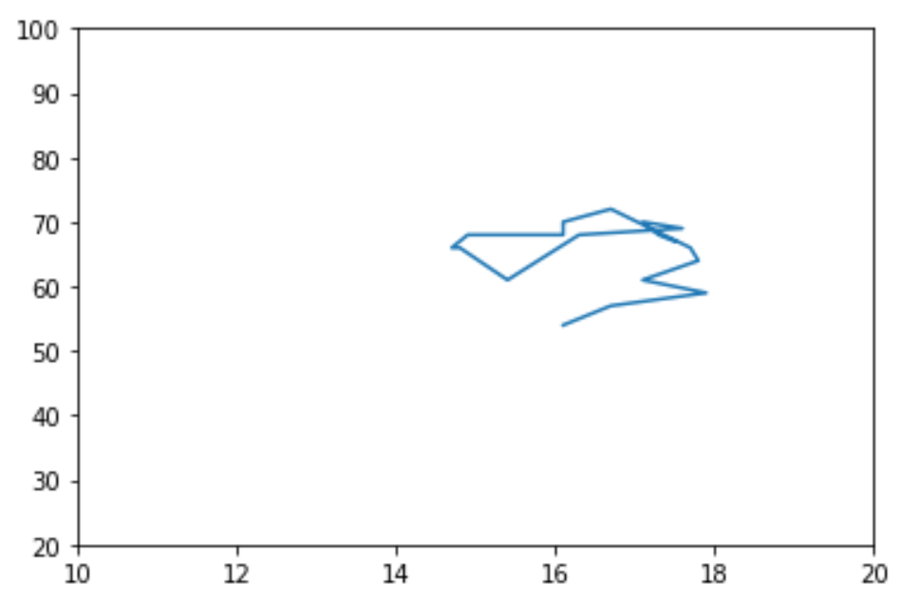
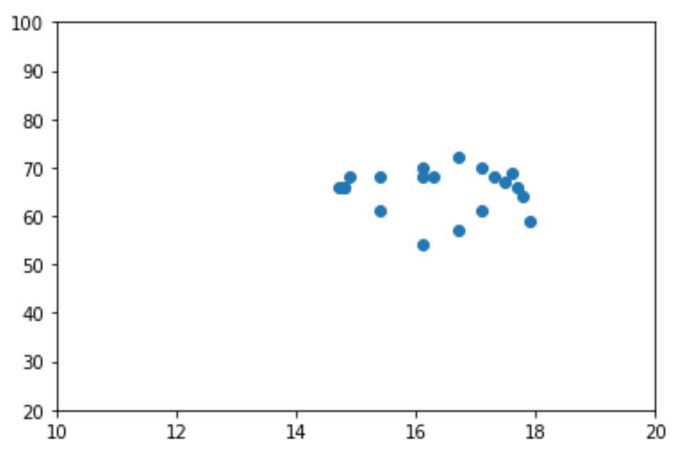


Scatter plot
Let’s plot temperature vs humidity

Slide 9
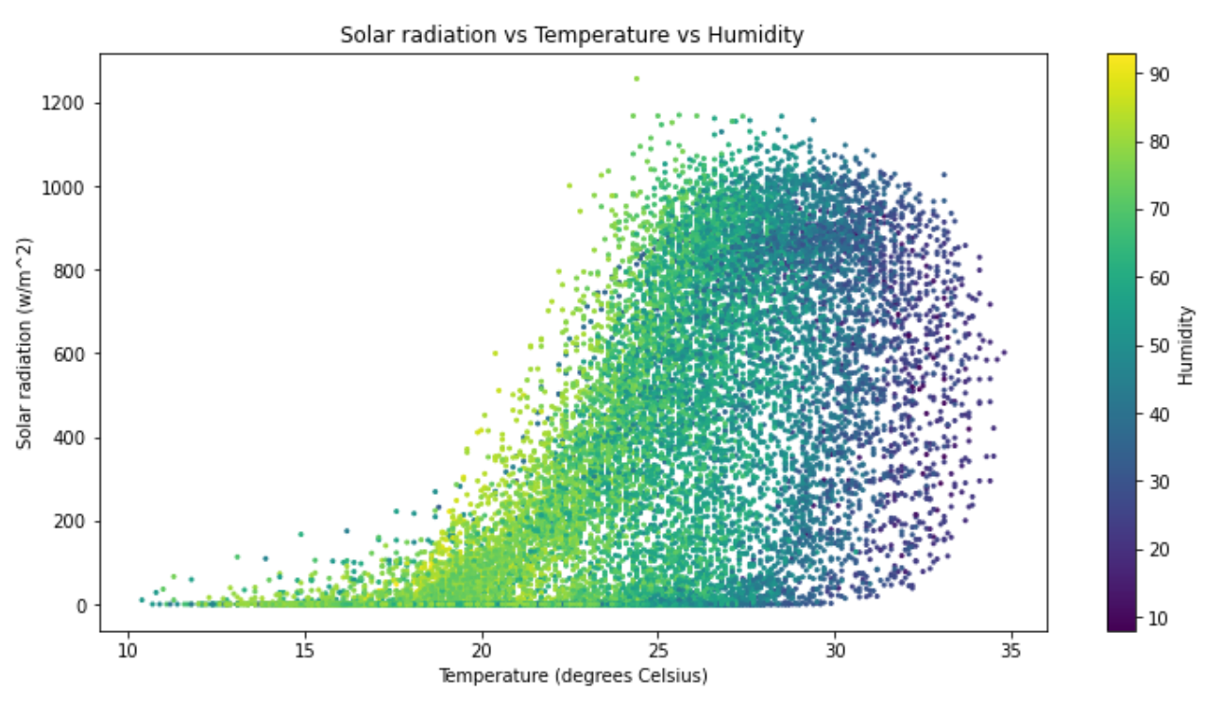
Scatter plot – Adding a third dimension
With a scatter plot, you can also add a third dataset
Let’s add Humidity data using colors
During the exercises we will learn how to create this plot

Slide 10
Plotting – Summary
Multiple axes
plt.subplots(rows, columns
Adding text
ax.text()
Scatter plot
ax.scatter()
Arba Minch University | Python training

Slide 11

Good luck!

