Slide 1
Module 5.1 Working with Satellite Data
Python for Data Processing

Slide 2
Contents
What is NetCDF?
Loading and saving a NetCDF file
NetCDF metadata
Selecting data from a NetCDF file
Boolean slicing
Mathematics
Plotting on a map

Slide 3
What is NetCDF?
NetCDF files are commonly used in climatology and meteorology applications
E.g., weather forecasting and climate change → satellite data
Characteristic 1: it contains metadata
What type of data does it contain?
What are the data units?
What is the data size?
What are the dimensions?
Characteristic 2: it is multidimensional

Slide 4
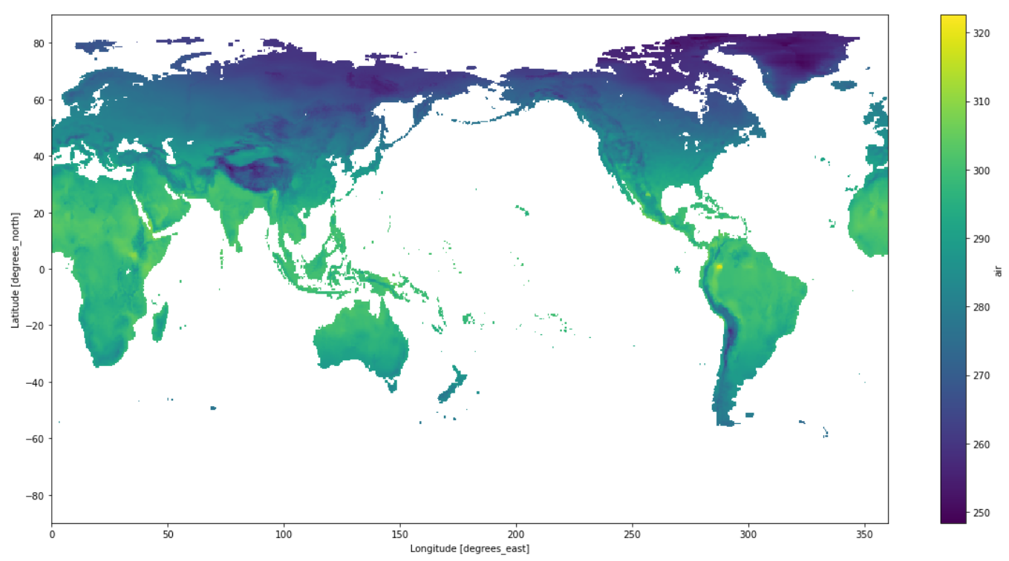
What is NetCDF?
Metadata
Temperature
Degrees Kelvin
How many dimensions?

Slide 5
What is NetCDF?
How many dimensions?

Slide 6


Loading a NetCDF file
To load a NetCDF file in Python, we need the package xarray
From xarray, we use the function .open_dataset()

Slide 7



Saving a NetCDF file
You can also save the NetCDF file to a .csv file
This takes two steps:
Change the NetCDF to a pandas dataframe
Save the dataframe to a .csv file
However, this is not recommended!

Slide 8
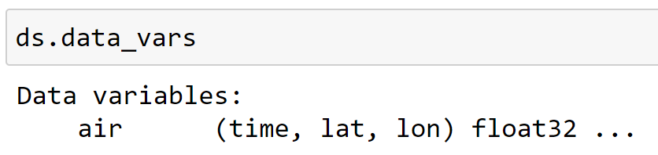

NetCDF metadata
NetCDF files contain a lot of metadata
This metadata can be discovered using attributes
For example, using ds.data_vars we can check what data is inside
We can acces this data by using the data name as attribute
Let’s see what this gives as output…

Slide 9
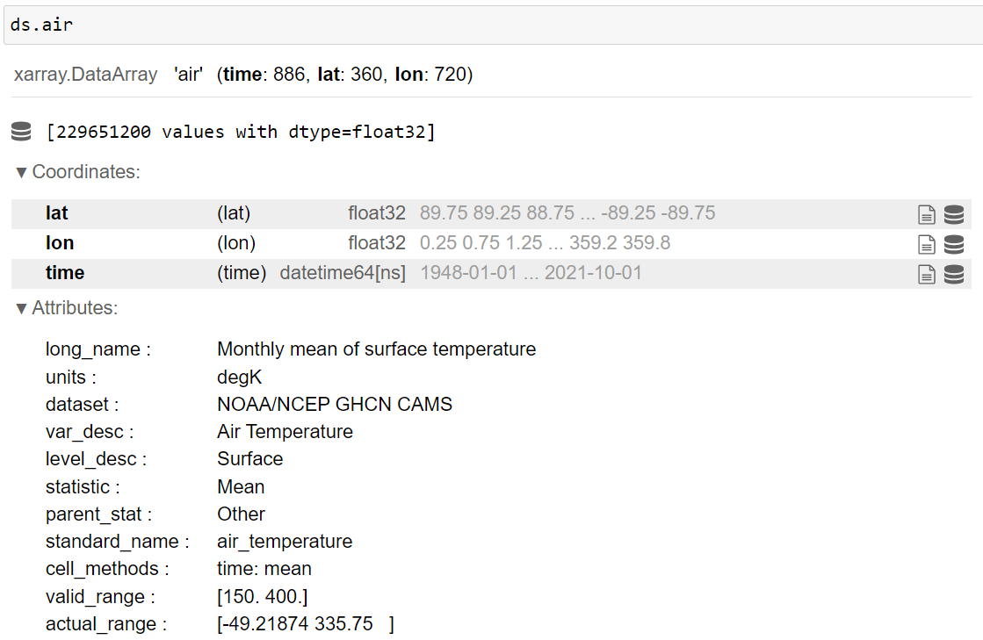
9

Slide 10
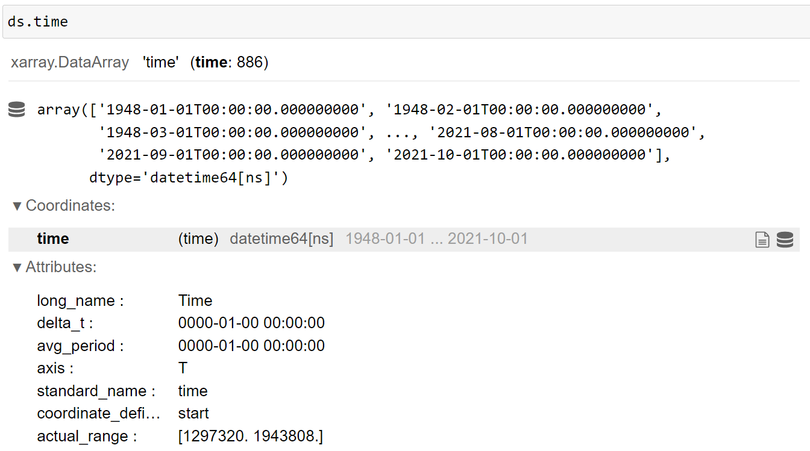
In the same way we can explore specific coordinates / dimensions
10

Slide 11
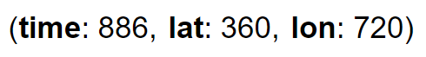

Selecting data – Boolean slicing
With dataframes we could select data in two dimensions: rows and columns
.loc[row_selection, column_selection]
However, now we will slice in multiple dimensions
We saw this:
We can slice using:

Slide 12
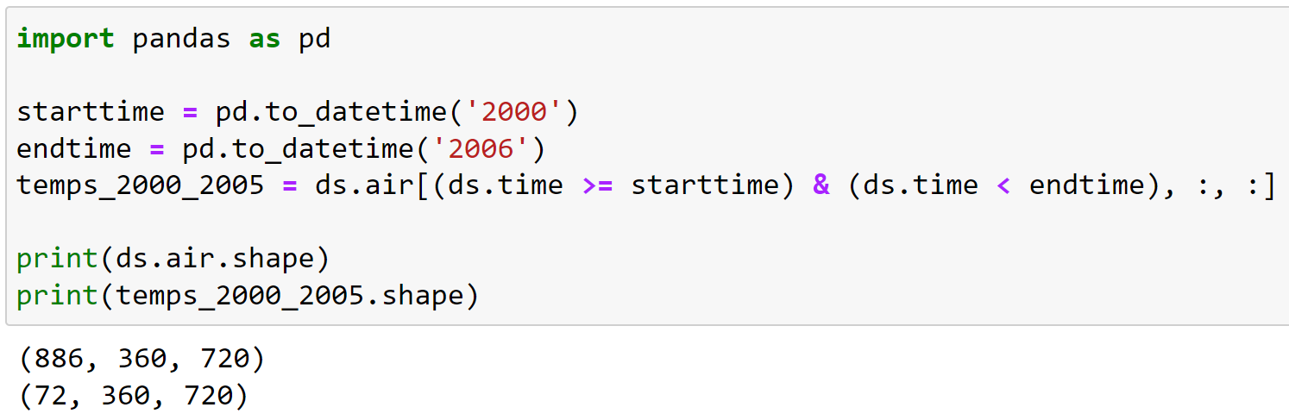
Selecting data – Boolean slicing
Let’s say we want only the temperatures of the years 2000-2005
In which dimension should we slice?
We use the coordinates to create the booleans

Slide 13
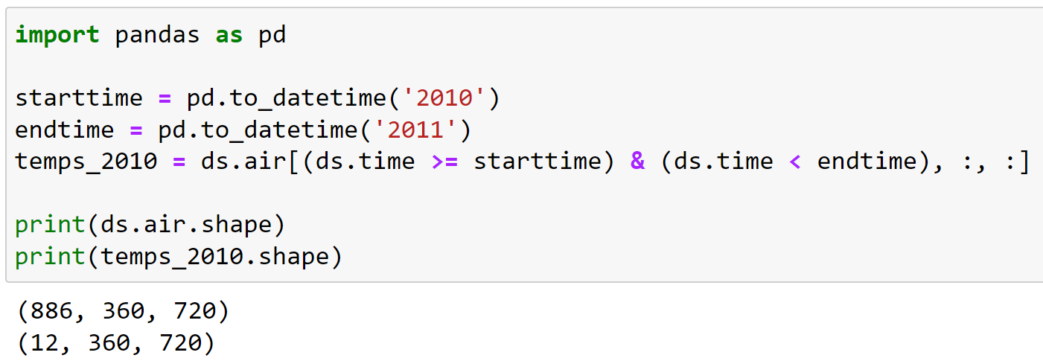
Selecting data – Boolean slicing
When we want to select another time range, we only need to change the starttime and endtime (and the variable name)

Slide 14
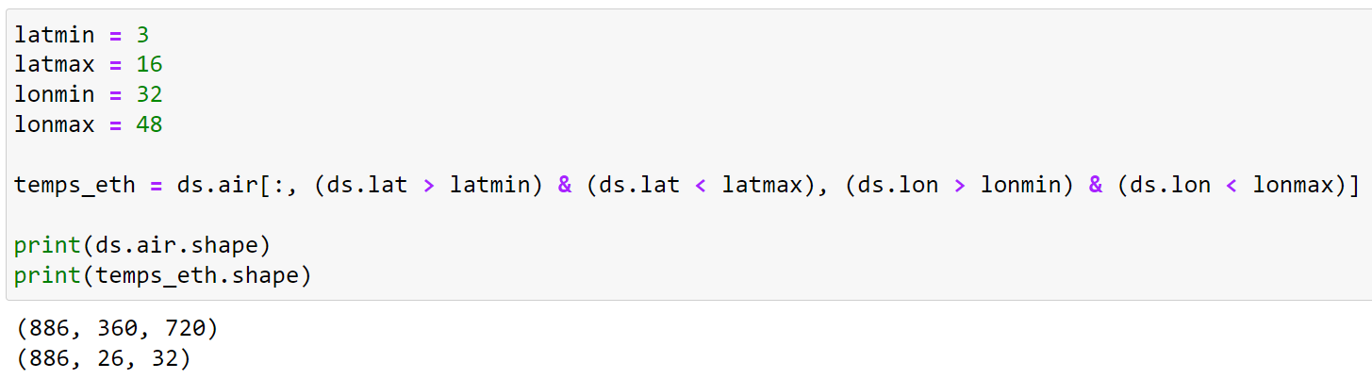
Selecting data – Boolean slicing
Let’s say we want only the temperatures of Ethiopia
In which dimension(s) should we slice?
What information do we need for slicing?
When we want to select another region, we only need to change these boundaries

Slide 15
Selecting data – Mathematics
Now that we know how to select data, we can also do calculations on the selections
In module 3 we have worked with numpy functions like np.max(), np.min() and np.mean()
These functions can be applied to specific dimension(s)
By using the argument axis= inside the function

Slide 16

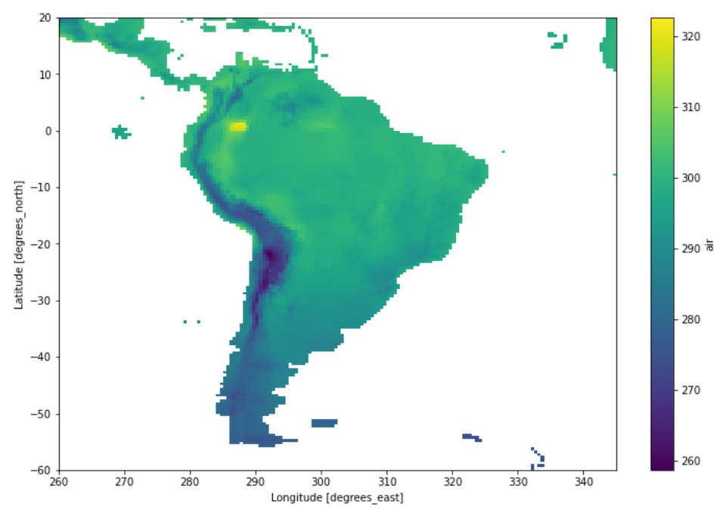
Selecting data – Mathematics
We selected all temperatures of the region South-America
For the years 1948-2021
How can we calculate, for every location, the mean temperature over time?
To what dimension(s) should we apply the calculation?

Slide 17

Selecting data – Mathematics
We selected all temperatures of the region South-America
For the years 1948-2021
How can we calculate, for every location, the mean temperature over time?
To what dimension(s) should we apply the calculation?

Slide 18

Selecting data – Mathematics
How can we calculate, for every timestep, the mean temperature for the whole region?
To what dimension(s) should we apply the calculation?

Slide 19

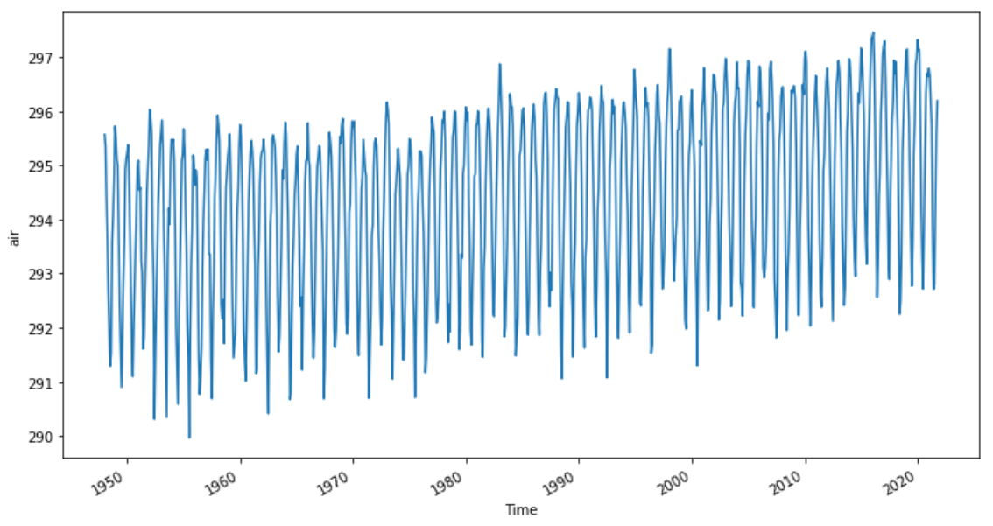
Selecting data – Mathematics
How can we calculate, for every timestep, the mean temperature for the whole region?
To what dimension(s) should we apply the calculation?

Slide 20
Working with Satellite Data – Summary
NetCDF is a filetype to store satellite data
Metadata, multidimensional
Loading NetCDF file
Xarray, xr.open_dataset()
Saving NetCDF to .csv is not recommended
Explore NetCDF metadata using attributes
Selecting data using boolean slicing and numpy functions
Watch the dimensions/coordinates!
Arba Minch University | Python training

Slide 21

Good luck!

