Slide 1
ICG 2
Electric Boogaloo
Design Review

Slide 2
High Level Architecture
User-Provided Inputs
My Reflection Implementation
Output Header File
DataStructures.hh
Interface Code Generator
io_DataStructures.hh
Input Header File
DataType Library
SimulationCode.cpp
Executable
User-provided program
Final result

Slide 3
Type Representation
DataType is the base class of a hierarchy of types that can be used to represent all supported types. This allows the arbitrary composition of types. Doxygen
abstract
DataType
concrete
ArrayType
EnumType
PointerType
StringType
PrimitiveType
CompositeType
SequenceType
SpecifiedPrimitiveType<T>
SpecifiedSequenceType<T>
SpecifiedCompositeType<T>

Slide 4
Type representation with composition
Foo
CompositeType
class Foo {
int a[5][4];
Bar b;
};
class Bar {
vector<string> c;
unsigned long d;
};
a
b
[5]
ArrayType
Bar
CompositeType
Element Type
c
d
[4]
ArrayType
vector
SequenceType
unsigned long
PrimitiveType
Element Type
Element Type
int
PrimitiveType
string
StringType

Slide 5
What’s in a DataType?
Each DataType class has:
Total size of type in bytes
String representation of the type name
Allocator and deallocator
Subclasses hold specific information about their own structure
CompositeDataType has a map of its members
ArrayDataType has information about its elements
Types that represent a literal (primitives, strings) have the ability to get or set a value at a given address
Foo
CompositeType
Members
Name | DataType* | Offset
a | ArrayType | 0x0
b | CompositeType | 0x50

Slide 6
Managing DataTypes at runtime
The DataTypeInator keeps track of types at runtime
DataTypes are registered and validated at initialization time
New pointer and array types can be created during runtime
provide the transformation from string -> DataType* at runtime
Handles parsing, namespaces, typedef statements
“int” | SpecifiedPrimitiveType<int>
“unsigned long” | SpecifiedPrimitiveType<unsigned long>
“std::string” | StringType
“Foo” | SpecifiedCompositeType<Foo>
“Bar[5]” | ArrayType
“vector<string>” | SpecifiedSequenceType<vector<string>>

Slide 7
Memory Management
This is as similar to the current Trick interface that I can manage
Keep track of all allocated data structures’ location, type, and name
Use the DataTypeInator to get DataType from user provided string
Delete local allocs in destructor, leave extern allocs alone
Foo * f_ptr = memoryManager->declare_var(“Foo foo”);
memoryManager->declare_var(“std::vector<int> x”, &x);
Memory
Manager
Name: foo
Type: “Foo”
Address: 0xc0ffee
Storage: local
Name: x
Type: “std::vector<int>”
Address: 0xdeadbeef
Storage: extern
doxygen code

Slide 8
Assignment from string using DataTypes
“foo.b.c[5] = \“Hello Trick!\””
Steps:
Parse assignment string
Get the allocation named “foo” from the memory manager, along with its starting address and DataType
Traverse the composite tree of the Foo DataType using remaining name parts “b”, “c”, “[5]” to calculate the address of foo.b.c[5]
Assign the string literal “Hello Trick!” to the string object at that calculated address
code
code
class Foo {
Bar b;
};
class Bar {
vector<string> c;
};
code
Name: foo
Type: “Foo”
Address: 0xc0ffee
code
Memory
Manager
code

Slide 9
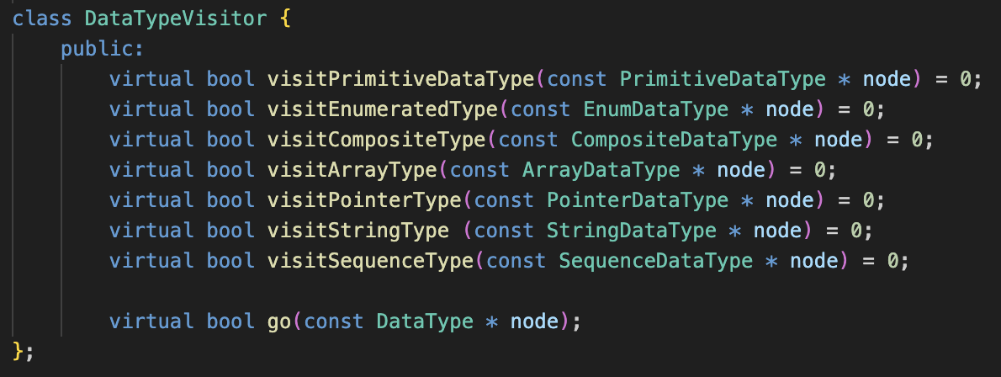
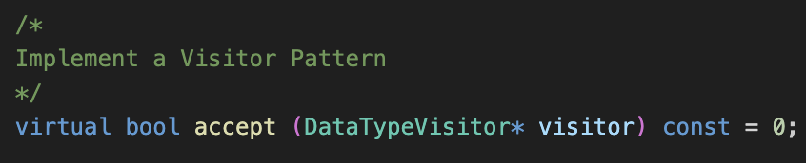
Traversing DataTypes without dynamic_cast
Use a visitor pattern with double dispatch to:
Avoid bloating the DataType classes and/or using slow dynamic casting
Provide a way to write arbitrary algorithms with awareness of which subclass of DataType they are operating on
In DataType base class
Doxygen, code

Slide 10
Implementing DataType Algorithms
Entry points are in DataTypeAlgorithms.hpp doxygen code
Visitor algorithms can do many things -
Search the tree
LookupNameByAddress
LookupAddressByName
Traverse the entire tree
FindLeaves
PrintValue
Apply an operation to target type(s) and ignore all others
GetValue
AssignValue
ResizeSequence

Slide 11
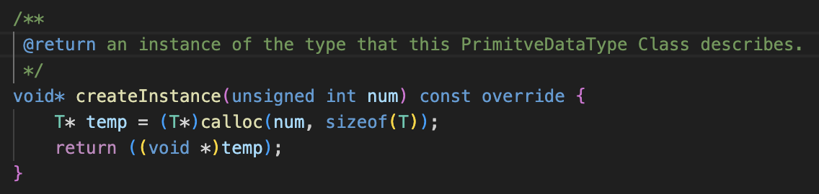
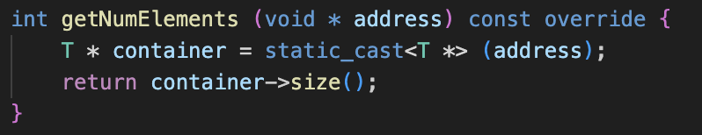
Type representation with Templates
Some DataTypes must take the class that is being represented as a template parameter to implement some operations. C++ does not allow for a virtual templated function, so they must inherit from a non-templated class that defines the specialized interface.
getNumElements in SpecifiedSequenceType<T>
createInstance in SpecifiedPrimitiveType<T>
DataType
PrimitiveType
SequenceType
CompositeType
SpecifiedPrimitiveType<T>
SpecifiedSequenceType<T>
SpecifiedCompositeType<T>

Slide 12
Interface Code Generator
This overarching structure is the same as Alex’s current ICG
User-Provided Inputs
DataStructures.hh
Interface Code Generator
io_DataStructures.hh
Generate AST
Traverse AST
Intermediate Representation
Code Generation

Slide 13
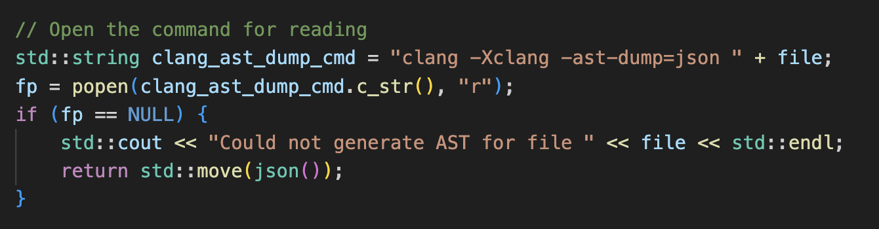
AST Generation
LibClang has been ditched!
Instead, use normal Clang to dump an AST to json
This is somewhat experimental and hacky
Code

Slide 14
AST Filtering
This AST includes all system headers
Filter it manually
Get the system header paths by running clang -### <filename> code
Prune AST json tree by chopping off branches that are located in those paths code
Note - the existence of the SourceManager class means that maybe instead of doing the filtering upfront, we could just prune the traversal like LibClang and Alex’s code does. I don’t think it matters much.
Filtering utility is available as a standalone tool here. It is useful for debugging.

Slide 15
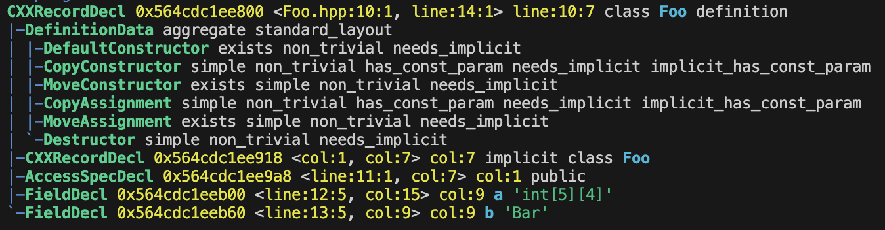
Traversing the Abstract Syntax Tree
At this stage of compilation, the compiler has already done things that are hard, like pulled in all includes, resolved macros, figured out fully qualified names, and generated class template instantiations

Slide 16
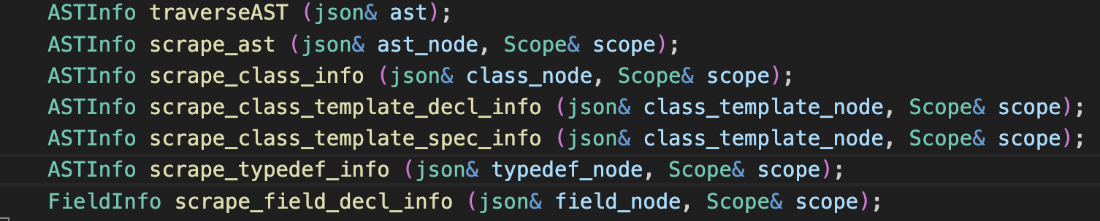
AST Traversal
JClang doxygen code
I’ve written some utilities to make interacting with the Json AST easier
I want to ensure that the entire Json AST is exposed, to prevent issues like the LibClang and template specialization problem from happening
Implements a traversal model close to what LibClang supports

Slide 17
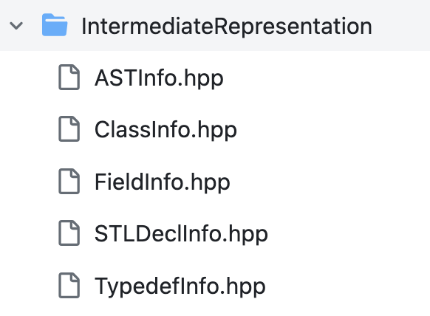
Intermediate Representation
Traverse the AST to scrape intermediate representations of:
Classes
Includes field and base classes
Field
Save name and type
Class Templates
Only pay attention to specializations, so really just treat these as normal classes with funky names
TypeDefs
Need alias name -> full canonical name
STL
STLs must be defined specially, so we need to scrape all types of STLs used

Slide 18
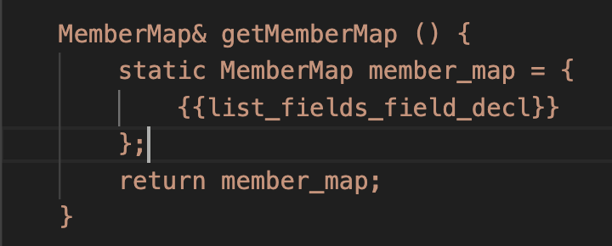
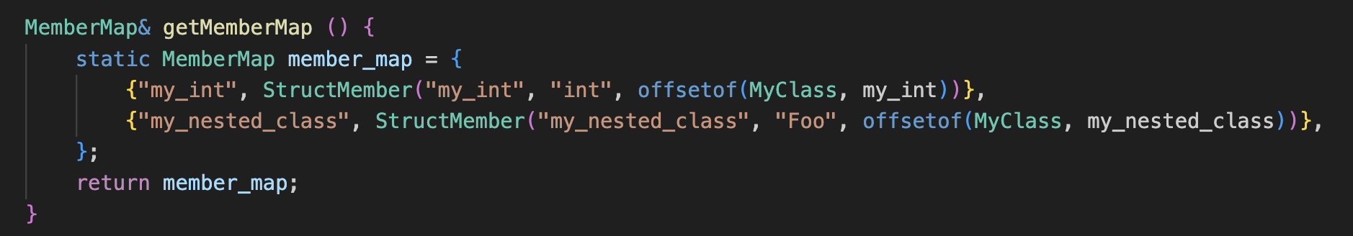
Code generation method
Use template engine (similar in concept to mustache, not C++ templates) to perform source code generation. Hardcoded strings have the expected structure, and they are filled in by the information scraped from the AST

Slide 19
Special Considerations

Slide 20
CompositeTypes
Composite types use a new design that takes advantage of template specialization!
Foo
MemberMap
class Foo {
int a[5][4];
Bar b;
};
Class
Definition
(user provided)
Name | DataType | Offset
a | int[5][4] | 0x0
b | Bar | 0x50
class SpecifiedCompositeType<Foo> : public CompositeType {
MemberMap& getMemberMap () {
static MemberMap member_map = {
{"a", StructMember("a", "int[5][4]", offsetof(Foo, a))},
{"b", StructMember("b", "Bar", offsetof(Foo, b))} };
return member_map;
}
};
Type Definition (ICG generated)

Slide 21
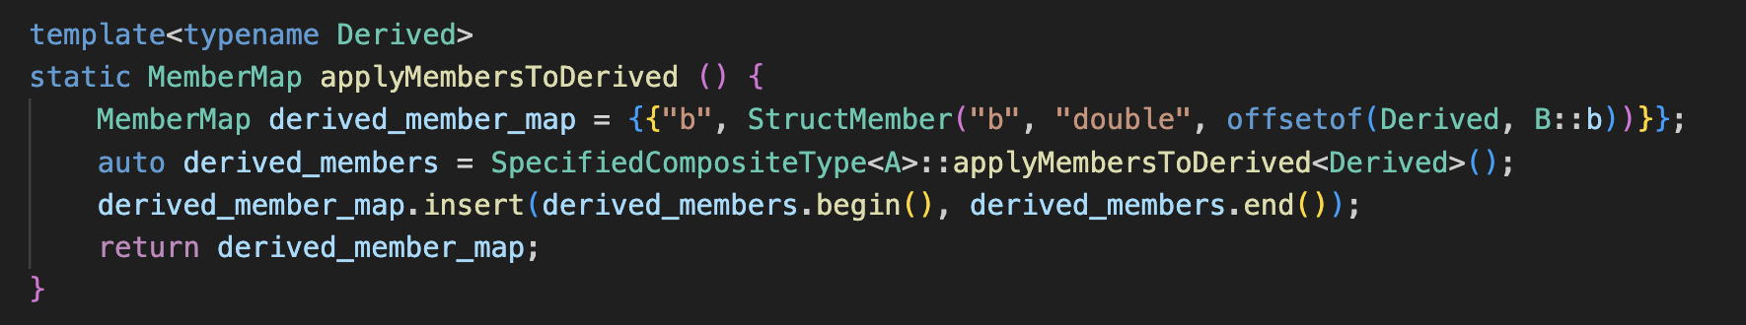
Inheritance
Accessible inherited members are included in the MemberMap as a normal member. They are assembled using the applyMembersToDerived() function, which is generated as part of the SpecifiedCompositeType<T> class.
Note - this is complex, I’ll write better docs for it. Look at the inheritance test to see a working example.

Slide 22
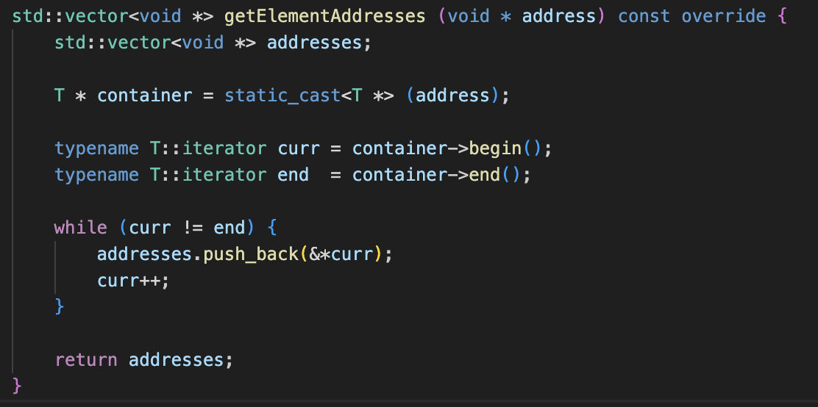
STL Types
STL sequence types (vector, deque, list) are supported. They must be specifically registered with the DataTypeInator by ICG generated code.
The key method that makes this work is the getElementAddresses() method
in SpecifiedPrimitiveType<T>.
Since STLs can reallocate themselves, this method must be called EVERY TIME a traversal is done, and pointers to elements should never be stored.
This is used by visitors.

Slide 23
Dealing with Pointers
Data structures may have pointers to one another! These connections should be included in the state checkpoint functionality.
Memory
Manager
Name: bar
Type: “int *”
Address: 0xc0ffee
Name: x
Type: “int[5]”
Address: 0xdeadbeef
Checkpoint String:
bar = &x[2];
[0]
[1]
[2]
[3]
[4]
0xdeadbef7
100 | 200 | 300 | 400 | 500
We cannot save literal addresses in a checkpoint, since the memory may not always be allocated in the same way. Instead, save the name of the variable that is being pointed to, which can be looked up at restore time as long as it is in managed memory.

Slide 24
TypeDef Statements
TypeDef statements are scraped by ICG and registered with the DataTypeInator.
The DataTypeInator uses a TypeDefDictionary (code, doxygen) to track these things. One step in the resolve function is to look up the type name in this dictionary. This allows the user to use their typedef’d names with the memory manager.
memoryManager.declare_var(“MyString s”);

Slide 25
Namespaces/Nested classes
Namespaces and nested classes are transparent to DataTypes, just treated as funky names.
They are handled by ICG. Types of fields are fully qualified in the AST, and tracking the scope allows class definitions to be correctly qualified.

