Slide 1
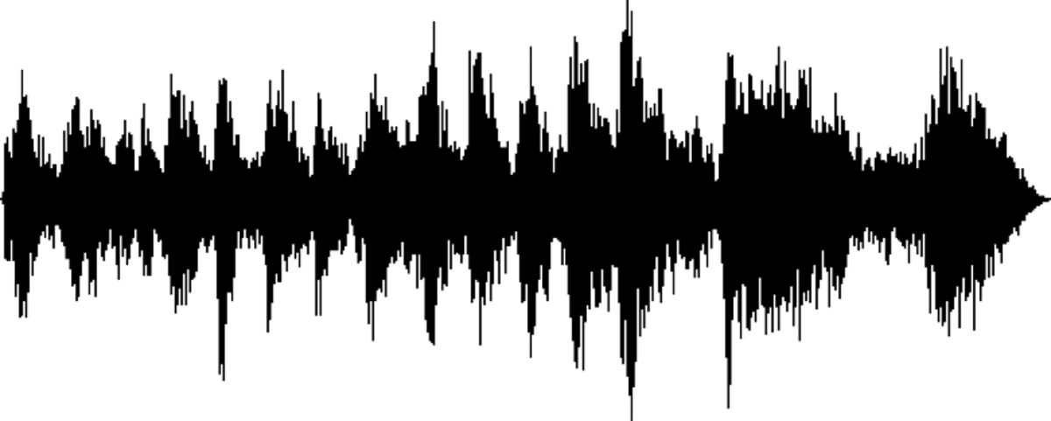
Generate Graphs Tab: Medium-level Representation
Legend
Variable
Constant
Input
Function
Output
fun/ui.
Import Addition Graphical Packages
“Datatables with Processed SQL Data”
(data.tables)
ui.
User chooses graphs
“Graphs”
(jpeg, png, R-Object, etc)
“Formatted Datatables with SQL Data”
(data.tables)
ui.
User chooses options for graphs
fun.
Display graphs

