Slide 1
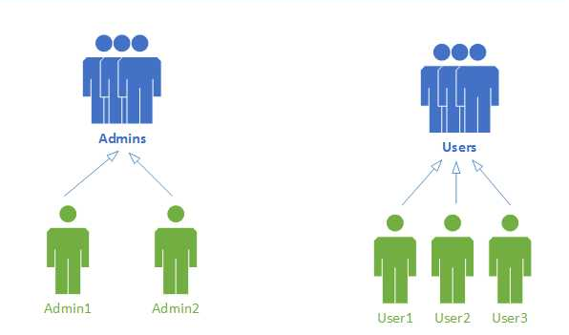
CREATE ROLE admins; — create group “admins"
CREATE USER admin1 LOGIN INHERIT; — create user account “admin1″ that will inherit rights from the group it member of, and it is able to login the database.
GRANT admins to admin1; — set “admin1″ as a member of “admins"

Slide 2
testdb
test
test1
test2
GRANT SELECT ON TABLE test TO GROUP admins; — allow group “admins" to use SELECT on table “test“.
GRANT ALL ON DATABASE testdb to admin1; — allow user “admin1" to have all rights to use the database “testdb“.

