Slide 1
GAM 372: Object Oriented Game Development
Software installation &
Project set-up

Slide 2
Software
Perforce:
Follow the instructions for Perforce Client Setup
Many documents to read and tutorials to watch!
Read them and watch them!
Note: For those more familiar with SVN:
Perforce is much more automated than SVN, but
It has a tighter binding between the repository and the local copy (called a ‘workspace’)
A lot easier to copy/paste within a workspace (not need for svn/export)
Visual Studio:
We’ll be using Visual Studio Ultimate (2013) C++
Search for ‘VS Ultimate’ and get ‘Update 4’

Slide 3
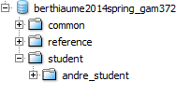
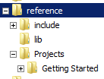
Folder Structure
Once you setup your local workspace you should see the following folders:
Public exchange folder:
Everyone has Read/Write access
Lectures, Libraries, etc.:
Read only
Student folders:
You only see yours and have read/write access

Slide 4
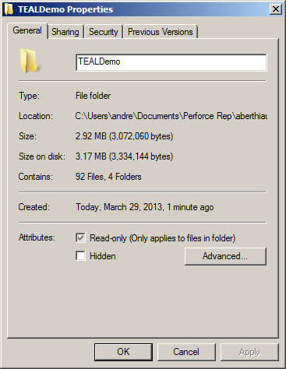
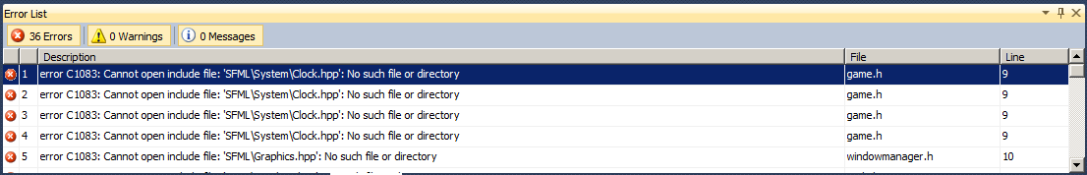
Creating a Project: Option 1: Copying from existing
Copy ‘TEALDemo’ into your own folder.
The original is in ‘Reference/Projects’
Right-click the new folder and select ‘properties’
Make sure to uncheck ‘Read Only’
Open the solution (.sln file)
Build and …
We need to tell the IDE where to find the libraries for this project

Slide 5
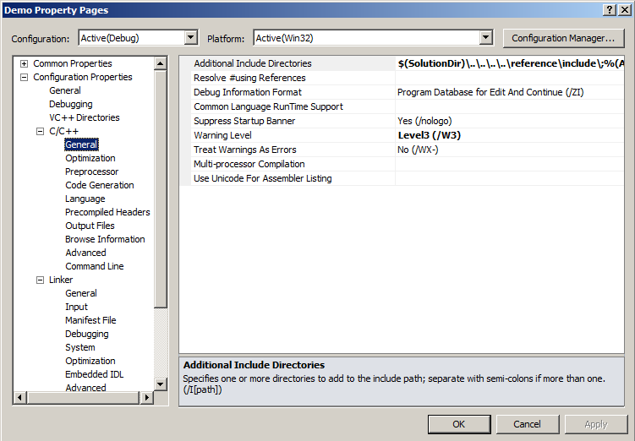
Project Configuration
Right-click on the project (‘Demo’ in this case) and select properties
We need to change 3 entries:
Compilation stage: To find the various headers from SFML
Linking stage: To find the various SFML library files
Execution stage: To find the various SFML dll files

Slide 6
Project Configuration: Compilation
Always start the folder with the macro ‘$(SolutionDir)’
This is the folder where the .sln file is located.
Write up the relative path to ‘reference\include’ in your workspace

Slide 7
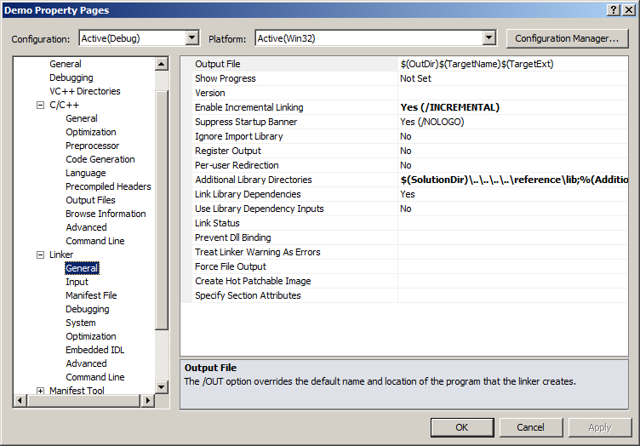
Project Configuration: Linking
Always start the folder with the macro ‘$(SolutionDir)’
This is the folder where the .sln file is located.
Write up the relative path to ‘reference\lib’ in your workspace

Slide 8
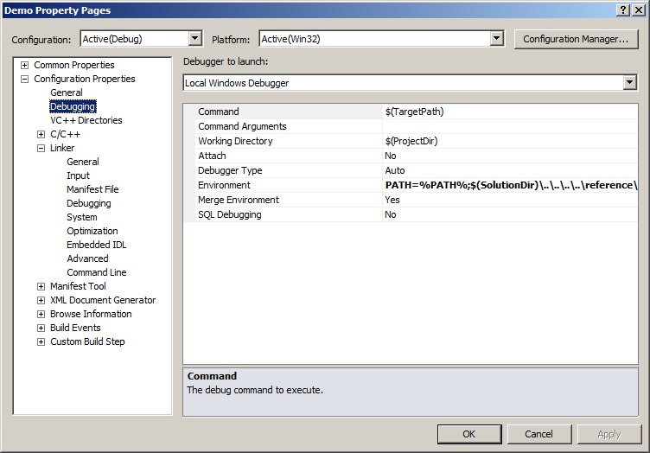
Project Configuration: Execution
Set the execution shell’s ‘PATH’ environment variable to include the ‘reference\lib’ folder
Again, use a relative path from ‘$(SolutionDir)’

Slide 9
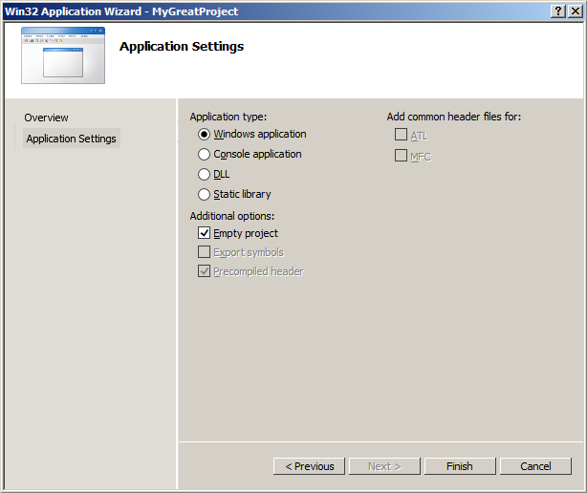
Creating a Project: Option 2: Jiggering the Files
Option 1: leaves you with a new project having the same old name.
Option 2 fixes that:
In Visual Studio: File/New/Project
Select a Visual C++ and Win32 Project
Enter the name and location for the project
In the next window, press ‘Next’
Check ‘Empty Project’ and ‘finish’
This gives is an empty project with the correct name,
Close Visual Studio and now we’ll ‘jigger’ the project.

Slide 10
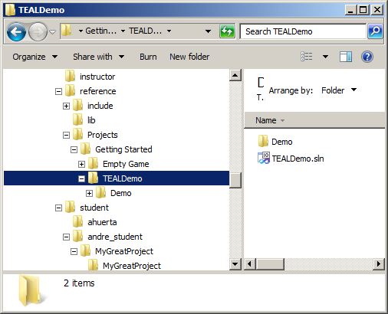
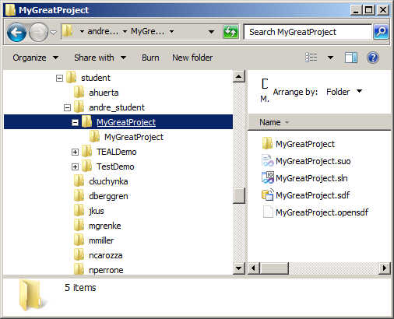
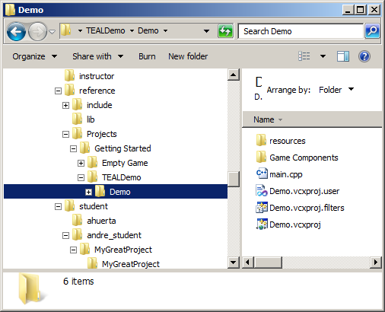
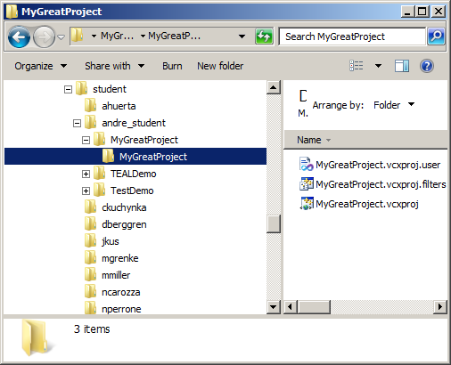
Creating a Project: Option 2: Jiggering the Files
Locate the project source files
Locate the project destination
Delete
COPY
Note: As before, you may need to uncheck the read-only flags on those copied file and folders

Slide 11
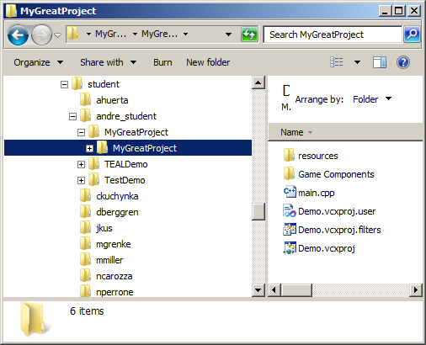
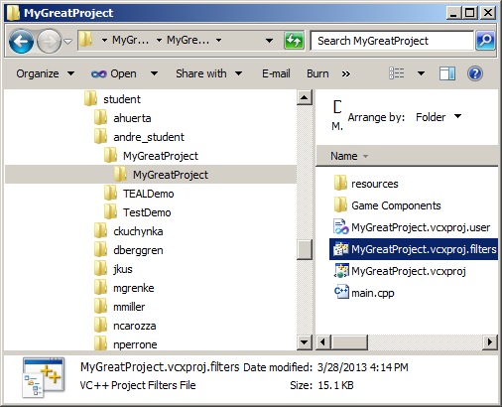
Creating a Project: Option 2: Jiggering the Files
Rename
Rename all three file with the project name
(‘MyGreatProject’ in this case)
Open in Visual Studio and fix all the configuration paths as before.

Slide 12
Creating a Project: Option 3: From scratch
If you understand the previous two options, this shouldn’t be too complicated.
Follow the Creating and Configuring a SFML project
Use the SFML folder in your workspace
Stick to using dynamic libraries
As shown in the ‘TEALDemo’ and ‘Empty Game’ examples, your project will need to have
the ‘Game Components/TEAL’ subfolder and
main.cpp that starts the game as shown in these projects

