Slide 1
Data Science Journals
NYC Datascience Academy
Web Scrap Project
In Suk Jang
8/2/2017

Slide 2

Data Science Research Papers
Research hot topics?
Active researchers?
Frequency of publications?

Slide 3
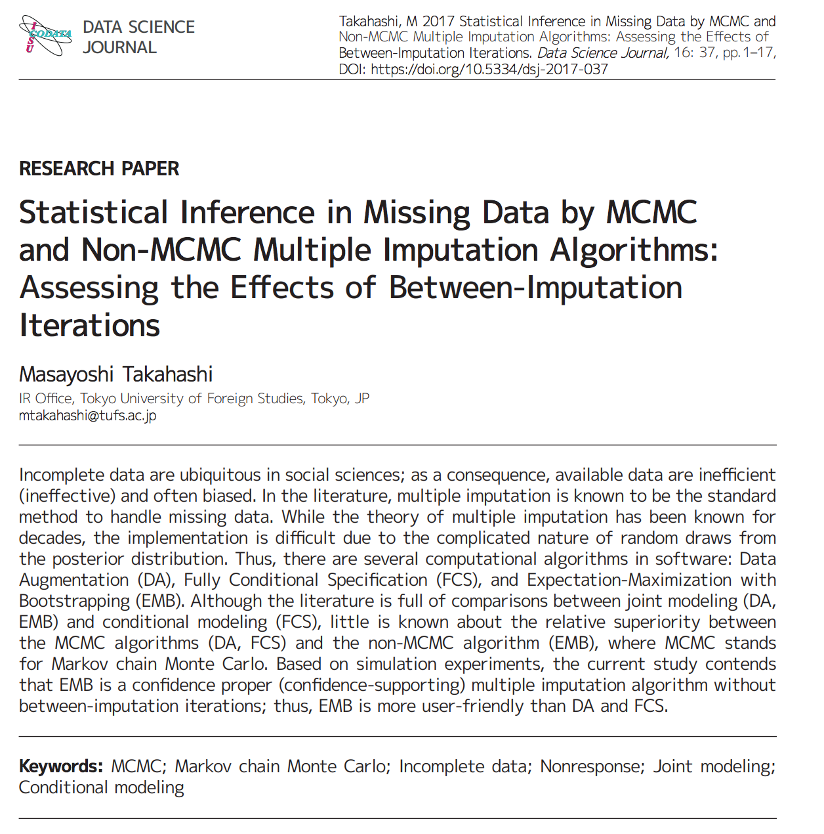

Slide 4
https://datascience.codata.org/articles/
Author
Keywords
Email

Slide 5
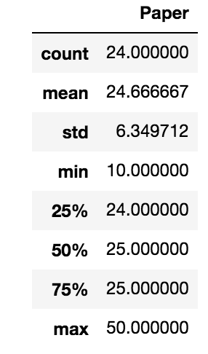
Frequency of Publications

Slide 6
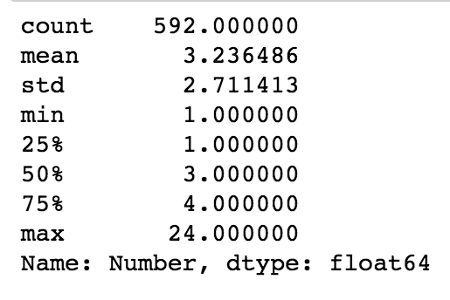
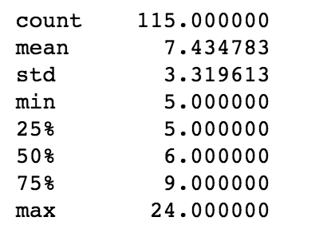

Slide 7
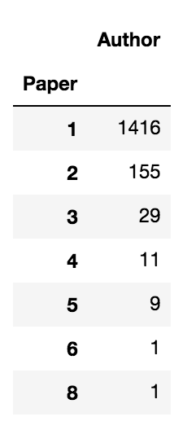

Slide 8
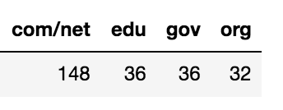
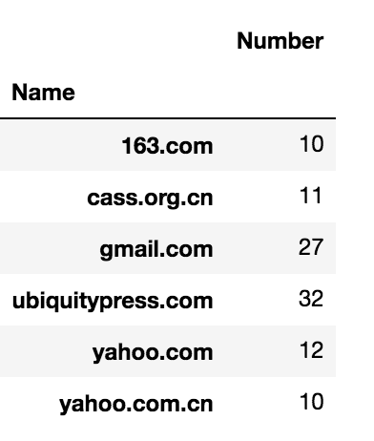

Slide 9
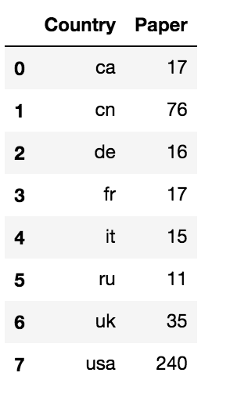

Slide 10
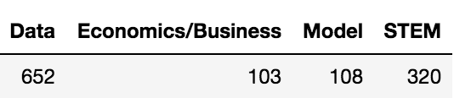

Slide 11
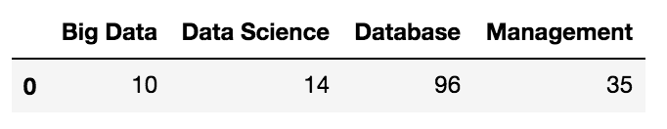

Slide 12
