Slide 1
Pricing and GSA QBR: Q4 FY26
May 19, 2026

Slide 2
Executive Summary
A La Carte Highlights:
Initiatives underway / action needed
ALC RIG / Monetization Score: Originating ALC RIG in Q2 increased +2ppts QoQ and flat YoY at 0.81 with full logo churn offsetting benefits from price increase, LiHA, and HEP conversions
Pilot Performance: Discounting is down significantly QoQ and YoY while NAMER pilot usage is down significantly so far QTD due to a focus on selling healthier pilots coming off of continued low renewal RIG
Price Change Impact: Hiring drove $10.4M (115% attainment) in price change impact for H1FY26 in GSA, led by new business and HEP conversion strength
MYD Discounting and RIG: Input on which GSA AD teams to integrate into MVP charter. Pricing to build scaled reporting available in Q4 and integrate into future GSA QBR
Pilot Performance: Monitor renewal performance of Q3 pilots and understand patterns of low performing pilots
To be updated
Enterprise Programs Insights:
Initiatives underway / action needed
Win Rates: Pipeline volume is sufficient, but a ~9pp close-rate shortfall is compressing weighted coverage and creating. There is an opportunity to increase bookings by ~$1.5M
Drive targeted execution on high-value mid- and late-stage opportunities to recover conversion and unlock the ~$1.5M — without relying on incremental pipeline creation.
L6M Overutilization:is resulting in ~$500K of unmonetized bookings, indicating opportunity leakage tied to sizing discipline
Sizing Guardrails: Refine and operationalize sizing guardrails by codifying best practices from tenured reps (“Moneyball” analysis) and scaling those behaviors across the team. Partner with GTME to strengthen enablement around EP positioning and deal sizing to ensure full monetization at close.

Slide 3
Agenda
1 | Introduction (2 mins)
2 | A La Carte Programs (20 mins) RIG / Monetization Score Pilot Performance Price Change Performance
3 | Enterprise Programs (25 mins) H1 Lookback Q3TD Account Utilisation Deep Dive
To be updated

Slide 4
ALC RIG /Monetization Score
A la Carte
Agenda
Pilot Performance
To be updated
Price Change Performance
A la Carte

Slide 5
ALC RIG / Hiring Share Score
Originating ALC RIG in Q2 increased +2ppts QoQ and flat YoY at 0.81 with full logo churn offsetting benefits from price increase, LiHA, and HEP conversions
GSA Hiring Originating ALC RIG (Q2 FY26)
$55.4M
RIG: 0.81
To be updated
$13.0M
$1.0M
$45.0M
$1.7M
$2.1M
$0.3M
$3.0M
RTA
Full Logo Churn
Unit Churn
Price Increase Capture
LiHA Bookings
EP Conversion Growth
Other (Debooks, Swaps, Overrides, etc)
Total Orig ALC Renewal Bookings
(distinct from price change impact)
(inclusive of unit churn from price change)
YoY
 | 0% | -2% | 0% |  | 17%
Key Insights
Strong capture rate from the price increase offset the 3% YoY increase in unit churn that was driven by non-pricing factors, contributing to net +$0.4M
Full churn is the biggest driver of ALC RIG < 1, comprising 23% of Hiring RTA
Unit churn for originating MYD and SYD is similar (2ppt differential), indicating that there are pressures distinct from demand weaknesses driving down growth
In contrast, NAMER originating MYDs decreased 7 ppt more than originating SYDs
Discussion:
What are drivers of full logo churn?
Are there different drivers for unit churn for originating MYDs vs. SYDs? What explains the similar rates?
Notes:
Would lbp is exploring a myd auto renewal option so it can allow us to drive more opt ins help us short up more auto renewals?
Capture rate is GSA is 85%

Slide 6
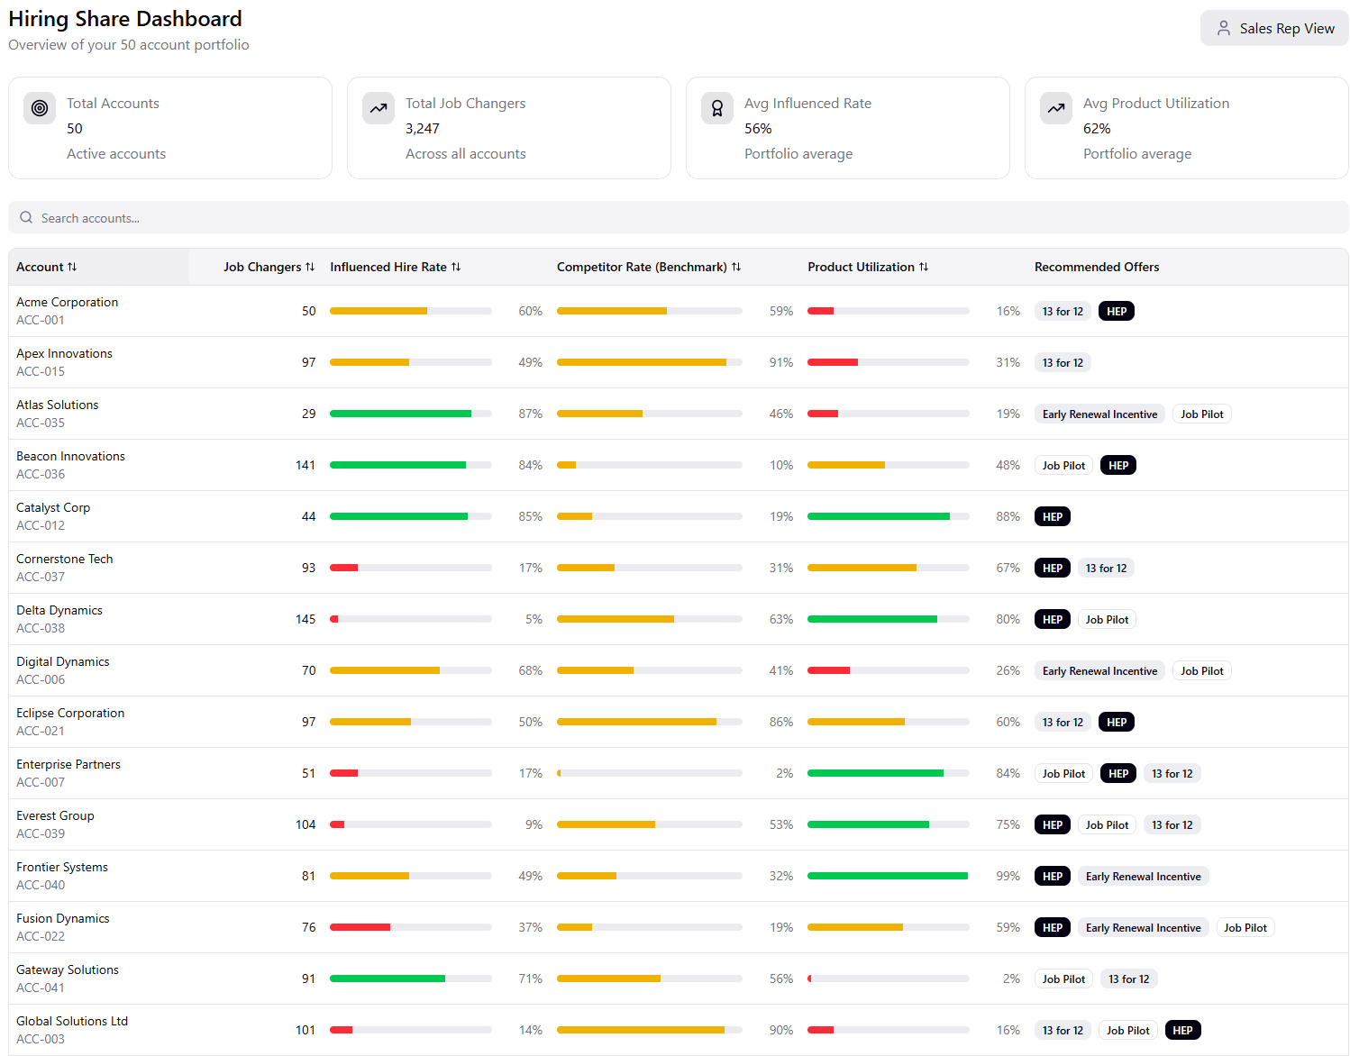
ALC RIG / Hiring Share Score
To bolster unit growth / ALC RIG, there is an opportunity to direct field to accounts with growing hires and capture more of their hiring needs with Hiring Share Score
Problem
Today, we do not capture all hiring activity based on customer needs, and customers often do not purchase full suite of products
Hiring growth shows little correlation as a driver of ALC RIG. Currently, accounts growing hires only show a 4pp difference in RIG vs those with flat/declining total hires. However, growing influenced hires at customer level, drives +12pp of RIG
WIP Solution
Pricing has developed a “hiring share score” dashboarding tool to assist ADs in capturing additional growth opportunities. This view is used in customer conversations today, so we are scaling a metric to evaluate success internally with the same positioning
We are currently piloting MVP of share score tool with selected NAMER and EMEAL ADs and want to extend this further with other sales orgs with the goal to collect user feedback for usability and accuracy of hiring efficiency data for planning, and potential enhancements required for scaled release in MyBizDash
Core Metrics: Reps will see total and influenced hires, cost per influenced hire, and competitive benchmarks for industry, (consistent with data presented in Merlin). We will also include suggested offers based on customer’s existing relationship / hiring activity
Next Steps
MVP Sales charter: Receive feedback on hiring share framework / data as a growth strategy for ADs. Data will be provided to sellers to understand impact in driving ALC RIG. Charter will conclude in Q3 to inform rec on scaled reporting across LTS.
Scaled reporting: Starting in Q4, we will leverage feedback to provide insights on performance management and rec sales plays to capture additional hiring share, segment-level insights and account-level actions to drive ALC RIG
To be updated
Sales-facing dashboard
Ask: Is there interest in expanding the share score sales charter with a GSA AD team?

Slide 7
TAE Pilot Performance
Discounting is down significantly QoQ and YoY while NAMER pilot usage is down significantly so far QTD due to a focus on selling healthier pilots coming off of continued low renewal RIG
TAE Pilot Performance
 | # of Paid Pilots |  |  | Pilot ASPs ($ in K) |  |  | Avg. Discount (excludes LiHA Tier 2 Promo) |  |  | Avg. Duration (Months) |  |  | Pilot Bookings % of TAE GSA Bookings |  |  | Pilot Renewal Conversion % |  |  | Pilot Renewal RIG
 | Q2 FY26 | Q3 FY26 QTD | YoY | Q2 FY26 | Q3 FY26 QTD | YoY | Q2 FY26 | Q3 FY26 QTD | YoY | Q2 FY26 | Q3 FY26 QTD | YoY | Q2 FY26 | Q3 FY26 QTD | YoY | Q2 FY26 | Q3 FY26 QTD | YoY | Q2 FY26 | Q3 FY26 QTD | YoY
NAMER
EMEAL
Total GSA
3
1
2
Key Insights:
1
2
3
Note: Q1 QTD info is as of Feb 09, 2026. Based on TAEs only

Slide 8
Price / Offer Performance
FY26 MYD comp changes have led to healthier discounting behavior and renewed use of MYD offers, driving $823k in total Q2 impact for GSA
Change in MYD Offer Policy
Offer Uptake
MYD Discounting Changes
To be updated
Offer | Impact | Usage | First-Year Bookings
TalentPlus | $66k | 21 | $204k
Hiring Growth | $176k | 13 | $208k
Core 4 | $186k | 23 | $252k
PlusOneJobs | $19k | 18 | $245k
Total | $477k | 75 | $909k
 | Q2 FY26 | Q2 FY25 | YoY Change
3-YR MYD Opp Count | 1094 | 1665 | (-34.3%)
3-YR MYD Total Bookings | $19.0M | $31.1M | (-38.9%)
3-YR MYD Discount $ | $1.12k | $3.63M | (-69.1%)
3-YR MYD Discount Rate | 2.94% | 4.76% | (-38.2%)
Total Impact | $346k
Newly eligible offers are driving incremental $477k in impact, led by Core 4 and Hiring Growth both capturing high incremental impact with moderate usage
Reduced 3-year discounting drove $346k in savings, with MYD discount rate falling by 38.2% (2.9% FY26 vs 4.8% FY25), reflecting tighter pricing control and fewer long-term deal discounts
Notes: Data from July 1, 2025 – December 31, 2025
Notes:
lbp is exploring a myd auto renewal option so it can allow us to drive more opt ins.

Slide 9
Price / Offer Performance
Hiring drove $10.4M (115% attainment) in price change impact for H1FY26 in GSA, led by new business and HEP conversion strength
 |  |  | A La Carte |  |  |  | EP
Segment | HTD Attmt. | Total Price Impact | ALC Total | Renewal | Add Ons | New Business | EP Total | EP Ren | EP Conv | Capture Rate | RIG %
NAMER |  | $6.92M | $6.47M | $2.59M / 87% | $0.43M / 75% | $3.45M / 53% | $0.45M | $0M | $0.45M | 71% | 0.81
EMEAL |  | $3.50M | $3.25M | $1.71M / 89% | $0.25M / 73% | $1.29M / 57% | $0.25M | $0M | $0.25M | 74% | 0.79
Total | 115% | $10.42M | $9.72M | $4.30M / 88% | $0.68M / 74% | $4.74M / 55% | $0.70M | $0M | $0.70M | 72% | 0.80
To be updated
1
2
1
GSA strength led by ALC new business over-attainment in capture rate and bookings
New business generated $4.7M (148% attainment) in impact, driven by capture rate overperformance (+9 ppts, 55% actual vs 46% plan) and bookings strength (+$31M, $120M actual vs $89M plan)
2
EP Conversions have already surpassed H1FY26 plan from very strong RIG
EP conversions generated $700k in pricing H1 impact (172% attainment) driven by very strong RIG (+14ppts,, 2.18 actual vs 2.04 plan) and bookings exceeding plan (+$3.3M, $9.3M actual vs $6M plan)
Notes: Data from July 1, 2025 – December 31, 2025

Slide 10
Actions from last QBR
HEP
Whitespace
Agenda
Performance Summary (H1 and Q3 to date)
To be updated
Deep Dive: Account Utilization
02.17.2026
HEP Whitespace

Slide 11
11
Follow Ups
Completed | On Track | Requires More Info | Not Started
Follow Up Action Items from last QBR
To be updated
# | Action to be taken | Next Steps highlighted during last QBR | Update | Status
1 | Are we sizing HEPs effectively? | Gather feedback from the field Pricing to interview 20 reps to understand drivers for these outcomes (i.e. data issues, objection handling) Share findings and recommendations with Travis and the GSA Sales Advisory Board | To discuss during this QBR Slides 14-18 Appendix HEP
2 | HEP Flattening Recommendation | Overview submitted to Mark Pricing to complete research and share recommendation | Policy went live Feb 2026 Rep enablement to follow in March
3 | Tighten MF Usage (TCV Impacting) | Discuss options with Travis Propose Recommendation | Discount Policy (VP approval on discounts) went live Feb 2026 for TAE only
4 | MyBiz Dash addition -> Activation Metrics | Central Ops designing an addition to MyBiz dash to track activation metrics by rep / region | Updated and live on myBiz Dash

Slide 12
12
Q3 Summary
Overview
Q3 Over‑Achievement (+16% v plan) driven by pitch and higher ASP, proving volume can offset win‑rate drag
FY26 Q3 Plan to Actuals Bridge [Y1 Bookings]
FY26 Q3 Supporting Metrics
+19%
$28.0 M
CVR
field bkgs. vs plan
$0.0 M
$0.8 M
# Pitches
Actual. vs plan
Win %*
Actual. (vs plan)
RIG
Actual (vs plan)
$23.5 M
$2.1 M
$1.6 M
2,984
(148% vs Plan)
18%
(-7pp vs Plan)
2.23
(+0.18 vs Plan)
Q3 Plan
Acquisition
Conversions
Add-Ons
Renewals
Q3 Actuals
TAE
field bkgs. vs plan
CVR $
Actual vs plan
ASP
Actuals vs plan
112%
134%
100%
116%
Attainment
$20.3M
(+112% vs Plan)
$6.50M
(134% vs Plan)
$51K
( +$5K vs Plan)
* *Win Rate CVR % measures the number of Net New Closed Won HEP over the total number of priced deals that are closed (Closed Won or Closed Disengaged).

Slide 13

Q3 Summary
Data as of 2/11
HEP Net-New Q3: Forecast to land on EP Plan
Legend (Actuals vs. Plan)
100%+ plan attainment
95% - 99% plan attainment
<95% plan attainment
 | Current Q: Q3 FY26 |  |  |  |  |  | Looking Forward: Q4 FY26
 | Priced deals (% of Plan) | CVR (#) * (vs. Plan) | RIG (vs. Plan) | ASP (vs. Plan) | CW Bookings (vs. Plan) | Outlook (USD$M) | Priced deals | Walk-in bookings
APAC | 621 (114%) | 29% (+7pp) | 1.70 (+0.15) | $79K | $5.3M (50%) | $10.8M | 169 | $1.1M
EMEAL | 1,629 (99%) | 17% (-4pp) | 1.68 (+0.13) | $105K | $15.9M (39%) | $40.7M | 817 | £2.1M
NAMER | 1,223 (99%) | 27% (+3pp) | 1.53(-0.01) | $107K | $24.0M (69%) | $34.8M | 560 | $8.5M
GSA | 2,737 (124%) | 16% (-9pp) | 2.16 (+0.10) | $51K (+$4K) | $10.7 M (45%) | $23.5M | 442 | $0.7M
-EMEA AD | 317 | 13% | 2.26 | $50K | $1.28M |  | 135
-EMEA AE | 420 | 7% |  | $47K | $0.6M |  | 35
-NAMER AD | 222 | 20% | 2.10 | $57K | $1.73M |  | 88
-NAMER AE | 1,783 | 21% |  | $52K | $7.15M |  | 116
To be updated
Drivers of Success
Areas of Opportunity
ASP is outperforming plan, driven by improved discount discipline in NAMER, contributing +$3K QoQ. EMEA AE ASP softness driven by Pilot Renewal EP mix ($45K vs. $53K in NAMER)
TAE: Recover win-rate performance on existing pipeline, which would unlock ~$1M–$1.5M additional bookings and materially improve weighted coverage without needing incremental pipeline creation.
GSA strength sustained in EP-priced deals, driving a +7% QoQ increase in rep activation – My Biz Dash now launched for monitoring activation by team (here)
Higher RIG in Q3 is driven by smaller average ALC RTA deal size ($17K vs. $21K in Q2), meaning EP conversions require a larger step-up to reach HEP eligibility criteria

Slide 14

Are we sizing TAE HEPs correctly?
To be updated
Hypothesis:
"Inconsistent EP positioning and sizing decisions — driven by when and how reps introduce EP — lead to mis-sized deals, resulting in under-utilization risk or delayed Monetization in Year 1"

Slide 15
GTM EP Motions
Early signals on how EP motion choice drives utilisation outcomes
When Field are using
What we see
To be updated
New Business EP
1
EP positioned early as the default
Sizing anchored to future growth
Proof of Concept already established
1
High under-utilisation (Month 1 → 6)
Accounts rarely self-correct
Oversizing + weak early adoption signals long-term growth risk
2
2
3
3
Pilot Renewal EP
Pilot first to validate value
Clear success criteria and usage tracking
EP sizing set at pilot renewal using real usage data
1
1
Higher average utilisation by Month 6
Better right-sizing and adoption alignment
Over-utilisation signals value; monetisation potential at true-up
2
2
3
3
Under utilization = <80% usage, Average Utilization = 80%-120% usage, Over utilization = 120%+ usage,

Slide 16
Account Utilization
What impact does this have?
Accurate inputs for EPs is Critical to Capturing Value and Protecting Renewals
To be updated
Under-utilisation increases churn risk and complicates renewal conversations, putting RTA at risk
After
6 Months
Under Utilization
New Business EP
Pilot Renewal
50%
45%
45%
Over-utilisation indicates unrealised monetisation and upside in Year-1 bookings (~$500K in missed bookings over the past 6 months)*
35%
20%
5%
Over Utilization
AD2+ [ENT] Year-1 true-up capture rates are below expectations, driven by the complexity of the pricing conversation
Under Utilisaiton
Average Utilisation
Over Utilization
# Accounts
12
49
1
63
10
28
Findings are directional and will be validated as additional cohorts mature – time stamp at August 2025 (1 month being September (2025, 6 months being January 2026) * Regional Splits in Appendix, Slide 27

Slide 17
Rep Feedback
Top 3 Field Call Outs: Sales Rep Behaviors*
To be updated
1
2
3
Calculating the Sizing of EPs is challenging
Positioning an EP is complex for less tenured reps
Pilots are easier to sell than New Business EP
Takeaway
Less-tenured reps (AE1 & AE2) are struggling with EP sizing and positioning, describing the motion as unstructured and difficult to land, which is impacting confidence and execution consistency (Particularly in EMEA)
*20 Sales Reps interviewed across NAMER & EMEA TAE

Slide 18
Potential Actions
Utilisation Discipline Drives Year-1 Bookings and Renewal Health
Potential Options
To be updated
Finding (What)
Lever (Why)
Ideas (How)
Owner (Who)
Sizing EPs is challenging for less tenured reps
Undersizing / oversizing create missed Y1 bookings opportunity and potential growth risk at renewal.
Money baller Sessions to share best practice (AE3 / AE4)
Using Merlin Job Reports to validate inputs where possible
Field FAQ on Data Classification (FAQ)
Sales
1
EP Positioning varies across reps, there is no consistency in structure
EP positioning lacks clear, consistent guardrails, causing junior reps to over-explain or default to pilots—especially in finance-led, multi-stakeholder deals—resulting in confusion and stalled execution.
HEPU Activation Scheduled Session (Spring: EMEA)
Practice Environment – Hyperbound Bots
Advanced Features in Gong
Rolling out MEDDPICC– helping to qualify leads
HEPU True up Enablement to ensure unmonetized value is captured
GTME
Sales
2
45% of accounts after 6M are underutilized
Underutilization if not monitored can create a churn risk at renewal and bring complex conversations for the AD.
Map out the customer handover process from AE to AD2+
Evaluate the Onboarding & Implementation Process
Pricing / SOPs
3
Discussion
Are there any additional considerations or ideas on how we can better monetise Year-1 bookings from our
over-utilisation cohort?

Slide 19
Actions for next QBR
Completed | On Track | Requires More Info | Not Started
Action Items
# | Action to be taken | Next Steps | Owner | Timeline | Status
1 | Are Y1 True ups and Renewals set up for success​ | Pricing to Meet more TAEs to understand more about onboarding / activation Partner to help map out ideal workflow for AE -> AD2+ Interview AD2+ Reps | Cliodhna, SOPs, GTME | Ongoing
2 | Analyse Pitch Rates by Region & Function | Pricing to partner with Sales Ops to break down pitch rates by region (NAMER vs. EMEA) and sales to identify performance gaps and opportunity areas. | Cliodhna, SOPs | Q3
3 | Review Pricing SLAs by Region | Assess whether there are differences in pricing turnaround times (SLAs) across regions that could be impacting EMEA conversion or win rates. | Cliodhna, Deal Desk | Q3
4 | Align on EMEA Commercial Behaviours and Enablement Focus | Pricing to partner with GTME to analyse NAMER vs. EMEA pitching differences, define the specific commercial behaviours we want to drive in EMEA. Pricing to deliver a concise one-pager summarizing findings and recommended enablement focus areas. | Cliodhna, Chris H | Q3 / Q4
To be updated

Slide 20
Appendix
MYD Discounting and RIG
Offers Performance
Pilot Performance
Price Change Performance

Slide 21
A La Carte
MYD Discounting and RIG
Offers Performance
Pilot Performance
Price Change Performance

Slide 22
MYD / Unit Churn
Despite fewer discounted MYDs, the discount rate increased slightly in Jan ’26 compared with FY26 Q2, while MYD renewal RIG continued to decline
ALC Performance (MYDs + SYDs) for Jan’26
 | Orig. Deal | Renewal Outcome |  | Total GSA |  | NAMER |  | EMEAL
 |  |  |  | % of Renewals (QoQ) | RIG (QoQ) | % of Renewals (QoQ) | RIG (QoQ) | % of Renewals (QoQ) | RIG (QoQ)
Renewal Outcome / RIG | MYD | SYD | % Downgrade to SYD / RIG | 38% / (11ppt) | 0.96 / (1ppt) | 50% / (25ppt) | 0.93 / (-17ppt) | 34% / (6ppt) | 0.97 / (9ppt)
 |  | HEP | % Renewed as HEP / RIG | 2% / (-13ppt) | 2.73 / (20ppt) | 0% (-21ppt) | 0 (-2.56) | 3% / (-9ppt) | 2.73/ (23ppt)
 |  | MYD | % Renewed as MYD / RIG | 60% / (2ppt) | 1.01 / (-3ppt) | 50% / (-4ppt) | 1.04 / (-4ppt) | 63% / (3ppt) | 1.00 / (-2ppt)
 | SYD | MYD | % Upgrade to MYD / RIG | 22% / (-5ppt) | 1.05 / (5ppt) | 20% / (-4ppt) | 1.12/ (10ppt) | 24% / (-6ppt) | 1.00/ (1ppt)
 |  | SYD | % Renewed to SYD / RIG | 77% / (5ppt) | 0.99/ (2ppt) | 74% / (4ppt) | 0.99 / (0ppt) | 75% / (5ppt) | 0.99 / (3ppt)
 | Overall MYD RIG¹ |  |  |  | 1.04 / (0ppt) |  | 1.11 / (7ppt) |  | 1.00 / (0ppt)
 |  |  |  | % of Discounted Deals | QoQ Change | % of Discounted Deals | QoQ Change | % of Discounted Deals | QoQ Change
Discount Deals as % of Total | MYD | MYD |  | 57% | 2ppt | 80% | 14ppt | 52% | 1ppt
 | SYD | MYD |  | 57% | 2ppt | 67% | 4ppt | 49% | -1ppt
 |  | SYD |  | 5% | 0ppt | 6% | 0ppt | 4% | -1ppt
 | TAE MYD |  |  | 61% | -7ppt | 62% | -10ppt | 61% | 9ppt
 | Overall MYD |  |  | 58% | -2ppt | 67% | -1ppt | 53% | -3ppt
To be updated
2
1
Key Insights: Fewer discounted MYDs but at higher discount rates: While we’re seeing a slight improvement in the overall share of MYDs discounted (-2ppt QoQ) with the larger improvement by TAE MYDs (-7ppt QoQ), the overall MYD discount rate (excluding LiHA/RPS+ deals) is at 6% (1ppt above the MYD discount cap) lead by MYD conversions.
However, RIG continues to degrade: Overall MYD RIG stabilized at 1.04, however, MYD renewals RIG decreased (-3ppt QoQ) lead by NAMER (-4ppt). LiHA/RPS+ MYD renewals have a 7ppt higher RIG QoQ compared to non-LiHA/RPS+ MYD renewals. LiHA/RPS+ MYD conversions have a 10ppt higher RIG QoQ compared to non-LiHA/RPS+ MYD conversions
Actions Taking/Opportunities:
Remind team that they can receive MYD credit uplift with approved offers, including the LIHA offset and RPS+ Upgrade offers, providing more growth opportunity vs. discretionary discounting
1
2
Notes: Data from 10/1/25-1/31/26. Exclude NP A&G deals with 50%+ discount. RIG includes only CW opportunities
1. Comprised of opps that closed won as MYDs
22
Overall MYD RIG Q2 QTD has declined driven by increased share of MYDs upgrading to HEPs and increased use of discounting for renewing MYDs
Notes:
Data excludes closed disengaged deals LiHA/RPS+ deals seeing higher RIG: Of MYD renewals where MYD -> MYD, 13% were LiHA/RPS+ deals. Overall RIG for these deals was 7ppt higher (1.08 vs non-LIHA/RPS+ 1.00).
Of MYD conversions where SYD->MYD, 10% were LiHA/RPS+ deals. Overall RIG for these deals was 10ppt higher (1.14 vs non-LIHA/RPS+ 1.04). Overall discount rate (inc TAE MYD) is 8% but when we remove the LiHA/RPS+ deals, overall discount rate is 6.3% (vs 5.2% in Q2)

Slide 23
HEP
MYD Discounting and RIG
Offers Performance
Pilot Performance
Price Change Performance
Notes:
Pilot – rep usage to HEP bookings (mix / number---how many pilots convert into HEPs vs. not)

Slide 24




Utilization Feedback
New Business EP
Strengths
Weaknesses
Opportunities
Threats
To be updated
Strong early utilization when sizing and onboarding are aligned
Effective at front-loading impact in early customer lifecycle
Acquisition EPs often under-utilized at months 1, 3, 6, and 12
Systemic oversizing and weak adoption
Enforce structured sizing discipline
Share evidence-based success stories
Clarify EP terms (e.g., “unlimited”)
Under-sizing increases volatility and renewal risk for AD.
Acquisition EP used as default close

Slide 25
Utilization Feedback
New Business EP
Strengths
Weaknesses
Opportunities
Threats
To be updated
Strong early utilization when sizing and onboarding are aligned
Effective at front-loading impact in early customer lifecycle
Acquisition EPs often under-utilized at months 1, 3, 6, and 12
Systemic oversizing and weak adoption
Enforce structured sizing discipline
Share evidence-based success stories
Clarify EP terms (e.g., “unlimited”)
Under-sizing increases volatility and renewal risk for AD.
Acquisition EP used as default close

Slide 26
WIP
Pilots and data drive correct EP sizing—and better outcomes
What the Data Shows
What the Field are saying
Why does this matter
A
To be updated
Pilots are the strongest lever for correct EP sizing
Pilot Renewals cluster in healthy utilisation
Acquisition EPs are largely under-utilised
Pilots drive more accurate sizing
Top reps use pilots primarily as a learning and calibration mechanism, not just value proof
Pilots enable observation of real usage, expectation-setting, and confident EP sizing at renewal
Pilots underperform when success criteria, conversion pricing, or timelines are unclear upfront
Pilot-renewal EPs are healthier because they are sized on evidence, not assumptions
Without usage evidence, acquisition EPs default to conservative sizing to win the deal
Conservative sizing leads to utilization instability over time
B
Utilisation outcomes vary widely across EPs, with significant shelfware in acquisition deals
This variance indicates inconsistent sizing discipline
Sold packages are often misaligned with actual hiring activity
Data-backed sizing (Merlin) separates strong from weak EP outcomes
Reps rely on Merlin job reports to validate job volume, growth, and ROI
Merlin is one of the few trusted, objective inputs for EP sizing
Without a structured sizing methodology, inputs vary by rep confidence, leading to over- or under-selling
Merlin connects pricing discussions to real-world usage
Provides a defensible, customer-facing rationale for EP size and buffer
Without Merlin, EP sizing becomes subjective and incentive-driven
C
Acquisition EPs are heavily under-utilised at Month 1, 3, 6, and 12
This pattern indicates systemic oversizing or weak adoption
Underperformance is structural, not isolated
Reps face strong pressure to close multi-year EPs at acquisition
EPs are often positioned as a cost-reduction lever to overcome buyer hesitation
Enablement gaps, pricing complexity, and approval friction push reps toward price-led packages that are easier to sell but harder to sustain
Underperformance is not driven by rep error
It is the predictable outcome of selling long-term EPs without usage confidence
Treating acquisition EP as the default close, rather than a gated motion, increases downstream risk
Non Pilot EPs underperform due to structural mis-sizing
D
Top reps size EPs to expected growth plus buffer and set clear expectations at close
Clear communication of limits, renewal implications, and expansion mechanics reduces friction
Too many options (pilot, EP, a la carte) overwhelm buyers and stall decisions
Confusing HEPU terminology, especially “unlimited,” drives misalignment
Utilisation volatility—both under and over—is often set at the point of sale
Early calibration of expectations reduces renegotiation and dissatisfaction
Simplifying the decision path lowers surprise at renewal
Early calibration and decision simplicity reduce long-term friction
Early over-utilisation appears in Month 1/3 across some cohorts
Signals tight sizing or unclear expectations at close
Early misalignment increases downstream friction

Slide 27
Regional Utilization
New Business EP
Pilot Renewal
Time Stamp: August 2025, ( After 6 Months Jan’26)
After
6 Months
62%
To be updated
39%
40%
GSA NAMER
25%
21%
13%
Under Utilisaiton
Average Utilisation
Over Utilisaiton
After
6 Months
64%
GSA EMEA
33%
33%
38%
29%
0%
Under Utilisaiton
Average Utilisation
Over Utilisaiton
Findings are directional and will be validated as additional cohorts mature

Slide 28
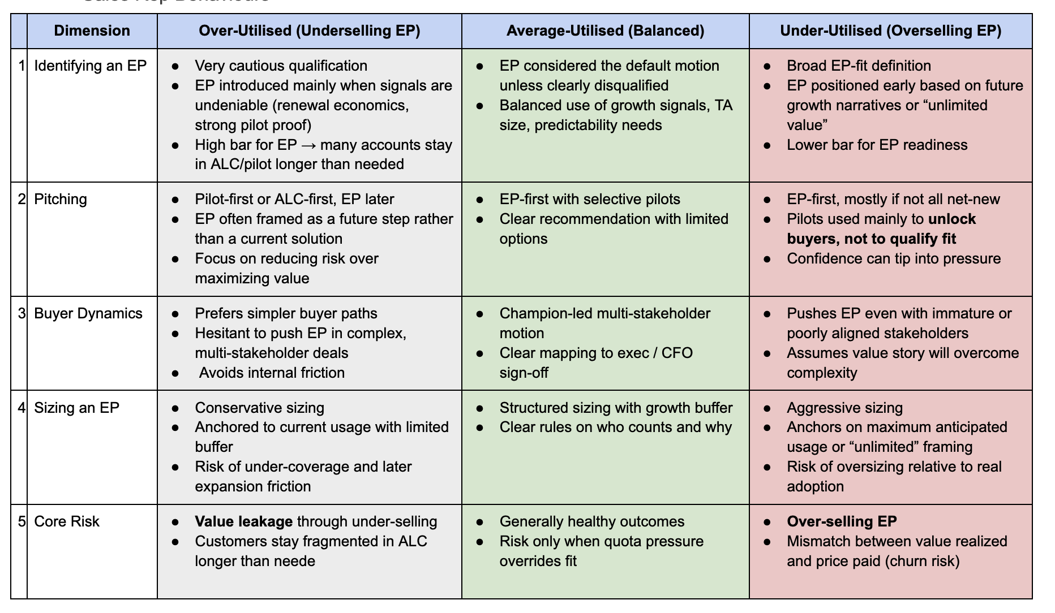
Field Feedback broken into different cohorts
Rep Feedback
To be updated

