Slide 1
Big Bank Control for Medium Enterprise
Powering Investment
Company Risk Monitor

Slide 2

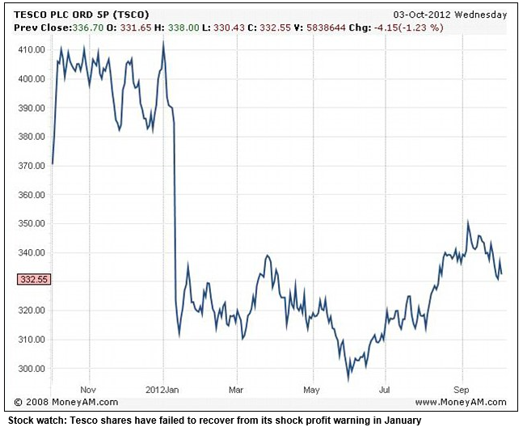




Slide 3
✓
Continuous evaluation of company health
✓
Catalyst for companies and investors to talk
✓
Guaranteed support by documents

Slide 4
Value
Bank
Traditional mezzanine lenders
Peer-to-peer
Target opportunities
Not targeted
Risk

Slide 5
Company A
Company B
Company C
 Cash
✓
✓
✗
 Revenue
✓
✗
✗
 Receivables
✓
✓
✓
 Debt
✓
✓
✓

Slide 6
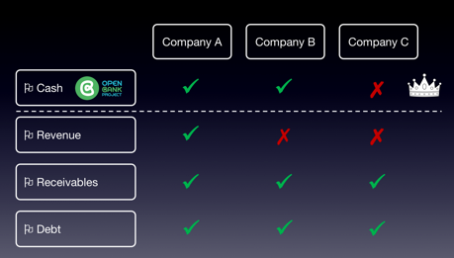
Company
Server
Flags
Blockchain
Investor

Slide 7
DEMO

Slide 8
Big Bank Control for Medium Enterprise
Powering Investment
Company Risk Monitor

