Slide 1
Think Java 2nd Edition
Chapter 1—Computer Programming

Slide 2
Computer Hardware
Processor – CPU (Central Processing Unit)
Memory – RAM (Random Access Memory)

Slide 3
Definition of a Program
A program is a sequence of instructions that specifies how to perform a computation on computer hardware.

Slide 4
Fundamental Operations (1)
input: Get data from the keyboard, a file, a sensor, or some other device
output: Display data on the screen, or send data to a file or other device.
math: Perform basic mathematical operations like addition and division.

Slide 5
Fundamental Operations (2)
decision: Check for certain conditions and execute the appropriate code.
repetition: Perform an action repeatedly, usually with some variation.
All programs are composed of these sorts of operations.

Slide 6
The Hello World program
public class Hello {
public static void main(String[] args) {
// generate some simple output
System.out.println("Hello, World!");
}
}

Slide 7
The Hello World program
public class Hello {
public static void main(String[] args) {
// generate some simple output
System.out.println("Hello, World!");
}
}
Java programs are made up of class and method definitions, and methods are made up of statements.

Slide 8
The Hello World program
public class Hello {
public static void main(String[] args) {
// generate some simple output
System.out.println("Hello, World!");
}
}
statements end with
a semicolon
A statement is a line of code that performs a basic action.
Java is case-sensitive. System, system and SYSTEM are all different.

Slide 9
The Hello World program
public class Hello {
public static void main(String[] args) {
// generate some simple output
System.out.println("Hello, World!");
}
}
A method is a named sequence of statements.
main is special: when the program runs, it starts at the first statement in main and ends when it finishes the last statement.

Slide 10
The Hello World program
public class Hello {
public static void main(String[] args) {
// generate some simple output
System.out.println("Hello, World!");
}
}
A class is a collection of methods.
By convention, class names start with a capital letter.
A class name must match the file name; this class would have to go into a file named Hello.java

Slide 11
The Hello World program
public class Hello {
public static void main(String[] args) {
// generate some simple output
System.out.println("Hello, World!");
}
}
Java uses curly braces { and } to group things together.
In Hello.java, the outermost braces contain the class definition.
The inner braces contain the method definition.

Slide 12
The Hello World program
public class Hello {
public static void main(String[] args) {
// generate some simple output
System.out.println("Hello, World!");
}
}
Lines beginning with // are comments, which are a bit of English text that explain the code.
Java ignores everything from // to the end of the line.

Slide 13
Low Level Languages
Machine language
Directly executable on CPU hardware
Assembly language: one-to-one translation of text to CPU instructions

Slide 14
High Level Languages
Easier to program than low level
Portable – can run on different hardware with few or no modifications
Two types: interpreted and compiled languages

Slide 15
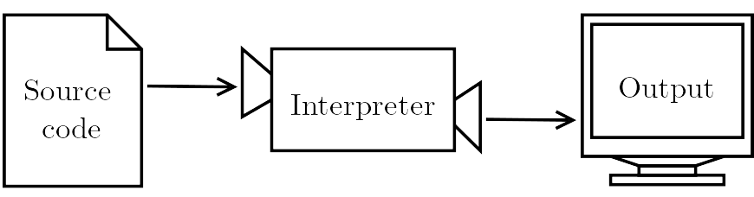
Interpreter
Alternately reads lines and executes the code

Slide 16
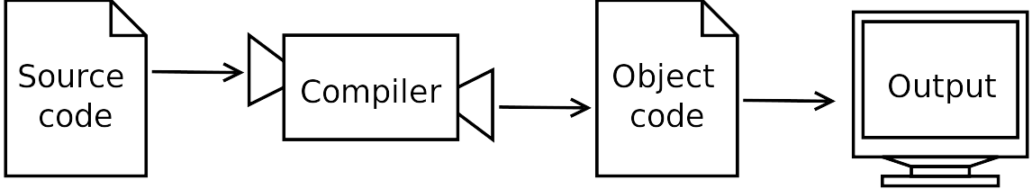
Compiler
Reads the entire program
Translates it completely before the program starts running
Result of translation is called object code
Object code is at the machine language level, and is not portable

Slide 17
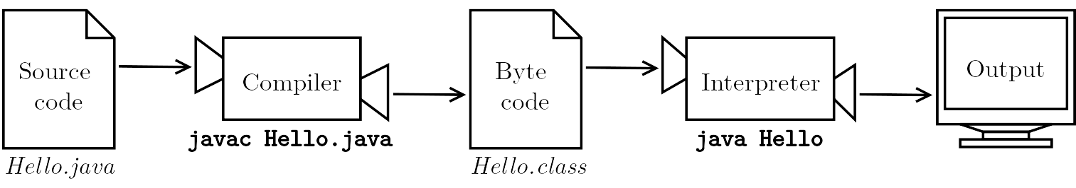
Java Compiler
Java is both compiled and interpreted.
The Java compiler generates code for a virtual machine (the Java Virtual Machine - JVM)
Byte code is portable; it can be transferred to another machine
Java compiler: javac
Java byte code interpreter: java

Slide 18
Another Program
public class Example {
public static void main(String[] args) {
// generate some simple output
System.out.println("Good news:"); // first line
System.out.println("Java works!"); // second line
}
}
A method can contain multiple statements.
Comments can be at the end of a line as well as on their own line.
Phrases in quotation marks are strings made up of characters.
Characters include letters, numbers, punctuation marks, symbols, spaces, tabs, etc.

Slide 19
print vs. println
public class Example1 {
public static void main(String[] args) {
System.out.println("door");
System.out.println("bell");
}
}
public class Example2 {
public static void main(String[] args) {
System.out.print("door");
System.out.println("bell");
}
}
Output:
door
bell
Output:
doorbell
println stands for “print line”--it appends a newline that moves to the beginning of the next line.
print does not append a newline.
If you want a space between the words, you must put it inside the quote marks:
System.out.print("door ");

Slide 20
Formatting Source Code (1)
Spaces are required between “words” in Java. In general, if you can’t tell where a word begins and ends, neither can Java.
publicclassNoSpaces {
publicstaticvoidmain(String[]args) {
System.out.println("bad.");
}
}

Slide 21
Formatting Source Code (2)
Most other spaces (including newlines) are optional. Java is OK
with these programs:
public class Ugly {
public static void main(String[] args) {
System.out.println("Java likes me.");
}
}
public class SuperUgly{public static
void main(String[
]args) { System.out.println
("Unreadable to humans.") ;
} }

Slide 22
Formatting Source Code (3)
Instead, follow your course’s guidelines for spaces and indenting
to make sure your code is readable:
public class Better {
public static void main(String[] args) {
System.out.println("Java likes me.");
System.out.println("Humans can read me too.");
}
}

Slide 23
Escape Sequences (1)
Escape sequences let you put special characters in a string.
\n puts a newline inside a string
This code:
System.out.println("one\ntwo");
Produces this output:
one
two

Slide 24
Escape Sequences (2)
\" lets you put a quote mark inside a string.
\" lets you put a quote mark inside a string.
This code:
System.out.println("Say \"cheese\" please!");
Produces this output:
Say "cheese" please!
Without the backslash, the " before cheese
would end the string.

Slide 25
Escape Sequences (2)
Here are the most common escape sequences in Java:
\n | newline
\t | tab
\" | double quote
\\ | backslash

Slide 26
Computer Science
algorithm: a sequence of steps that specifies how to solve a problem
computer science: the science of algorithms, including their discovery and analysis
debugging: the process of tracking down and correcting programming errors
It’s all about problem solving.

