Slide 1
Think Java 2nd Edition
Chapter 3—Input and Output

Slide 2
The System Class
Provides methods related to your environment
System.out is a special value in that class
One of its methods is println()

Slide 3
The System Class
You can print the value of the System.out variable.
System.out.println(System.out);
package
memory address
java.io.PrintStream@378bf509
class

Slide 4
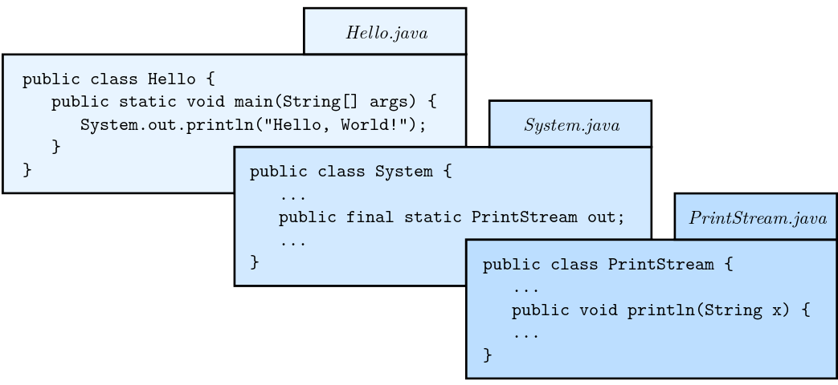
The System Class
Part of Java
library

Slide 5
The Scanner Class
Provides the System.in value
It is an instance of the InputStream class.
The Scanner class belongs to the java.util package.
You must explicitly import this class: import java.util.Scanner;
Notes:
You can use System.out and System.in without importing them because they belong to the java.lang package, which is automatically imported into all Java programs.

Slide 6
Must be outside the
class definition
import java.util.Scanner; public class Echo { public static void main(String[] args) { String line; Scanner in = new Scanner(System.in); System.out.print("Type something: "); line = in.nextLine(); System.out.println("You said: " + line); System.out.print("Type something else: "); line = in.nextLine(); System.out.println("You said: " + line); } }
Scanner will read from
System.in (keyboard)
Declare a Scanner
Read a line of text
from the Scanner in

Slide 7
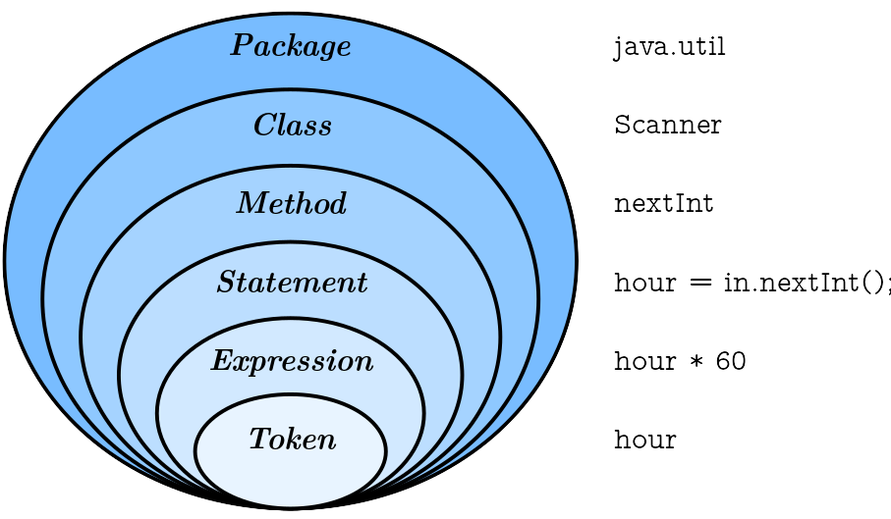
Language Elements

Slide 8
Language Elements
Knowing the terms helps you interpret error messages.
The Java language consists of the elements in the preceding slide.
The Java library is a set of 1000+ classes that you can import into your programs.

Slide 9
Literals and Constants
Declare variables and
create the Scanner
int inch;
double cm;
Scanner in = new Scanner(System.in);

Slide 10
Literals and Constants
int inch;
double cm;
Scanner in = new Scanner(System.in);
System.out.print("How many inches? ");
inch = in.nextInt();
Prompt on same line
as cursor
Read input and
convert to integer

Slide 11
Literals and Constants
int inch;
double cm;
Scanner in = new Scanner(System.in);
System.out.print("How many inches? ");
inch = in.nextInt();
cm = inch * 2.54;
System.out.print(inch + " in = ");
System.out.println(cm + " cm");
Multiply by
conversion factor

Slide 12
Literals and Constants
int inch;
double cm;
Scanner in = new Scanner(System.in);
System.out.print("How many inches? ");
inch = in.nextInt();
double cmPerInch = 2.54
cm = inch * cmPerInch;
System.out.print(inch + " in = ");
System.out.println(cm + " cm");
Give the “magic number”
a name.

Slide 13
Literals and Constants
int inch;
double cm;
Scanner in = new Scanner(System.in);
System.out.print("How many inches? ");
inch = in.nextInt();
final double CM_PER_INCH = 2.54
cm = inch * CM_PER_INCH;
System.out.print(inch + " in = ");
System.out.println(cm + " cm");
Make this
a constant
Use underscores
between words

Slide 14
Formatting Output
format string
System.out.printf("Four thirds = %.3f", 4.0 / 3.0);
Stands for
“print formatted”
Format specifier
Value to fill in specifier

Slide 15
Formatting Output
int inch = 57;
double cm = inch * CM_PER_INCH;
System.out.printf("%d in = %.2f cm\n", inch, cm);
two specifiers
two values
Output: 57 in = 144.78 cm

Slide 16
Format Specifiers
%d | Integer in base 10 (decimal) | 12345
%,d | Integer with comma separators | 12,345
%08d | Padded with zeros, at least 8 digits wide | 00012345
%f | Floating-point number | 6.789000
%.2f | Rounded to two decimal places | 6.79
%s | String of characters | Hello
%x | Integer in base 16 (hexadecimal) | b5614e

Slide 17
Reading Error Messages
Should be
a comma
int inch = 57;
System.out.printf("inches = %d " + inch);
Works out to this
int inch = 57;
System.out.printf("inches = %d57");
No values to format

Slide 18
Reading Error Messages
int inch = 57;
System.out.printf("inches = %d " + inch);
Exception name
Additional information
Exception in thread "main" java.util.MissingFormatArgumentException:
Format specifier '%d'
at java.util.Formatter.format(Formatter.java:2519)
at java.io.PrintStream.format(PrintStream.java:970)
at java.io.PrintStream.printf(PrintStream.java:871)
at Example.main(Example.java:10)
stack trace
Method
Source file
Line number

Slide 19
Type Cast Operators
double cm = in.nextDouble();
int inch = cm / CM_PER_INCH;
System.out.printf("inches = %d ", inch);
Compiler gives this error:
error: incompatible types: possible lossy conversion from double to int
inches = cm / CM_PER_INCH;
^
The compiler won’t let you do an operation that will lose the fractional part of the result.

Slide 20
Type Cast Operators
double cm = in.nextDouble();
int inch = (int) (cm / CM_PER_INCH);
System.out.printf("inches = %d ", inch);
(int) is a cast that tells the compiler that you want to convert the result to an integer.
The parentheses around the expression are necessary—you want the expression evaluated first, then the result converted to an integer.
The fractional part of the result of division is thrown away.

Slide 21
Type Cast Operators
int totalSales = 47;
int nCustomers = 5;
double avgSale = totalSales / nCustomers;
The right hand side divides two integer values; the result will be 9.
What do we do if we want the answer to be 9.40?

Slide 22
Type Cast Operators
int totalSales = 47;
int nCustomers = 5;
double avgSale = 1.0 * totalSales / nCustomers;
Multiplying by a double will force the result to be converted to double.

Slide 23
Type Cast Operators
You can also use a cast to convert one of the operands to double:
int totalSales = 47;
int nCustomers = 5;
double avgSale = (double) totalSales / nCustomers;
You can cast either operand (or both) to double:
double avgSale = totalSales / (double) nCustomers;
double avgSale = (double) totalSales / (double) nCustomers;
But this will not give the correct result! Why?
double avgSale = (double) (totalSales / nCustomers);

Slide 24
The Remainder Operator: %
The / operator gives the quotient of two integers.
The % operator gives the remainder of the division.
47 / 5 → 9
47 % 5 → 2
Also called mod or modulo.
Same priority level as * and /

Slide 25
The Remainder Operator: %
int totalMinutes;
int hours;
int minutes;
System.out.printf("Enter total minutes: ");
totalMinutes = input.nextInt();
hours = totalMinutes / 60;
minutes = totalMinutes % 60;
System.out.printf("%d hrs %d minutes\n", hours, minutes);

Slide 26
The Remainder Operator: %
Other examples of using %
int n;
n % 10 → rightmost digit of n
n % 100 → rightmost two digits of n
int quantity;
quantity / 12 → dozens
quantity % 12 → units

Slide 27
How Scanner Works
source code
Scanner in = new Scanner(System.in);
System.out.print("What is your name? ");
name = in.nextLine();
System.out.print("What is your age? ");
age = in.nextInt();
System.out.printf("Hello %s, age %d\n", name, age);
output
What is your name? Michelle Simmons
What is your age? 54
Hello Michelle Simmons, age 54

Slide 28
How Scanner Works
Reading the name first: Stream of characters as viewed by Scanner
M
i
c
h
e
l
l
e
S
i
m
m
o
n
s
\n
5
4
\n
nextLine() reads up to a newline character:
M
i
c
h
e
l
l
e
S
i
m
m
o
n
s
\n
5
4
\n
nextInt() skips leading whitespace and reads the integer:
M
i
c
h
e
l
l
e
S
i
m
m
o
n
s
\n
5
4
\n

Slide 29
How Scanner Works
source code
Scanner in = new Scanner(System.in);
System.out.print("What is your age? ");
age = in.nextInt();
System.out.print("What is your name? ");
name = in.nextLine();
System.out.printf("Hello %s, age %d\n", name, age);
switch order
output
What is your age? 54
What is your name? Hello , age 54

Slide 30
How Scanner Works
Reading the age first: Stream of characters as viewed by Scanner
5
4
\n
M
i
c
h
e
l
l
e
S
i
m
m
o
n
s
\n
nextInt() reads the integer:
5
4
\n
M
i
c
h
e
l
l
e
S
i
m
m
o
n
s
\n
nextLine() reads up to a newline—but it’s already there, and returns the empty string:

Slide 31
Solving the Scanner Problem
source code
Scanner in = new Scanner(System.in);
System.out.print("What is your age? ");
age = in.nextInt();
in.nextLine(); // read the newline and discard it
System.out.print("What is your name? ");
name = in.nextLine();
System.out.printf("Hello %s, age %d\n", name, age);
output
What is your age? 54
What is your name? Michelle Simmons
Hello Michelle Simmons, age 54

