Slide 1
Think Java 2nd Edition Extra Exercises Book
Chapter 14—Extending Classes

Slide 2
Composition
Deck
(the aggregating class)
public class Deck {
private Card[] cards;
...
}
has-a (array of) Card
(the aggregated class)

Slide 3
Composition
Deck
1
public class Deck {
private Card[] cards;
...
}
many
Card

Slide 4
Composition
The toaster company
makes this part
A toaster has:
A chassis with a number of slots (1-4)
A lever to push bread down or pop it out
A power supply to turn the toaster on and o_x001b_ff
A dial to control the darkness (1=light, 10=dark)
The company buys
these from another
supplier.

Slide 5
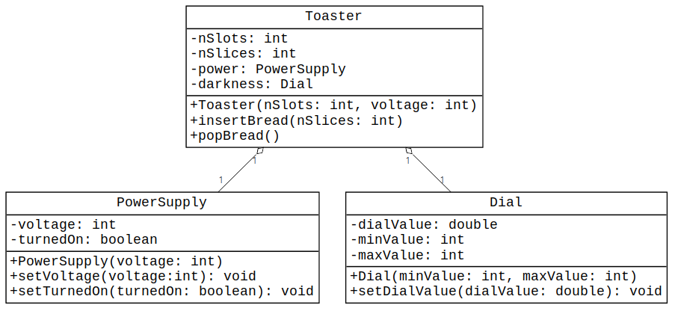
Composition

Slide 6
Aggregated Class Constructors
public PowerSupply(int voltage) {
if (voltage == 220) {
this.voltage = voltage;
} else {
this.voltage = 110;
}
// new power supplies are
// always off
this.turnedOn = false;
}
public Dial(int minValue, int maxValue) {
this.minValue = minValue;
this.maxValue = maxValue;
// set to lowest value
this.dialValue = minValue;
}

Slide 7
Aggregator Class Constructor
class Toaster {
private int nSlots;
private int nSlices;
private PowerSupply power;
private Dial darkness;
public Toaster(int nSlots, int voltage) {
this.nSlots = Math.max(1, Math.min(4, nSlots));
this.nSlices = 0;
this.power = new PowerSupply(voltage);
this.darkness = new Dial(1, 10);
}
// ...
}
These belong to the
Toaster
These require a call to
the aggregated class
constructors.

Slide 8
Exposing Aggregated Class Methods
public boolean isTurnedOn() {
return power.isTurnedOn();
}
public void setTurnedOn(boolean turnedOn) {
power.setTurnedOn(turnedOn);
}
public double getDialValue() {
return darkness.getDialValue();
}
public void setDialValue(double dialValue) {
darkness.setDialValue(dialValue);
}
These methods go in
the Toaster class to
make the aggregated
class methods
available to users
of Toaster.

Slide 9
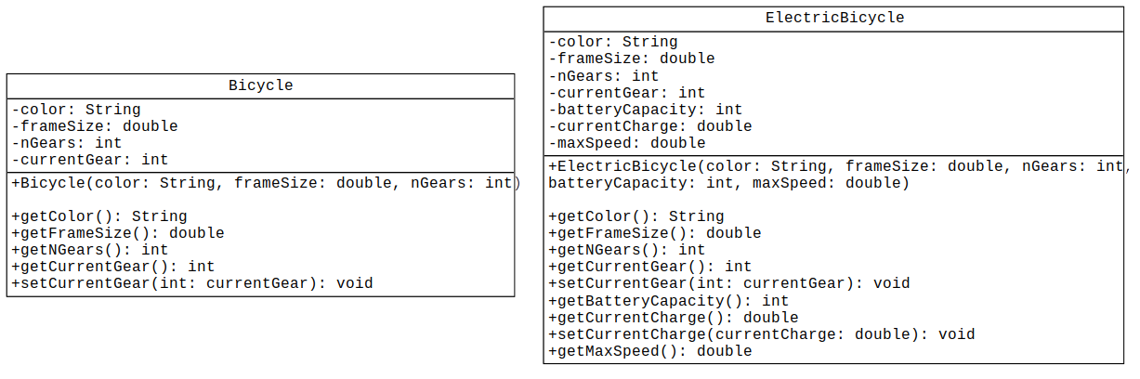
Classes with Many Common Elements

Slide 10
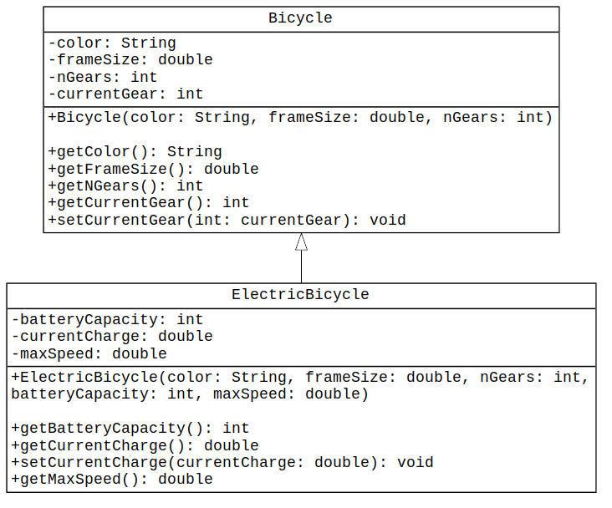
Using Inheritance
Parent class
(superclass)
An
ElectricBicycle
is-a
Bicycle
Child class
(subclass)

Slide 11
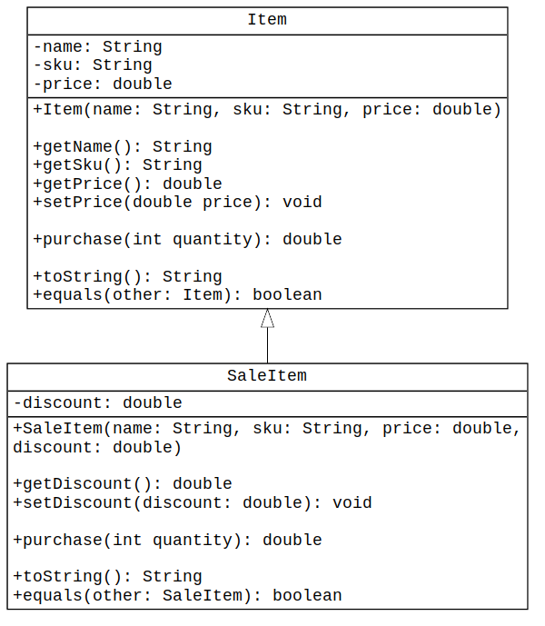
Using Inheritance
name and sku
are initialized by
the constructor
name and sku
do not have
setters
A SaleItem
is-an
Item
calculates purchase
price for a given
quantity

Slide 12
Specifying a Child Class (Subclass)
public class Item {
…
}
public class SaleItem extends Item {
…
}
The extends keyword
specifies that SaleItem is
a subclass of Item.

Slide 13
Constructors for Parent/Child
public Item(String name, String sku, double price) {
this.name = name;
this.sku = sku;
this.price = Math.abs(price);
}
public SaleItem(String name, String sku, double price,
double discount) {
this.name = name;
this.sku = sku;
this.price = Math.abs(price);
this.discount = Math.max(0,
Math.min(discount, 1.00));
}

Slide 14
Constructors for Parent/Child
public Item(String name, String sku, double price) {
this.name = name;
this.sku = sku;
this.price = Math.abs(price);
}
public SaleItem(String name, String sku, double price,
double discount) {
this.name = name;
this.sku = sku;
this.price = Math.abs(price);
this.discount = Math.max(0,
Math.min(discount, 1.00));
}
These attributes
are private in Item

Slide 15
Constructors for Parent/Child
public Item(String name, String sku, double price) {
this.name = name;
this.sku = sku;
this.price = Math.abs(price);
}
public SaleItem(String name, String sku, double price,
double discount) {
setName(name);
setSku(sku);
setPrice(price);
this.discount = Math.max(0,
Math.min(discount, 1.00));
}
These methods do not
exist in Item

Slide 16
Constructors for Parent/Child
public Item(String name, String sku, double price) {
this.name = name;
this.sku = sku;
this.price = Math.abs(price);
}
public SaleItem(String name, String sku, double price,
double discount) {
super(name, sku, price);
this.discount = Math.max(0,
Math.min(discount, 1.00));
}
This must be the first
non-comment line
in the constructor.

Slide 17
Additional SaleItem Methods
public double purchase(int quantity) {
return (this.getPrice() * quantity) *
(1 - discount);
}
public String toString() {
return String.format("%s (%s): $%.2f - %.1f%% discount",
this.getName(), this.getSku(), this.getPrice(),
this.discount * 100.0);
}
public boolean equals(SaleItem other) {
return (this.getName().equals(other.getName()) &&
this.getSku().equals(other.getSku()) &&
this.getPrice() == other.getPrice() &&
this.discount == other.discount);
}

Slide 18
Additional SaleItem Methods
Highlighted code is
same as in superclass.
public double purchase(int quantity) {
return (this.getPrice() * quantity) *
(1 - discount);
}
public String toString() {
return String.format("%s (%s): $%.2f - %.1f%% discount",
this.getName(), this.getSku(), this.getPrice(),
this.discount * 100.0);
}
public boolean equals(SaleItem other) {
return (this.getName().equals(other.getName()) &&
this.getSku().equals(other.getSku()) &&
this.getPrice() == other.getPrice() &&
this.discount == other.discount);
}

Slide 19
Additional SaleItem Methods
public double purchase(int quantity) {
return (super.purchase(quantity)) *
(1 - discount);
}
public String toString() {
return String.format("%s - %.1f%% discount",
super.toString(),
this.discount * 100.0);
}
public boolean equals(SaleItem other) {
return (super.equals(other) &&
this.discount == other.discount);
}
We can call the
superclass methods
to avoid duplication.

Slide 20
Polymorphism
public class Polymorphism {
public static void main(String[] args) {
Item item1 = new Item("Cat Food", "CF-909", 7.85);
Item item2 = new SaleItem("Lima Beans", "LB-104",
5.95, 7.5);
System.out.println("item 1: " + item1.toString());
System.out.println("item 2: " + item2.toString());
}
}
No problem here.

Slide 21
Polymorphism
public class Polymorphism {
public static void main(String[] args) {
Item item1 = new Item("Cat Food", "CF-909", 7.85);
Item item2 = new SaleItem("Lima Beans", "LB-104",
5.95, 7.5);
System.out.println("item 1: " + item1.toString());
System.out.println("item 2: " + item2.toString());
}
}
How is this
possible?

Slide 22
Polymorphism
Item item2 = new SaleItem("Lima Beans", "LB-104", 5.95, 7.5);
A SaleItem is-an Item.
Java lets you assign a subclass object to a superclass variable.
This is called polymorphism.

Slide 23
Polymorphism
SaleItem wrong = new Item("Invalid", "BAD-000", 6.66);
Not all Items are SaleItems.
You can not assign a superclass object to a subclass variable.

Slide 24
Dynamic Binding
public class Polymorphism {
public static void main(String[] args) {
Item item1 = new Item("Cat Food", "CF-909", 7.85);
Item item2 = new SaleItem("Lima Beans", "LB-104",
5.95, 7.5);
System.out.println("item 1: " + item1.toString());
System.out.println("item 2: " + item2.toString());
}
}
At compile time, both
item1 and item2 are
considered to be Item
objects.

Slide 25
Dynamic Binding
public class Polymorphism {
public static void main(String[] args) {
Item item1 = new Item("Cat Food", "CF-909", 7.85);
Item item2 = new SaleItem("Lima Beans", "LB-104",
5.95, 7.5);
System.out.println("item 1: " + item1.toString());
System.out.println("item 2: " + item2.toString());
}
}
At run time, the JVM determines the actual type of item1 and item2.
item1.toString() will call the method in the Item class
item2.toString() will call the method in the SaleItem class.
This is called dynamic binding.

Slide 26
Polymorphism/Dynamic Binding Interaction
public class PolyArray {
public static void main(String[] args) {
Item [] foods = {
new Item("Rye Bread", "RB-010", 3.95),
new SaleItem("Tomato Soup", "TS-882", 1.29, 0.05),
new SaleItem("Canned Lima Beans", "CLB-104", 2.98, 0.155),
new SaleItem("Frozen Pizza", "FP-326",5.90, 0.12),
new Item("Organic Salsa", "OS-245", 3.79)
};
// ...
}
}
Polymorphism makes all these array element
assignments valid. (A SaleItem is-an Item.)

Slide 27
Polymorphism/Dy namic Binding Interaction
Here is pseudocode to display all the items in the foods array:
for (Item food: foods) {
System.out.printf("%s: ", food.getName());
if (food is a sale item) {
discounted price is getPrice() * (1 - getDiscount());
display discounted price;
} else {
display getPrice();
}
}

Slide 28
Polymorphism/Dy namic Binding Interaction
Here is pseudocode to display all the items in the foods array:
for (Item food: foods) {
System.out.printf("%s: ", food.getName());
if (food is a sale item) {
discounted price is getPrice() * (1 - getDiscount());
display discounted price;
} else {
display getPrice();
}
}
How can we determine
whether an array entry
is a SaleItem
at run time?

Slide 29
Polymorphism/Dy namic Binding Interaction
for (Item food: foods) {
System.out.printf("%s: ", food.getName());
if (food instanceof SaleItem) {
discounted price is getPrice() * (1 - getDiscount());
display discounted price;
} else {
display getPrice();
}
}
The instanceof
operator returns true if
the object is an
instance of the class.

Slide 30
Polymorphism/Dy namic Binding Interaction
for (Item food: foods) {
System.out.printf("%s: ", food.getName());
if (food instanceof SaleItem) {
double discPrice = food.getPrice() * (1 – food.getDiscount());
display discounted price;
} else {
display getPrice();
}
}
This works fine.
getPrice() is
inherited from Item.

Slide 31
Polymorphism/Dy namic Binding Interaction
for (Item food: foods) {
System.out.printf("%s: ", food.getName());
if (food instanceof SaleItem) {
double discPrice = food.getPrice() * (1 – food.getDiscount());
display discounted price;
} else {
display getPrice();
}
}
This won’t work. The compiler
thinks food is an Item, but
Item does not have a
getDiscount() method.

Slide 32
Polymorphism/Dy namic Binding Interaction
for (Item food: foods) {
System.out.printf("%s: ", food.getName());
if (food instanceof SaleItem) {
double discPrice = food.getPrice() *
(1 – ((SaleItem) food).getDiscount());
display discounted price;
} else {
display getPrice();
}
}
We use a cast to tell the compiler to
treat food as a SaleItem.
It’s OK to do this, because we know
food is an instanceof SaleItem.

Slide 33
Polymorphism/Dy namic Binding Interaction
for (Item food: foods) {
System.out.printf("%s: ", food.getName());
if (food instanceof SaleItem) {
double discPrice = food.getPrice() *
(1 – ((SaleItem) food).getDiscount());
display discounted price;
} else {
display getPrice();
}
}
...and that allows us to use the getDiscount() method.

Slide 34
Summary
A subclass (the child class) extends a superclass (the parent class).
A subclass constructor can call the superclass constructor by invoking the super method.
If you use a super constructor, it must be the first non-comment line.
Subclass methods can invoke the superclass methods by using super.method anywhere in the subclass method body.

Slide 35
Summary
Polymorphism allows you to assign a subclass object to a superclass variable.
At compile time, the compiler sees the superclass variable as having the superclass data type.
At run time, the compiler uses the actual data type of the object.

Slide 36
Summary
The compiler won't let you call a method that exists only in the subclass on a superclass variable.
Use the instanceof operator to determine whether a variable belongs to a class or not.
You can use a cast to tell the compiler to treat a superclass variable as a subclass object at compile time.

