Slide 1
Introduction to
Functional Programming
with
ClojureScript
David Eisenberg

Slide 2
Terminology
Clojure
A dialect of Lisp that runs on the JVM

Slide 3
Terminology
Clojure
A dialect of Lisp that runs on the JVM
ClojureScript
A dialect of Clojure targeting JavaScript
The compiler

Slide 4
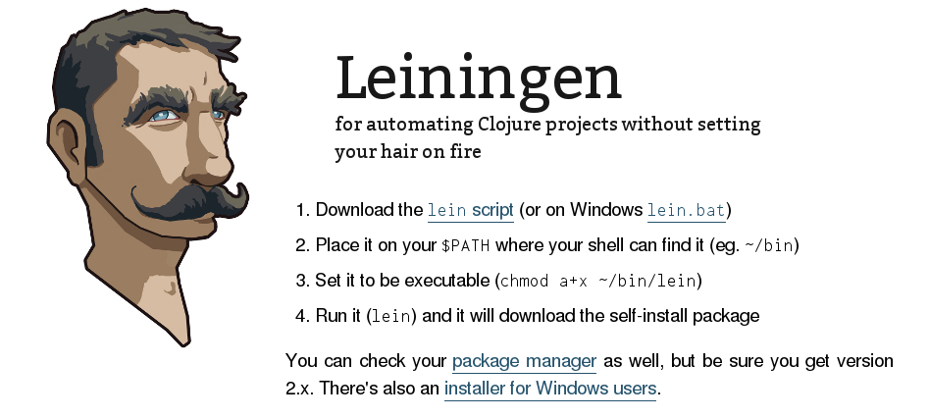
http://leiningen.org

Slide 5








Slide 6



Slide 7
lein new figwheel example
cd example

Slide 8
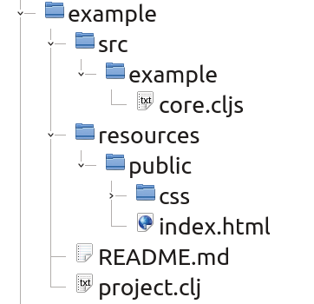

Slide 9
Read
Evaluate
Print
Loop

Slide 10
lein figwheel
rlwrap lein figwheel

Slide 11
Variables
x = 8;
x
8

Slide 12
Variables
x = 8;
x = 9;
x
8 9

Slide 13
Variables
x = 8;
x = 9;
x
8 9

Slide 14
Variables
x = 8

Slide 15
Variables
x = 8
x = 9

Slide 16

Variables
x = 8
x = 9
Image by xvoltagex from freeimages.com

Slide 17
Variables
(def x 8)

Slide 18
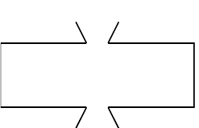
Functions
8
inc
9

Slide 19
Functional Programming
Functions transform data.

Slide 20
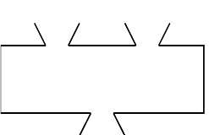
Functions
3
4
x²
x²
9
16
+
25
√
5

Slide 21
Functions
(def name (fn [params] body))

Slide 22
Functions
(def name (fn [params] body))
(def square (fn [x] (* x x)))

Slide 23
Functions
(defn name [params] body)
(defn cube [a] (* a a a))

Slide 24
Accessing JavaScript
(.method object args)
(.sqrt js/Math 2)

Slide 25
Accessing JavaScript
Full version | Shortcut
(.sqrt js/Math 2) | (js/Math.sqrt 2)
(.parseFloat js/window "12.34") | (js/window.parseFloat "12.34") (js/parseFloat "12.34")

Slide 26
Accessing JavaScript
(.-property object)
(.-PI js/Math)

Slide 27
Accessing JavaScript
(class. args)
(js/Date.)
(js/Date. 0)

Slide 28
Functions
(get-value! id-string)
(to-number string)

Slide 29
Functions
(defn get-value! [id-string]
(.-value
(js/document.getElementById id-string)))

Slide 30
Conditionals with if
(if condition true-expr
false-expr)
(if (< x 0) (- x) x)

Slide 31
Functions
(defn to-number [str]
(if (js/isNaN (js/parseFloat str))
0
(js/parseFloat str)))

Slide 32
Let’s use let
(let [symbol1 value1
symbol2 value2]
(expr)...
(expr))

Slide 33
Functions
(defn to-number [str]
(let [n (js/parseFloat str)]
(if (js/isNaN n) 0 n)))

Slide 34
def vs. let
(def x 8)
–The symbol x is available to all functions in the namespace.
(let [y 42]
(expr))
–The symbol y is available only to expressions within the
(let...)

Slide 35
Collections
List
'(1 2 3)
(list 1 2 3)

Slide 36
Collections
List
'(1 2 3)
(list 1 2 3)
Vector
["a" "b" "c"]
(vector "a" "b" "c")

Slide 37
Collections
List
'(1 2 3)
(list 1 2 3)
Vector
["a" "b" "c"]
(vector "a" "b" "c")
Map
{"quantity" 29
"price" 3.75}

Slide 38
Collections
List
'(1 2 3)
(list 1 2 3)
Vector
["a" "b" "c"]
(vector "a" "b" "c")
Map
{"quantity" 29
"price" 3.75}
Set
#{3 5 1 7 2}

Slide 39
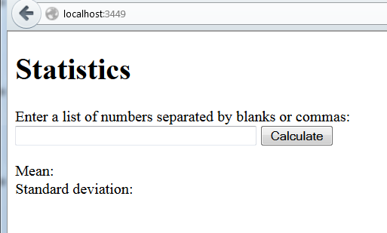

Slide 40
To acquire data:
Take comma-separated input string
↓
Split into individual items
↓
Convert to numbers
↓
Eliminate non-numerics
"1, 3, x, 7, 5"
↓
["1" "3" "x" "7" "5"]
↓
[1 3 NaN 7 5]
↓
[1 3 7 5]

Slide 41
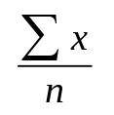
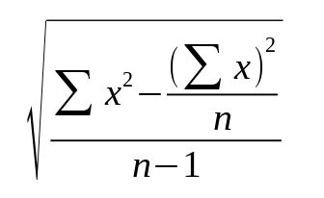
Mean
Standard Deviation

Slide 42
To calculate mean and standard deviation:
Get number of items in list
Reduce list to a sum
Reduce list to a sum of squares
[1 3 7 5] → 4
[1 3 7 5] → 16
[1 3 7 5] → 84

Slide 43
To acquire data:
Take comma-separated input string
↓
Split into individual items
↓
Convert to numbers
↓
Eliminate non-numerics
"1, 3, x, 7, 5"
↓
["1" "3" "x" "7" "5"]
↓
[1 3 NaN 7 5]
↓
[1 3 7 5]

Slide 44
(map f [x₀ x₁ x₂ ... x_{n}])
[ x₀ x₁ x₂ ... x_{n} ]
↓ ↓ ↓ ↓
[ f(x₀) f(x₁) f(x₂) ... f(x_{n}) ]

Slide 45
This is a function that
takes one argument
(map f [x₀ x₁ x₂ ... x_{n}])
[ x₀ x₁ x₂ ... x_{n} ]
↓ ↓ ↓ ↓
[ f(x₀) f(x₁) f(x₂) ... f(x_{n}) ]

Slide 46
(defn square [x]
(* x x))
(map square [12 4 1.5 9])
[ 12 4 1.5 9 ]
↓ ↓ ↓ ↓
(square 12) (square 4)(square 1.5) (square 9)
↓ ↓ ↓ ↓
( 144 16 2.25 81 )

Slide 47
This is a function that takes one argument and returns true or false.
(filter f [x₀ x₁ x₂ ... x_{n}])
(filter even? [3 16 22 7 4])
[ 3 16 22 7 4 ]
(even? 3) (even? 16) (even? 22) (even? 7) (even? 4)
false true true false true
↓ ↓ ↓
( 16 22 4 )

Slide 48
Mean
Standard Deviation

Slide 49
To calculate mean and standard deviation:
Get number of items in list
Reduce list to a sum
Reduce list to a sum of squares
[1 3 7 5] → 4
[1 3 7 5] → 16
[1 3 7 5] → 84

Slide 50
(count numbers)

Slide 51
(reduce sum 0 data)
(def data [ 5 4 6 ])

Slide 52
(reduce sum 0 data)
(def data [ 5 4 6 ])

Slide 53
(reduce sum 0 data)
(def data [ 5 4 6 ])

Slide 54
(reduce sum 0 data)
(def data [ 5 4 6 ])

Slide 55
(defn sum [acc x] (+ acc x))
(reduce sum 0 data)
(def data [ 5 4 6 ])

Slide 56
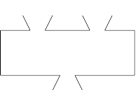
(defn sum [acc x] (+ acc x))
(reduce sum 0 data)
(def data [ 5 4 6 ])
0
sum
5

Slide 57
(defn sum [acc x] (+ acc x))
(reduce sum 0 data)
(def data [ 5 4 6 ])
5
sum
5
9

Slide 58
(defn sum [acc x] (+ acc x))
(reduce sum 0 data)
(def data [ 5 4 6 ])
9
sum
9
15

Slide 59
(defn sum [acc x] (+ acc x))
(reduce sum 0 data)
(def data [ 5 4 6 ])
15

Slide 60
(reduce + 0 data)
(def data [ 5 4 6 ])
15

Slide 61
Where to go from here
You can think functionally in JavaScript.
You can use map, reduce, and filter in JavaScript.

Slide 62
Where to go from here
DOM manipulation
Google “closure” library
dommy
Domina
Enfocus
Reagent (if you are using React)

Slide 63
Where to go from here
Documentation
https://github.com/clojure/clojurescript/wiki
http://funcool.github.io/clojurescript-unraveled/
Somewhat more advanced topics
https://github.com/cljsinfo/cljs-api-docs/tree/catalog
http://clojurescriptmadeeasy.com/
Further exercises
https://github.com/jdeisenberg/etudes-for-clojurescript

