Slide 1
Using Express and Mongo
27 Apr 2017

Slide 2
Creating an Express App
https://expressjs.com/en/starter/generator.html
npm install express-generator -g
express --view=ejs books
cd books
npm install

Slide 3
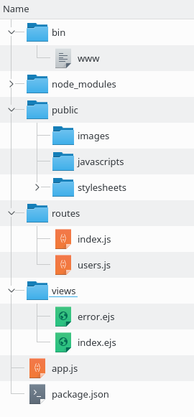
Project Directory

Slide 4
Testing the server
Test the server:
DEBUG=myapp:* npm start
To avoid reloads:
npm install nodemon --save-dev
node_modules/.bin/nodemon

Slide 5
Getting/Showing Form Data
In file.js:
router.get('/', function(req, res, next) {
res.render('file', { title: 'Express',
value: req.query.fieldname});
});
<h1><%= title %></h1>
The field contained <%= value%>.
In file.ejs:

Slide 6
EJS – Embedded JavaScript
<% if expr { %>
<p>Expression evaluates to <%= expr %></p>
<% } else { %>
<p>Expression is false
<% } %>
<ul>
<% for (var i = 0; i < array.length; i++) { %>
<li>Item <%= i %>: <%= array[i] %></li>
<% } %>
</ul>

Slide 7
MongoDB Structure
A Database consists of
  Collections
    Of Documents
Where a “document” is a BSON (Binary representation of JSON) object.

Slide 8
Sample Collection
{_id: 1, course: "CS075", units: 3.0}
{_id: 2, course: "CS076", units: 3.0}
{_id: 3, course: "MATH013", units: 5.0}
The _id field is required and must be unique.

Slide 9
Creating a Database from Mongo Shell
$ mongo chemistry
> db // show current database
chemistry
> db.elements.insert({"_id": 1,
"name": "Hydrogen",
"symbol": "H"})
WriteResult({ "nInserted" : 1 })
> db.elements.find()
{ "_id" : 1, "name" : "Hydrogen", "symbol" : "H" }

Slide 10
Using Mongo from JavaScript
var MongoClient =
require('mongodb').MongoClient;
var assert = require('assert');
var ObjectId = require('mongodb').ObjectID;
var url =
'mongodb://localhost:27017/database';

Slide 11
Using Mongo in Express
var express = require('express');
var router = express.Router();
var MongoClient = require('mongodb').MongoClient;
var assert = require('assert');
var ObjectId = require('mongodb').ObjectID;
var url = 'mongodb://localhost:27017/database';

Slide 12
Using Mongo in Express (2)
router.get('/', function(req, res, next) {
MongoClient.connect(url, function(err, db) {
assert.equal(null, err);
var cursor = db.collection('collection').find();
cursor.toArray(function(err, docs) {
assert.equal(null, err);
db.close();
res.render('view', {'fieldName': docs});
});
});
});
module.exports = router;

