Slide 1
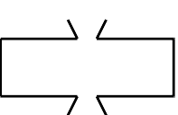
(map discount price-vector)
price-vector [3.95 6.80 2.49 5.33 1.99]
discount
(3.555

Slide 2
(map discount price-vector)
price-vector [3.95 6.80 2.49 5.33 1.99]
discount
(3.555 6.12

Slide 3
(map discount price-vector)
price-vector [3.95 6.80 2.49 5.33 1.99]
discount
(3.555 6.12 2.241

Slide 4
(map discount price-vector)
price-vector [3.95 6.80 2.49 5.33 1.99]
discount
(3.555 6.12 2.241 4.797

Slide 5
(map discount price-vector)
price-vector [3.95 6.80 2.49 5.33 1.99]
discount
(3.555 6.12 2.241 4.797 1.791)

Slide 6
(map discount price-vector)
price-vector [3.95 6.80 2.49 5.33 1.99]
(3.555 6.12 2.241 4.797 1.791)

