Slide 1
Calvert and NSoG Spatial Comparison

Slide 2
Methods to note
Only photosynthetic species retained
Dinoflagellates removed (suggested by Louis):
Gymnodinium
Gyrodinium
Katodinium
2018 QU39 from 0m, everything else 5m (will make case that pigments are comparable?)
QU39 (weekly) downscaled to meet Calvert (monthly) by selecting closest date to Calvert survey. Monthly average would skew results. Always a QU39 day within a few days of Calvert surveys
Some Calvert surveys started at end of month and extended into next (i.e. one station sampled on August 31st for the “September” survey. For plots with data separated out by month, I pushed this station into the next month September to avoid having two data points in the same month.

Slide 3
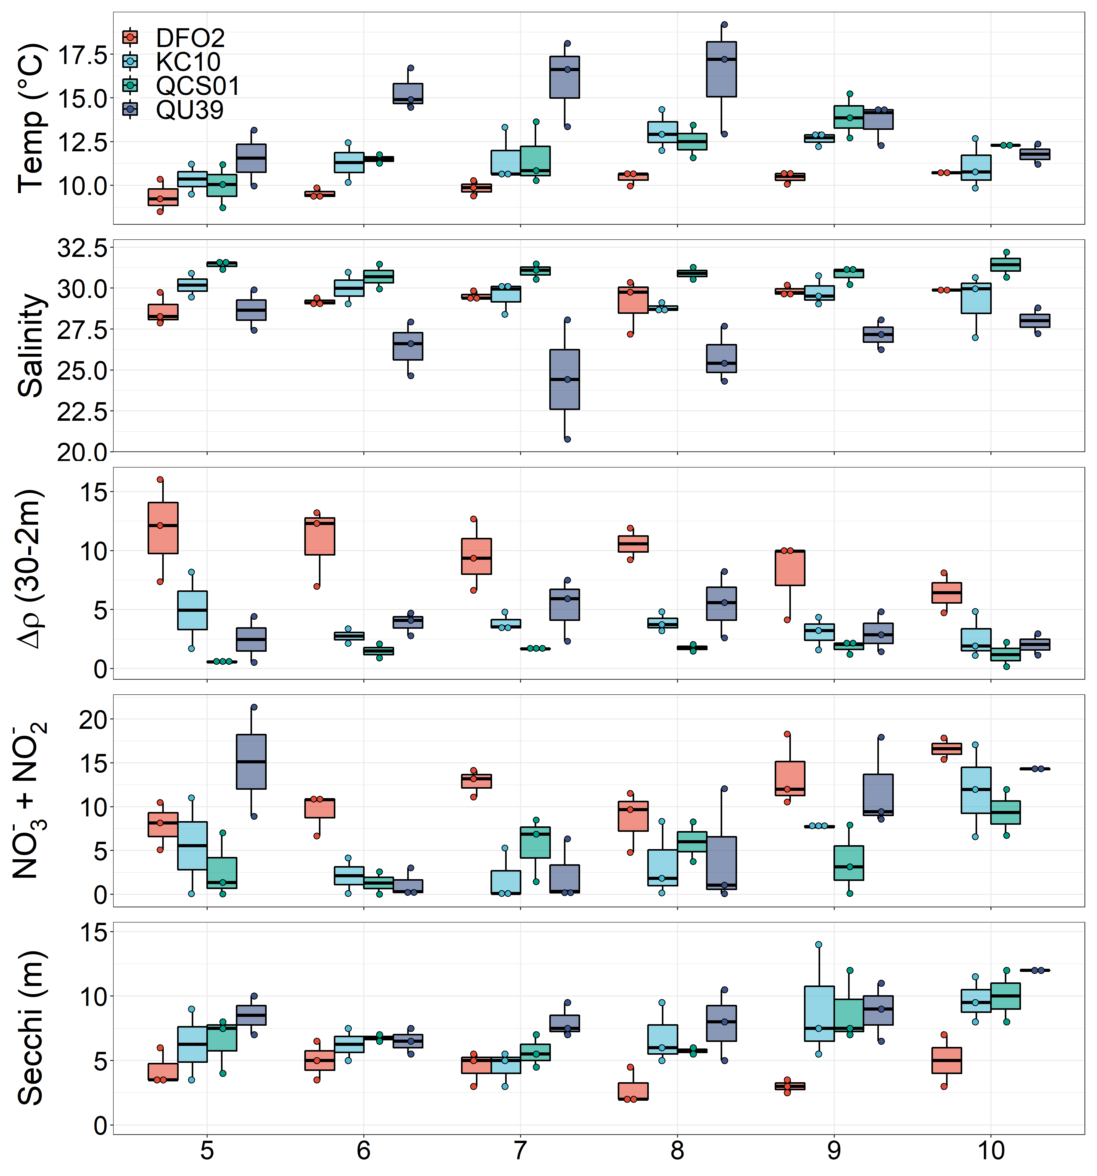
Physical-Chemical (5m)

Slide 4
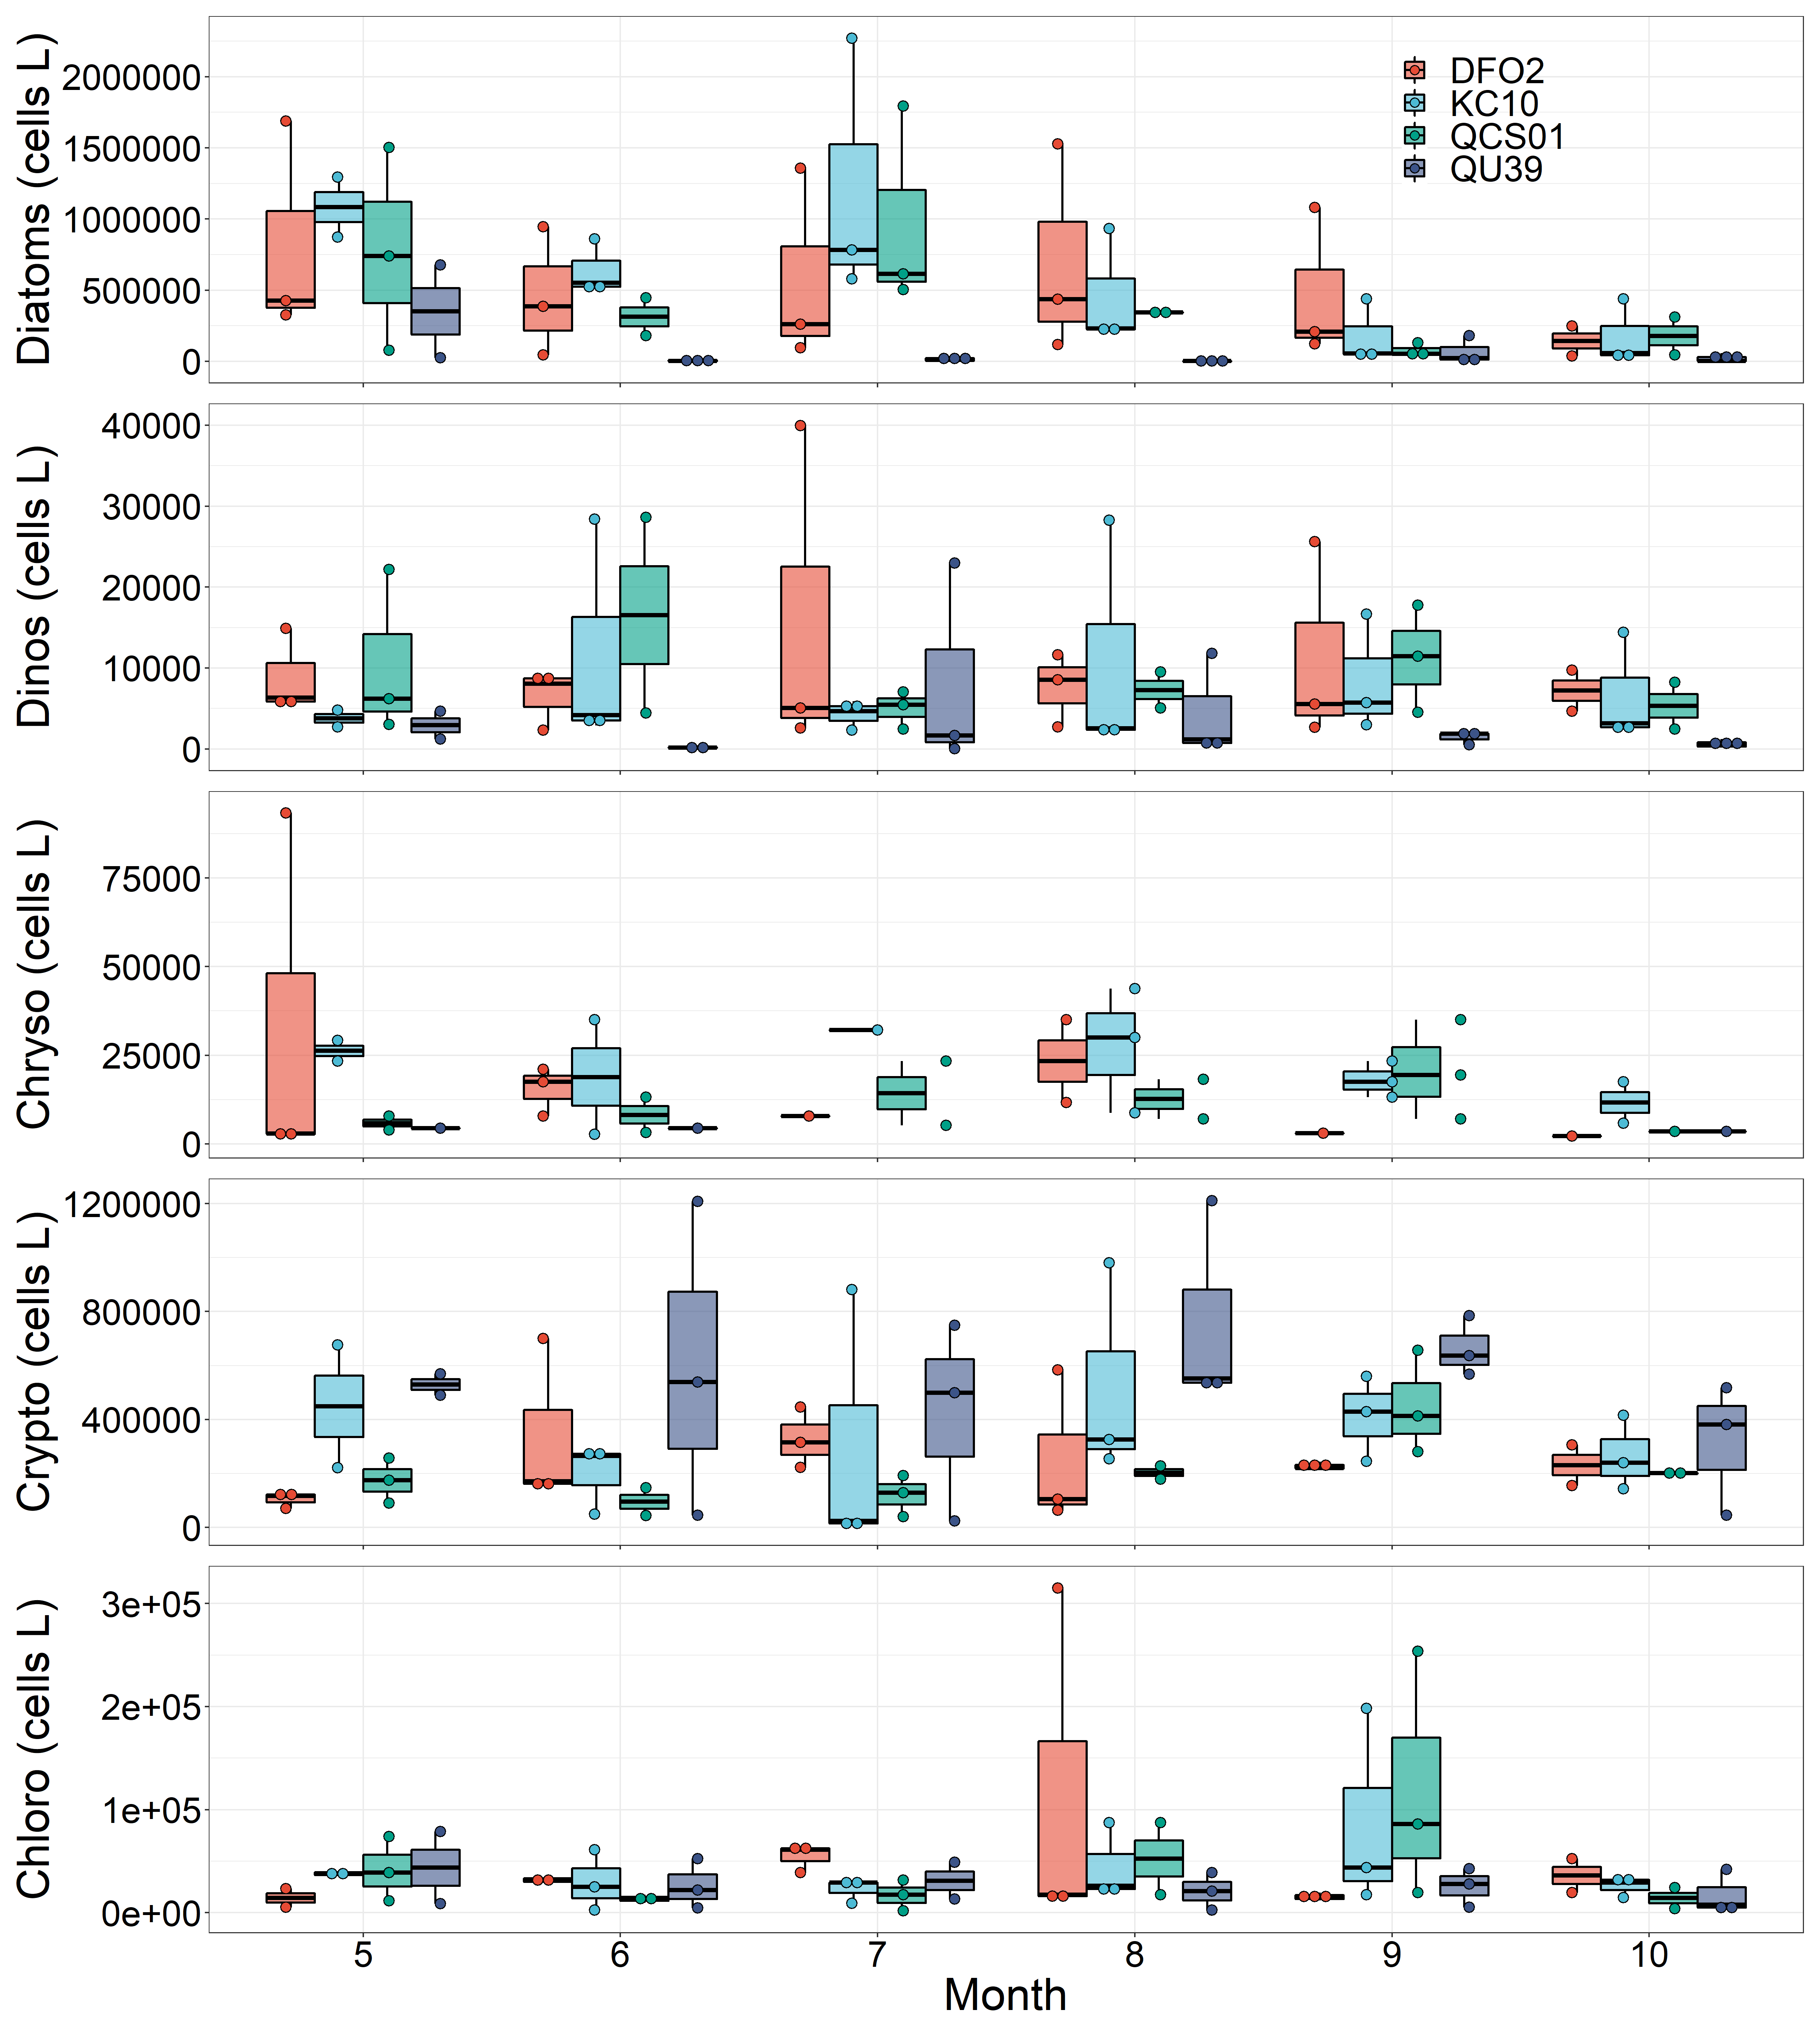
Group Level Abundance
Ebria tripartite is sometimes included as a dinoflagellate
Need to fix this.
Gah! This standardization and species are going to kill me.
Key point 1) NSoG is diatom poor from June through August. The dominant physical difference when compared to the central coast is greater temperature, notably from June through August.

Slide 5
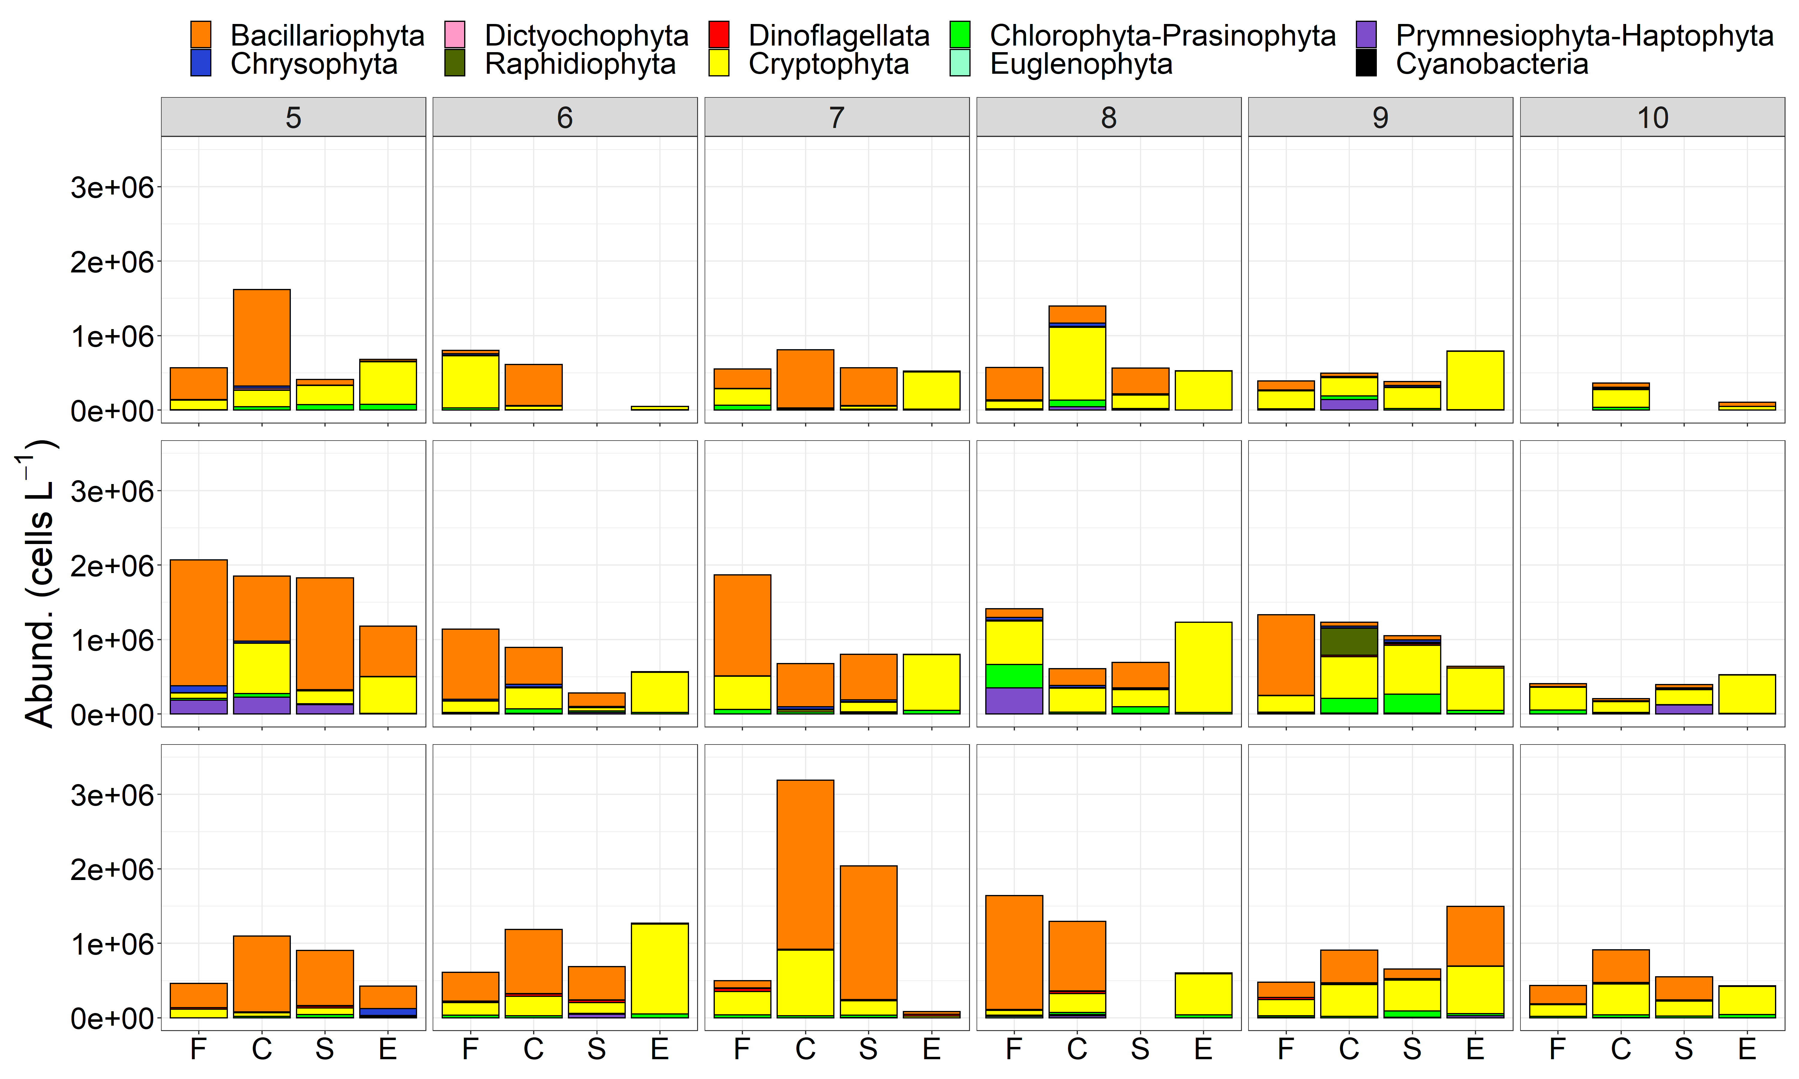
Microscopy Abundance
2018
QU39 lacks diatoms
2019
2020

Slide 6
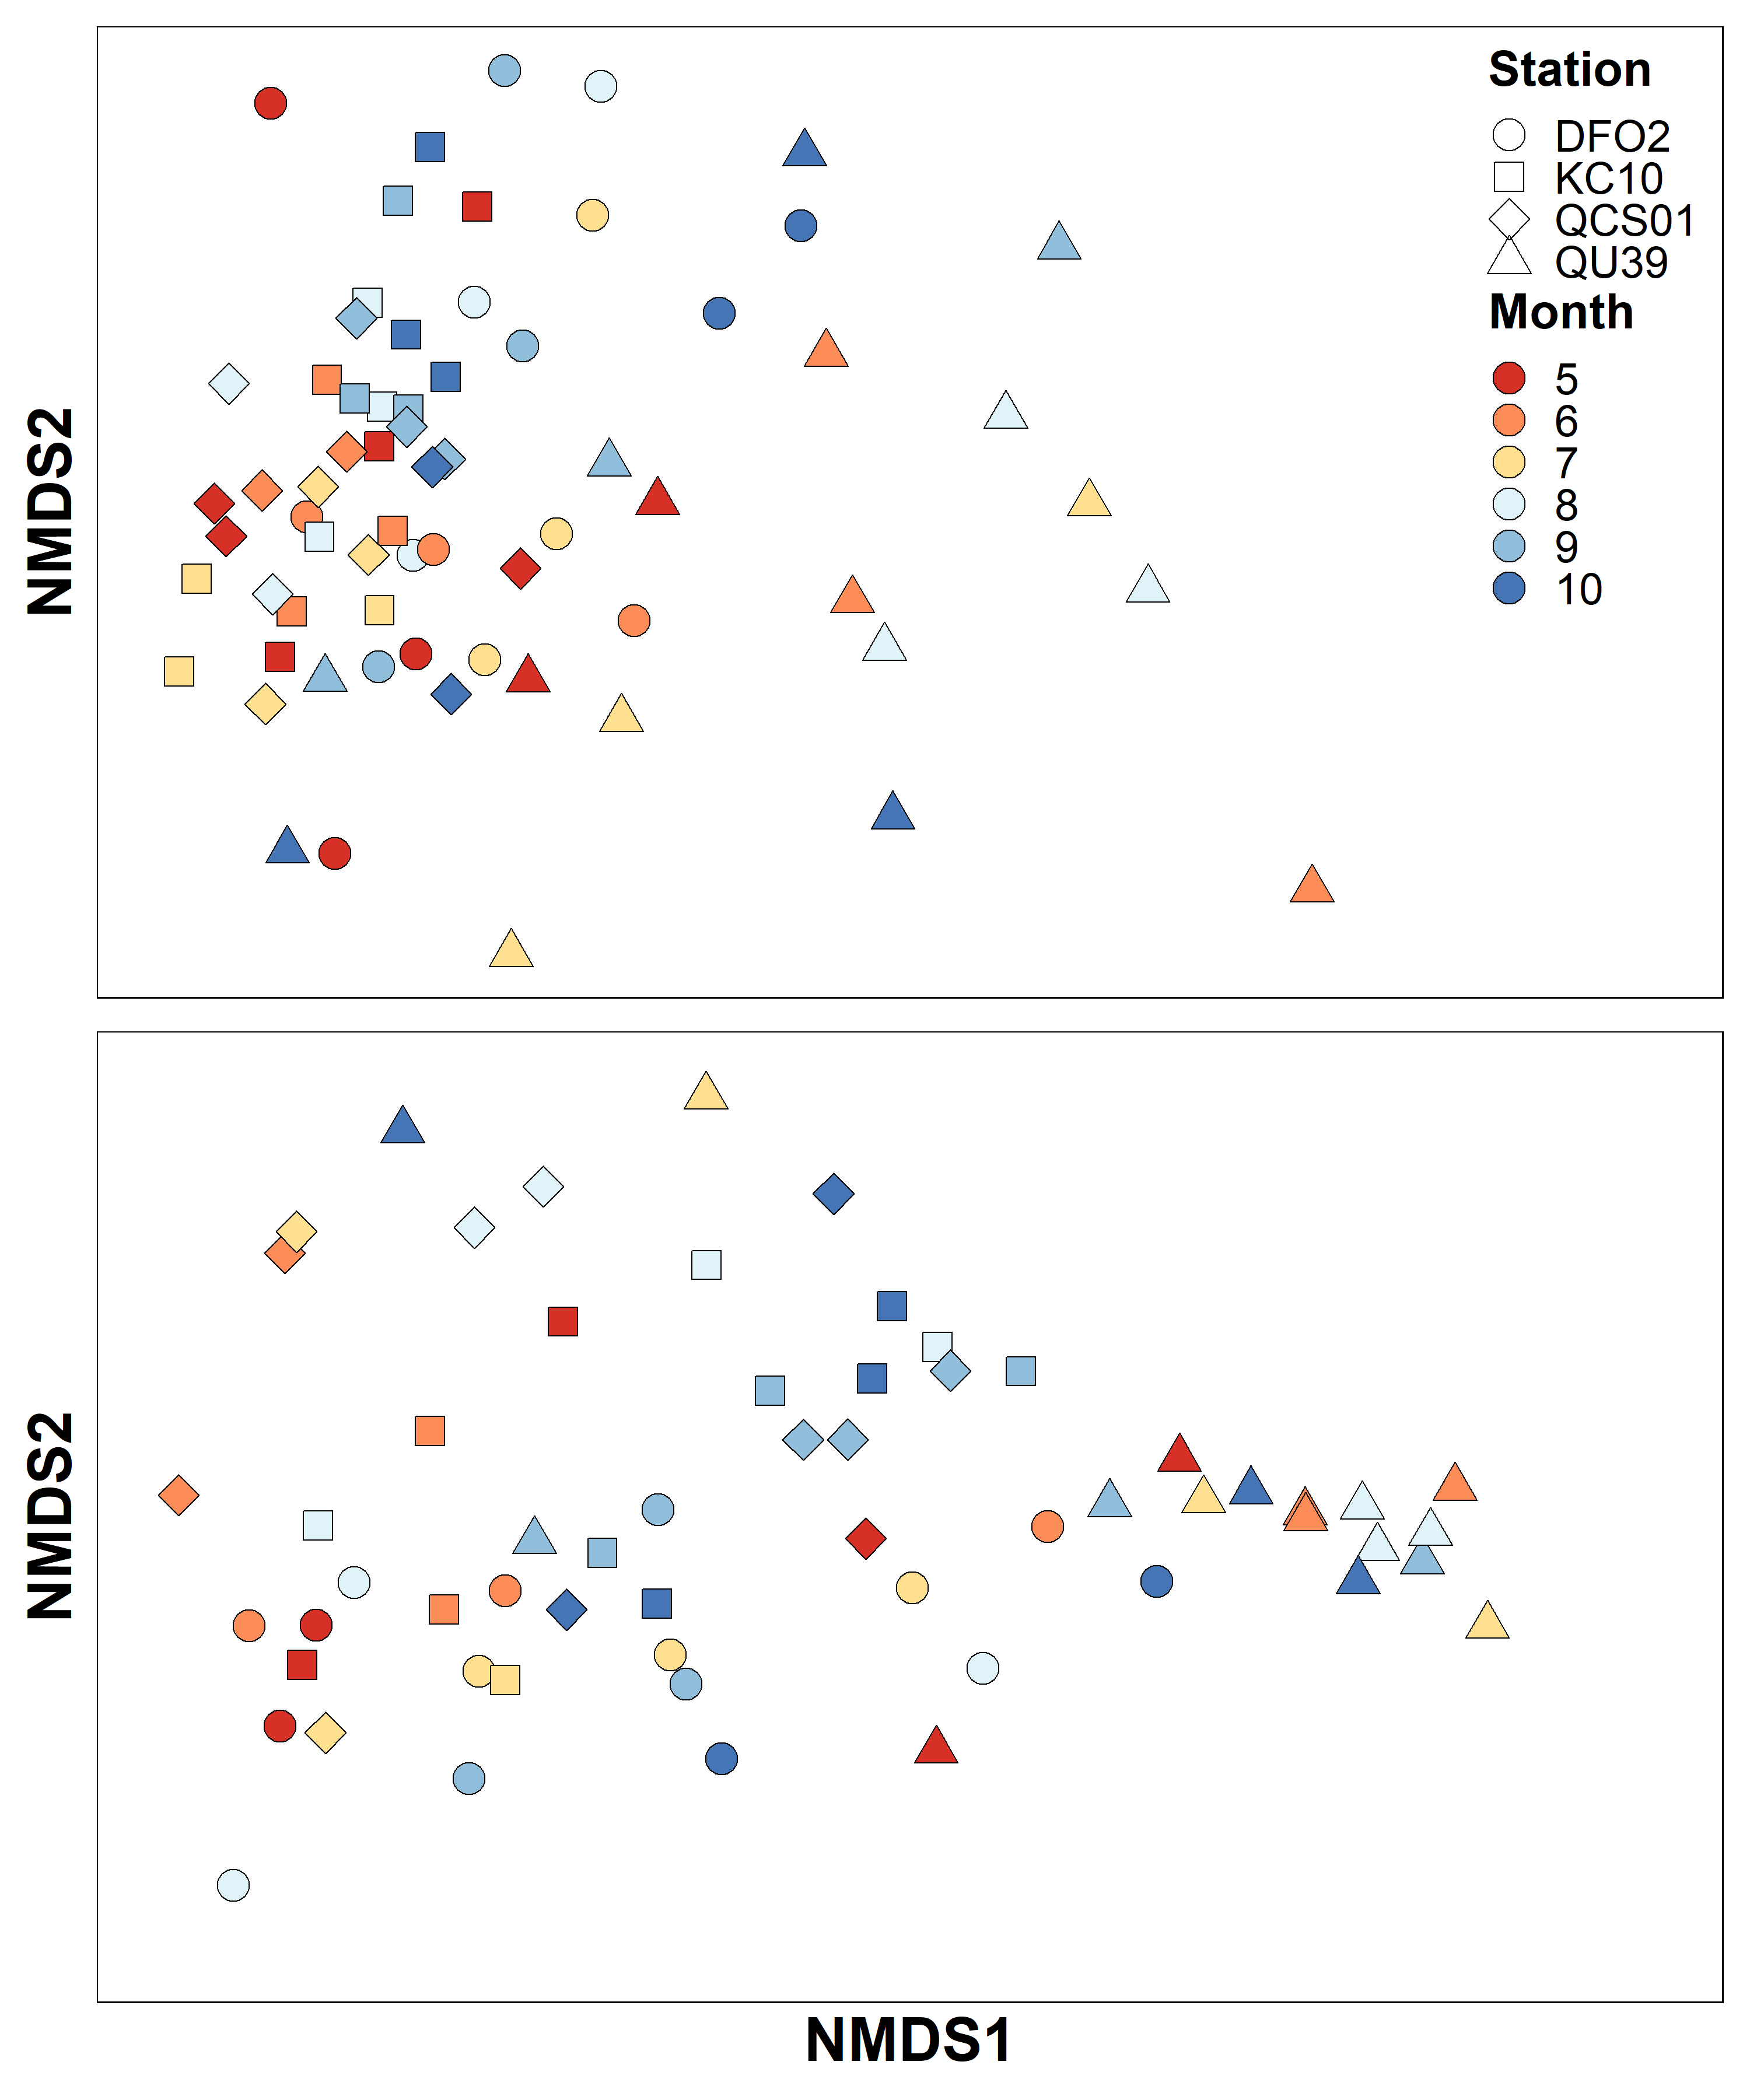
Microscopy Abundance – nMDS
Bray Curtis similarity
QU39 is different during the summer (lack of diatoms)
QU39 June and rest of stations more similar
Seems to be a rough spring-autumn gradient (excluding QU39)
Log¹⁰(Abundance)
sqrt(Relative Abundance)

Slide 7
Statistical tests added to nMDS analysis
ANOSIM
Differences in log10(abundance + 1) data between:
Region (Calvert vs NSoG) – p = 0.0001, R = 0.62
Site (QCS01, KC10, DFO2, QU39) – p = 0.0001, R = 0.27
1) Indicator species - between region
Calvert – only where P <= 0.01
Chaetoceros tenuissimus 0.720 0.0001 ***
Skeletonema marinoi 0.684 0.0001 ***
Leptocylindrus danicus 0.661 0.0001 ***
Dinophyceae 0.623 0.0001 ***
Euglenozoa 0.604 0.0001 ***
Thalassiosira 0.588 0.0001 ***
Cylindrotheca closterium 0.563 0.0001 ***
Ceratium lineatum 0.494 0.0007 ***
Thalassionema nitzschioides 0.484 0.0005 ***
Chaetoceros cinctus 0.483 0.0004 ***
Pennales 0.477 0.0001 ***
Biddulphiales 0.471 0.0007 ***
Dinophysis acuminata 0.462 0.0010 ***
Pseudo-nitzschia seriata 0.461 0.0006 ***
Chaetoceros debilis 0.460 0.0009 ***
Pseudo-nitzschia spp. 0.448 0.0005 ***
QU39
Corethron criophilum 0.364 0.0024 **
Central coast indicators are mostly diatoms, which are largely absent at QU39 in the summer. This seems to drive the dissimilarity in cluster analysis and nMDS.

Slide 8
Statistical tests added to nMDS analysis
2) Indicator species - between Calvert Stations
Group DFO2 #sps. 1
stat p.value
Dinophysis acuta 0.376 0.0189 *
Group KC10 #sps. 1
stat p.value
Biddulphiales 0.335 0.0471 *
Group QCS01 #sps. 6
stat p.value
Chaetoceros decipiens 0.455 0.0049 **
Dactyliosolen phuketensis 0.429 0.0072 **
Detonula pumila 0.422 0.0058 **
Thalassiosira rotula 0.412 0.0101 *
Ditylum brightwellii 0.390 0.0130 *
Prorocentrum micans 0.380 0.0200 *
Group KC10+QCS01 #sps. 12
stat p.value
Ceratium lineatum 0.581 0.0003 ***
Dactyliosolen fragilissimus 0.513 0.0006 ***
Chaetoceros debilis 0.490 0.0012 **
Guinardia delicatula 0.448 0.0037 **
Rhizosolenia setigera 0.415 0.0082 **
Chaetoceros seiracanthus 0.411 0.0098 **
Pseudo-nitzschia seriata 0.401 0.0097 **
Protoperidinium steinii 0.399 0.0164 *
Chaetoceros similis 0.381 0.0195 *
Pseudo-nitzschia 0.368 0.0227 *
Pterosperma 0.351 0.0336 *
Leptocylindrus danicus 0.349 0.0403 *
Suggests differences in ecology across the Shelf to fjord gradient – DFO2 is the most different as KC10 and QCS01 share species. Not quite sure about these designations as when I plot these species, some are often at multiple stations.

Slide 9
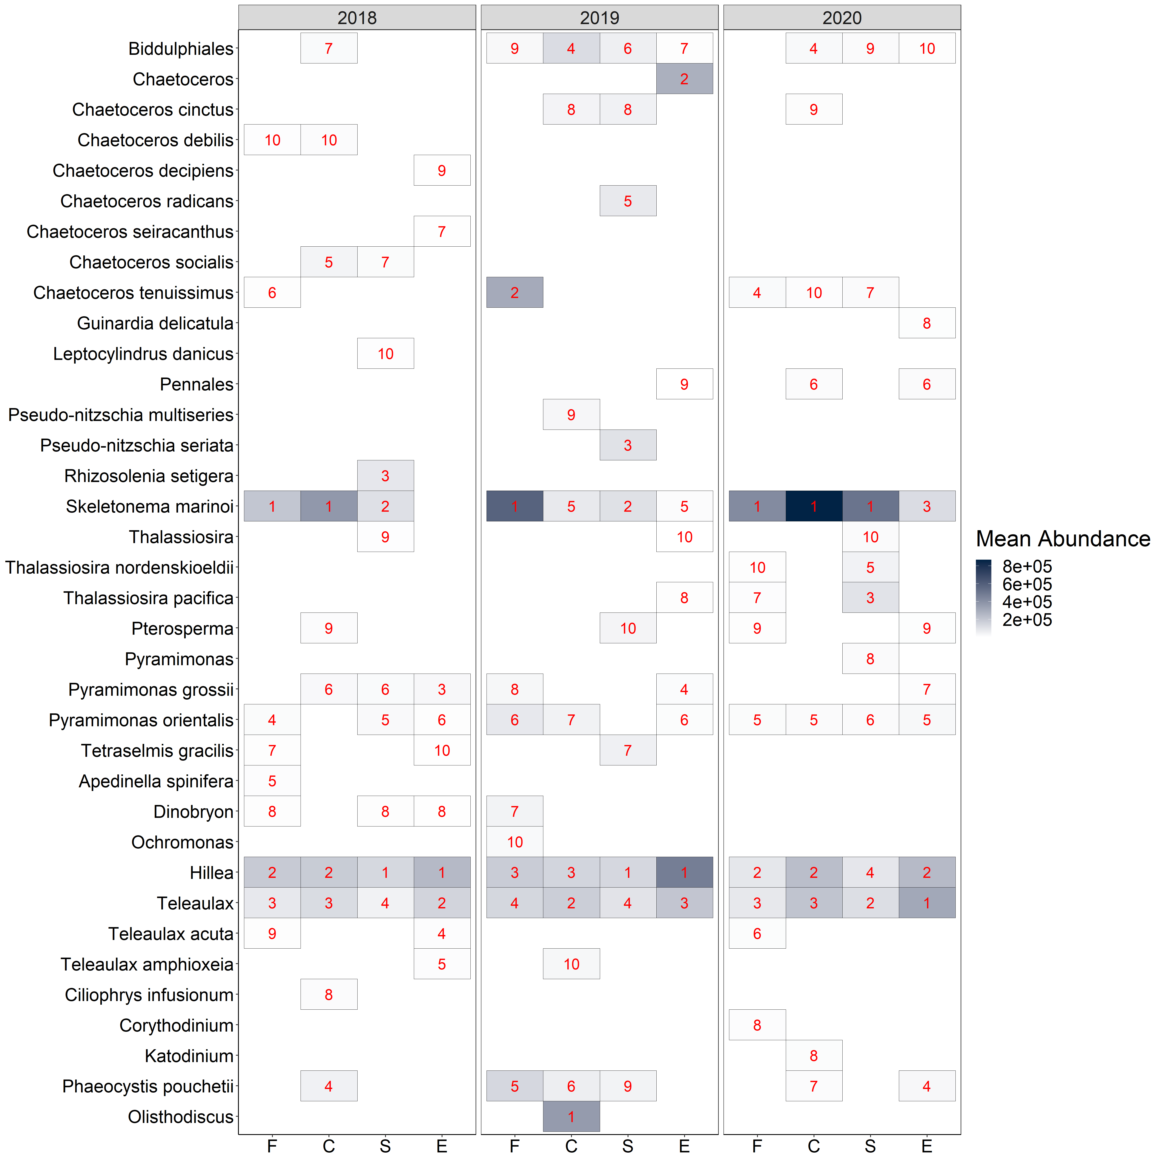
June – Sept. mean abundance station/year. Only top 10 species for each station shown (rank in red).
In general (annual averages)
Skeletonema marinoi generally has highest abundance on central coast.
Cryptophytes Hillea and Teleaulax are prolific at all stations, but dominant abundance wise at QU39.

Slide 10
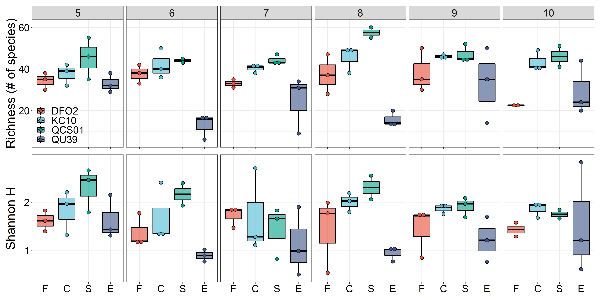
Diversity
QU39 typically has the lowest richness and diversity, notably from June through August, with increases in the fall representative of increases in diatoms?
I think QCS01 in August may be influenced by upwelling/offshore?
Least frequent data removed – need to fix and update.

Slide 11
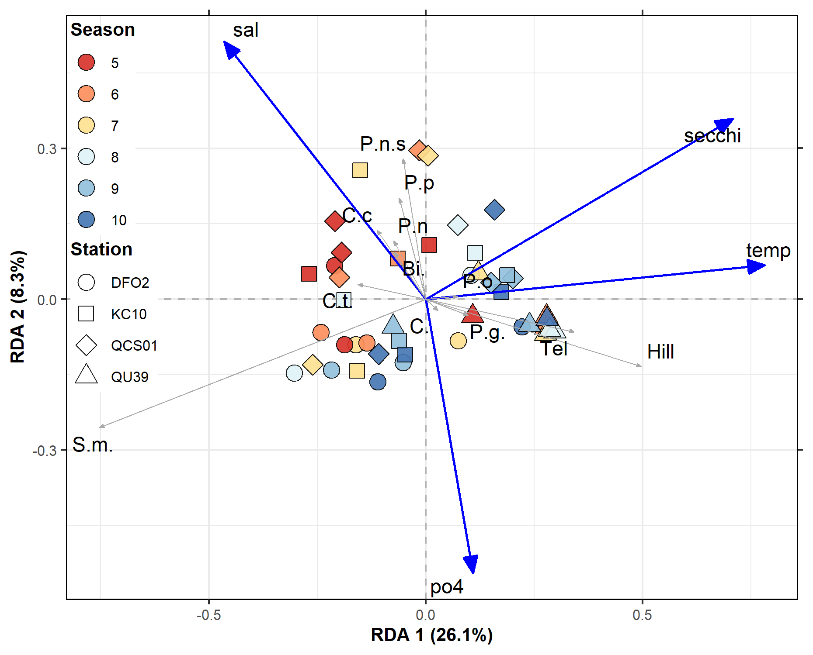
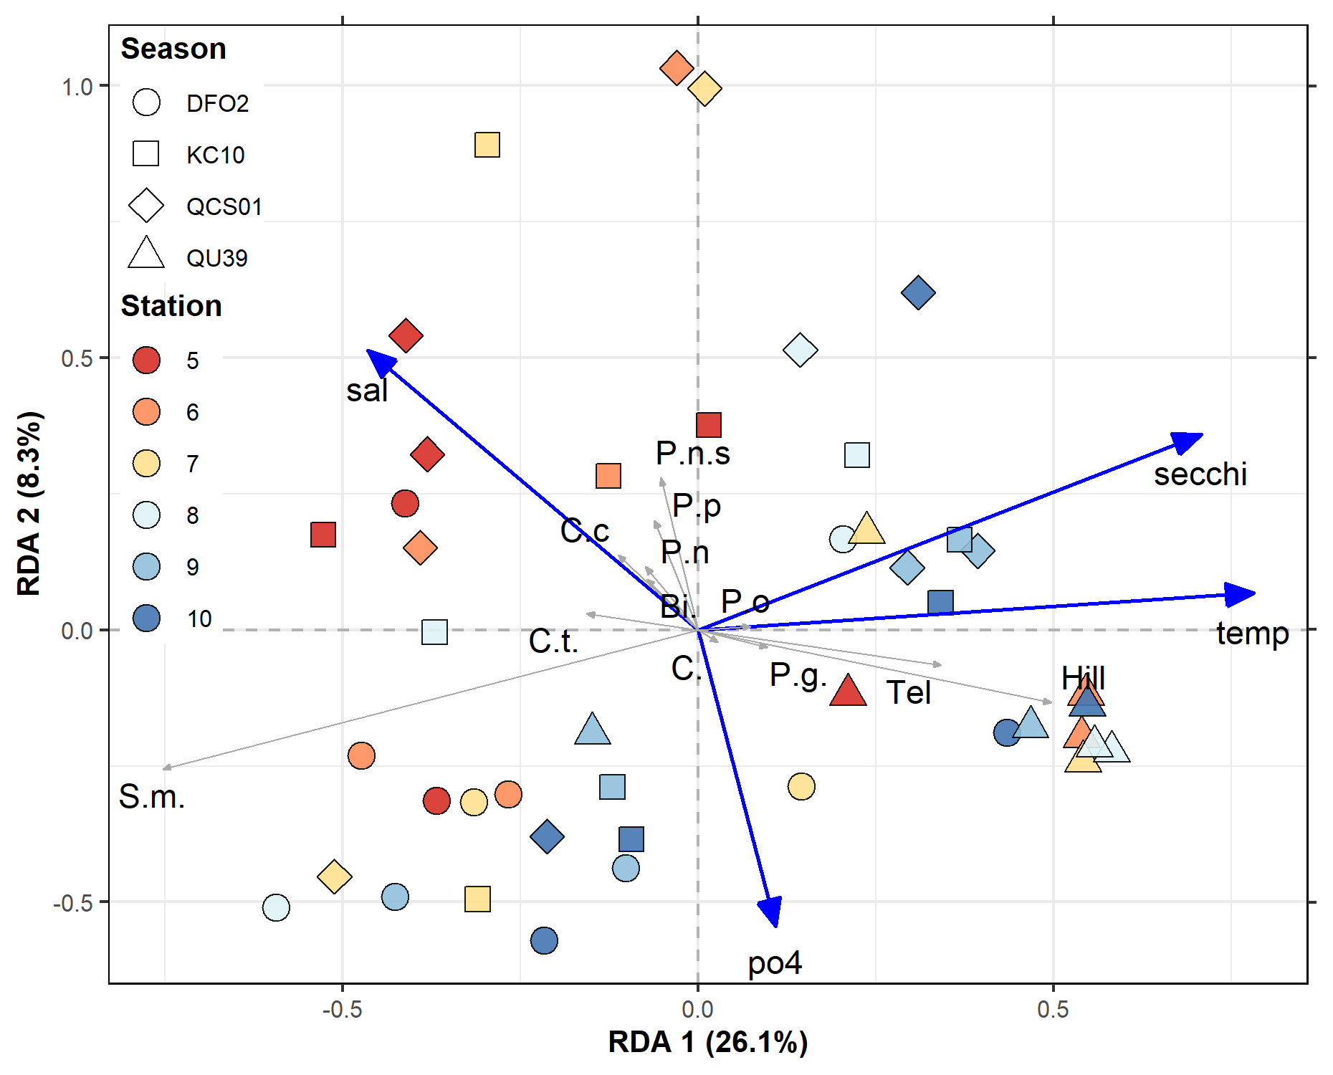
Multivariate Statistics – RDA, interpretation next plot.
Scaling 1
Scaling 2
Eigenvectors are scaled to unit length
Distances among objects - Euclidean distances
Projecting an object at right angle on a response variable or a quantitative explanatory variable approximates the position of the object along that variable.
The angles among response vectors are meaningless
Angles between response and explanatory variables in the biplot reflect their correlations
Relationship between the centroid and a response variable (species) is found by projecting the centroid at right angle on the variable (as for individual objects).
Eigenvectors are scaled to the square root of their eigenvalue.
Distances - not approximations of their Euclidean distances
Projecting an object at right angle on a response or an explanatory variable approximates the value of the object along that variable
Angles in the biplot between response and explanatory variables, and between response variables themselves or explanatory variables themselves, reflect their correlations.
Angles between descriptors in the biplot reflect their covariances or correlations.
Relationship between the centroid of a qualitative explanatory variable and a response variable (species) is found by projecting the centroid at right angle on the variable (as for individual objects).

Slide 12
Multivariate Statistics – RDA
Scaling 1
Scaling 2
Axis 1 (RDA 1), which contains the majority of the explained variance (27.8%), is driven by temperature
There is a rough spring to late summer gradient along this axis (late summer is warmer)
A cluster is comprised of QU39 and two DFO2 stations, and these are related to Telelaux and Hillea (cryptophytes) and temperature
Skeletonema marinoi is inversely related to temperature and a grouping of Calvert spring/summer (bloom) samples (includes DFO2)
Axis 2 (RDA 1) – driven by salinity, but much less constrained variability explained (5.5%)
Group of primarily QCS01 and KC10 summer samples related to non-Skel.m. diatoms (i.e. Chaetoceros spp (C.S., C.C.), pseudo nitzschia (P.n.s), increased salinity and reduced po4 (DFO2 is different in summer – also suggested by indicator species analysis and diversity/richness).

Slide 13
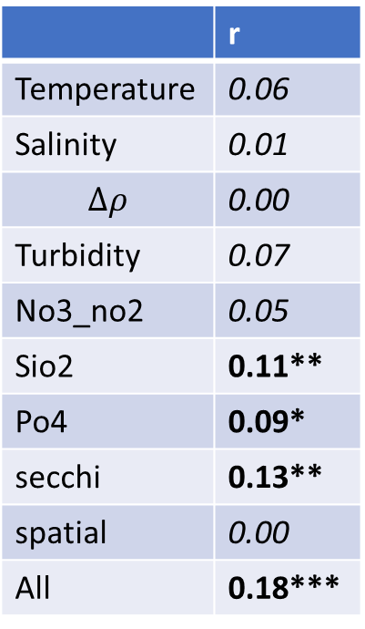
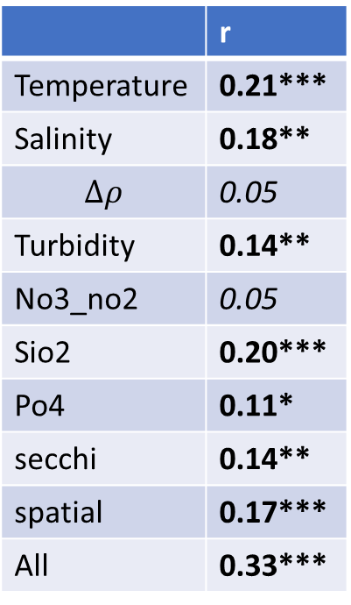
Mantel Tests
Test – Does species Bray Curtis dissimilarity vary along gradients of drivers?
Calvert + QU39
Similar to RDA results
Bray-Curtis dissimilarity becomes more dissimilar with spatial distance – shows regional difference
Calvert Alone
Less environmental drivers, but when all environmental drivers combined (centered and standardized), becomes a significant driver.
Location is no longer a driver, which suggests shelf-fjord connectivity and differences driven by environmental drivers – similar to nMDS where all Calvert stations mostly clustered.
Calvert + QU39
Calvert Only
 | r
Temperature | 0.21***
Salinity | 0.18**
$$∆ρ$$ | 0.05
Turbidity | 0.14**
No3_no2 | 0.05
Sio2 | 0.20***
Po4 | 0.11*
secchi | 0.14**
spatial | 0.17***
All | 0.33***
 | r
Temperature | 0.06
Salinity | 0.01
$$∆ρ$$ | 0.00
Turbidity | 0.07
No3_no2 | 0.05
Sio2 | 0.11**
Po4 | 0.09*
secchi | 0.13**
spatial | 0.00
All | 0.18***

Slide 14
Chemtax – Do we include?
Do we include?
Add to standardization
Show plots
Timeseries
Station average
nMDS
Pigments and chemtax outputs.
ANOSIM and indicator species.
RDA with centered and standardized
Pigments against species?
2019 plot with a measure of upwelling – haptophytes
Why am I getting so many dictyos in 2020
Need to maybe re-run data for consistency

Slide 15
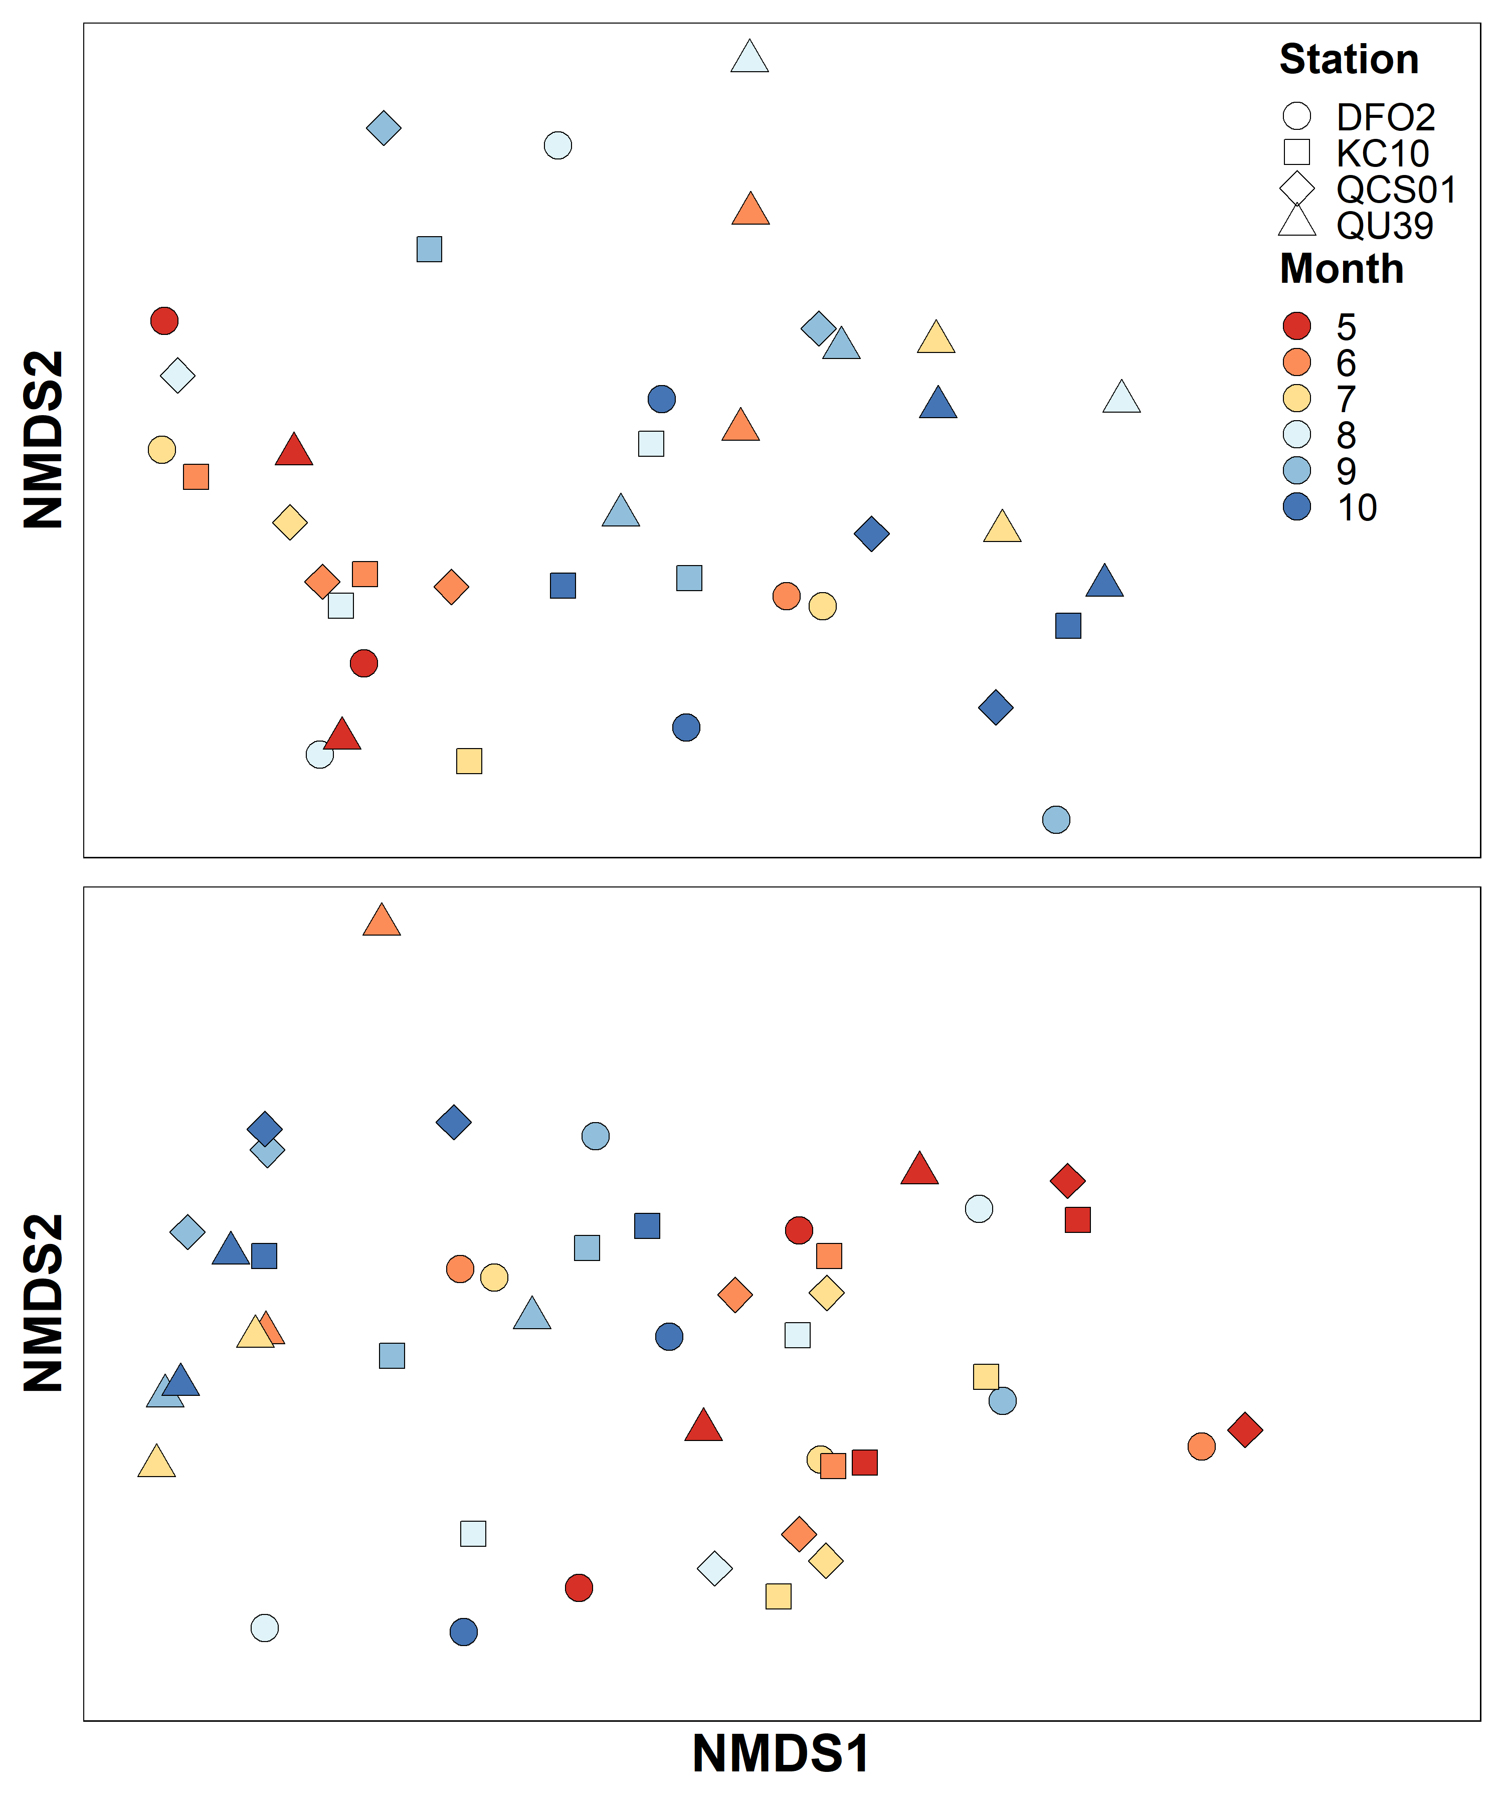
Chemtax nMDS
Unlike taxonomy, little differences between QU39 and Calvert stations – fewer things to separate on (species versus pigment groups, but also, greater importance and similarity in small species biomass not seen by microscopy
Seems to be more of a seasonal gradient (generally) and I suspect bloom versus non-bloom.

