Slide 1
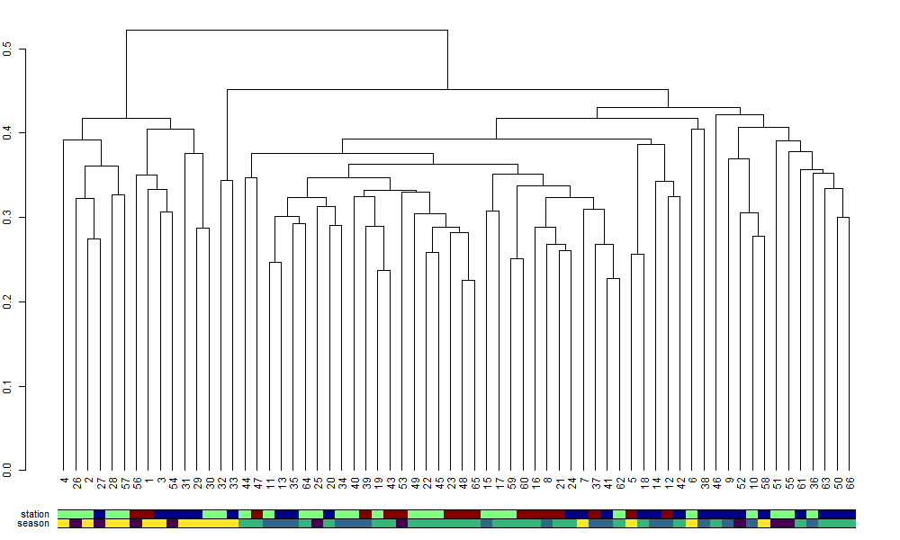
QCS01
KC10
DFO2
Winter (Jan – Mar)
Spring (Apr – Jun)
Summer (Jul - Sept
Autumn (Oct – Dec)

Slide 2
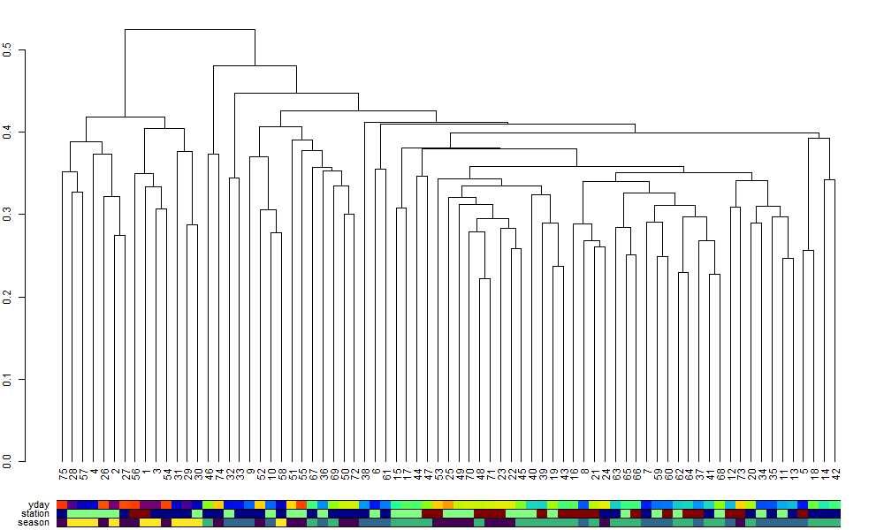

Slide 3
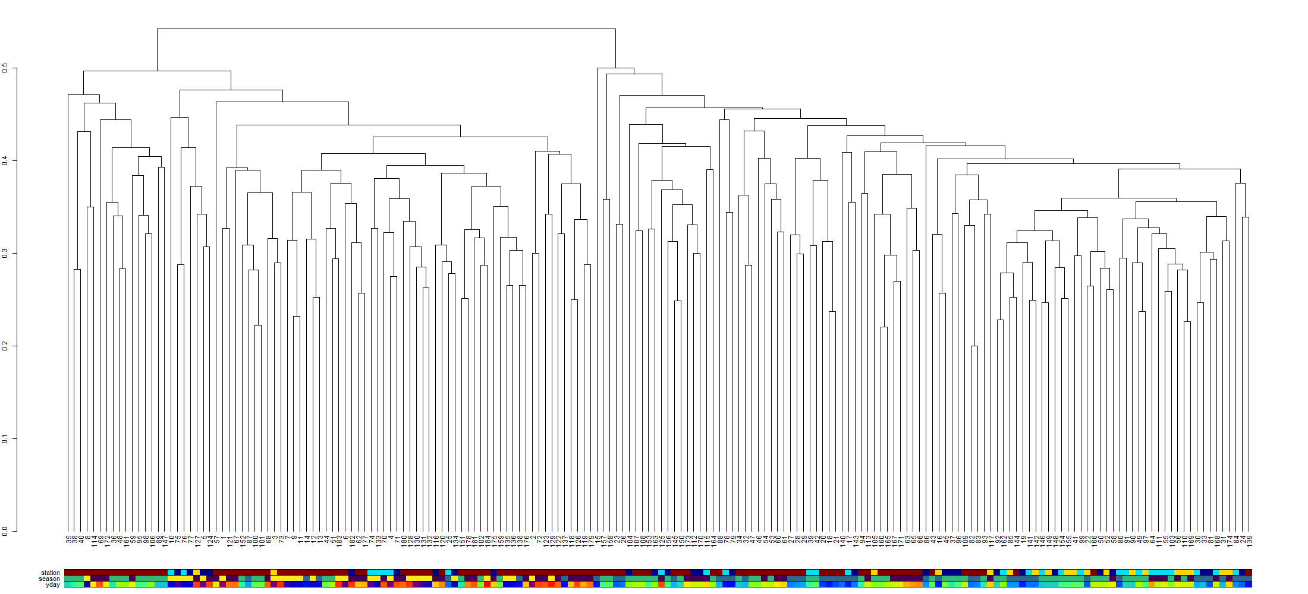

Slide 4
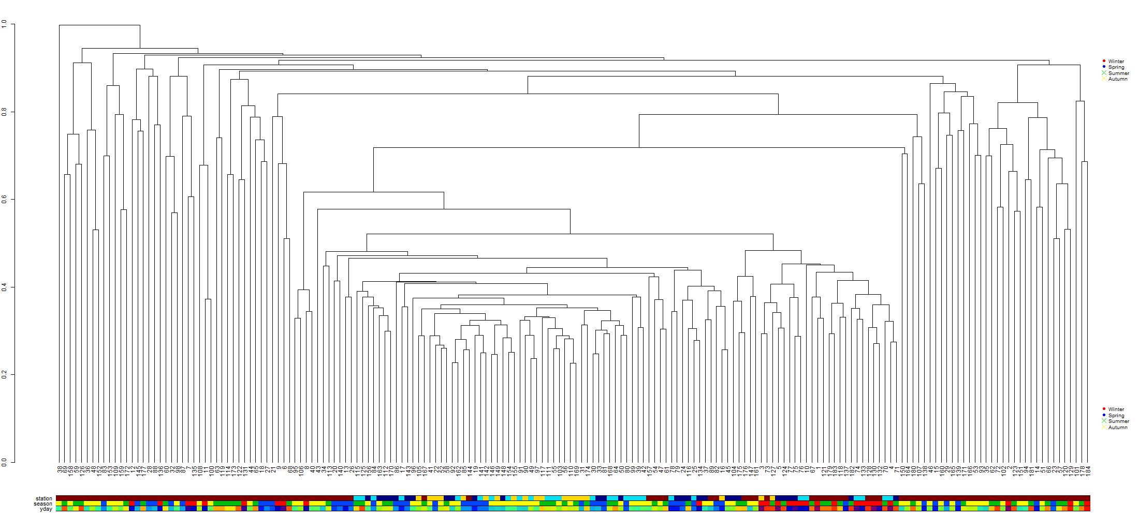
This is with 2018-2020 (three years of data) including QU39 (monthly averaged to make more comparable and reduce data from QU39 (crazy amount of points if included. Data long transformed log10(x+1). Things to do:
Add legends.
Try to make colors better – can’t get seasonal colors to match up with seasons
Make bars bigger
Maybe color lines as station to reduce amount of bars.

