Slide 1
FRCA Election App
Digital Voting for Office Bearer Elections
Offline · Anonymous · Rules-Compliant · Auditable
Free Reformed Churches of Australia

Slide 2
How It Changes the Process
Current: Paper Ballots
New: Digital + Paper
1
Print blank ballot papers
1
Generate unique voting codes
2
Hand out ballots at the door
2
Hand out code slips at the door
3
Brothers fill in names by hand
3
Brothers vote on their phones
4
Collect all ballot papers
4
Votes counted instantly
5
2–3 brothers count every paper manually
5
Enter paper ballot totals (if any)
6
Calculate thresholds by hand
6
Thresholds calculated automatically
7
Announce results
7
Show results on projector
Slow counting · Human error · No live progress
Instant results · No counting errors · Live progress

Slide 3
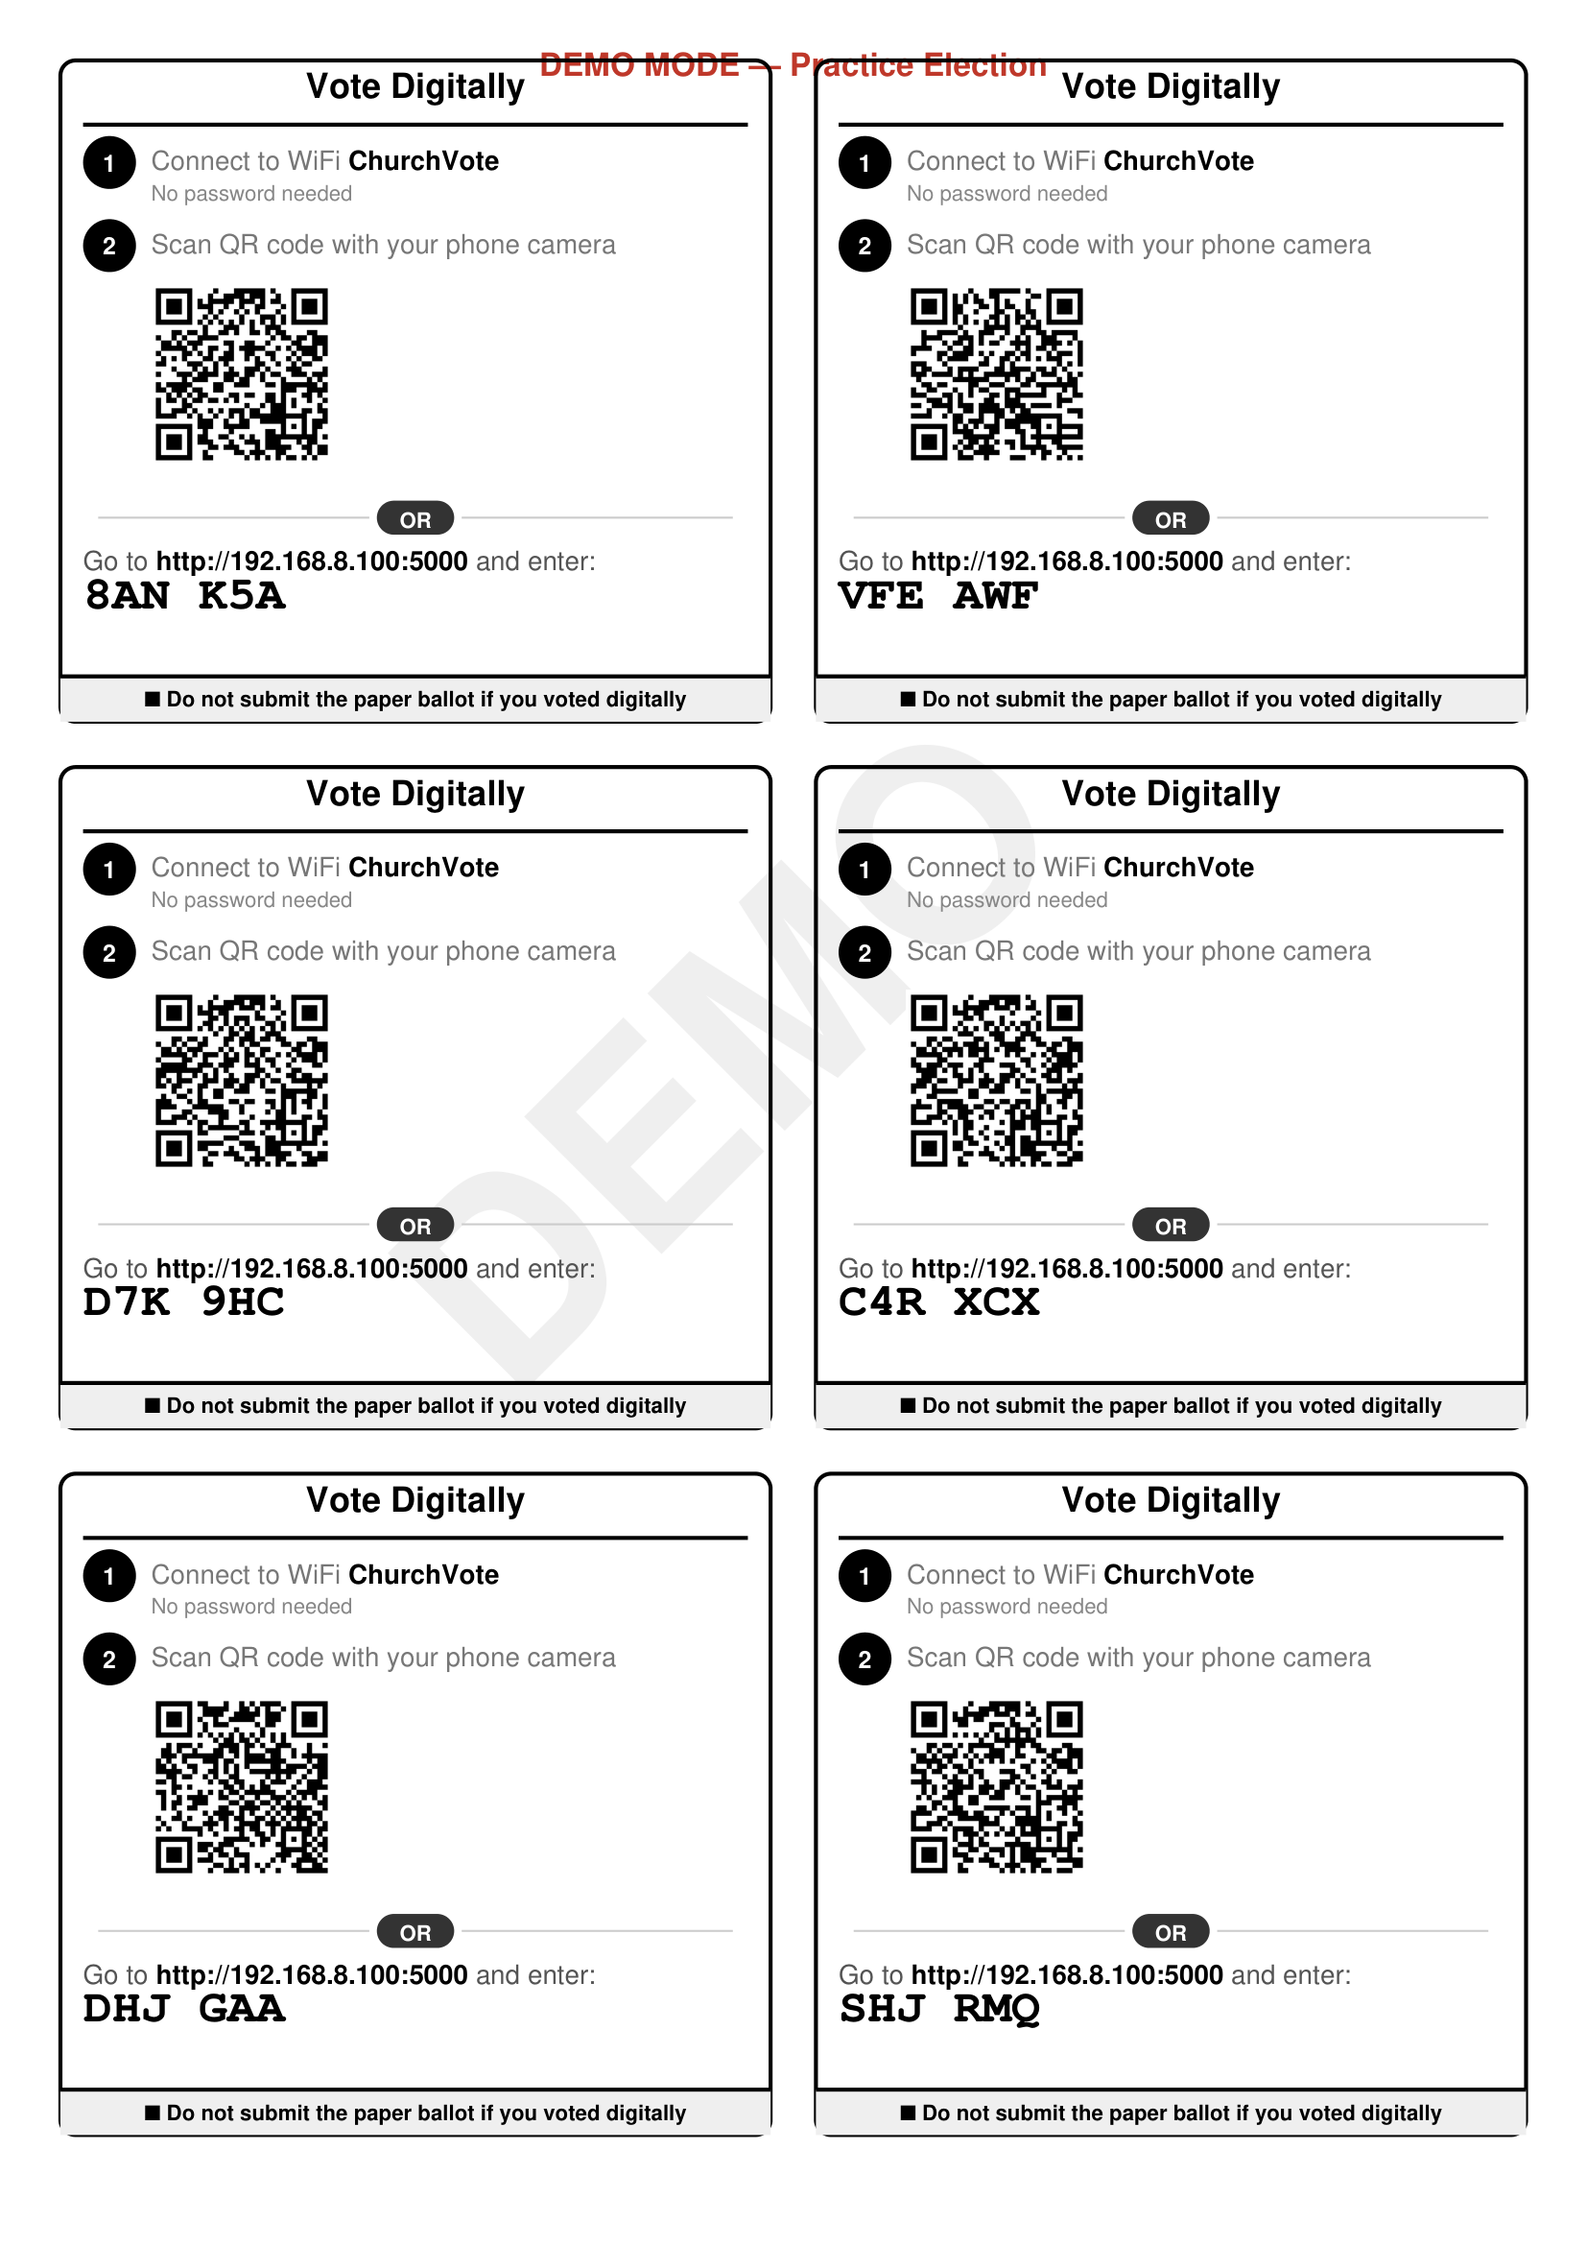
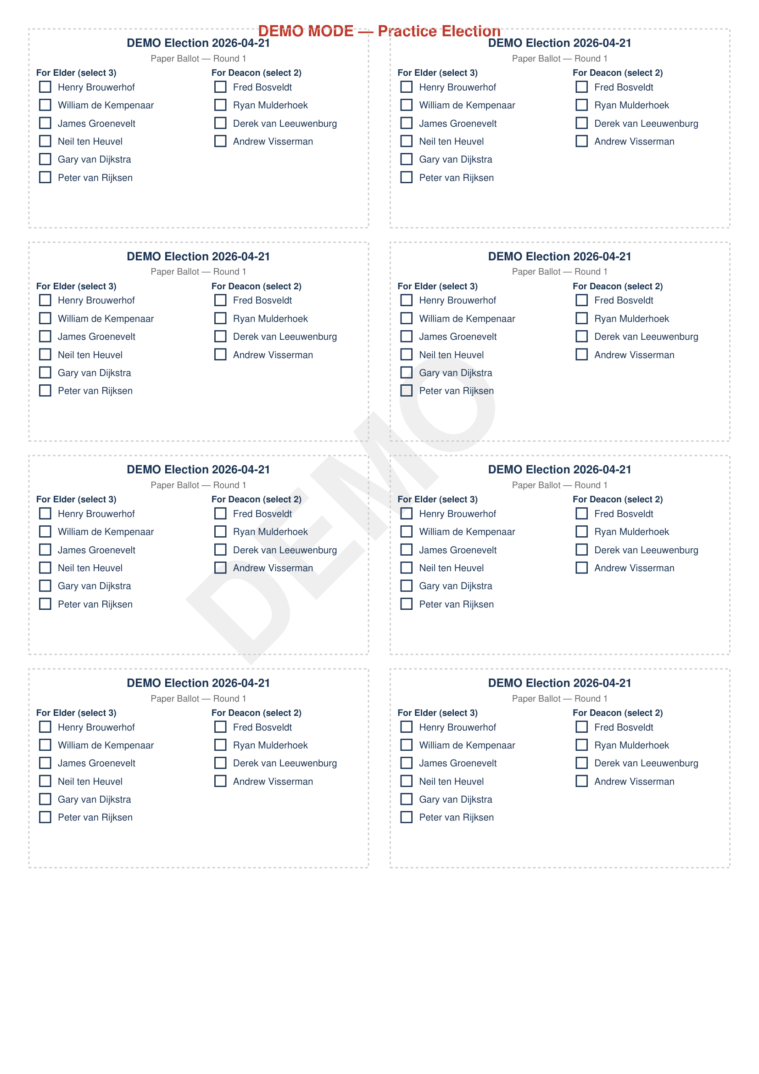
What Gets Printed
Code Slips
Paper Ballots
Each brother receives one slip with a unique
6-character code and QR code.
For brothers who prefer paper.
Counted alongside digital votes.

Slide 4
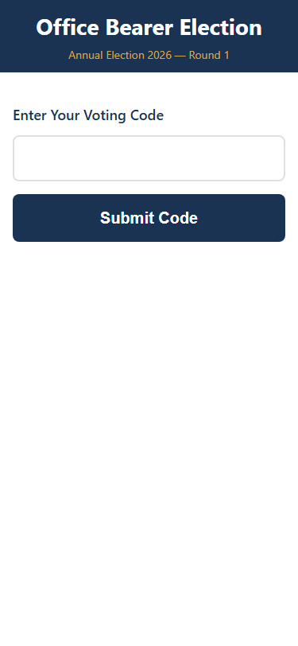
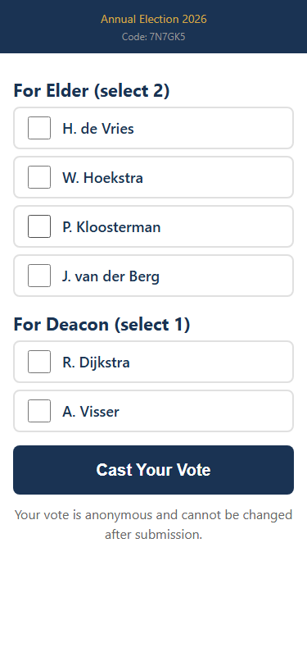
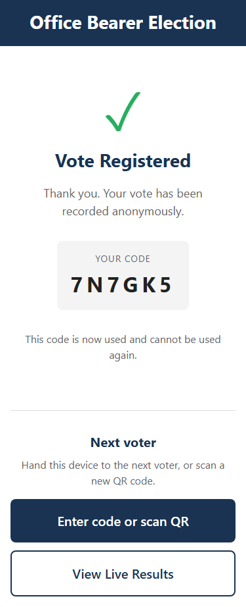
Election Day: How Brothers Vote
1. Enter Code
2. Cast Vote
3. Confirmed
Type the 6-character
code from their slip
Select candidates
for each office
Vote submitted.
Code is burned.

Slide 5
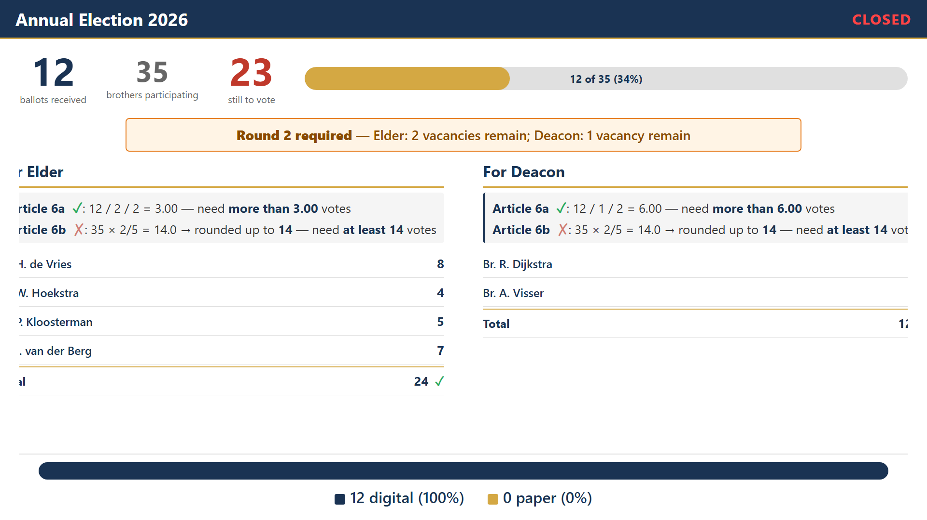
Live Projector Display
Real-time results shown to the congregation during and after voting.

Slide 6
Key Assurances
Anonymous by Design
No link between codes and votes in the database. Votes cannot be traced, even with full access.
Offline & Local
Runs entirely on one laptop over church WiFi. No data leaves the building. No internet required.
Paper Is Always the Backup
Paper ballots remain a first-class option. If anything goes wrong, switch to paper immediately.
Rules-Compliant
Article 2 slate validation, Article 6 threshold calculations, Article 7 partial ballot support — all automatic.
Open Source & Auditable
The consistory can inspect the source code and database at any time. Nothing is hidden.

