Slide 1
FRCA Election App
Training Guide for Consistory
Office Bearer Elections for Free Reformed Churches

Slide 2
What is the Election App?
1
Offline & Local
Runs on one laptop over church WiFi. No internet needed.
2
Phone Voting
Brothers vote on their own phones using unique one-time codes.
3
Paper + Digital
Paper ballots counted alongside digital votes.
4
Rules Compliant
Article 2, 6, 7 & 11 thresholds calculated automatically.

Slide 3
How It Works
1
2
3
4
SETUP
→
CODES
→
VOTE
→
COUNT
Create election,
add offices &
candidates
Generate & print
voting code slips
Brothers enter code
on phone & select
candidates
Close voting, add
paper ballots,
view results

Slide 4
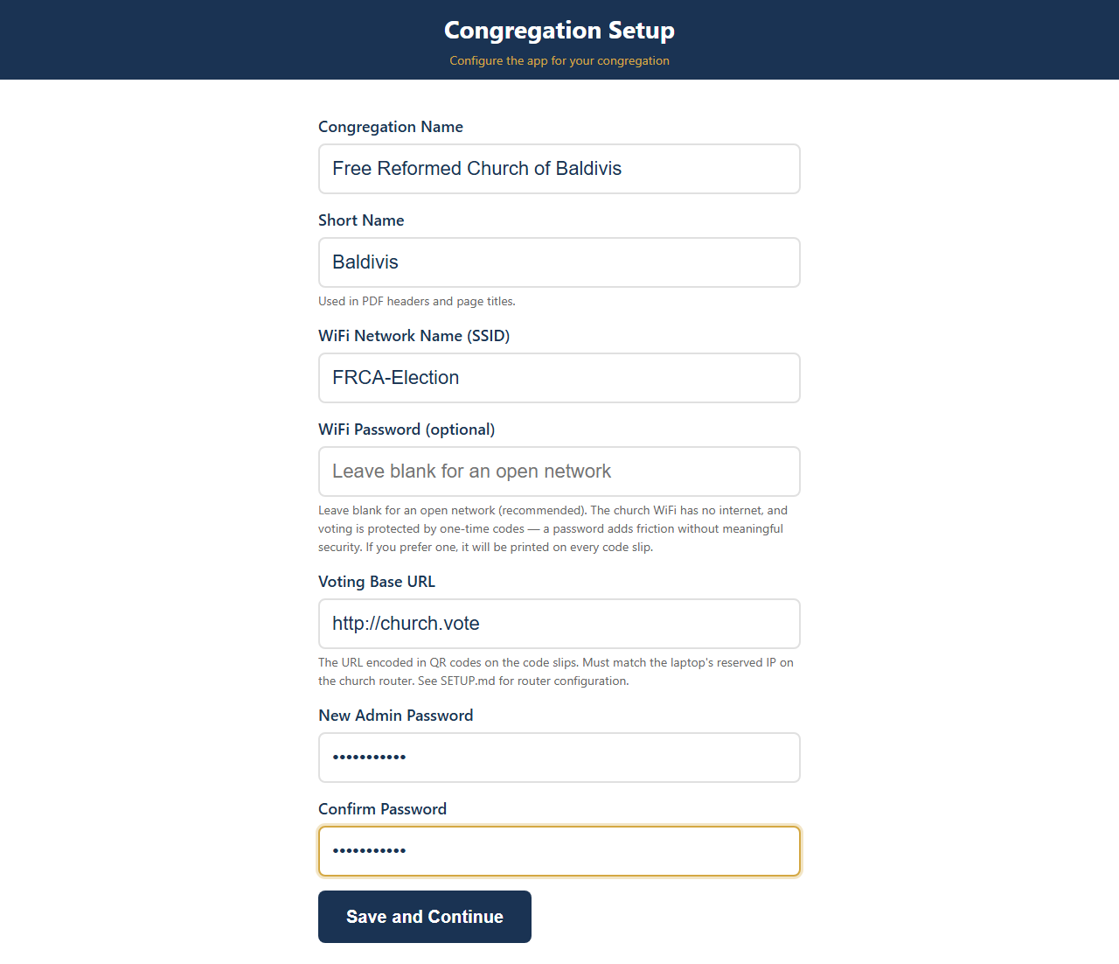
Step 1: First-Time Setup
Open the admin panel and complete the setup wizard: • Congregation name
• WiFi network name (SSID)
• New admin password
This only needs to be done once.

Slide 5
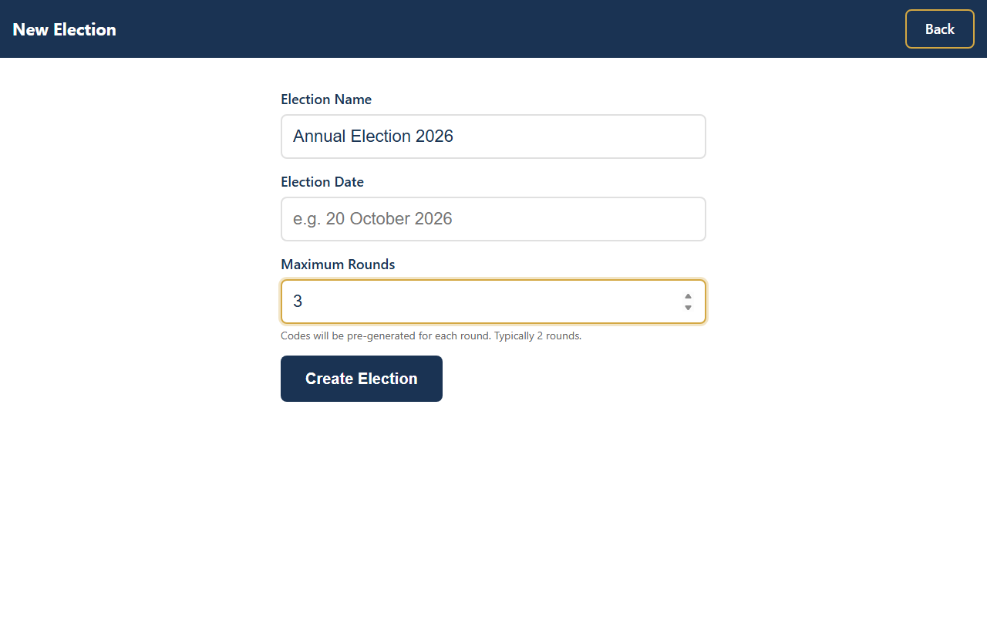
Step 2: Create an Election
From the dashboard, click “+ New Election”. Enter:
• Election name
• Maximum rounds (typically 2–3)
• Election date

Slide 6
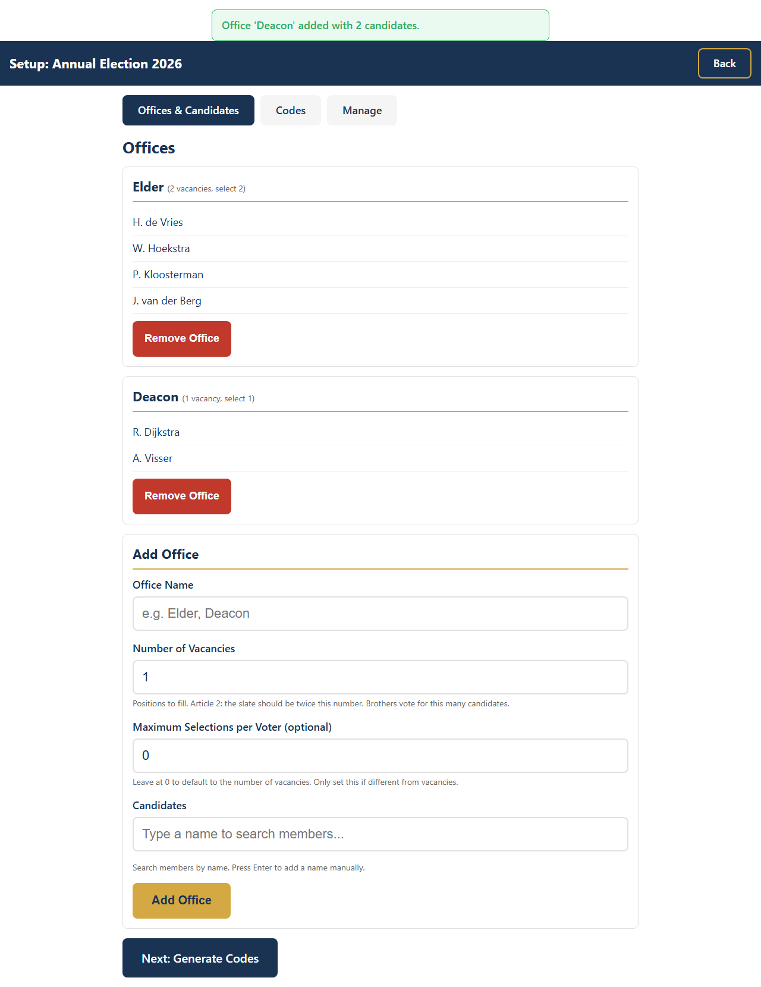
Step 3: Add Offices & Candidates
For each office (Elder, Deacon): • Set the number of vacancies
• Add candidates by typing names
• Click “Add Office”
Article 2: The slate must be exactly
twice the vacancies. The app enforces this.

Slide 7
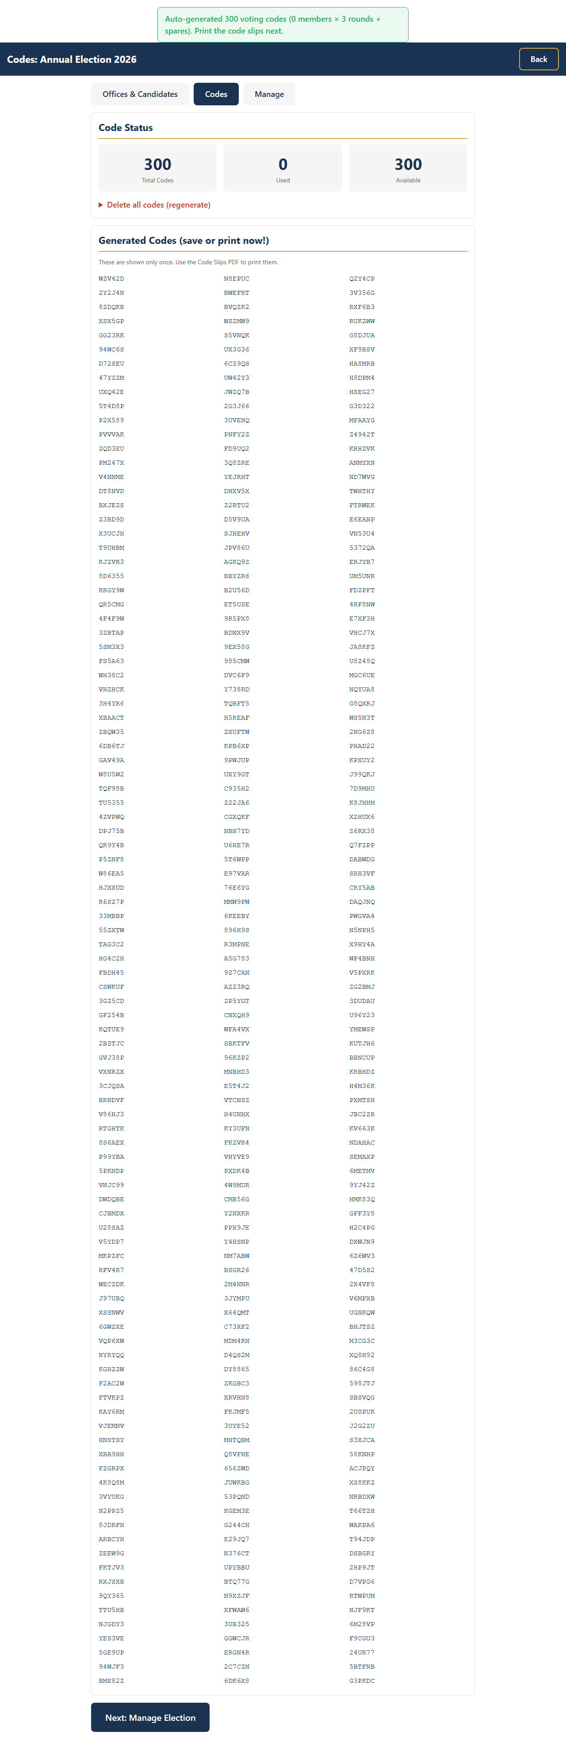
Step 4: Generate & Print Codes
Generate enough codes for all brothers plus some spares. Then download and print: • Code Slips PDF — individual slips with QR codes for each brother
• Paper Ballot PDF — for brothers who prefer to vote on paper
Each code can only be used once.

Slide 8
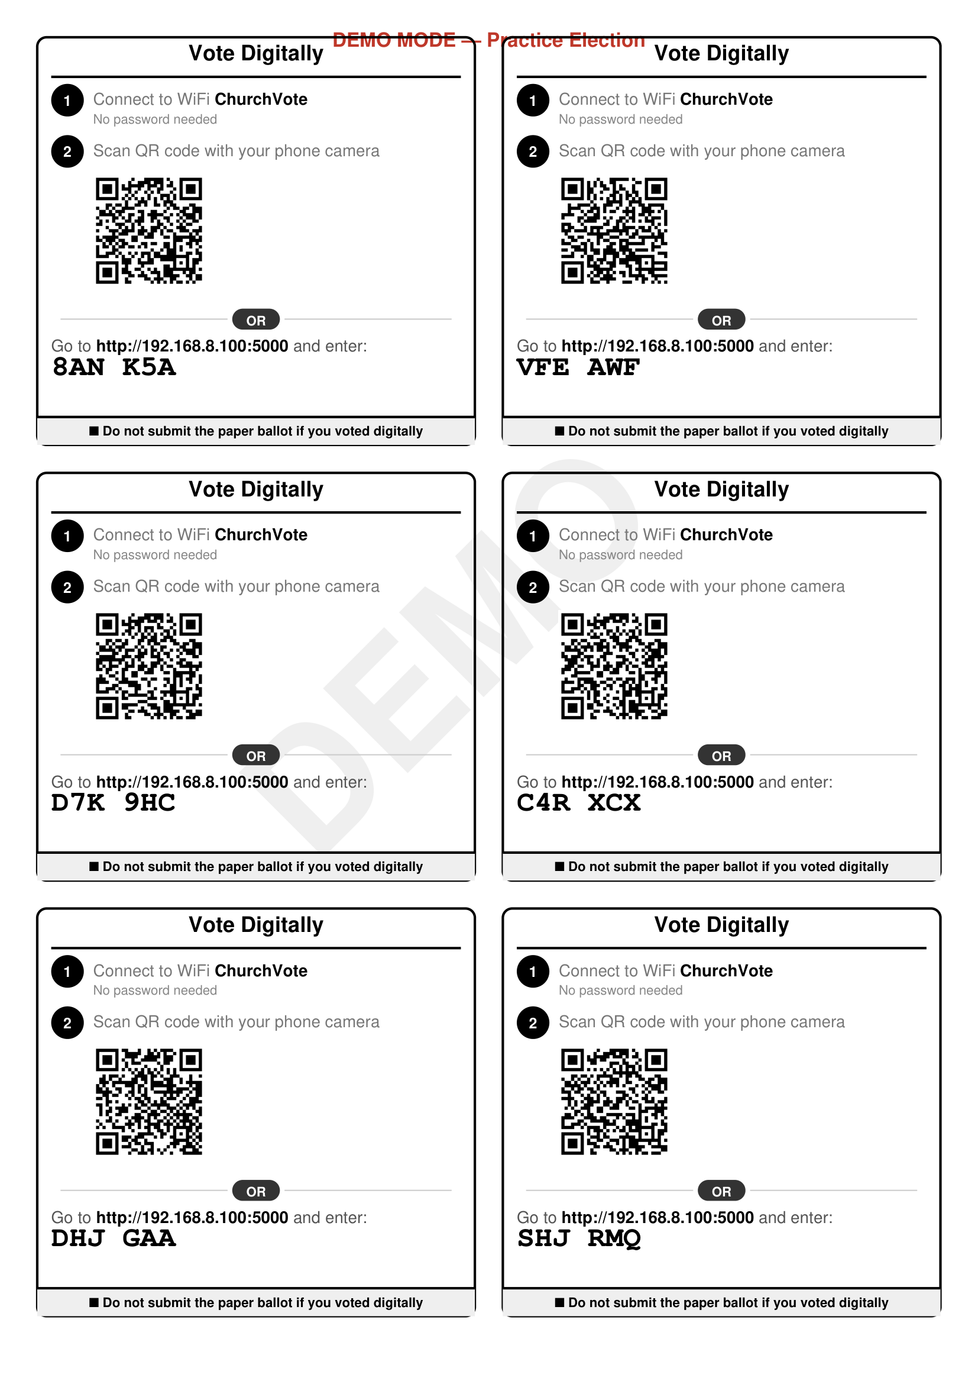
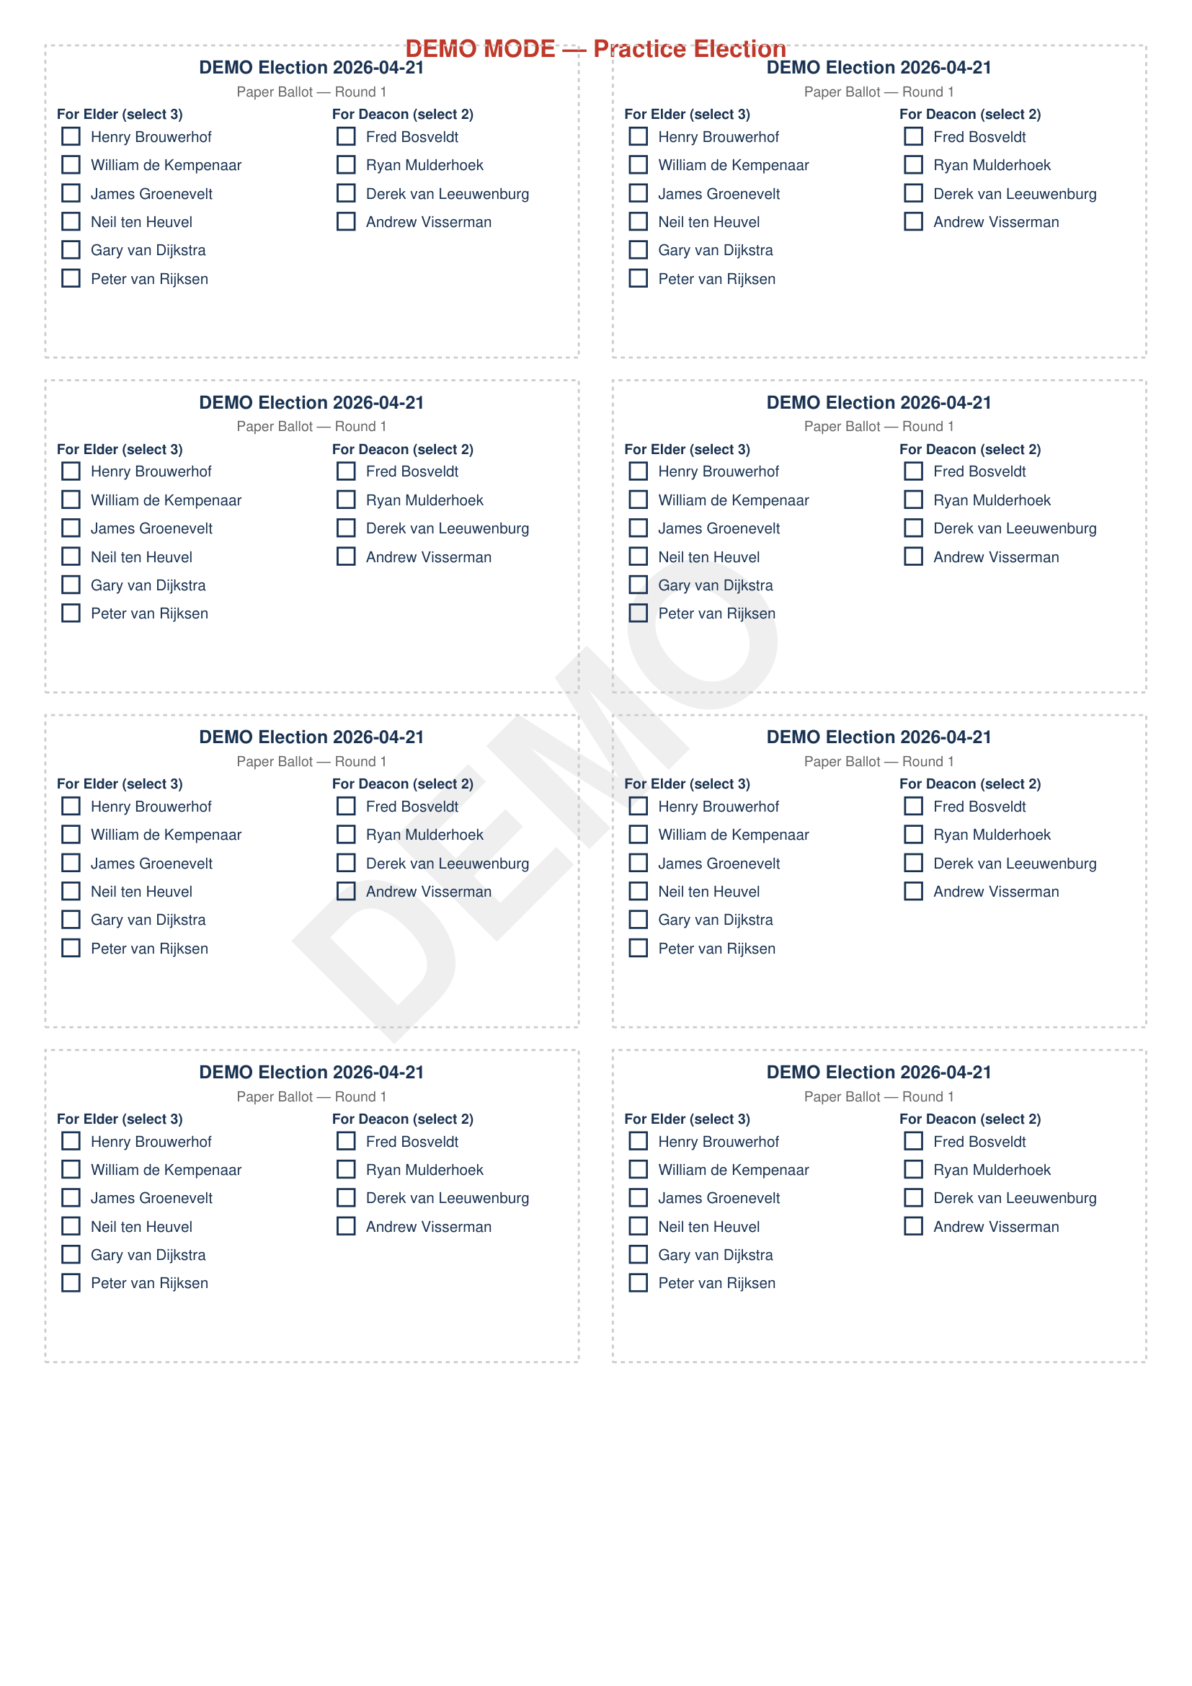
What Gets Printed
Code Slips
Paper Ballots
Each brother receives one slip with a unique
6-character code and QR code.
For brothers who prefer paper.
Counted alongside digital votes.

Slide 9
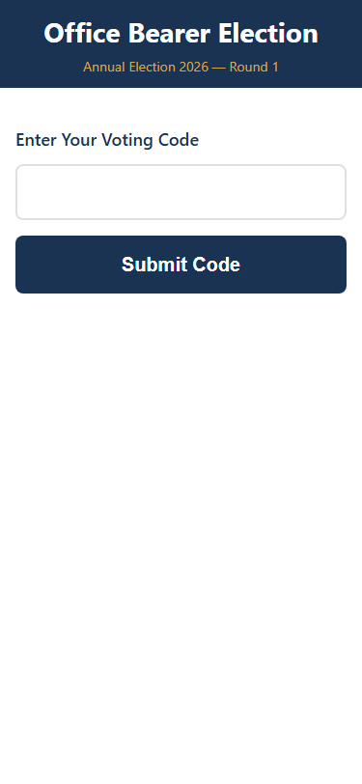
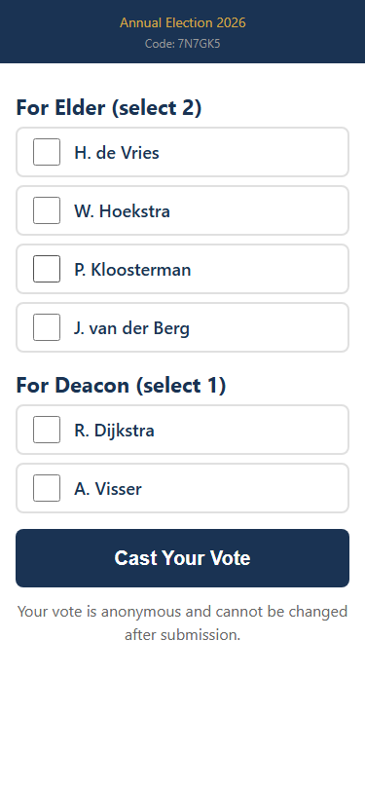
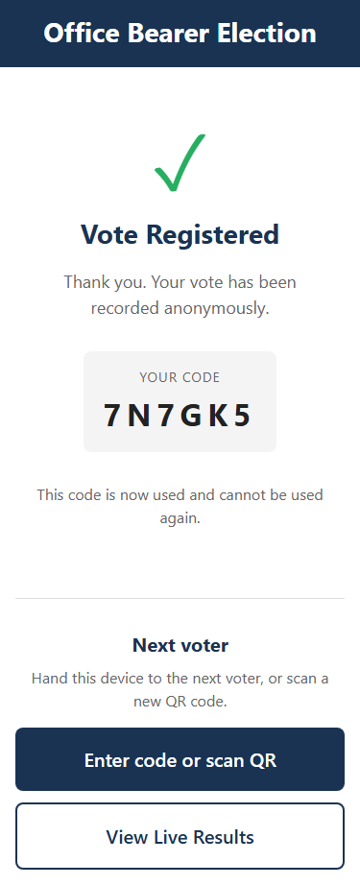
Election Day: How Brothers Vote
1. Enter Code
2. Cast Vote
3. Confirmed
Type the 6-character
code from their slip
Select candidates
for each office
Vote submitted.
Code is burned.

Slide 10
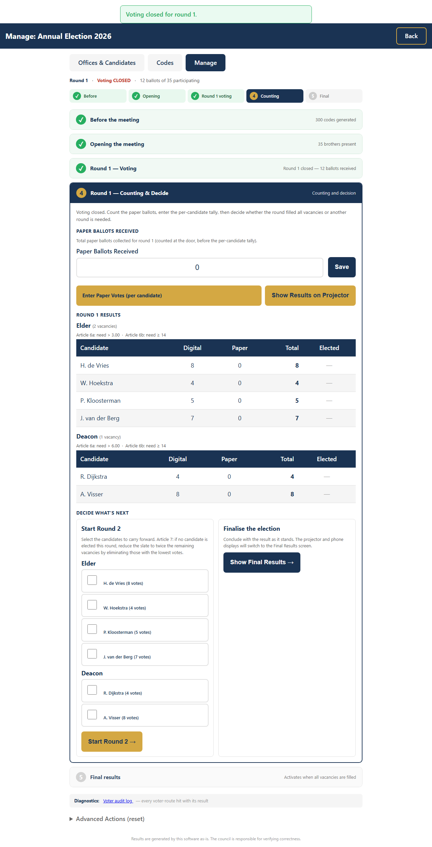
Monitoring & Results
After closing voting: • Enter paper ballot counts
• Enter postal votes (if any)
• Set brothers present count
The app automatically calculates Article 6 thresholds: 6a: votes > total / vacancies / 2
6b: votes ≥ participants × 2/5
Both conditions must be met.

Slide 11
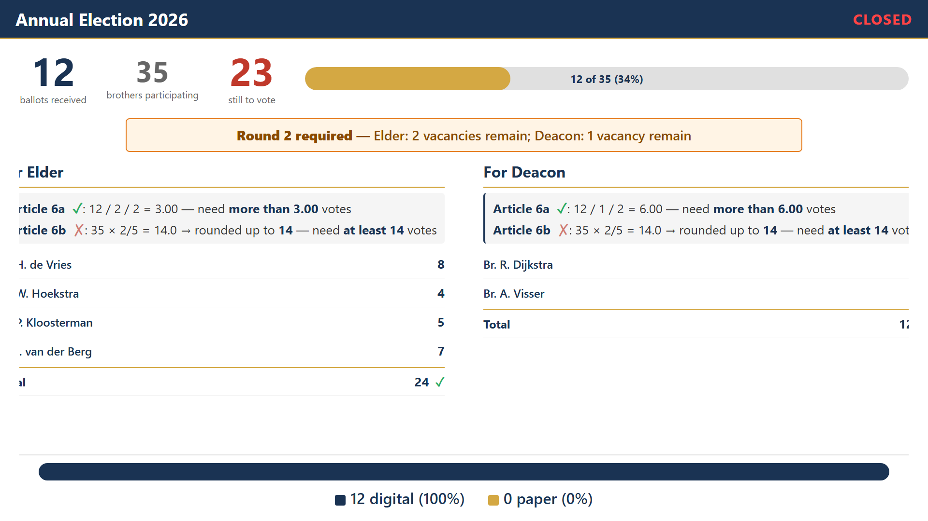
Projector Display
Live results shown to the congregation when enabled by admin.

Slide 12
Safety & Fallback
Anonymous by Design
No link between codes and votes in the database. Even with full access, votes cannot be traced.
Paper Is Always the Backup
If anything goes wrong, switch to paper ballots immediately. Paper and digital votes are counted together.
All Data Stays Local
The app runs entirely on church WiFi. Nothing is sent to the internet.
Fully Auditable
The database can be inspected by the consistory at any time. The source code is open.

Slide 13
Questions?
The full Admin Guide, Setup Instructions, and Failsafe Procedures are included with the app. Run a dry-run election before election day
using the UAT Script.

